Slide 1

The Big Data Revolution

Slide 2
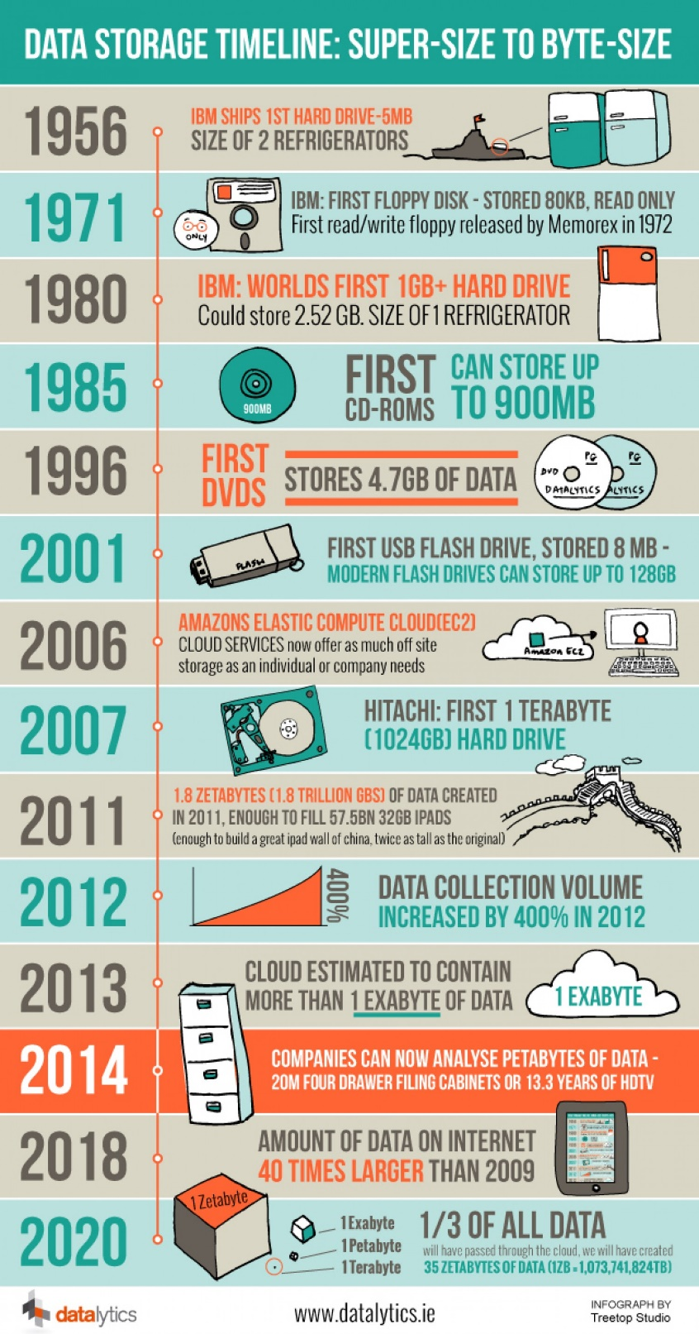
The Big Data Revolution is the result of great advancements in 4 areas:
Data generation volume
Storage capacity
Computing speed
Internet speed

Slide 3
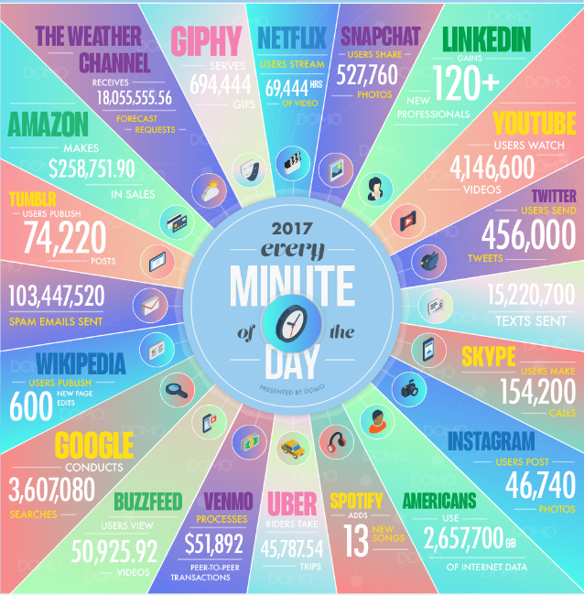

Slide 4
Programming skills for data analysis are essential in the era of data explosion

Slide 5
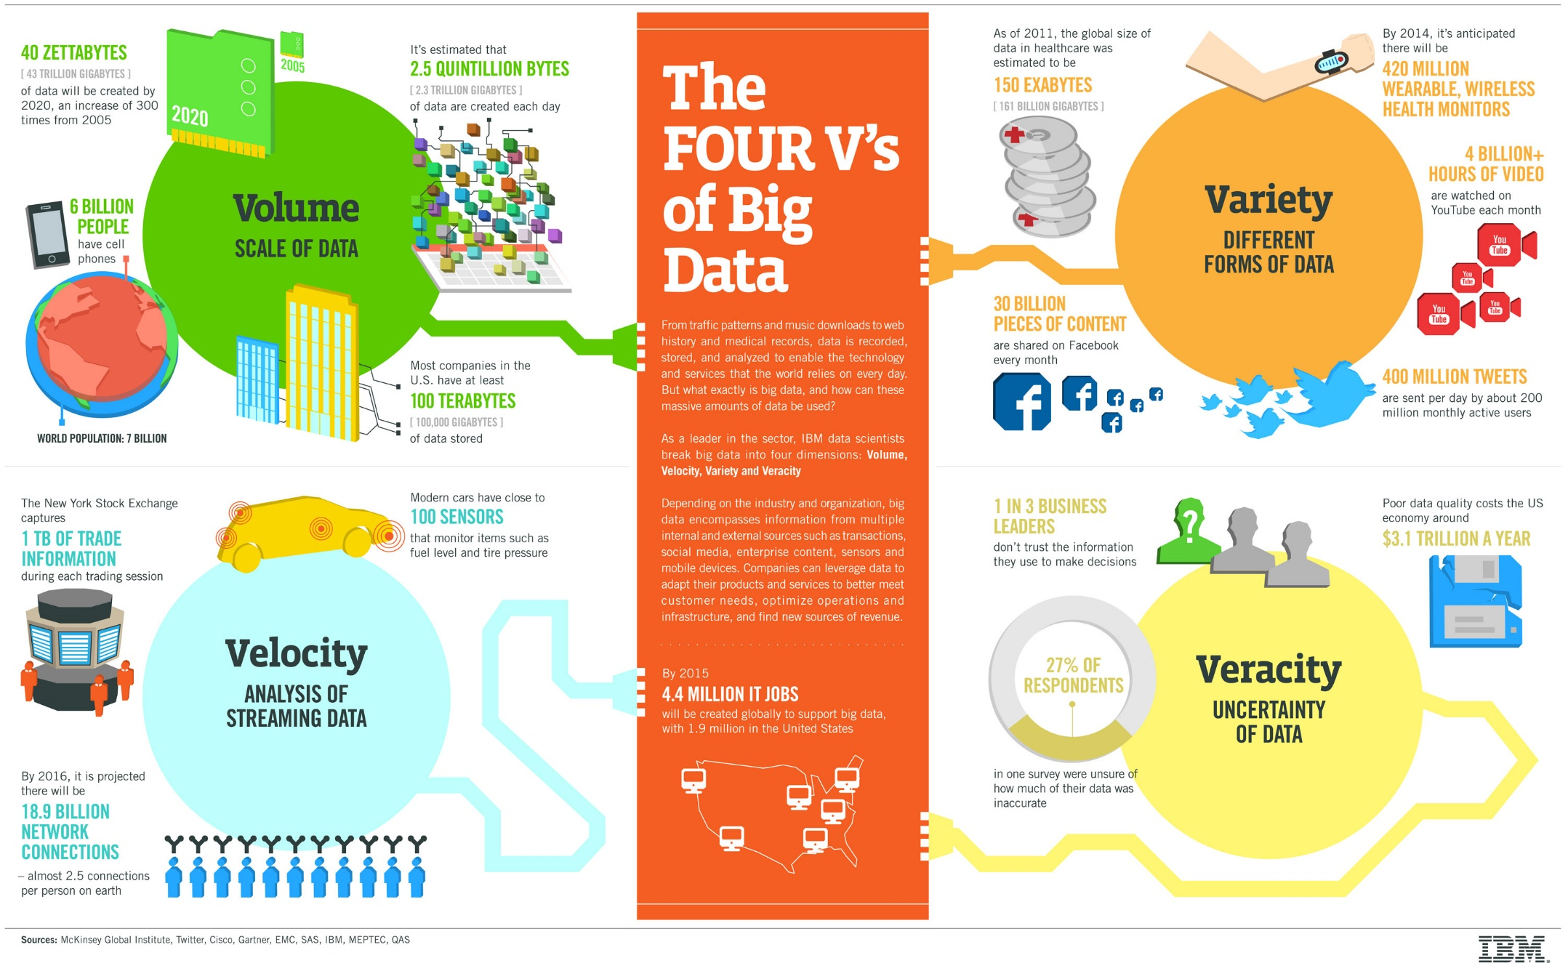

Slide 6



Lecture plan: scientific computing
Introduction to NumPy & SciPy
Plotting using MatPlotLib
Data Analysis Example

Slide 7
NumPy and SciPy
NumPy and SciPy are packages for scientific computing that provide fast pre-compiled mathematical and numerical functions.
NumPy (Numeric Python) - good for manipulating large arrays and matrices of numeric data.
SciPy (Scientific Python) - extends NumPy with many useful algorithms, e.g.:
minimization, regression, and other math techniques

Slide 8
NumPy and SciPy
NumPy and SciPy are open-source, and therefore provide a free Matlab alternative.
Matlab – widely used, but expensive
NumPy and SciPy are popular among scientists & researchers applying math to large datasets.
Read more here: http://docs.scipy.org/doc/numpy/reference/

Slide 9
Importing the required modules
Already in Anaconda.
Still, need to import at the beginning of your program
For example:
import numpy as np, matplotlib, scipy
Alias

Slide 10
NumPy’s main object is the Array
Array: It is a table of elements (usually numbers), indexed by a tuple of integers.
Rank the number of axes (=dimensions)
A vector is an array of rank 1
A 2D matrix is an array of rank 2.

Slide 11
Python list vs. NumPy’s Array
Both used to store any data type, can be indexed and iterated through
Arrays have to be declared while lists don't (part of Python's syntax)
So what are Arrays good for?
Performing arithmetic functions on the elements
Storing data more compactly and effectively

Slide 12
The Array object - Creation
List to initialize
>>> import numpy as np
>>> a = np.array([0, 1, 2]) # 1D array of size 3
>>> a
array([0,1,2])
>>> mat=np.array([[0, 1, 2], [3, 4, 5]]) # 2D array of size 2x3
>>> mat
array([[0,1,2],
[3,4,5]])
2 | 1 | 0
Nested list
2 | 1 | 0
5 | 4 | 3

Slide 13
Creating an array of zeros or ones
>>> np.zeros(7, dtype=int)
array([0, 0, 0, 0, 0, 0, 0])
>>> np.ones((2,3), dtype=float)
array([[ 1., 1., 1.],
[ 1., 1., 1.]])
Declaring types can make life easier..

Slide 14
Creating arrays containing number sequences
>>> np.arange(10)
array([0, 1, 2, 3, 4, 5, 6, 7, 8, 9])
>>> np.arange(2,7)
array([2, 3, 4, 5, 6])
>>> np.arange(2,7,2) # start, end (exclusive), step
array([2, 4, 6])
Like range(10), but
returns a numpy array object

Slide 15
More array operations
# linspace: start, end, number of elements
>>> print(np.linspace(1,5,9))
[ 1. 1.5 2. 2.5 3. 3.5 4. 4.5 5. ]
# Arrays with random values: (0 , 1)
>>> print (np.random.rand(5))
[ 0.53844313 0.3384871 0.5763536 0.29159273 0.43938366]
# slicing is similar to standard lists
>>> a=np.arange(1, 5.5, 0.5)
>>> print( a[3:1:-1] )
[ 2.5 2. ]

Slide 16
Array – Attributes & Methods
>>> mat = np.array([[0, 1, 2], [3, 4, 5]]) # Creates a 2 x 3 array
>>> mat
array([[0,1,2],
[3,4,5]])
>>> mat.ndim #number of dimensions
2
>>> mat.shape #dimension sizes
(2, 3)
>>> len(mat) # returns the size of the first dimension
2
>>> mat.T #Transpose
array([[0, 3],
[1, 4],
[2, 5]])
2 | 1 | 0
5 | 4 | 3
No parentheses
Same as lists
3 | 0
4 | 1
5 | 2

Slide 17
Reshaping an Array
>>> a = np.arrange(10.0)
>>> a
array([ 0., 1., 2., 3., 4., 5., 6., 7., 8., 9.])
>>> a = a.reshape((5, 2))
>>> a
array([[ 0., 1.],
[ 2., 3.],
[ 4., 5],
[ 6., 7.],
[ 8., 9.]])
>>> a.shape
(5, 2)
9. | 8. | 7. | 6. | 5. | 4. | 3. | 2. | 1. | 0.
Reshape
Creates a new array
1. | 0.
3. | 2.
5. | 4.
7. | 6.
9. | 8.

Slide 18
Creating an Array of a specific type
>>> a = np.array(range(10), dtype=float)
>>> a
array([ 0., 1., 2., 3., 4., 5., 6., 7., 8., 9.])
>>> a.dtype
dtype('float64')
Additional ways to create arrays in NumPy:
http://docs.scipy.org/doc/numpy-1.10.1/reference/routines.array-creation.html#routines-array-creation

Slide 19
Types of np arrays
>>> a
array([ 0., 1., 2., 3., 4., 5., 6., 7., 8., 9.])
>>> a.dtype
dtype('float64’)
>>> type(a)
numpy.ndarray

Slide 20
Indexing and slicing: similar to lists
>>> a = np.diag(np.arange(3))
array([[0, 0, 0],
[0, 1, 0],
[0, 0, 2]])
>>> a[1, 1]
1
>>> a[2, 1] = 10
>>> a[1, :] # Row at index 1 a[1] also works
array([ 0, 1, 0])
>>> a[:, 1] # Column at index 1
array([ 0, 1, 10])
>>> a[2, 1:]
array([10, 2])
Diagonal matrix:
Al non-diag elements are 0

Slide 21
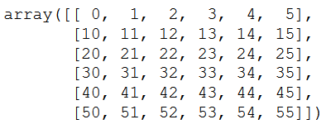
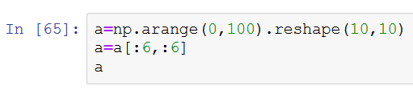
Indexing and slicing: matrices
How do we create this array?

Slide 22
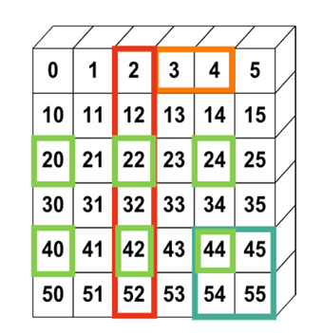

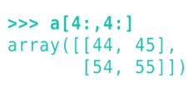

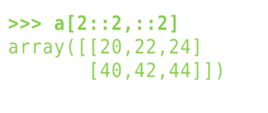

Indexing and slicing: matrices
Let’s select the colored areas
Also:

Slide 23
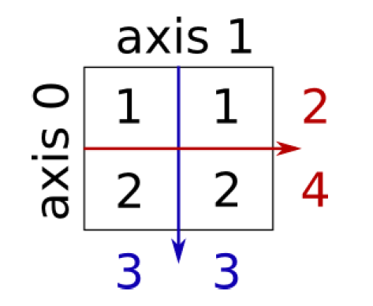
Reductions: Sum
>>> x = np.array([[1, 1], [2, 2]])
>>> x
array([[1, 1],
[2, 2]])
>>> x.sum() # ALL elements
6
>>> x.sum(axis=0) # sum the columns along axis 0
array([3, 3])
>>> x[:, 0].sum(), x[:, 1].sum()
(3, 3)
>>> x.sum(axis=1) # sum the rows along axis 1
array([2, 4])
>>> x[0, :].sum(), x[1, :].sum()
(2, 4)
Also works with x.min, x.max, x.mean etc.

Slide 24
Sorting along an axis
>>> a = np.array([[4, 3, 5], [1, 2, 1]])
>>> b = np.sort(a, axis=1)
>>> b
array([[3, 4, 5],
[1, 1, 2]])
axis 1
4 | 3 | 5
1 | 2 | 1
axis 0
>>> a.sort(axis=1)
>>> a
array([[3, 4, 5],
[1, 1, 2]])
a.sort does not return
a value

Slide 25
Array Arithmetic
Arithmetic operators on arrays apply elementwise.
A new array is created and filled with the result.
Very useful for vector calculations
>>> x = np.array([1, 5, 2])
>>> y = np.array([7, 4, 1])
>>> x + y
array([8, 9, 3])
>>> x * y # element by element multiplication! Use np.dot(x,y) for matrix multiplication.
array([ 7, 20, 2])
>>> x - y
array([-6, 1, 1])
>>> x / y
array([0, 1, 2])
>>> x % y
array([1, 1, 0])
Note that here, x and y have the same size

Slide 26
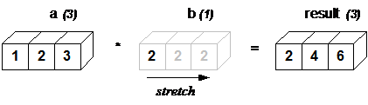
Broadcasting
NumPy operations are usually done element-by-element which requires two arrays to have exactly the same shape:
But this will also work:
>>> a = np.array([1.0,2.0,3.0])
>>> b = np.array([2.0,2.0,2.0])
>>> a * b
array([ 2., 4., 6.])
>>> a = np.array([1.0,2.0,3.0])
>>> b = 2.0
>>> a * b
array([ 2., 4., 6.])
Same result

Slide 27
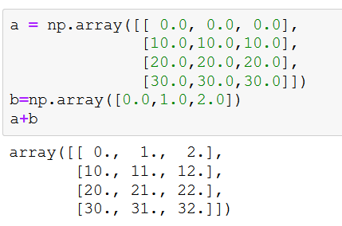
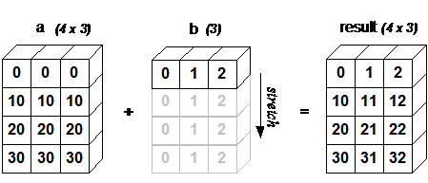
Broadcasting
One array can be “stretched” along the auxiliary axis, to fit the other

Slide 28
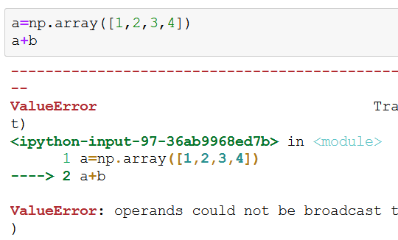
Broadcasting
Be careful of dimension mismatch

Slide 29
Comparisons and Boolean operations
>>> a = np.array([1, 4, 3, 5, 2, 3])
>>> b = np.array([1, 2, 4, 5, 2, 1])
>>> a==b
array([ True, False, False, True, True, False], dtype=bool)
>>> comp=a==b
# array of Booleans, elementwise comparison

Slide 30
Comparisons and Boolean operations
>>> comp = a==b
>>> comp
array([ True, False, False, True, True, False], dtype=bool)
>>> comp.any()
True
>>> comp.all()
False
>>> comp.nonzero()
(array([0, 3, 4], dtype=int64),)
Are any true?
Are all true?
Indices of True elements

Slide 31
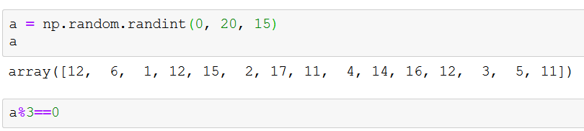
Applying a logical operation to an Array
What will be the result?
What will be the type of the new object?

Slide 32
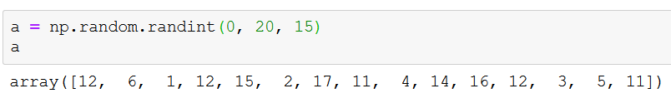

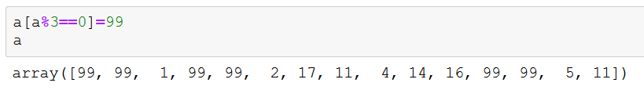
Using logic for indexing
Extremely useful –
for getting only the array elements you want
Also for assignments

Slide 33
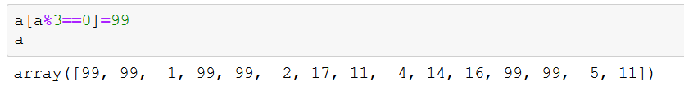

Indexing with a list
Note the [ [

Slide 34
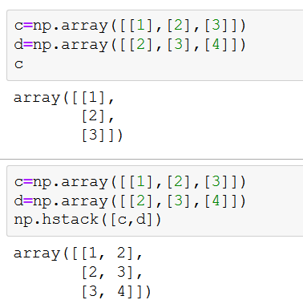
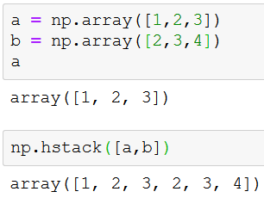
Array stacking
How to concatenate arrays?
a+b : doesn’t work…
a.append(b) : bad
Solution: hstack
Tuple or list

Slide 35
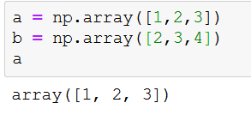
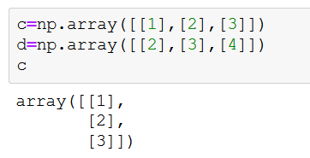
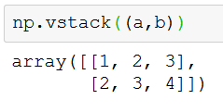
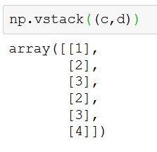
Vertical Stacking

Slide 36
Exercises – with Numpy
Create two arrays with 0…99 and add them
Create an array with all even numbers between 1000 and 10000
Crate 3 matrices of size 4x4: ones, zeros, random, diagonal of (5,6,7,8), and add them to a matrix. Print the Transpose of the matrix
Create an array of 1, 3, 5, …, 201, and reshape it to 10x10
Slice this array to get only the 4 middle elements
Print the sum of the rows

Slide 37
Exercises [2]– with Numpy
Create two arrays with 0…99 and add them
Using broadcasting, multiple the array 0,1,…,99 by 100
Create a random array with 100 elements, and count how many are bigger than 50
9. Create two random arrays of 1000 elements and count how many equal elements there are

Slide 38
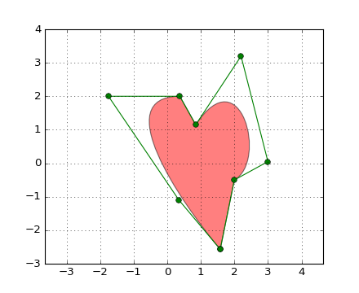
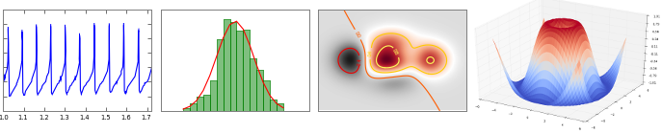
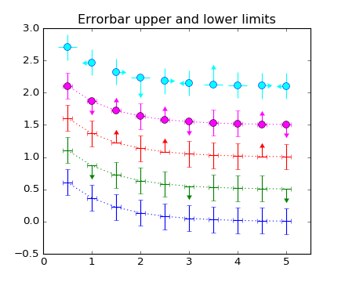

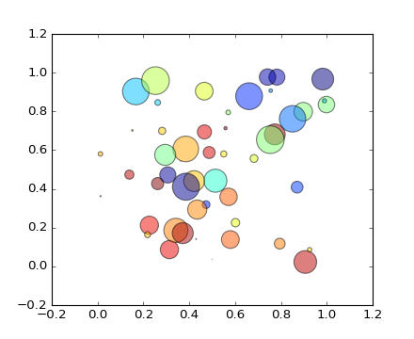
Plotting
“A plot is worth a thousand words"

Slide 39
matplotlib is a python 2D plotting library which produces publication quality figures in a variety of hardcopy formats and in an interactive manner.
You can generate plots, histograms, power spectra, bar charts, errorcharts, scatterplots, etc, with just a few lines of code.
Check this out:
http://matplotlib.org/gallery.html

Slide 40
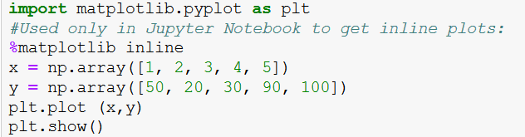
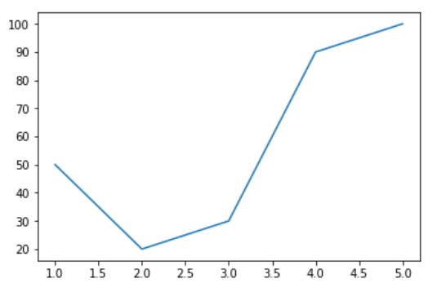
Example 1

Slide 41
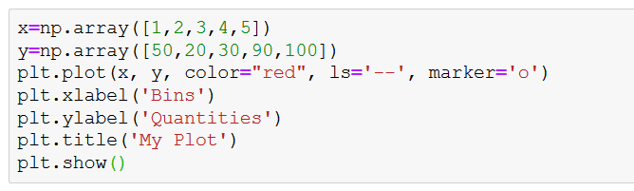
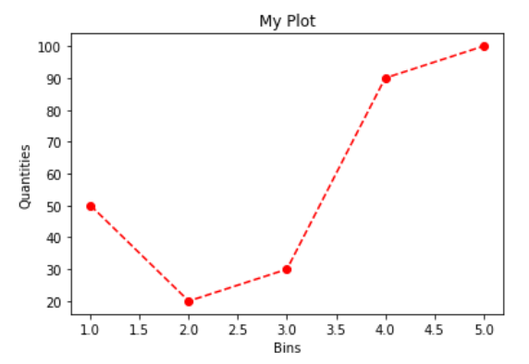
Different line styles

Slide 42
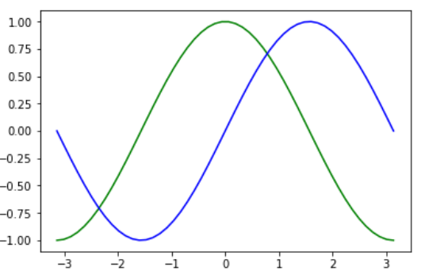
Example 2 – Sin and Cos
import matplotlib.pyplot as plt
import numpy as np
x = np.linspace(-np.pi, np.pi)
y, z = np.cos(x), np.sin(x)
plt.plot(x, y, color = 'green')
plt.plot(x, z, color = 'blue')
plt.show()

Slide 43
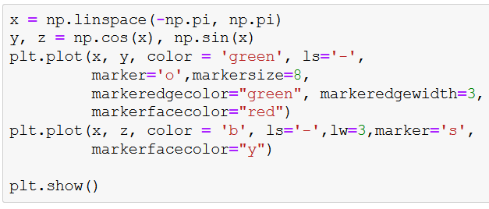
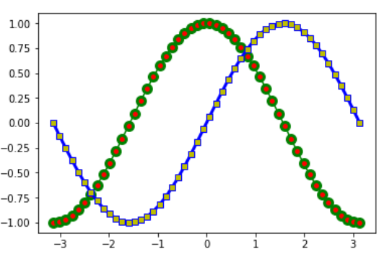
Example 2b- Sin and Cos with Style

Slide 44
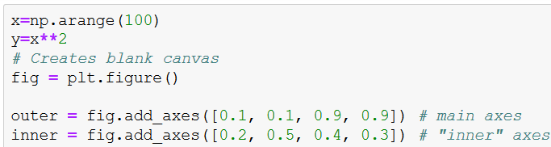
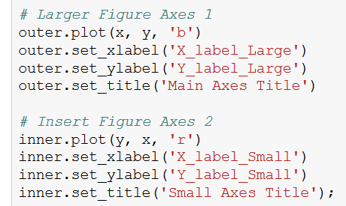
Multiple Axes in same Figure

Slide 45
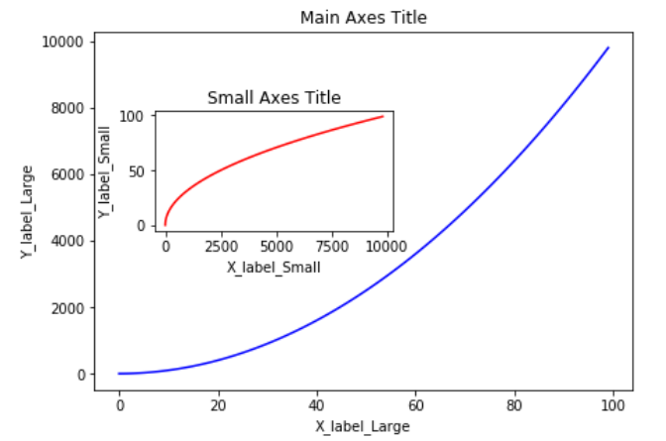
Result
X as a function
Of Y...

Slide 46
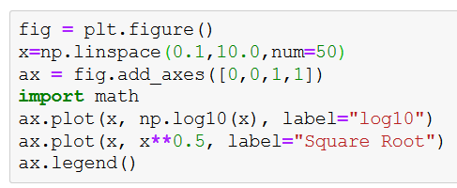
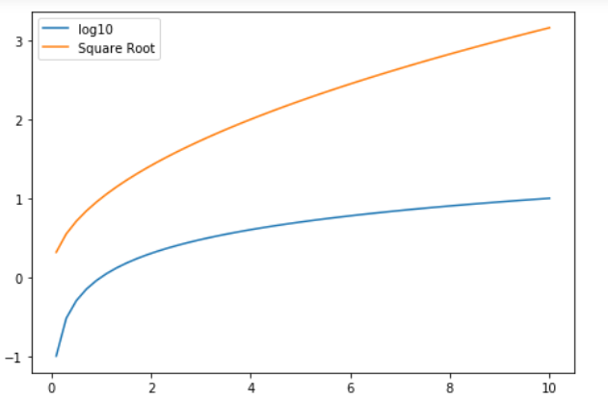
Legends & Labels

Slide 47
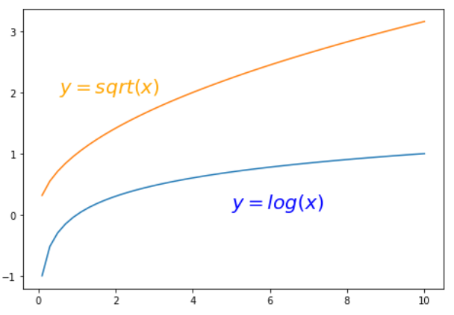
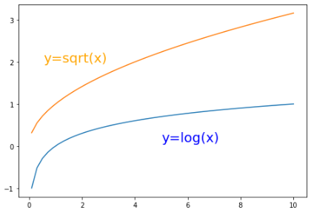
Annotating
Values on Axes

Slide 48
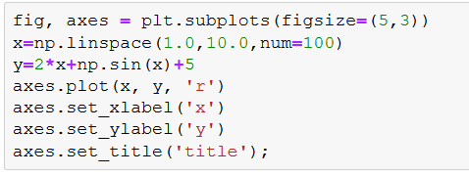
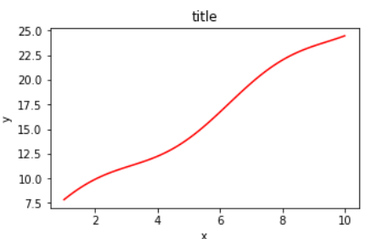
Controlling Figure size

Slide 49
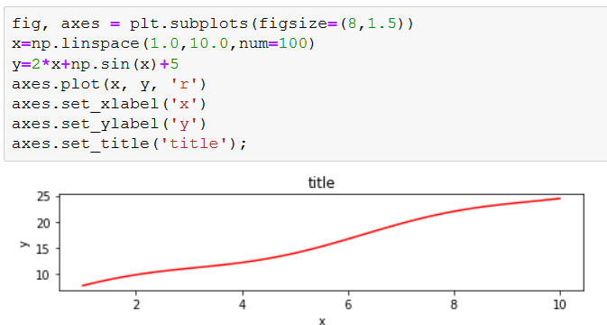
Controlling Figure size

Slide 50
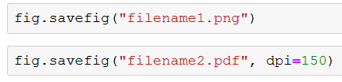
Saving Figures
Multiple picture formats supported, including PDF

Slide 51
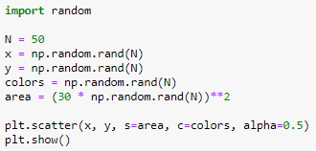
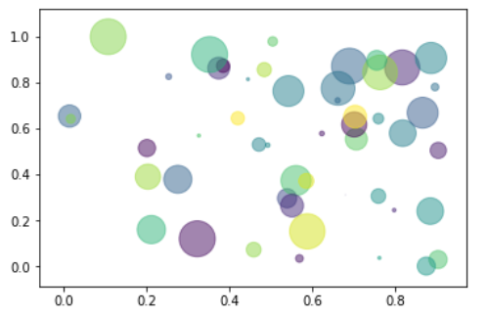
Some Useful Plots: Scatter

Slide 52
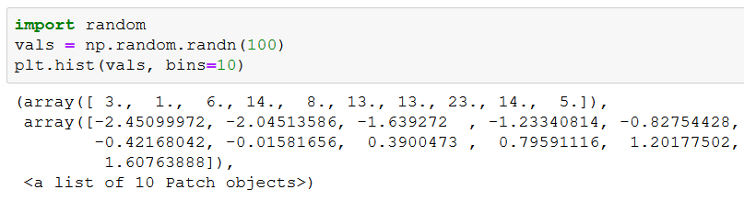
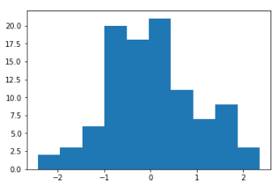
Some Useful Plots: Histogram
Generate 100 values from Normal distribution (with randn)
Insert them into 10 bins and plot
Remember
bucket sort

Slide 53

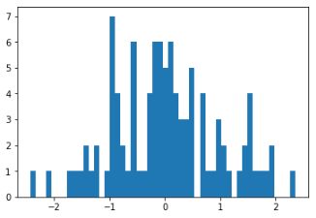
Histogram – more bins
Same values – 50 bins
50 bins
10 bins

Slide 54
Exercises – with Numpy
Create a numpy array with the values 0,1,2,…,49,50,49,…,2,1 and plot it:
As a graph
As a histogram
Plot the function sin(x)+2*cos(y) netween -2*pi and +2*pi. Use linspace
Save the image

Slide 55

3D Plots
Need to define :
Imports
Figure with 3d
X and Y, Z
Surface
Optional: Colors for surface

Slide 56


3D Plots - Data

Slide 57

3D Plots - meshgrid

Slide 58

3D Plots - meshgrid

Slide 59

3D Plots - imports

Slide 60

3D Plots - data
Z = sin ( sqrt ( x^2 + y^2) )

Slide 61

3D Plots - surface

Slide 62


3D Plots - colorbar

Slide 63
3D Plots – final plot

Slide 64

Example: Simple data analysis using Numpy Processing medical data

Slide 65

Real data analysis example
Look at the file inflammation-01.csv
(download the lecture’s code)
Tables as CSV files
Text files
Each row holds the same number of columns
Values are separated by commas

Slide 66

Real data analysis example
Look at the file inflammation-01.csv
The data: inflammation level in patients after a treatment (CSV) format
Each row holds information for a single patient
The columns represent successive days.
The first few lines in the file:
Days
Patients

Slide 67

Reading the data using NumPy

Slide 68

Properties of the data

Slide 69
Tasks
Remove the first and last 10 days
Plot the average, min, and max inflammation score per day
Find the patient with the largest sum of inflamations
Find the patient who was sick (value>= 5) for the longest time

Slide 70

Data trimming and plots
# remove the 10 first and last days n,m = data.shape data = data[:,10:(m-9)]
How can we get the average/min/max of each day?

Slide 71

Removing first and last 10 days

Slide 72


Inflammation values per day

Slide 73
Summary: scientific computing
Numpy – library for math
Matplotlib – Library for plotting graphs
Used for data analysis
We will return to these libraries in the future

