Slide 1
Understanding Corporate Culture Shaping the Values, Vision, and Success of Our Organization
Presented by: Amiksha Ghaghada
Date: 26 October 2024

Slide 2
Elements of Corporate Culture
Definition: Corporate culture encompasses the beliefs, values, and behaviors that determine how a company’s employees and management interact and handle business.
Components:
Shared values
Company vision and mission
Workplace practices and norms

Slide 3

Importance of Corporate Culture
Sets the Tone for Behavior: Shapes how employees interact and handle decisions.
Enhances Engagement & Retention: Employees feel connected to a strong, positive culture.
Improves Performance: Aligns everyone towards common goals, boosting productivity.
Strengthens Brand Image: Builds reputation with clients and potential talent.

Slide 4
Elements of Corporate Culture
Values: Core principles guiding the company (e.g., innovation, integrity).
Leadership Style: Approaches and communication methods leaders use.
Communication Patterns: Formal vs. informal, open-door policies, etc.
Work Environment: Physical and psychological aspects (e.g., open office, remote-friendly).
Rituals & Traditions: Events or habits that build a sense of community.

Slide 5
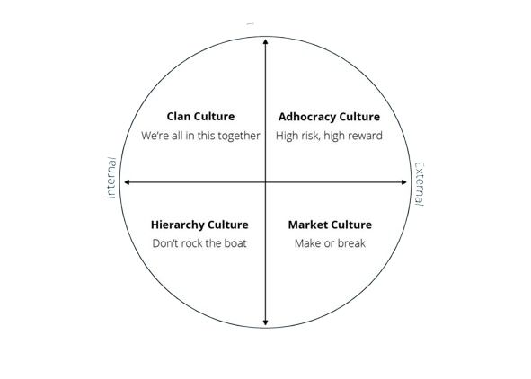
Types of Corporate Culture
Clan Culture: Emphasizes collaboration, employee development, and a family-like environment.
Adhocracy Culture: Focuses on innovation, creativity, and taking risks.
Market Culture: Results-oriented, emphasizing competition and achievement.
Hierarchy Culture: Structured and controlled, with clear processes and efficiency-focused.

Slide 6
Building a Positive Corporate Culture
Define and Communicate Values: Clear, consistent messaging of values.
Empower Leadership: Leaders model desired behaviors.
Foster Open Communication: Encourage transparency and feedback.
Recognize and Reward Alignment with Culture: Celebrating behaviors that embody company values.
Invest in Employee Well-being: Prioritize health, growth, and a balanced work-life approach.

Slide 7

Benefits of a Strong Corporate Culture
Higher Employee Satisfaction and Retention
Increased Productivity and Efficiency
Improved Customer Satisfaction
Enhanced Brand Loyalty and Reputation
Stronger Adaptability to Change

Slide 8
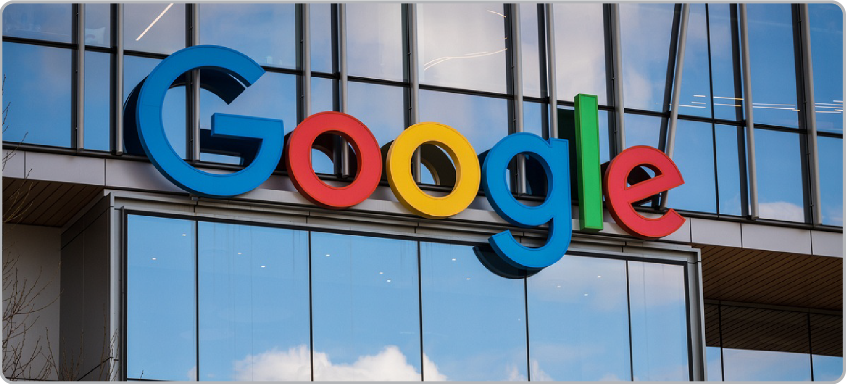
Examples of Successful Corporate Cultures
Google: Innovation and employee empowerment.
Zappos: Customer service-driven culture.
Patagonia: Environmental responsibility and sustainable practices.
Netflix: Freedom and responsibility culture.
.

Slide 9
Measuring Corporate Culture
Surveys and Feedback: Regular feedback from employees.
Employee Engagement Metrics: Satisfaction, turnover rates, etc.
Performance Indicators: Efficiency, productivity, and goal alignment.
Customer Feedback: External perception and brand image.

Slide 10
Conclusion
Recap: Importance of corporate culture and its benefits.
Final Thought: Corporate culture is a living part of the organization and should be actively nurtured to foster growth and success.
Q&A: Open floor for any questions.

Slide 11
Thank You
Amiksha Ghaghada Student of Tops Technology
2024 Batch

