Slide 1
Housekeeping Tracking System
Highlander Hotel

Slide 2
Objective & Methods
Create an Excel Macro Template for Housekeeping Records and Data Archiving
Assign Estimated Times for Room Departures and Stays
Determine Expected Shift Duration for Each Employee by Date
Data Modeling, Analyzing, and Comparing Daily Actual Time Durations with Expected Durations

Slide 3
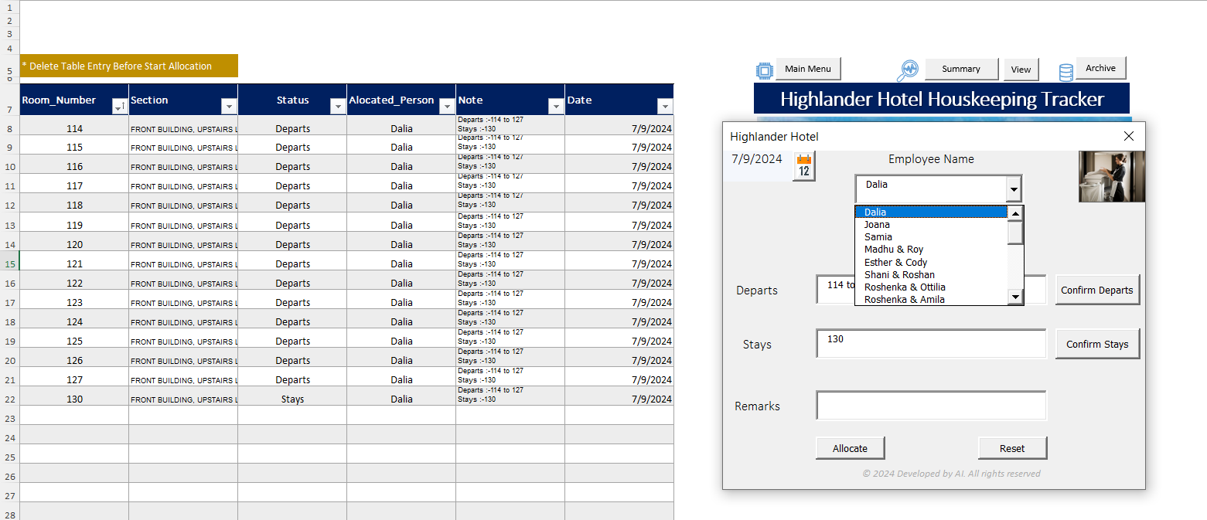
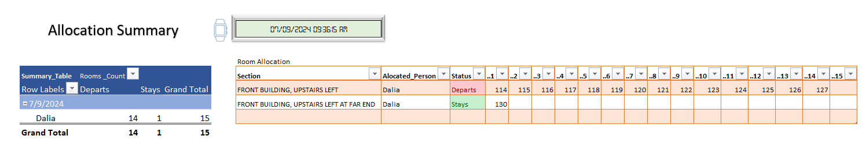




Record Daily Housekeeping Allocation
Daily Record book
Comprehensive and precise records for housekeeping allocations are now available

Slide 4
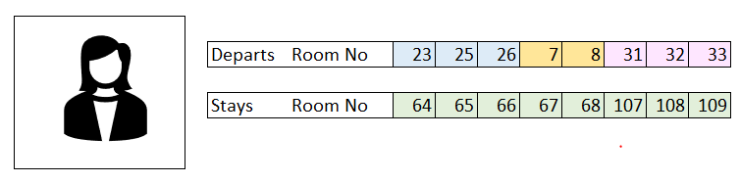
Estimated Time
Using the recorded data, it is possible to estimate the time allocation for each individual per shift
Assumption: Each person spends time only in their allocated rooms
Date :- 6/28/2024
25 min × 3 rooms
30 min × 2 rooms
40 min × 3 rooms
15 min × 8 rooms = 120 min
Total Estimated Time = Departs Time + Stays Time + Buffer Time
Total Estimated Time = 225 min + 120min + 30min = 375 min ---------> 6hrs : 15min

Slide 5

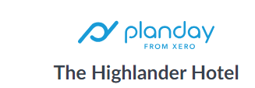

Actual Time
Actual in and out times can be extracted from Planday to compare actual time with estimated time
Web Scrapping
Date | EmpName | InOutTime | InTime | OutTime | Actual_hrs
6/28/2024 | Dalia Stupuriene | 08:30-14:41 | 8:30:00 AM | 2:41:00 PM | 6:11
6/28/2024 | Marjorie Macdonald | 08:30-15:13 | 8:30:00 AM | 3:13:00 PM | 6:43
6/28/2024 | Lydia Mensah | 09:00-15:31 | 9:00:00 AM | 3:31:00 PM | 6:31
6/28/2024 | Millicent Yamoah | 09:00-15:31 | 9:00:00 AM | 3:31:00 PM | 6:31
6/28/2024 | Jumoke Ilemobola | 09:01-16:11 | 9:01:00 AM | 4:11:00 PM | 7:10
6/28/2024 | Aline Vieira | 09:02-15:25 | 9:02:00 AM | 3:25:00 PM | 6:23
6/28/2024 | Eduardo Adomaitis | 09:02-15:25 | 9:02:00 AM | 3:25:00 PM | 6:23
Total Actual Time = 45 hrs :52 min

Slide 6
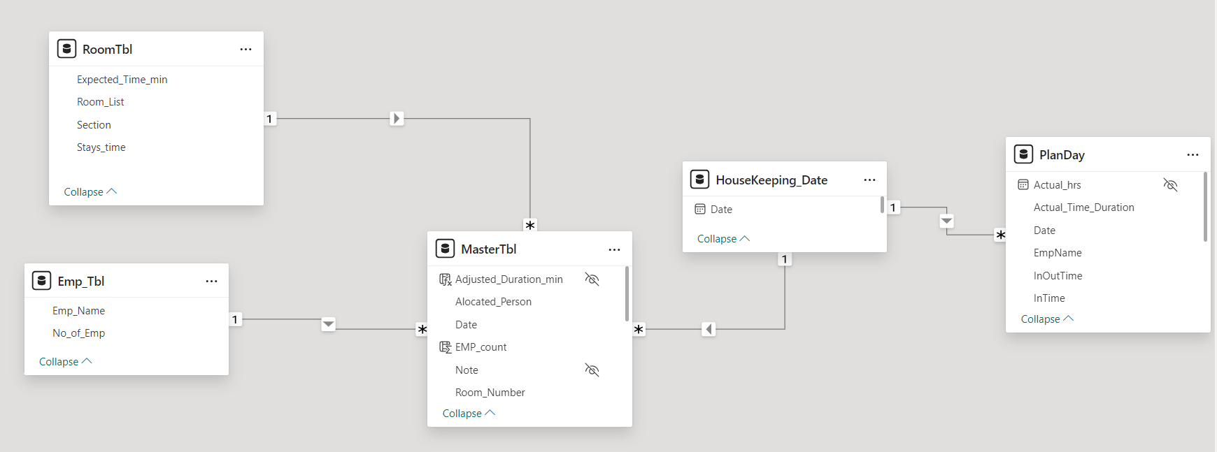
Data Modeling

Slide 7
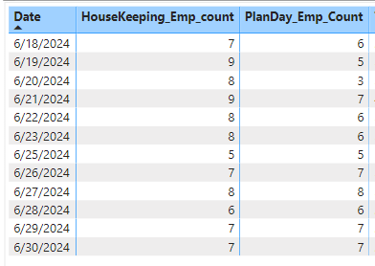
Drawbacks
Some employees' attendance not recorded on planday, thus unable to determine total actual working hours for several days.
Unable to track time spent on activities other than room-related tasks.
Using Planday comments, it's not possible to determine the actual clock-in and clock-out times after approval.

Slide 8
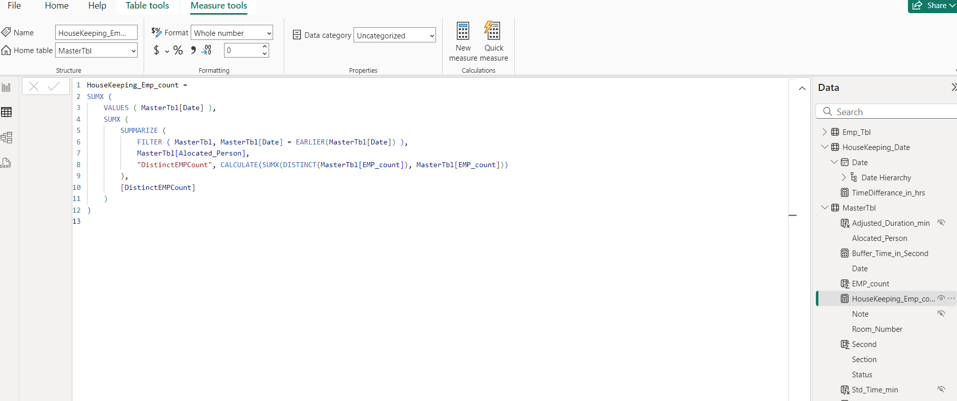
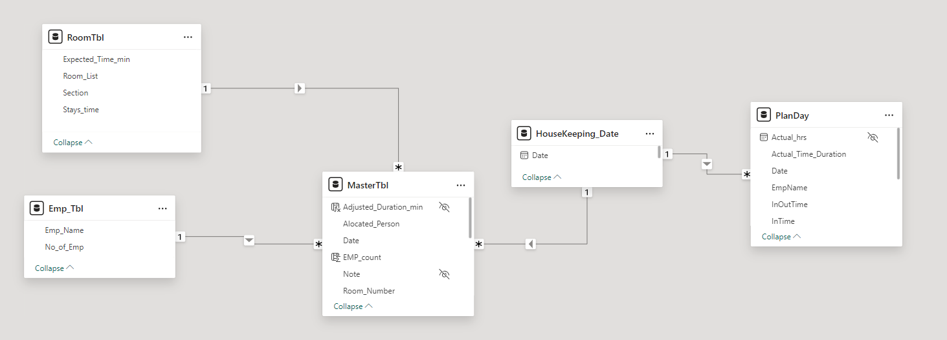
Data Model & Measures

Slide 9
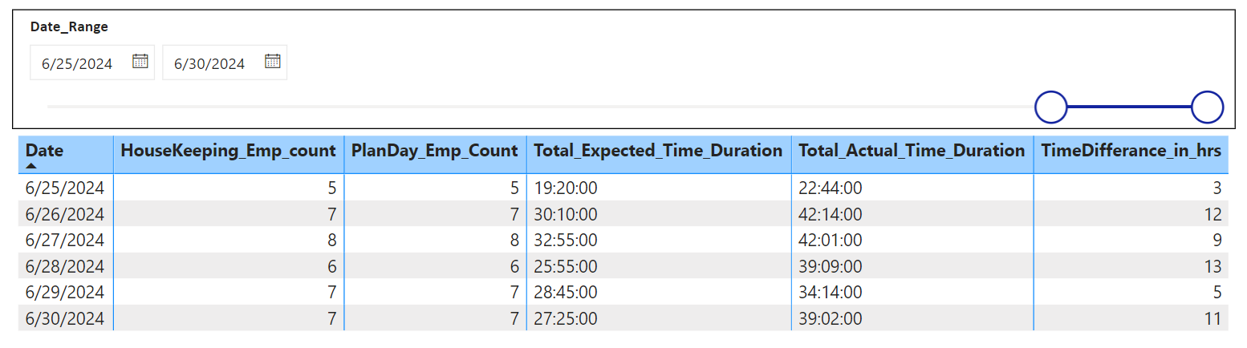
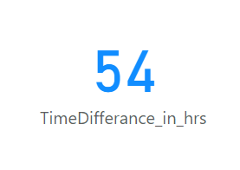
Analysis
Apple to apple Comparison Planday vs Estimated Time
Total Additional Hours for the six days

Slide 10
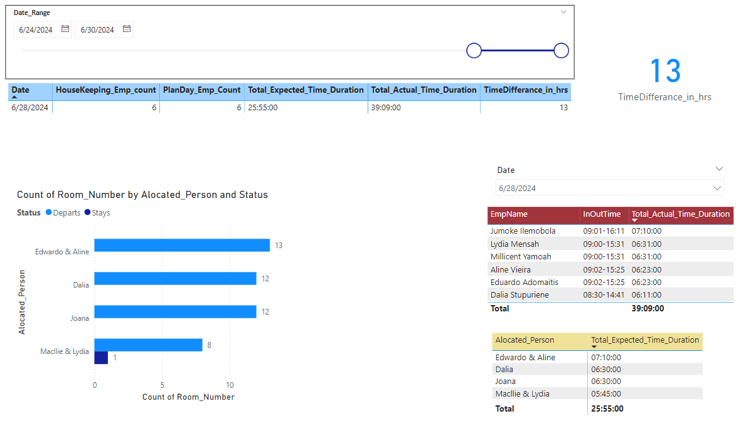
Planday →
Estimated →

Slide 11
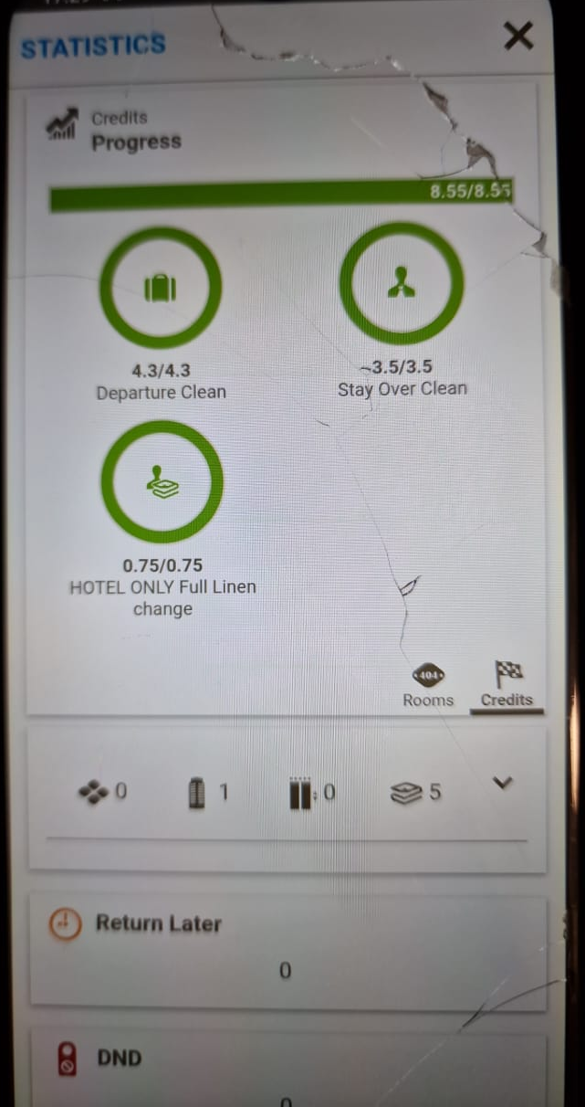
Suggestions
Real time monitoring
Ensure accuracy of clock-in and clock-out times in PlanDay.
Enter daily housekeeping records each day

Slide 12
THANK YOU !

