Slide 1
SMART METERING FOR HOME AUTOMATION

Slide 2
GROUP MEMBERS
E/15/136 ILLANKOON H.A.M.U
E/15/209 MADHUSHANI H.K.
E/15/385 WEERASINGHE S.P.A.P.E

Slide 3
INTRODUCTION
Developing a mobile application for the smart meter of CEB.

Slide 4
REQUIREMENTS
Displaying the monthly usage and monthly bill to the user.
Indicating the power supply/power cut state.
Implementing a soft switch to handle
the power supply.

Slide 5
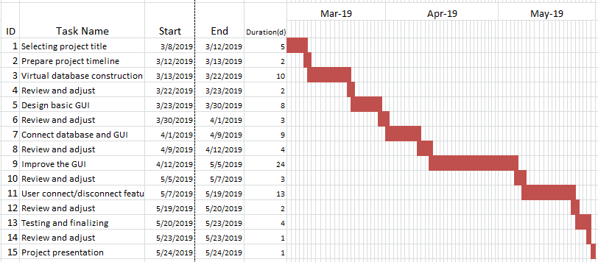
PROJECT TIMELINE
NOW WE ARE HERE….

Slide 6
USED TECHNOLOGIES
Microsoft sql
Programming Language - Java
Jtds JCBD library as the connection to the database.

Slide 7
COMPLETED MILESTONES
Basic GUI is designed.
GUI is connected with the database.
Home page is completed.
We are capable of
-Turning the method to Firebase database and use particular API
-Turning the implementation to MySQL and use Php to connect

Slide 8
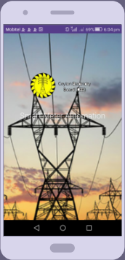
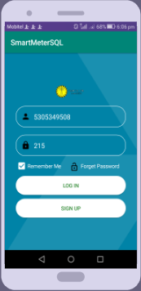
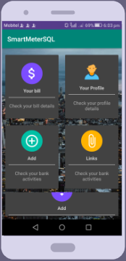
Opening page..
Login page..
Home page..

Slide 9
TASKS TO COMPLETE...
Improve GUI by adding widgets.
Soft switch implementation.
Attractive interfaces to the user

Slide 10
DIFFICULTIES
Had to revise the technology twice because the real database was received later.
Identifying some features of database.

Slide 11
DEMONSTRATION

Slide 12
THANK YOU !

Slide 13


