Slide 1
GUI FOR
SMART METERING FOR HOME AUTOMATION

Slide 2
GROUP MEMBERS
E/15/136 ILLANKOON H.A.M.U
E/15/209 MADHUSHANI H.K.
E/15/385 WEERASINGHE S.P.A.P.E

Slide 3

WHY ???
How your energy consumption varies?
Is your monthly bill accurate?
How can make a quick contact?
Is Payment troublesome?

Slide 4
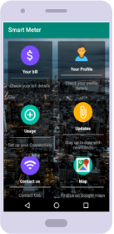
SOLUTION
Developing a user friendly mobile application to customers for satisfying customer requirements

Slide 5
INTRODUCTION
What
A mobile android application
For Representing data to the customers in a efficient way
Why
By creating a GUI for the automated data collecting system implemented by CEB
How

Slide 6
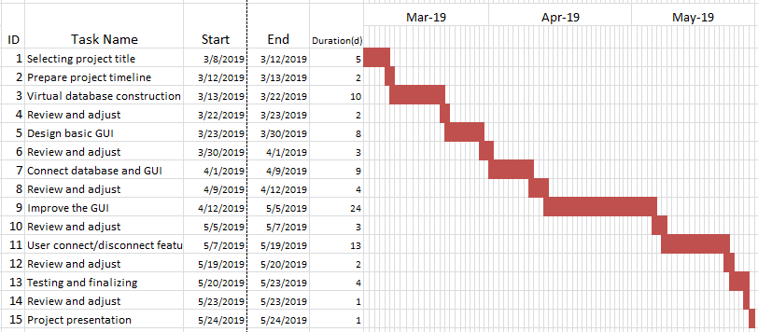
PROJECT PLAN

Slide 7
THINGS COMPLETED ...
Attractive, efficient user app has provided.
Bill page and Usage
User profile
Contact us page
Instant calling , Instant messaging
Google map service
Updates
Latest updates
Energy saving methods
Extra features - Login using QR Code, Access to payment

Slide 8
USED TECHNOLOGIES
Microsoft sql as database language
Services - Google play services, Google maps
JTDS,JDBC Drivers for database connection.
Various API’s .
Libraries - Graphview,helloCharts for data Visualization, Zxing for QR Code Scanner
Adobe XD , Adobe Photoshop CC
Android Studio
Programming language - java

Slide 9
DIFFICULTIES
Identifying technology was difficult initially.
Had to re-establish the hosting server

Slide 10
BENEFITS OF AGILE PROCESS
Changed technology after communication with CEB
MySQL,Php -> firebase -> MsSQL
After mid-evaluation, changed the GUI to simple,attractive theme
Soft switch implementation

Slide 11
DEMONSTRATION

Slide 12
THANK YOU !

Slide 13


