Slide 1
Implementing Class Diagram

Slide 2
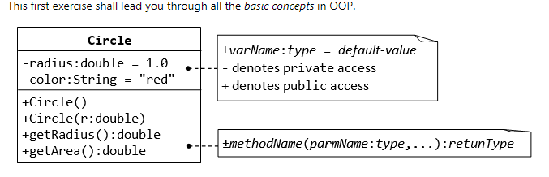
Example - 1

Slide 3
public class Circle {
private double radius;
private String color;
public Circle() {
radius = 1.0;
color = "red";
}
// 2nd constructor with given radius, but color default
public Circle(double r) {
radius = r;
color = "red";
}

Slide 4
// A public method for retrieving the radius
public double getRadius() {
return radius;
}
// A public method for computing the area of circle
public double getArea() {
return radius*radius*Math.PI;
}
}

Slide 5
public class TestCircle {
public static void main(String[] args) {
Circle c1 = new Circle();
// Invoke public methods on instance c1, via dot operator.
System.out.println("The circle has radius of "
+ c1.getRadius() + " and area of " + c1.getArea());
Circle c2 = new Circle(2.0);
System.out.println("The circle has radius of "
+ c2.getRadius() + " and area of " + c2.getArea());
}
}

Slide 6
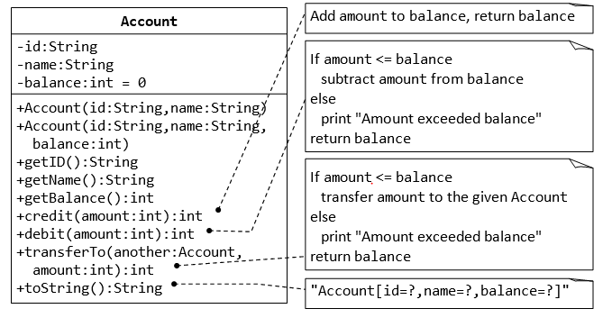

Slide 7
Method toString(): Every well-designed Java class should contain a public method called toString() that returns a short description of the instance (in a return type of String).
For example, include the following toString() methods to the Circle class:
public String toString() {
return "Circle[radius=" + radius + " color=" + color + "]";
}

Slide 8
Exercise

Slide 9
