Slide 1
Day 1: PLC Fundamentals and Basic Ladder Logic
Presented by:

Slide 2
Introduction to PLC and Ladder Logic
PLC fundamentals
Hardware components
Input and output devices
Basic ladder-logic instructions
Latching and SET/RESET operations

Slide 3
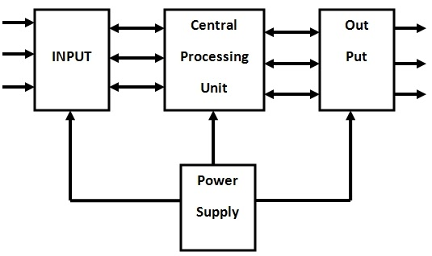
Learning Outcomes
Define a PLC and explain its purpose
Identify the main parts of a PLC
Differentiate input and output devices
Explain the PLC scan cycle
Understand NO and NC instructions
Develop basic ladder-logic programs
Create start–stop and latching circuits
Understand SET and RESET instructions

Slide 4
What Is Automation?
Automation is the use of control systems to operate machines or processes with minimal human
involvement.
Main purposes:
Reduce manual work
Improve production speed
Increase accuracy
Maintain consistent quality
Improve worker safety
Reduce human error
Real-life example: Automatic water tank
1. A sensor detects a low water level. 4. The high-level sensor detects that the tank is full.
2. The controller switches ON the pump. 5. The controller switches OFF the pump.
3. The tank fills with water.

Slide 5
What Is a PLC?
PLC stands for Programmable Logic Controller.
A PLC is a rugged industrial computer designed to:
Receive signals from input devices
Process the programmed logic
Control output devices
Continuously monitor machines and
industrial processes
Simple working concept:
Input → PLC program → Output
Example:
Push button → PLC → Motor
When the operator presses the push button, the PLC reads the signal, executes the program and switches ON the motor.

Slide 6
Why Is a PLC Used?
PLCs are commonly used because they are:
Easy to program and modify
Reliable in industrial environments
Suitable for continuous operation
Faster than traditional relay-control systems
Easy to troubleshoot
Capable of controlling many inputs and outputs
Expandable for future requirements
Real-time example: Conveyor system
A sensor detects a box on the conveyor. The PLC receives the sensor signal and operates a
pneumatic cylinder to push the box into the correct storage area.

Slide 7
Activity
DEVICE | INPUT or OUTPUT?
Push button | Input
Proximity sensor | Input
Temperature sensor | Input
Motor | Output
Indicator lamp | Output
Buzzer | Output

Slide 8
What Is a Relay?
A relay is an electrically operated switch. It uses a small electrical control signal to
switch another circuit ON or OFF.
Main parts of a relay:
Coil
Electromagnet
Common terminal (COM)
Normally Open contact (NO)
Normally Closed contact (NC)
How it works:
When the relay coil is not energized, the NO contact remains open and the NC contact remains closed.
When voltage is supplied to the coil, it produces a magnetic field.
The magnetic field moves the internal contact.
The NO contact closes, and the NC contact opens.
When the coil is switched OFF, the contacts return to their normal positions.

Slide 9
Simple example:
Push button → Relay coil → Lamp
When the push button is pressed, the relay coil energizes. Its NO contact closes and switches ON the lamp.
Real-life comparison:
“A relay works like a person operating a switch. The coil receives the command, and the relay contacts perform the switching action.”
Important point:
The word “normal” in NO and NC refers to the contact condition when the relay coil is not energized.

Slide 10
PLC vs Traditional Relay Control
Before PLCs, industrial machines were controlled using many electromechanical relays, timers, and extensive wiring.
Traditional relay control | PLC control
Logic is created through physical wiring | Logic is created through a program
Modifications require rewiring | Modifications can be made by editing the program
Requires more panel space | Requires less panel space
Troubleshooting is time-consuming | Online monitoring makes troubleshooting easier
Complex systems need many relays | One PLC can perform many control functions
Mechanical contacts experience wear | Program logic has no mechanical wear

Slide 11

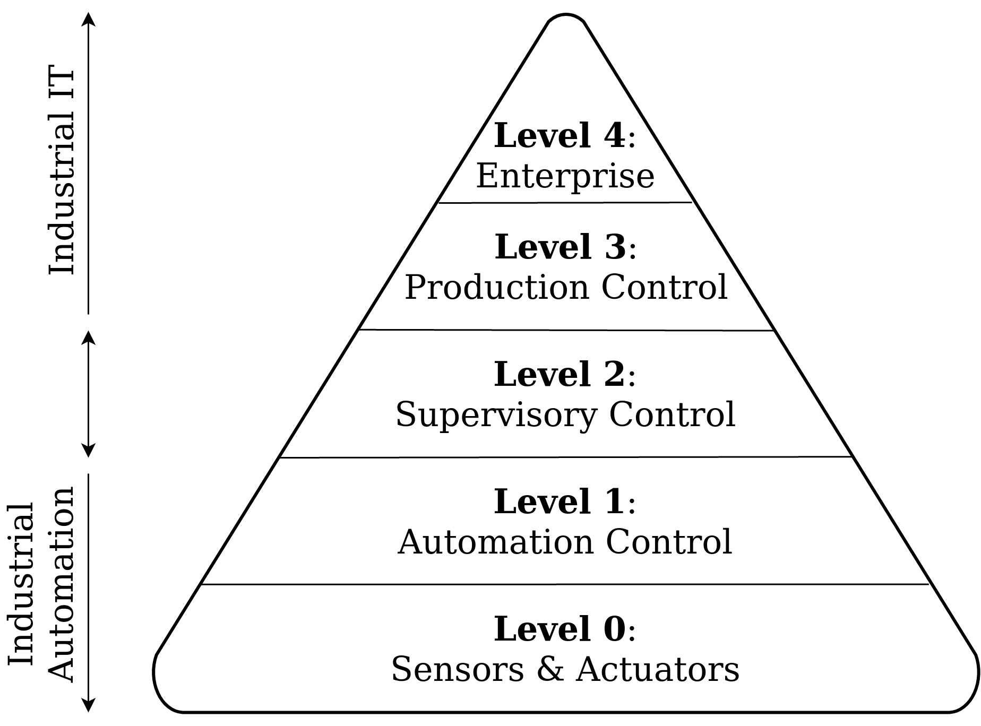
Real-time industrial example: Conveyor modification
Suppose a factory wants the conveyor to stop 10 seconds after a box is detected:
In relay control, a timer relay must be purchased, installed, and wired.
In PLC control, a timer instruction can simply be added to the program.
Important point:
A PLC does not completely eliminate relays. External relays or contactors may still be required to safely control high-power devices such as large motors and heaters.

Slide 12
Main Components of a PLC System
A PLC system consists of the following main components:
Power supply
Central Processing Unit (CPU)
Memory
Input module
Output module
Programming device
Communication interface
Simple working flow
Input devices → Input module → CPU and program → Output module → Output devices
Important point
The PLC output usually does not directly power a large industrial motor. It controls an intermediate device such as a relay, contactor or motor drive, which then operates the motor.

Slide 13
FUNCTION OF EACH COMPONENT
Component | Function
Power supply | Converts the incoming power into the voltage required by the PLC
CPU | Executes the program and controls PLC operations
Memory | Stores the operating system, user program and process data
Input module | Receives signals from sensors and switches
Output module | Sends control signals to actuators
Programming device | Used to create, download and monitor the PLC program
Communication interface | Allows the PLC to communicate with HMIs, SCADA systems, drives and other PLCs
Industrial example: Automatic conveyor
Input: A proximity sensor detects a box.
CPU: The PLC checks the programmed condition.
Output: The PLC switches ON the conveyor motor through a contactor.

Slide 14
How Does a PLC Work? (PLC Scan Cycle)
A PLC operates continuously in a repeated sequence known as the scan cycle.
Four main stages
Input scan
  The PLC reads the current status of all input devices.
  Example: It checks whether a push button is pressed or a sensor is activated.
Program scan
  The CPU executes the ladder program from the first rung to the last rung.
  It processes the conditions using the stored input status.
Output update
  The PLC switches the required outputs ON or OFF according to the program result.
  Example: It turns a motor or indicator lamp ON.
Internal operations
  The PLC performs communication, diagnostics and system checks.
The cycle then repeats continuously.
Input scan → Program scan → Output update → Internal operations → Repeat

Slide 15
Simple example:
Push button and lamp
Consider the following system:
Push button: Input
PLC program: Decision-making logic
Lamp: Output
When the push button is pressed:
The PLC reads the push-button signal.
It checks the programmed condition.
It updates the output.
The lamp switches ON.
The PLC repeats the same cycle.
Real-life comparison
The PLC scan cycle is similar to a security guard
repeatedly checking CCTV screens:
Observe: Check what is happening.
Decide: Compare it with the rules.
Act: Take the required action.
Repeat: Continue monitoring.
Important points
The time required to complete one cycle is called scan time.
Scan time is generally measured in milliseconds.
Scan time depends on the CPU speed, program size, communication and number of instructions.
The PLC normally executes ladder logic from top to bottom and left to right.

Slide 16
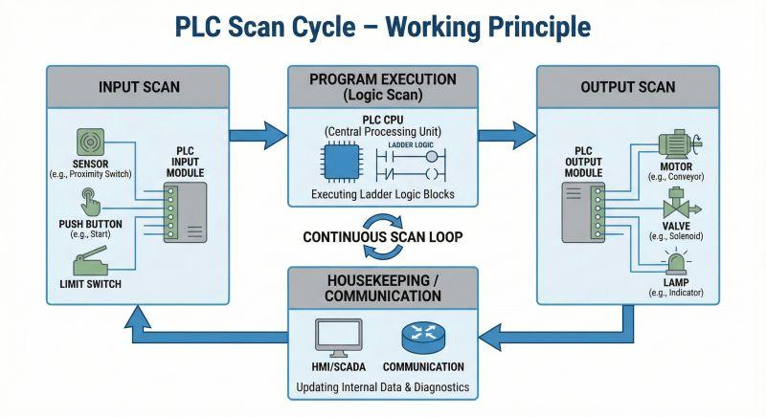
Activity
Arrange these operations in the correct order:
Update outputs
Read inputs
Execute the program

Slide 17
Types of PLC Inputs and Outputs
A PLC communicates with machines through input and output signals.
Inputs provide information to the PLC.
Outputs receive commands from the PLC and perform an action.
1. Digital signals
A digital signal has only two states:
ON or OFF
1 or 0
TRUE or FALSE
Digital inputs | Digital outputs
Push button | Indicator lamp
Limit switch | Buzzer
Proximity sensor | Solenoid valve
Float switch | Contactor
Emergency-stop feedback | Relay
Example: When a box activates a proximity sensor, the PLC turns ON the conveyor motor.

Slide 18
2. Analog signals
An analog signal represents a continuously changing value.
Common industrial signal ranges:
0–10 V
4–20 mA
Analog inputs | Analog outputs
Temperature transmitter | Variable Frequency Drive speed reference
Pressure transmitter | Control valve position
Level transmitter | Heater power controller
Flow transmitter | Analog display or meter
Example: A temperature transmitter sends a 4–20 mA signal representing 0–100°C. The PLC uses this value to control a cooling fan or valve.

Slide 19
Digital | Analog
Only two states | Range of values
Lamp ON/OFF | Lamp brightness 0–100%
Motor Start/Stop | Motor speed control
Tank Low/Full switch | Exact tank level measurement
Important point
PLC input and output modules must match the signal type and electrical rating of the connected device.

Slide 20
PLC Input and Output Addressing
Every input, output and internal memory location in a PLC is given a unique address.
An address helps the PLC identify:
Which input signal must be read
Which output device must be controlled
Which internal memory value must be used
Field device | Type | Example address
Start push button | Digital input | I0.0
Stop push button | Digital input | I0.1
Proximity sensor | Digital input | I0.2
Motor contactor | Digital output | Q0.0
Indicator lamp | Digital output | Q0.1
These are Siemens-style addresses. Address formats vary depending on the PLC manufacturer and software.

Slide 21
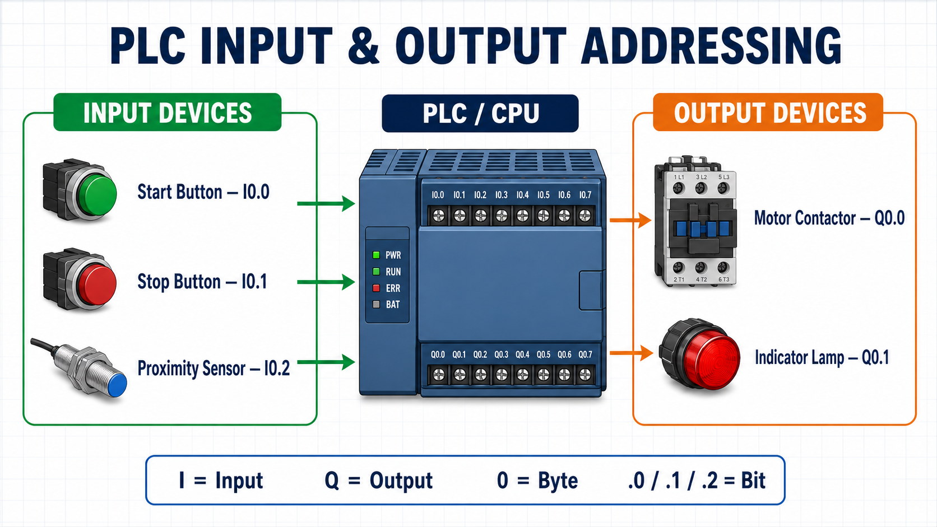
Understanding the address
For the address I0.2:
I represents Input
0 represents Byte 0
2 represents Bit 2
Example control operation
Consider a conveyor system:
Start button: I0.0
Stop button: I0.1
Box sensor: I0.2
Conveyor motor: Q0.0
Box-detected lamp: Q0.1
For the address Q0.1:​
Q represents Output ​
0 represents Byte 0 ​
1 represents Bit 1 ​
When the box sensor at I0.2 detects a box, the PLC
program can switch ON the indicator lamp at Q0.1.

Slide 22
Introduction to Ladder Logic
Ladder Logic is a graphical PLC programming language used to control industrial machines and processes.
It is called ladder logic because the program resembles a ladder.
Main parts of a ladder diagram
Left power rail: Represents the beginning of the logical path
Right power rail: Represents the end of the logical path
Rung: A horizontal line containing one control operation
Contacts: Represent input conditions or internal conditions
Coils: Represent output commands or internal results

Slide 23
Basic ladder rung
|----[ Start Button ]----------------( Lamp )----|
[ Start Button ] represents an input contact.
( Lamp ) represents an output coil.
When the input condition is TRUE, the rung becomes true and the output coil turns ON.
When the input condition is FALSE, the output coil turns OFF.
Example addresses
|----[ %IX0.0 ]---------------------( %QX0.0 )----|
Start button Lamp
Device | Variable name | CODESYS address
Start push button | Start_Button | %IX0.0
Indicator lamp | Lamp_Output | %QX0.0

Slide 24
How the PLC executes ladder logic
The PLC checks:
Is the condition on the left side true?
Is there a complete logical path across the rung?
If yes, energize the output coil.
If no, de-energize the output coil.
Ladder programs are generally scanned:
Left to right → Top to bottom
Real-life example: Automatic room light
A presence sensor detects a person.
The PLC receives the sensor signal.
The corresponding ladder contact becomes true.
The PLC energizes the lamp output.
When no person is detected, the lamp switches OFF.
Important
The lines in ladder logic represent a logical flow, not the actual electrical power flowing directly through the PLC program
Activity
(identify the following)
|----[ Level Sensor ]---------------( Water Pump )----|

Slide 25
Normally Open and Normally Closed Instructions
Ladder logic mainly uses two contact instructions to examine the status of a bit:
Normally Open (NO) instruction
Normally Closed (NC) instruction
Ladder symbols
Normally Open (NO) Normally Closed (NC)
----| |---- ----|/|----
Example 1 — Normally Open instruction
|----| |----------------------------( )----|
Start_Button Lamp
%IX0.0 %QX0.0
Start button bit = 0 → NO instruction is FALSE → Lamp is OFF
Start button bit = 1 → NO instruction is TRUE → Lamp is ON

Slide 26
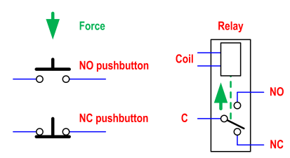
Example 2 — Normally Closed instruction
|----|/|----------------------------( )----|
Stop_Button Lamp
%IX0.1 %QX0.0
Stop button bit = 0 → NC instruction is TRUE → Lamp is ON
Stop button bit = 1 → NC instruction is FALSE → Lamp is OFF
Truth table
| Input-bit status | NO instruction —| |— | NC instruction —|/|— |
|---|---|---|
| 0 — OFF/FALSE | FALSE | TRUE |
| 1 — ON/TRUE | TRUE | FALSE |

Slide 27
Important
The NO or NC ladder instruction does not necessarily describe the physical construction of the push button.
Physical NO/NC describes the electrical state of the field device in its normal, unoperated condition.
Ladder NO/NC describes how the PLC program examines the stored bit.
For example, a physically NC stop button can still be represented by an NO instruction in the program, depending on the required logic and the input status.
Real-life example — Safety guard
A machine should operate only while its safety guard is closed.
Guard closed → Sensor bit is ON → NO instruction becomes TRUE
Guard opened → Sensor bit becomes OFF → Instruction becomes FALSE
PLC stops the machine
|----| |----------------------------( )----|
Sensor Buzzer
Sensor bit = 0 → Buzzer is OFF
Sensor bit = 1 → Buzzer is ON
|----|/|----------------------------( )----|
Sensor Buzzer
Sensor bit = 0 → Buzzer is ON
Sensor bit = 1 → Buzzer is OFF

Slide 28
Logic gate in PLC:
Logic gates are digital devices that produce an output based on the combination of inputs,
and the main types include:
AND NAND
OR NOR
NOT XOR
XNOR gates
AND – Output is HIGH only when all inputs are HIGH
OR – Output is HIGH when at least one input is HIGH
NOT – Inverts the input; HIGH becomes LOW and vice versa
NAND – Output is LOW only when all inputs are HIGH (inverted AND)
NOR – Output is HIGH only when all inputs are LOW (inverted OR)
XOR – Output is HIGH when inputs are different
XNOR – Output is HIGH when inputs are the same

Slide 29
AND Logic and OR Logic in Ladder Programming
Multiple contact instructions can be connected in series or parallel to create logical conditions.
1. AND Logic — Contacts in Series
In AND logic, all conditions must be TRUE for the output to turn ON.
|----| |---------| |--------------------( )----|
Input_A Input_B Output
Logic expression:
Output = Input_A AND Input_B
Truth table for AND logic
Input A | Input B | Output
OFF | OFF | OFF
OFF | ON | OFF
ON | OFF | OFF
ON | ON | ON

Slide 30
A motor can start only when:
The Start button is pressed, AND
The safety guard is closed
|-------| |--------------------| |---------------( Motor )----|
Start_Button Guard_Closed
If either condition is false, the motor will not start.
Real-life comparison:
A student can enter an examination hall only when they have a hall ticket AND an identity card.

Slide 31
2. OR Logic — Contacts in Parallel
In OR logic, the output turns ON when at least one
condition is TRUE.
|----+----| |----+------------------( )----|
| Input_A | Output
| |
+----| |----+
Input_B
Logic expression:
Output = Input_A OR Input_B
Truth table for OR logic
Input A | Input B | Output
OFF | OFF | OFF
OFF | ON | ON
ON | OFF | ON
ON | ON | ON

Slide 32
Industrial example: Alarm system
A warning buzzer must turn ON when:
The temperature is high, OR
The pressure is high
|----+----| |----+---------------( Buzzer )----|
| High_Temp |
| |
+----| |----+
High_Pressure
Either abnormal condition can activate the buzzer.
Real-life comparison:
You can contact a person using a phone call OR a text message.
Either method can achieve the result.
Connection | Logic operation | Requirement
Series contacts | AND | Every condition must be true
Parallel contacts | OR | Any one condition can be true

Slide 33
Start–Stop Motor Control Circuit
A Start–Stop circuit is used to start a motor with one push button and stop it with another.
Devices used
Device | Function | Example address
Start push button | Starts the motor | %IX0.0
Stop push button | Stops the motor | %IX0.1
Motor contactor | Controls motor power | %QX0.0
Basic ladder logic without latching
|----|/|---------| |----------------( )----|
Stop_Button Start_Button Motor
%IX0.1 %IX0.0 %QX0.0
Operation
Stop condition healthy and Start button pressed → Motor output turns ON.
Start button released → Motor output immediately turns OFF.
Stop condition activated → The logical path breaks and the motor turns OFF.

Slide 34
Latching (Seal-In) Logic
Latching allows an output to remain ON even after the momentary Start push button is released.
It is also called:
Seal-in logic
Holding circuit
Self-holding logic
Ladder diagram
Stop_Button Start_Button
|----|/|------------+-------| |-----------+----( Motor )----|
| |
+-------| |-----------+
Motor
Seal-in contact
Example variables:
|----|/|------------+-------| |-----------+----( )----|
Stop_Button | Start_Button | Motor
| |
+-------| |-----------+
Motor

Slide 35
Logic expression
Motor = Stop_OK AND (Start_Button OR Motor)
The Start button and Motor holding contact are connected in parallel, forming OR logic.
Step-by-step operation
Initially, the motor is OFF, so its holding contact is false.
Pressing Start completes the logical path.
The motor output turns ON.
The Motor contact in the parallel branch also becomes true.
Releasing Start does not stop the motor because the Motor contact maintains the path.
Pressing Stop breaks the path.
The motor output and its holding contact turn OFF.

Slide 36
Industrial example
For a conveyor:
Press Start once → conveyor continues running.
Release Start → conveyor remains running.
Press Stop → conveyor stops.
Real-life comparison
A latching circuit is similar to switching on a ceiling fan: you operate the switch once, and the fan continues running without holding the switch.
Important safety point
The Stop and safety conditions should be placed in series before the latching branch so that any stop condition can break the entire logical path.

Slide 37
SET and RESET Instructions
The SET and RESET instructions are another method of keeping an output or memory bit ON or OFF after a momentary input signal disappears.
SET: Stores the bit in the ON state.
RESET: Clears the same bit to the OFF state.
Ladder diagram
Rung 1: SET operation
|----| |----------------------------(S)----|
Start_Button Motor
%IX0.0 %QX0.0
Rung 2: RESET operation
|----| |----------------------------(R)----|
Stop_Button Motor
%IX0.1 %QX0.0
Step-by-step operation
Press the Start button.
The SET instruction makes the Motor bit ON.
Release Start—the Motor bit remains ON.
Press the Stop button.
The RESET instruction makes the Motor bit OFF.
Release Stop—the Motor bit remains OFF.

Slide 38
Difference from a normal output coil
Normal coil | SET/RESET
ON only while its rung is true | Remembers the previous command
Turns OFF when the rung becomes false | Remains ON until RESET is activated
Usually programmed in one rung | SET and RESET usually use separate rungs
Industrial example: Alarm indication
When a fault occurs, an alarm lamp must remain ON even if the fault signal appears only briefly.
Fault detected → SET alarm bit
Operator investigates the fault
Operator presses Acknowledge/Reset → RESET alarm bit
This ensures that a short fault is not missed.
Real-life comparison
SET and RESET work like separate ON and OFF buttons:
SET says, “Switch it ON and remember it.”
RESET says, “Switch it OFF and remember it.”

Slide 39
SET/RESET versus seal-in latching
Seal-in circuit | SET/RESET instructions
Uses the output’s own contact | Uses memory-type instructions
Holding path is visible in one rung | SET and RESET are placed on separate rungs
Stops when the common rung condition breaks | Remains stored until a RESET instruction executes
Easy for beginners to trace | Useful for event-based control and alarms
Important safety point
Avoid using SET/RESET alone for safety-critical motor stopping. Emergency stops and safety devices should use properly designed hardwired safety circuits or safety-rated PLC systems.
Also, ensure that the program clearly defines what should happen if SET and RESET become true during the same scan. The result can depend on instruction order and the PLC platform

