Slide 1
ROS 2 JAZZY MINI-PROJECT REPORT
ArUco Station Identification & Task Triggering
Automated AMR Dispatch Pipeline via Visual Marker Detection & State Machine Control
Student Name: Amin Ahmed G | Dept: B.E. Robotics & Automation Engineering, Anna University
Package: secure_station_dispatch (Phase 1 Deliverable) | Environment: ROS 2 Jazzy (Ubuntu 24.04)

Slide 2
01 | PROJECT OBJECTIVE
Automated AMR Station Dispatch
Visual Station Detection
Detect 4×4 ArUco markers placed at four industrial facility stations using an onboard camera sensor.
Station Identity Mapping
Map detected marker IDs (0–3) to station identities (Inspection, Assembly, Storage, Charging) via YAML registry.
ROS 2 Action Task Triggering
Initiate multi-step industrial task sequences managed asynchronously by a ROS 2 action client-server interface.
State Machine Control
Enforce IDLE ↔ TASK_IN_PROGRESS finite state transitions to prevent double-dispatch and race conditions.

Slide 3
02 | TECH STACK
Tools & Frameworks Used
ROS 2 Distribution
ROS 2 Jazzy Jalisco on Ubuntu 24.04 (Python 3.12)
Computer Vision
OpenCV (cv2.aruco DICT_4X4_50) and cv_bridge
ROS 2 Communication
Topics (Pub/Sub) and Action Client/Server (/station_task)
Custom Interfaces
StationMarker.msg & StationTask.action
Config & Storage
YAML (station_registry.yaml) & JSON Lines (dispatch_events.jsonl)
Build System
Colcon with CMake (CMakeLists.txt) & setuptools (setup.py)

Slide 4
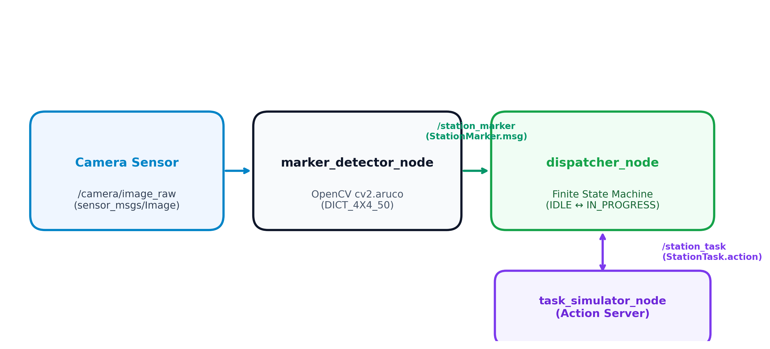
03 | SYSTEM ARCHITECTURE
Modular 3-Node Dispatch Pipeline
marker_detector_node.py
Processes /camera/image_raw using OpenCV ArUco detector and publishes StationMarker.msg on /station_marker.
dispatcher_node.py
Maintains IDLE ↔ TASK_IN_PROGRESS FSM, logs events, and sends action goals to the task server.
task_simulator_node.py
Action server for /station_task, executing 5-step simulated tasks with periodic progress feedback.

Slide 5
04 | ARCHITECTURAL DECISION
Why Split into 3 Separate Nodes?
Independent Testing & Debugging
Splitting vision processing, state management, and task execution allows each component to be developed, monitored, and unit-tested in isolation without blocking each other.
Mirrors Real-World AMR Architecture
Aligns with industrial mobile robot design standards by separating perception, decision-making, and execution into distinct, modular packages rather than a monolithic node.

Slide 6
05 | CUSTOM INTERFACES
StationMarker.msg & StationTask.action
StationMarker.msg (Telemetry)
• int32 marker_id — ArUco marker identifier (0–3)
• string station_name — Mapped station name
• float64[7] robot_pose — [x, y, z, qx, qy, qz, qw]
• float64 confidence — Detection confidence score
• Time stamp — ROS 2 detection timestamp
StationTask.action (Task Control)
Goal:
• string task_type — Task category (e.g. Inspection)
• string station_name — Target station
Result:
• bool success | string summary | float64 time
Feedback:
• string status | float64 progress (0–100%)

Slide 7
06 | STATION REGISTRY
Marker ID to Station & Task Mapping
Marker ID | Station Name | Task Type | Sim Duration | Steps
0 | Inspection Station | Inspection | ~3.0 s | 5 steps
1 | Assembly Station | Assembly | ~3.5 s | 5 steps
2 | Storage Station | Storage | ~2.7 s | 5 steps
3 | Charging Station | Charging | ~3.5 s | 5 steps

Slide 8
07 | STATE MACHINE CONTROL
Dispatcher Finite State Machine Flow
1. IDLE State
Dispatcher active, listening for incoming /station_marker detections.
2. Marker Received
Valid marker message arrives ➔ state transitions to TASK_IN_PROGRESS.
3. Lock In-Progress
State locked ➔ ignores subsequent marker detections during task run.
4. Action Execution
Dispatches StationTask goal ➔ receives periodic step progress feedback.
5. Result & Reset
Action result received ➔ logs to dispatch_events.jsonl ➔ resets to IDLE.

Slide 9
08 | TESTING & RESULTS
Automated Integration Test Verification
PIPELINE TEST SUMMARY
• Dispatched Events: 4 / 4 (100% Success)
• Completed Events: 4 / 4 (100% Success)
• Marker 0 (Inspection): ✓ PASS (~3.0s)
• Marker 1 (Assembly): ✓ PASS (~3.5s)
• Marker 2 (Storage): ✓ PASS (~2.7s)
• Marker 3 (Charging): ✓ PASS (~3.5s)
• Overall Result: ✓ PASS — All 4 Stations Verified
Audit Logging Evidence
Every dispatch and task completion event is written in real-time to dispatch_events.jsonl:
{
"timestamp": "2026-08-18T07:00:01Z",
"marker_id": 0,
"station": "Inspection Station",
"outcome": "DISPATCHED"
}
{
"timestamp": "2026-08-18T07:00:04Z",
"marker_id": 0,
"station": "Inspection Station",
"outcome": "COMPLETED"
}

Slide 10
09 | CHALLENGES FACED
ROS 2 Jazzy CMake Target Collision & Resolution
⚠️ The Build Collision Issue
• Standard ROS 2 Python packages use ament_python_install_package(secure_station_dispatch).
• In ROS 2 Jazzy, defining custom msg/action interfaces in the same package creates internal CMake targets sharing the package name.
• Result: colcon build failed with target redefinition errors.
✅ The Resolution
Replaced ament_python_install_package() with an explicit directory installation rule in CMakeLists.txt:
install(DIRECTORY secure_station_dispatch/
DESTINATION lib/python3.12/
site-packages/secure_station_dispatch
)
Outcome: Interfaces and Python modules build cleanly together without target collisions.

Slide 11
10 | CONCLUSION
Summary of Completed Deliverables
ArUco Station Identification
Accurately extracts 4×4 ArUco marker IDs from raw camera frames and maps them to industrial station identities.
ROS 2 Action Architecture
Manages multi-step simulated task execution using ROS 2 action server/client interfaces with progress feedback.
Finite State Machine Control
Maintains strict IDLE ↔ TASK_IN_PROGRESS state transitions to prevent double-dispatch and race conditions.
Structured Audit Logging
Generates deterministic JSON Lines event logs recording timestamps and task outcomes for facility tracking.

