Slide 1
Just
How Accurate
FIFA Game’s Predictions Are?
By Kevin Bindig & Amin Al-Ait

Slide 2

Myth
The video game FIFA is released on a yearly basis. It tracks a large amount of (but not all) players from 16 to 40 years old.
And our myth says that FIFA game is a good indicator for the progression of young talents in real life world of Football.

Slide 3
Myth
FIFA Career Mode: “lets you control your favourite team on and off the field." - Wikipedia
Aim: Players cross their predicted potential put by FIFA

Slide 4
Data Basis
Overall rating and potential rating of players in the game FIFA.
And track their rating progress in following FIFA games (07-21) from FIFA Game database website sofifa.com
We chose 360 players, age 19, for each FIFA year, sorted by maximum potential first.

Slide 5
Data Basis
Further, we aim to compare and contrast the overall distribution of every player to real life performance data scraped from their respective profiles in transfermarkt.de.

Slide 6
Data
The database: Name, Age, Club, Overall, Pot19.
Methods to create data sets and graphs
  Scraping packages
    Rvest
    Rselenium
  Plotting packages
    Ggplot2

Slide 7
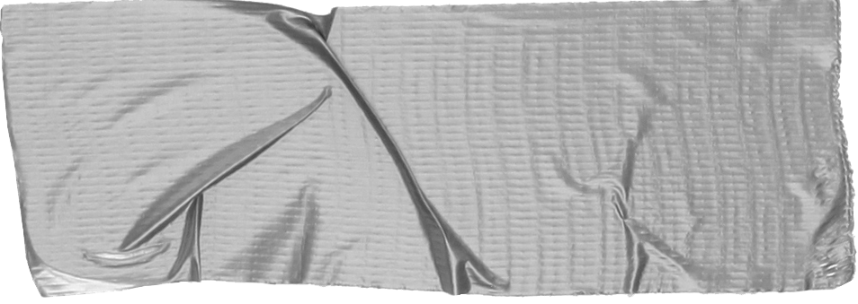

Info:
We decided to exclusively choose players at the age of 19 of every year (07 - 21).
Overall
The overall score of the player out of 100. (100 is a perfect player).
Prime Overall
Highest overall achieved by the player throughout his career
(Max) Potential
The potential put by FIFA on a player at the age of 19.
Difference
= Max Potential - Overall

Slide 8
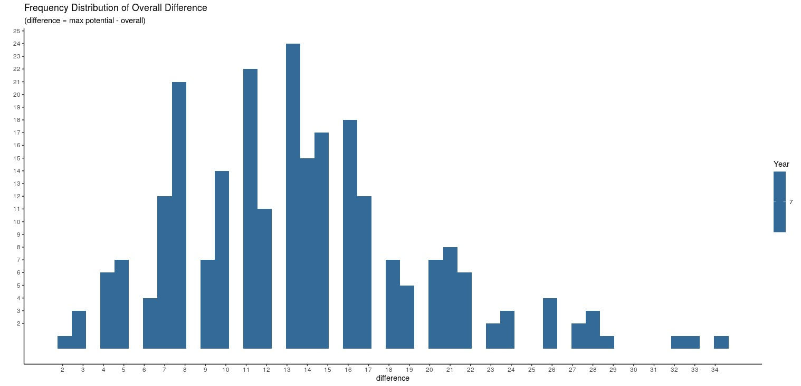

Slide 9
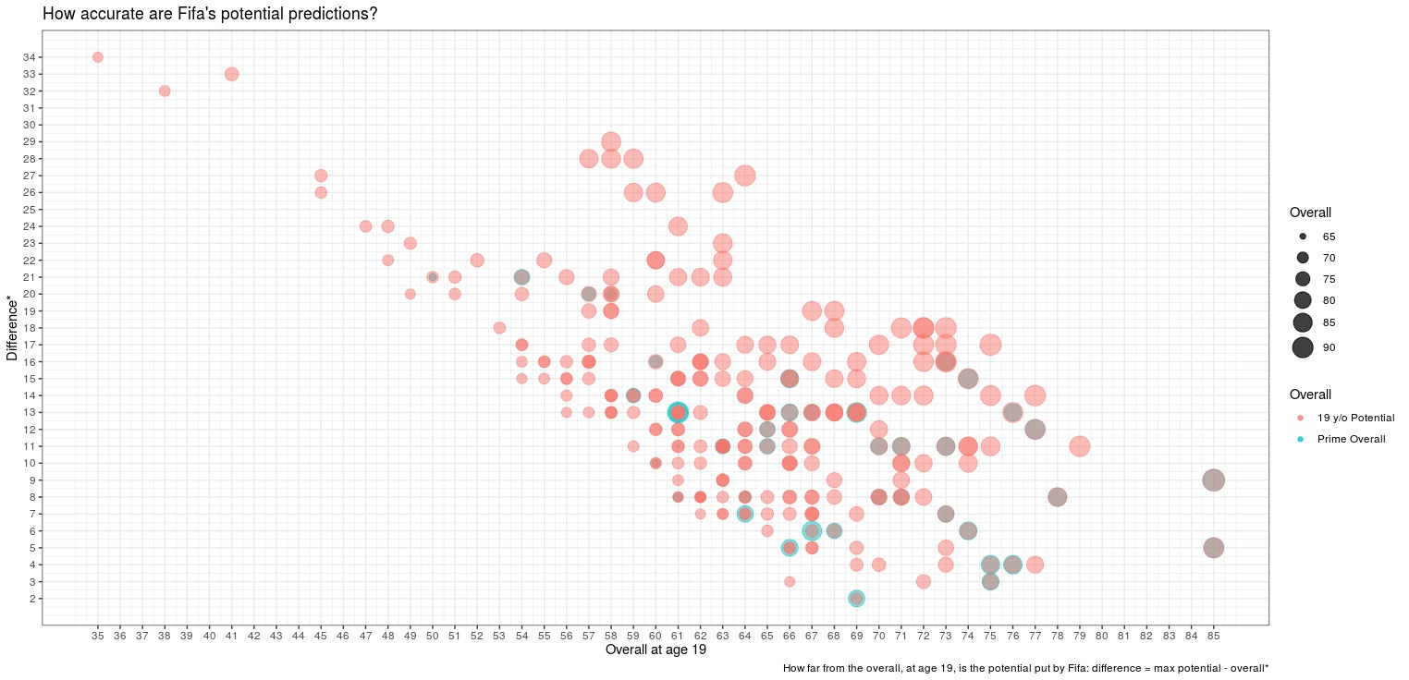

Slide 10
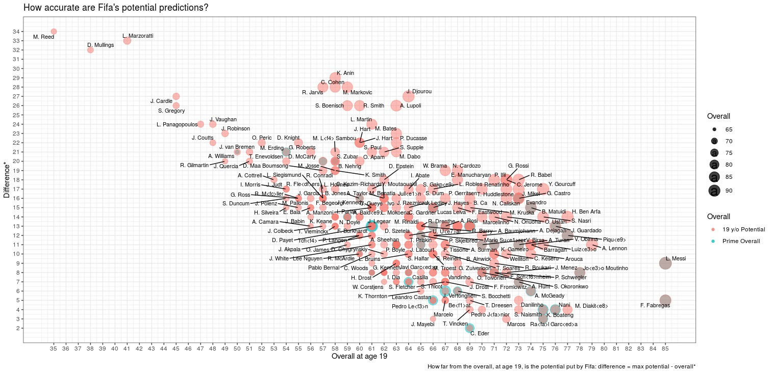

Slide 11
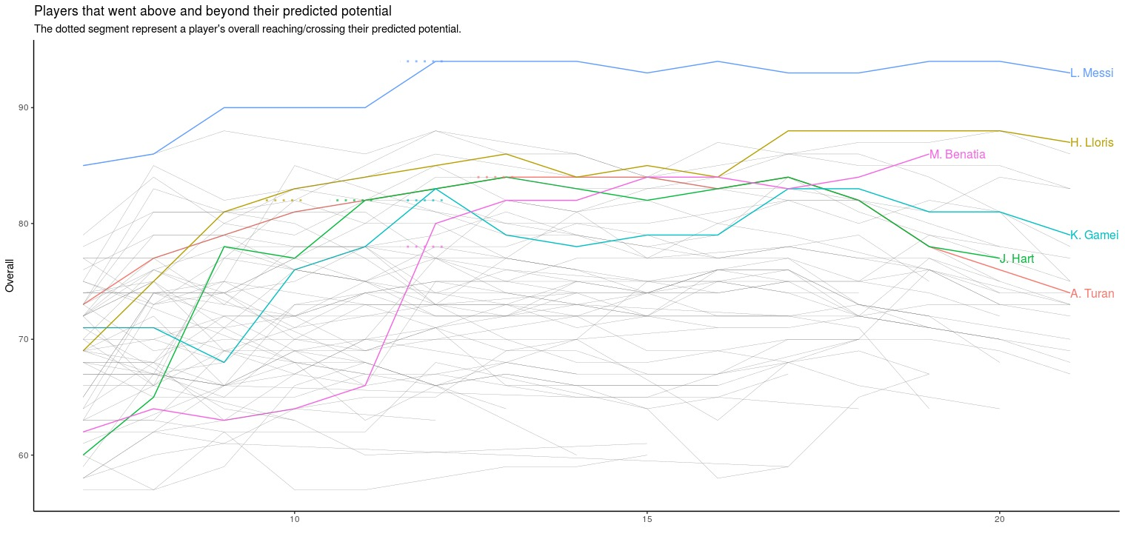

Slide 12
Dramaturgy
Conclusion & evaluation of the myth
  Out of 244 scraped players of year 07, only 27 players reach (and passed) their predicted potential rating.
  11% accuracy

Slide 13
Our plans
Build Bridge To Real World
Every player will have stats from their real life performance(games played, minutes played, points per game, goals, assists), so we can better connect the facts.
  Scraping!
Bigger Dataset
Increase player samples to 360 for each year from 07 to 21.
  More scraping!

