Slide 1
Online Tutor
A Place to learn
Group ID : 2018EWE06
Dewan Tariq Hasan (AE-10)
Md. Aminul Islam (AE-122)

Slide 2
Motivation
Education through internet
Place independent learning
Digitalization of the learning

Slide 3
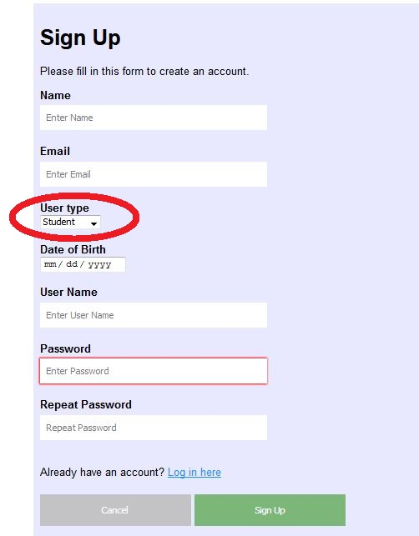
Users

Slide 4
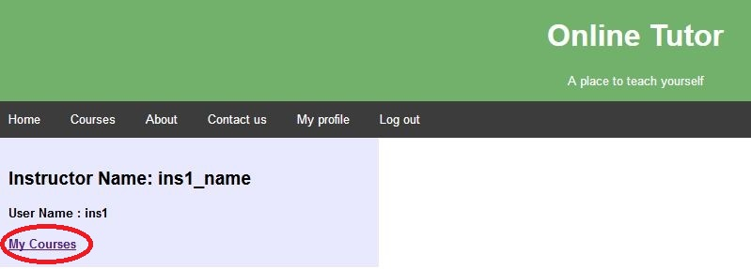
Instructor’s Profile

Slide 5
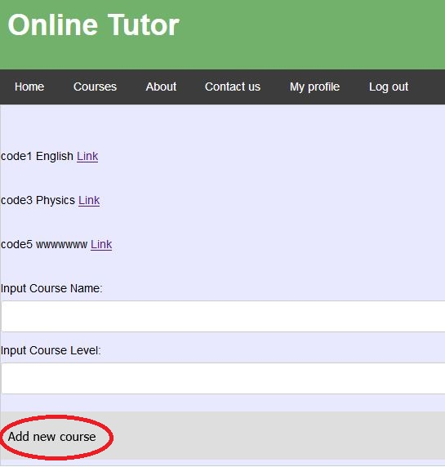
Instructor’s Courses

Slide 6
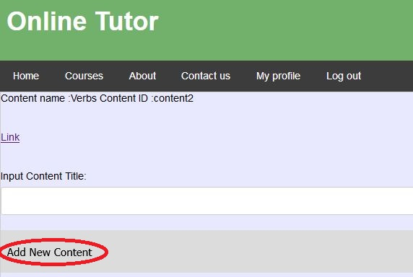
Content (Instructor)

Slide 7
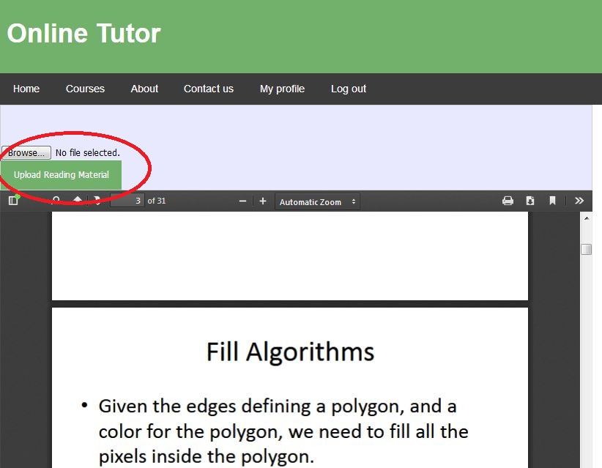
Upload Materials

Slide 8
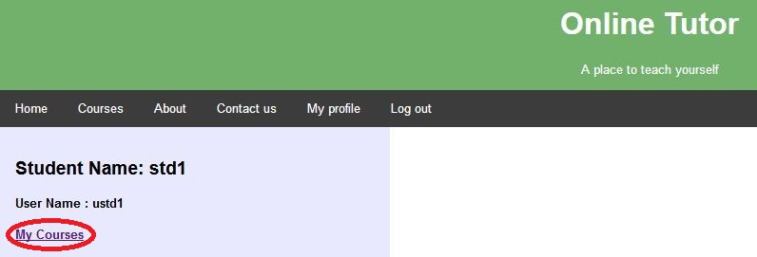
Student Profile

Slide 9
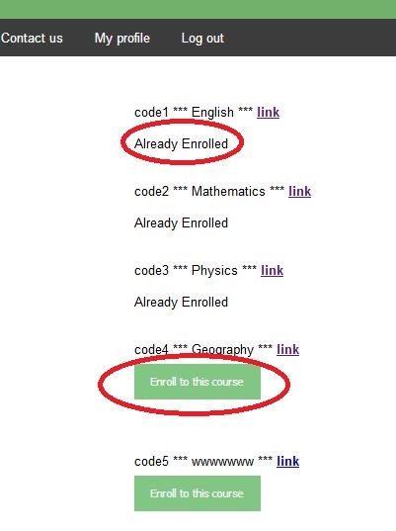
Course List as student

Slide 10
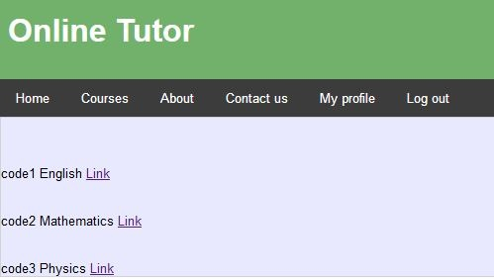
Student’s Courses

Slide 11
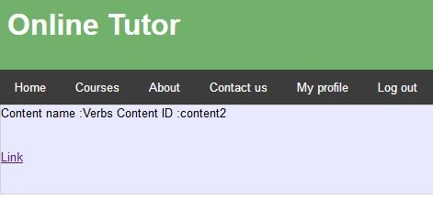
Content (Student)

Slide 12
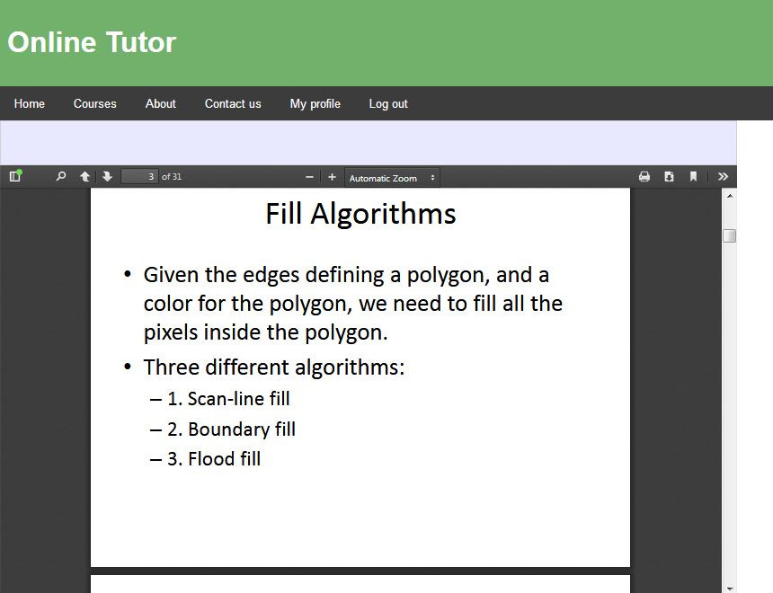
View Material

Slide 13
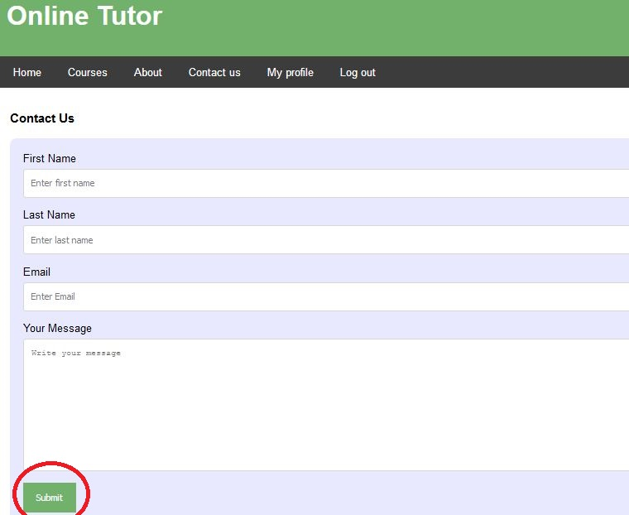
Contact Us

Slide 14
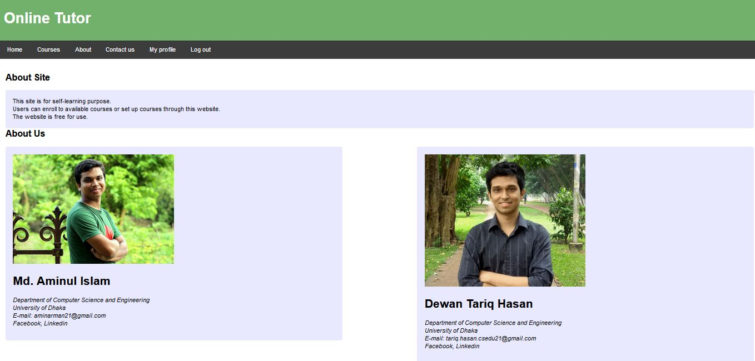
About

Slide 15
Future Improvement
Quiz for every Content
Course final quiz
More interactive
Adding video content

Slide 16
Thank You

