Slide 1


Agile Reinforcement Learning for Real-Time Task Scheduling in Edge Computing
Authors: Amin Avan^{(presenter)}, Akramul Azim, Qusay Mahmoud.
Notes:
Canadian AI 2025
May 26th-29th 2025
Calgary, Alberta.

Slide 2
Introduction:
Real-time applications
Soft real-time applications (SRTA)
significant processing demands.
execution on embedded devices.
offloading portions of workload to edge computing (EC).
Hard real-time applications
Task scheduling
Performance of SRTA depends on timeliness & accuracy of ‘task schedules’.
Task scheduling in EC is NP-hard
optimizing multiple objectives for both edge users & edge servers
evaluating numerous parameters inherent in EC
managing the dynamic EC environment
Heuristic- & meta-heuristic-based task scheduling algorithm struggle to find optimal/near-optimal `task schedules’, while RL is capable.
Notes:
2) deadline violations incur tolerable consequences || multimedia streaming, online gaming, video surveillance, social media feeds
3) impose significant processing demands in computational, memory, & power resources.
4) executing these tasks on embedded devices while meeting strict timing requirements places a substantial burden on these devices.
5) since SRTA has tolerable consequences, it is possible to offload some portion of it into edge servers
6) flight control systems, autopilot systems, heart pacemakers, insulin pumps, surgical robots || deadline violations incur severe consequences.
8) meeting deadline || efficient resource utilization & management || minimize latency, power consumption, maximize performance& throughput
14) owing to their inherent computational complexity, time-intensive calculations, requirement for fine-tuning numerous parameters, dependency on static EC models, and limited adaptability to dynamic EC conditions.

Slide 3
Introduction:_{(cont)}
Edge computing (EC)
Edge users can utilize idle edge server resources.
Edge servers: routers, switches, single-board computers, system-on-chip devices, server-grade machines.
Edge servers located in base stations, access points, roadside units
Geographically dispersed & distributed
Heterogeneous computational, RAM, storage
Lower & reliable communication latency
Reinforcement learning (RL)
Learns an optimal policy by interacting w/ environment via actions & receiving rewards.
Models complex environments by encoding multiple factors into states.
Dynamically updates its policies as conditions change.
Notes:
10) RL can optimize long-term outcomes even when rewards are not immediate.
11) RL balances exploring new actions with exploiting known rewards to improve performance. (Maximizes rewards by optimizing actions.)
14) RL dynamically updates policies as conditions change.
15) RL refines its policy over time based on cumulative experience.

Slide 4
Main Related works:
Deep Post-Decision States (DPDS) [9]:
A Deep Reinforcement Learning task scheduling algorithm
DPDS = Post-Decision States + Deep Deterministic Policy Gradient.
To accelerate RL-based task scheduling algorithm
Age-of-Information is incorporated to prioritize fresh environmental data.
Task scheduling problem is formulated as Constrained Markov Decision Process (CMDP)
Improves `power consumption’ & `AoI’
Neglects the real-time requirements of tasks.
Assumes the presence of a single edge server.
Notes:
5) quantifying freshness of information, which is crucial for SRTA.

Slide 5
Main Related works:_{(Cont.)}
Decentralized Task Offloading Scheduling Algorithm (DOSA) [10]:
a Deep Reinforcement Learning task scheduling algorithm
employs Double-DQN, Dueling-DQN, Prioritized Replay Memory, & Recurrent Neural Network
Considers `communication costs’ & `operational status’ of edge servers to reduce latency.
Accounts for required processor cycles & data transmission sizes of tasks
Overlooks heterogeneity of edge servers, remaining processing capacity, memory volume, response time

Slide 6
Main Related works:_{(Cont.)}
distributed computation (DCOM) [11]:
A Deep Reinforcement learning based approach
Designed to
maximize edge user QoS
minimize latency & power usage
Encounters scalability challenges
Large state-action space & DAG-based task dependencies significantly prolong RL-agent learning time.
RL struggles w/ normal- & large-scale problems.

Slide 7
Problem statement:
Most existing schedulers are designed for general-purpose applications, while SRTAs require metrics as hit-ratio, deadline, response time [4, 8–19].
Overlooks runtime of task scheduling algorithms.
RL-based approaches suffer from prolonged learning time
Prolonged learning time stems from trial-&-error in a large state-action space [9, 20].
Notes:
2) learning time required for the RL-agent to converge | the scheduling algorithm generates a task schedule upon receiving input data or when changes occur in the EC environment
3) make it unsuitable for real-time applications.

Slide 8
Problem formulation:
aRL’s goal: Maximize hit-ratio w/ minimal runtime
maximize hit-ratio:
C1.1: Each task is assigned to an edge server only if its response time meets its deadline.
C1.2: Task is allocated only if the edge server has sufficient resources.
minimize RL agent learning time (runtime):
C2.1: Each task is assigned to one edge server only.
C2.2: An edge server is available if all resource utilizations stay below a threshold.
Notes:
4) resources: processing, RAM, and storage

Slide 9
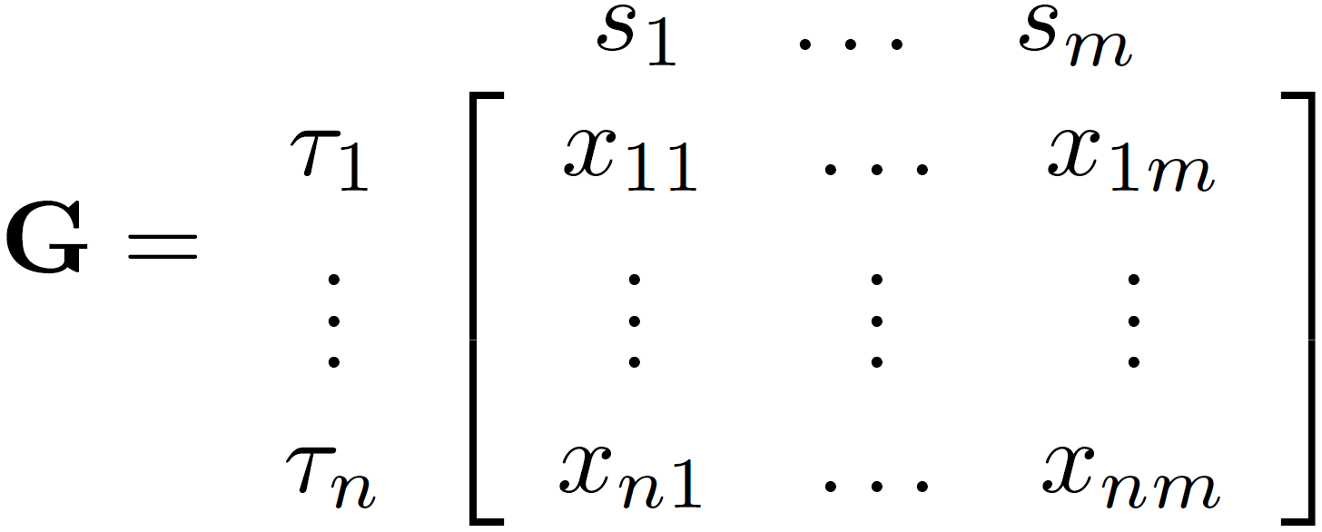
Agile Reinforcement Learning (aRL):
We formulates task scheduling problem w/ MDP.
Decision matrix(G) records task-to-server assignments by aRL.
Action masking & informed exploration accelerate aRL’s learning.
Action masking
Actions per episode are capped by task count.
Assignments per task are capped at one.
Informed exploration
Explores state-action space via EDF-guided exploration.
Notes:
3) A decision matrix (G) tracks the assignment decisions of the RL-agent during each episode of the learning phase. At the beginning of each episode, all cells in the decision matrix (G) are initialized to ‘zero’. When the RL-agent decides to assign a specific task to a particular edge server, the corresponding cell is updated to ‘one’. In decision matrix (G), columns represent edge servers & rows denote tasks.
Solved using DQN-based w/ 3-layer feedforward Q-network
6) an ‘action bound’ inspired by a finite-horizon concept is introduced. This restriction mitigates excessively long rollouts and ensures that each episode terminates within a specified timeframe. So, an episode terminates either when the total number of actions equals the total number of tasks.
7) restricts the RL-agent to one assignment decision per task, as defined in Eq. (4.7). After each action in an episode, the total number of possible actions (i.e., unassigned tasks) decreases, thereby reducing the state-action space over the course of the episode.
9) aRL selects a task with the earliest deadline among unassigned tasks to be assigned to an available edge server subject to the constraints (C1.2 & C2.2).

Slide 10
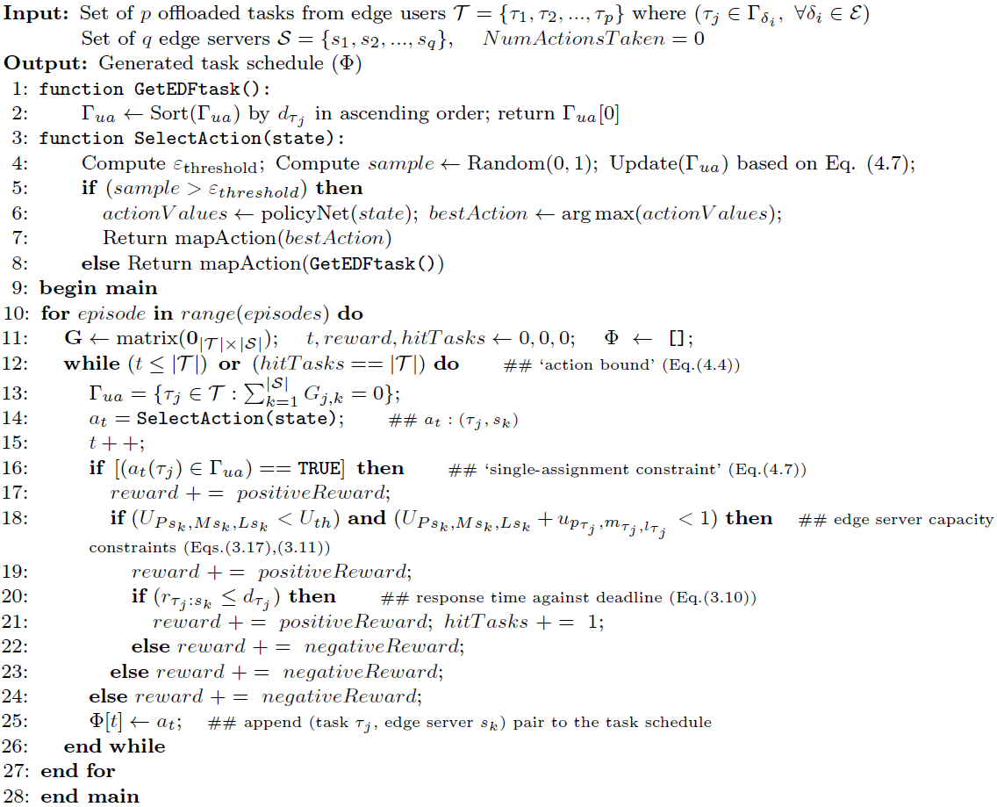
Agile Reinforcement Learning (aRL):_{(Cont.)}
aRL-agent gets P-reward per satisfied constraint & N-reward per violation.
Reward Function
P-reward per satisfied constraint
reward is multiplied by task criticality
N-reward per violated constraint
Fig. 1. Agile Reinforcement Learning (aRL) Algorithm

Slide 11
Experimental results:
EC: 22 zones, each w/ a base station & network switch.
Video surveillance app is evaluated in EC.
Edge users: resource-constrained cameras
52 edge users are randomly placed.
Services: 44×Crowd Counting, 6×Face Recognition, 1 ML Model per type.
Each service consists of tasks w/ distinct requirements.
Edge servers
4 edge servers deployed at separate BSs
Types: NVIDIA Jetson TX2, Intel Xeon E5430, Intel Xeon E5645
Algorithms evaluated at hit-ratio by
Runtime
RAM usage
power consumption
Fig. 2. Overview of the edge computing (EC) architecture.

Slide 12
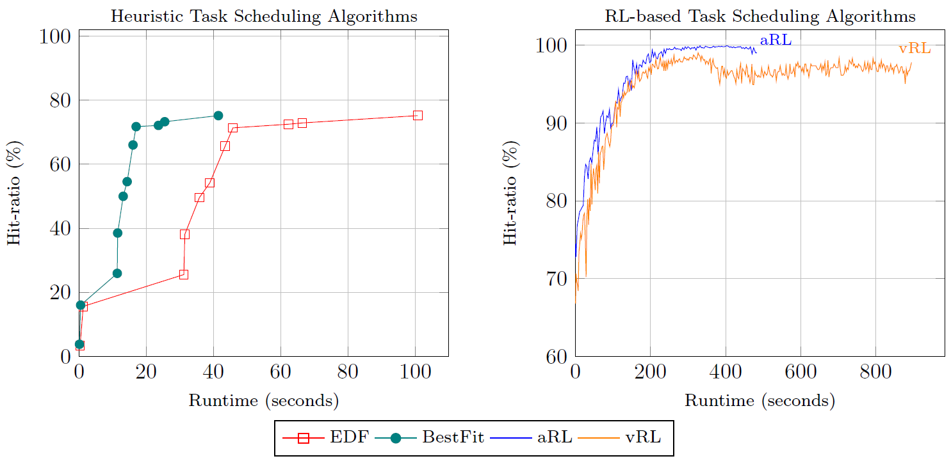
Experimental results - Runtime:
aRL outperforms EDF, BestFit, vRL in hit-ratio by 24%, 24%, 1.9%.
aRL is 46% faster than vRL.
Notes:
In contrast to previous approaches, PBQ is a scalable technique capable of
handling multiple servers in MEC.

Slide 13
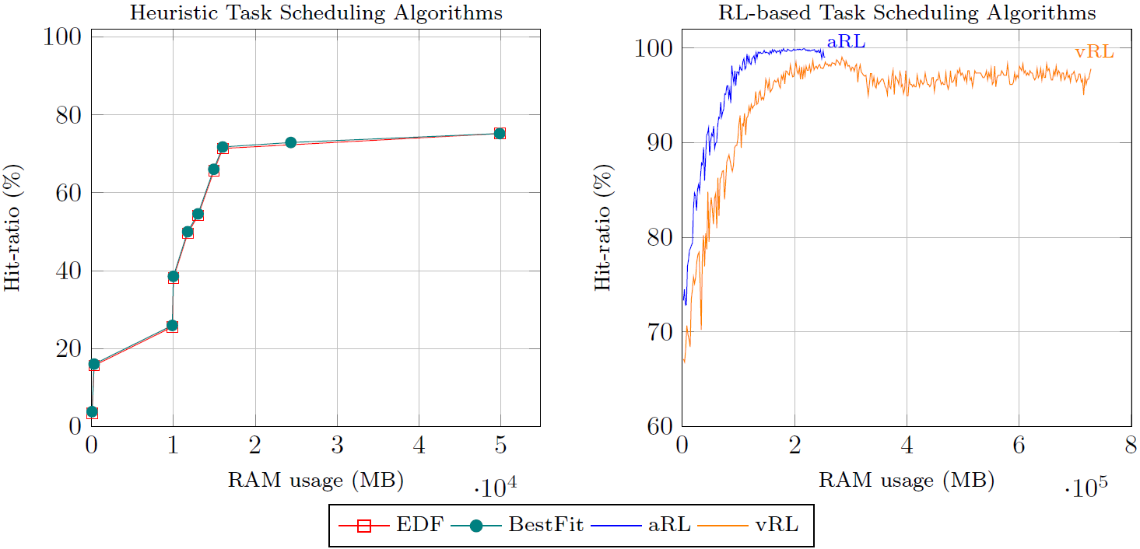
Experimental results – RAM usage:
aRL meets hit-ratio target using 65.5% less RAM than vRL.
EDF & BestFit fail to meet the target.
Notes:
In contrast to previous approaches, PBQ is a scalable technique capable of
handling multiple servers in MEC.

Slide 14
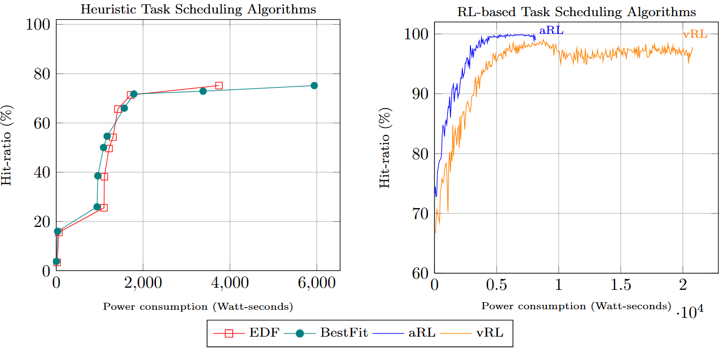
Experimental results – Power consumption:
aRL meets hit-ratio goal using 60.6% less power than vRL.
EDF & BestFit fail to meet the goal.
Notes:
In contrast to previous approaches, PBQ is a scalable technique capable of
handling multiple servers in MEC.

Slide 15
Conclusion:
aRL schedules SRTAs in EC w/ reduced learning time (runtime).
aRL aims to maximize hit-ratio w/ minimal runtime.
Achieved by incorporating `informed exploration’ & `action masking’.
aRL achieves highest hit-ratio among heuristic & RL baseline methods.
aRL reduces runtime (46%), RAM usage (65.5%), power consumption (60.6%) compared to vRL.

Slide 16

Amin Avan: amin.avan@ontariotechu.net
Akramul Azim: akramul.azim@ontariotechu.ca
Qusay Mahmoud: qusay.mahmoud@ontariotechu.ca

