Slide 1

          EGE UNIVERSITY FACULTY OF ENGINEERING FUNDEMENTAL OF SOFTWARE ENGINEERING
2024–2025 FALL SEMESTER PROJECT TOPİC
Personalized Learning Hub for Tutoring Centers
DELIVERY DATE: 12/06/2025
PREPARED BY
05210000273 Muhammed Orhantekin,
05210000004 Amin Azizzade,
05200000928 Nasrulla Emin,
05220000354 Yiğit Alp Demir
Group No: 2

Slide 2
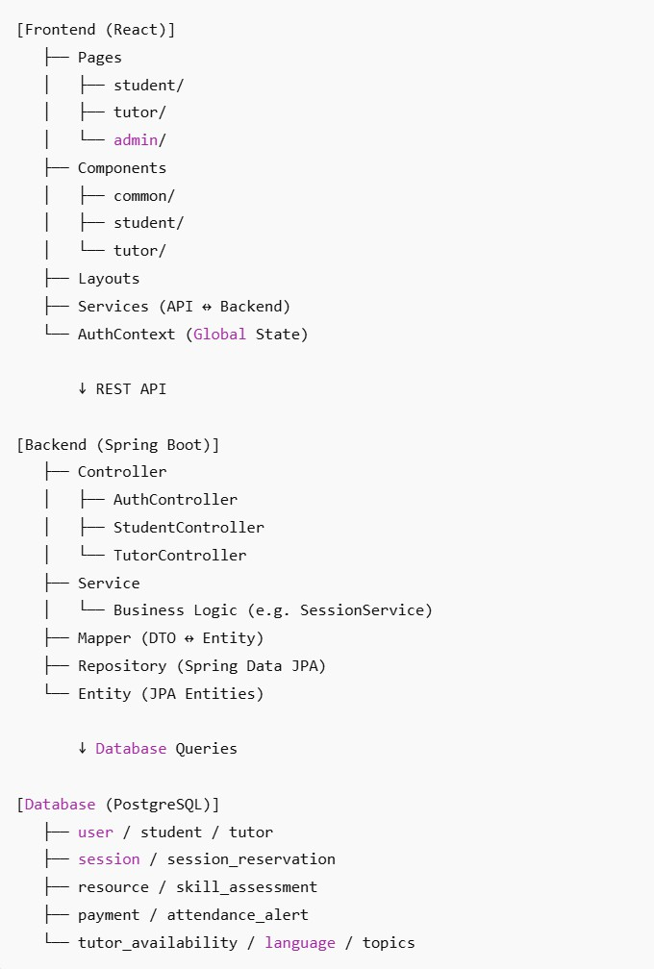
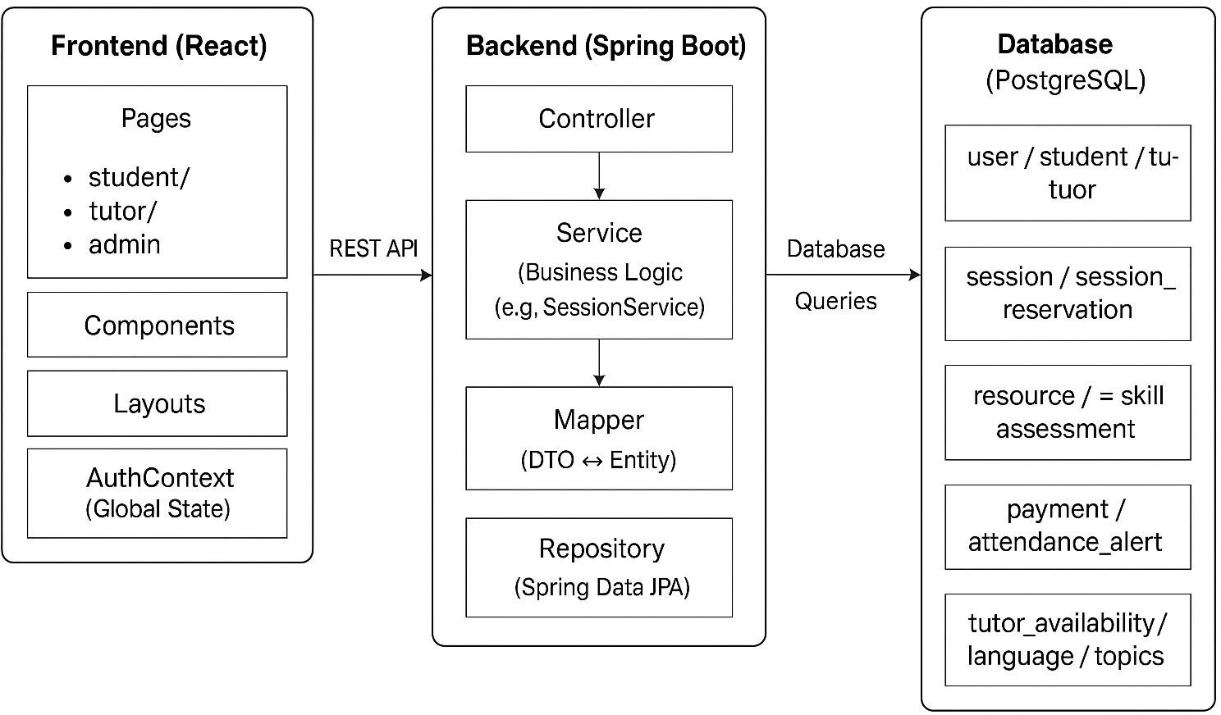
Architecture Section
1) General System and Blog Diagram

Slide 3
Personalized Learning Hub project is built upon the principle of layered architecture during the software development process. The application is a digital learning platform where users (students, tutors, and administrators) can plan educational processes, access resources, participate in sessions, and perform evaluations.
The system operates on three main layers:
  Frontend (React.js)
  Backend (Spring Boot, REST API)
  Database (PostgreSQL)
Each layer is designed independently and modularly. Communication between components is achieved through RESTful APIs over HTTP.

Slide 4
Inter-Component Communication
The entire system ensures inter-layer communication through REST API. This structure works as follows:
React Component
→ Axios Service
→ Spring Controller
→ Service Layer
→ Repository
→ PostgreSQL Query
→ Result → Mapper → DTO → JSON Response → React
In this way, all data flow in the system is organized in a transparent, manageable, and decoupled manner.
Conclusion Personalized Learning Hub is designed to support the MVC principle. However, specifically in terms of backend structure, Layered Architecture is explicitly implemented. This architecture ensures that the system is sustainable, extensible, and modular.

Slide 5
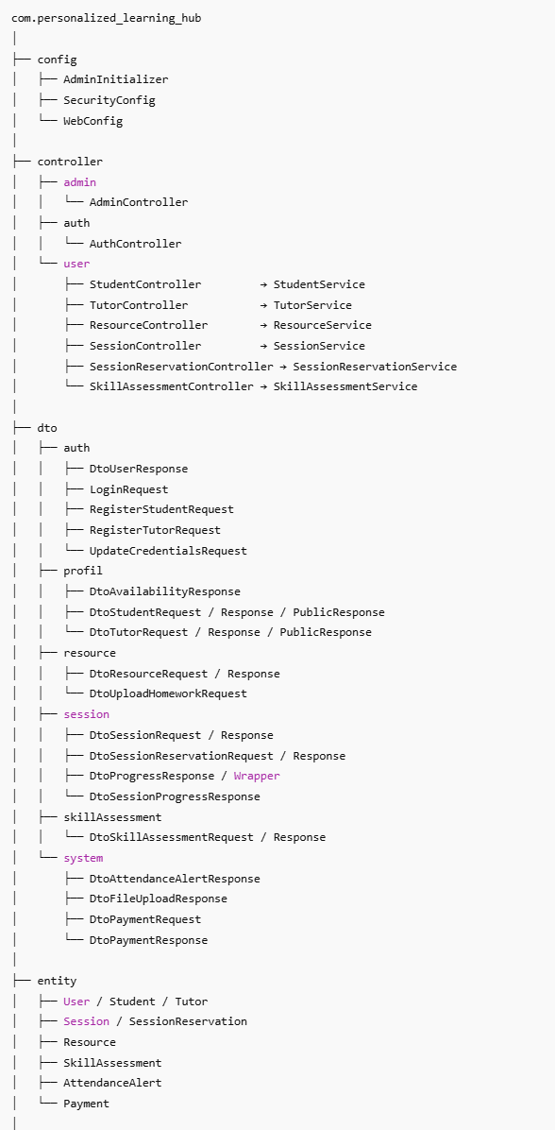
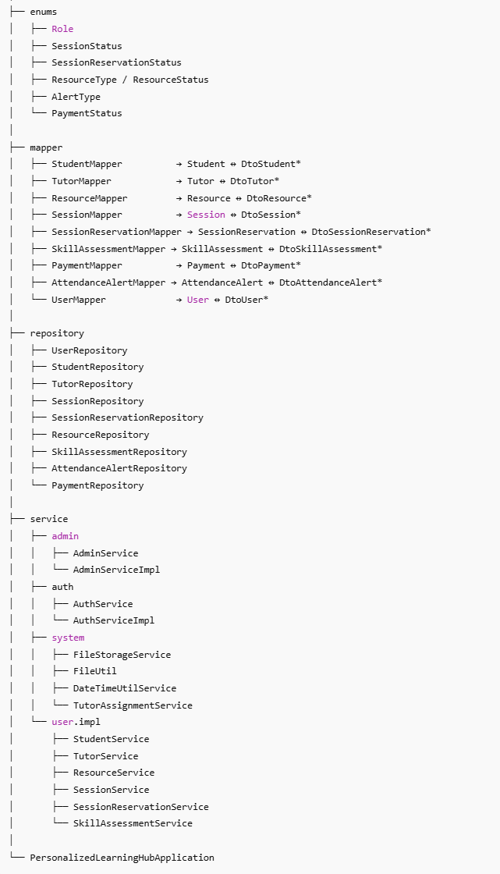
2) Backend Mimarisi (Spring Boot)

Slide 6
Backend Architecture Explanation
General Structure
The backend is based on Spring Boot and is clearly structured according to the layered architecture principle. The goal is to improve code readability, maintainability, and testability.
Each layer takes on a specific responsibility within the system and is independent from other layers.
This structure is built in accordance with the principles of Clean Architecture and Separation of Concerns (SoC).

Slide 7
Package Structure and Layers
1. config/
General application settings, security and web configurations are stored here.
Example: SecurityConfig, AdminInitializer
2. controller/
REST API endpoints that handle HTTP requests are defined here.
Each controller communicates only with the relevant service layer.
Examples:
StudentController → StudentService
ResourceController → ResourceService
3. dto/
Defines requests from the user and responses returned to the frontend.
Organized in a module-based structure (auth, session, resource, skillAssessment, etc.)
Naming conventions such as Dto*Request, Dto*Response, Dto*Wrapper are used to ensure readability.

Slide 8
4. entity/
Database model classes mapped via JPA.
Classes representing tables: User, Session, SkillAssessment, Payment, etc.
5. enums/
Constant values used within the application are kept here (e.g., SessionStatus, Role, ResourceType).
6. mapper/
Classes that perform DTO ↔ Entity transformations.
Each domain has a dedicated Mapper class and transformations are centralized.
This layer ensures data formatting, privacy, and simplification.
7. repository/
The database access layer working with Spring Data JPA.
Each entity has its own repository interface.
Example: SessionRepository, TutorRepository, AttendanceAlertRepository
8. service/
The business logic of the application is implemented here.
Separate service classes are written for each subsystem.
The use of service interface and ServiceImpl improves testability.
Helper services (e.g., TutorAssignmentService, FileStorageService) are located under the system/ package.

Slide 9
Layer Interaction Flow
Controller
↓
Service (Business Logic)
↓
Mapper (DTO ↔ Entity)
↓
Repository (Database Operations)
↓
Entity (Data Model)
Conclusion
Thanks to this backend architecture:
Modules can be developed and tested independently.
The role-based system structure is clearly separated.
Each operation is processed through the controller–service–repository chain, making the code easier to trace.
Use of DTOs ensures both secure and simplified data transfer.

Slide 10
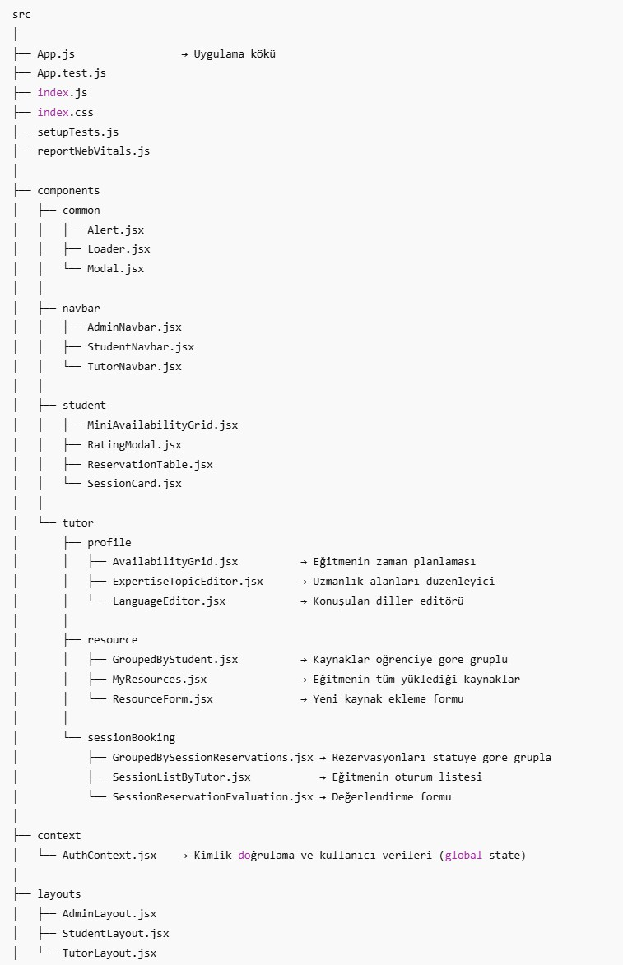
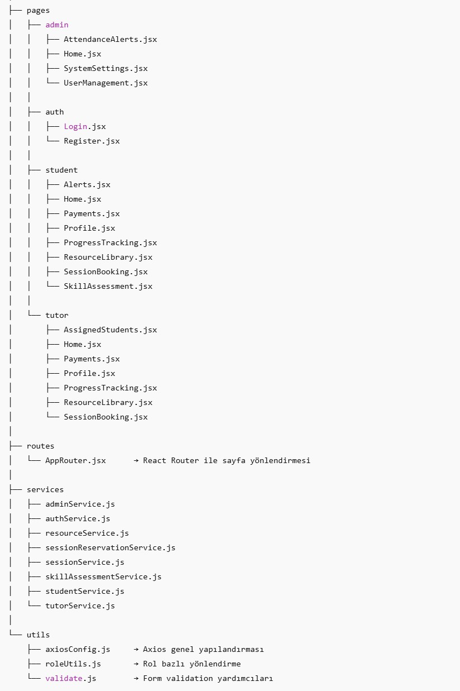
3) Frontend Mimarisi (React)

Slide 11
Frontend Architecture Explanation
General Structure
The frontend of the project is built on React.js and is structured according to component-based architectural principles.
Each user role (student, tutor, admin) has separate pages and component sets defined.
The project applies clean folder structure, role-based separation, service layer, and global state management, in line with common best practices.

Slide 12
Main Folders and Their Responsibilities
src/
  The root directory of the application.
  App.js is the entry point of the application.
  index.js connects the React application to the DOM.
components/
This folder contains UI components and is divided into three main groups:
  1. common/
  ○ Components shared across all roles (e.g., Alert.jsx, Modal.jsx)
  2. navbar/
  ○ Role-based navigation bars (AdminNavbar, StudentNavbar, TutorNavbar)
  3. student/
  ○ Student-specific components:
  ▪ MiniAvailabilityGrid: Displays tutor availabilities
  ▪ ReservationTable, RatingModal: Session booking and evaluation
  4. tutor/
  ○ Divided into subfolders based on tutor-specific functionalities:
  ▪ profile/: Tutor’s schedule, expertise area, spoken language editing
  ▪ resource/: Components for uploading and managing tutor’s resources
  ▪ sessionBooking/: Components for grouped session reservation and evaluation

Slide 13
pages/
The application’s every page is organized under this folder. It is grouped under 3 main roles:
• admin/: Admin interface – user management, settings, alert list
• auth/: Login, registration pages
• student/: Student main page, profile, resources, payment, assessment
• tutor/: Tutor main page, assigned students, assessment, resources
Each page serves as a container that includes relevant components.
services/
Each backend module has a separate *.js file corresponding to it. In this layer, backend APIs are accessed using Axios.
Example:
• sessionService.js → Session CRUD operations
• resourceService.js → Upload/download resources
• authService.js → Login/registration operations
Thanks to this structure, the frontend accesses the backend through an abstract service layer, not directly (separation of concerns).

Slide 14
context/
• AuthContext.jsx manages user session, role information, and identity data such as token throughout the application.
• Global state management is enabled through this structure.
layouts/
• Each user role has dedicated page layouts (AdminLayout, StudentLayout, TutorLayout)
• Common styles, top menus, and the overall page structure are maintained with these layouts.
routes/
• AppRouter.jsx controls all page routing.
• Using React Router, path definitions for all roles are centrally managed here.
utils/
• Includes helper files:
○ axiosConfig.js: API configuration
○ roleUtils.js: Role-based redirection
○ validate.js: Form validation operations

Slide 15
Inter-Layer Communication Flow
Page (pages/*)
↓
Component (components/*)
↓
Service (services/*.js)
↓
REST API
↓
Backend (Controller → Service → Repository)
This structure ensures the frontend is abstracted from the backend, enhancing component reusability and system sustainability.
Conclusion
  • The project offers a sustainable frontend architecture with a component-based and modular structure.
  • Role-based separation is optimized for security and user experience.
  • Centralized session management is provided through the Axios service layer and AuthContext.
  • UI consistency is maintained thanks to the layout structures.

Slide 16
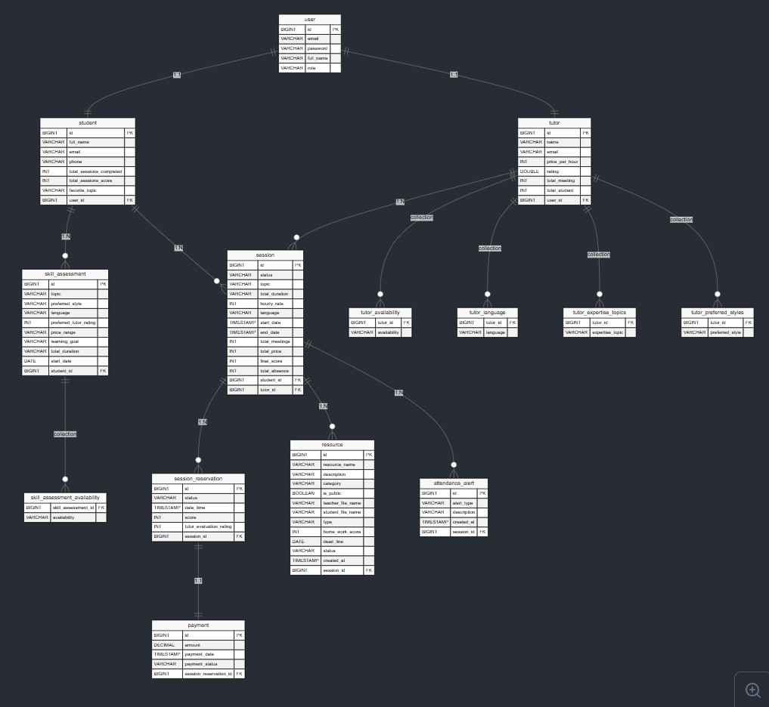
4) DataBase (PostreSQL) Structure
Database Table Lists
user
student
tutor
session
session_reservation
payment
resource
skill_assessment
attendance_alert
Also embedded table structures created with @ElementCollection:
tutor_availability
tutor_language
tutor_expertise_topics
tutor_preferred_styles
skill_assessment_availability

Slide 17
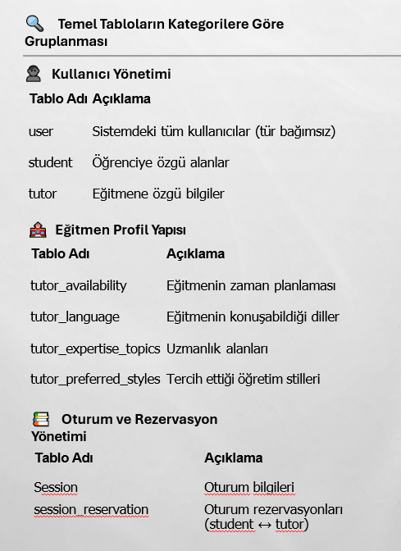
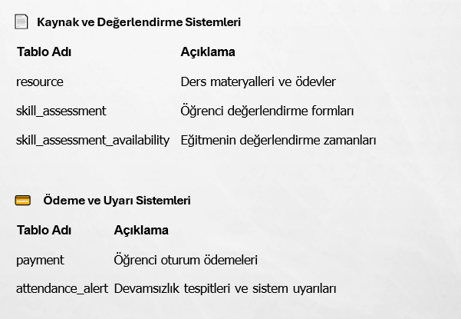
General Structure
• The database system is built on PostgreSQL. All data is organized within a schema named personalized-learning-hub. This structure is designed in a normalized manner with tables corresponding to each module of the project. Table relations are modeled robustly using primary–foreign key connections.
• The database structure is designed with a focus on high performance, data integrity, and sustainability.
Table Relationships
• Both student and tutor tables are linked to the user table via foreign key.
• The session table is related to tutor; each session belongs to a tutor.
• session_reservation is linked to both student and session.
• resource and skill_assessment tables are directly related to both tutor and student.
• The payment table is associated via student and session_reservation.
• The attendance_alert table tracks absence data based on the student.

Slide 18
UI Design Section
Project Overview
Personalized Learning Hub is a modern web platform offering an interactive learning experience between students and tutors.
• Developed with React, with role-based routing under the pages/ directory.
• Global state management is handled using AuthContext.jsx.
• Shared layouts for all users: StudentLayout, TutorLayout, AdminLayout
Key Features:
• Student Panel – Lesson tracking, resource access, assessments
• Tutor Panel – Student management, resource sharing, assessment
• Admin Panel – System management, user control
• Authentication – Secure login and registration system

Slide 19
1) UI Mimarisi
Klasör Yapısı
src/
├── components/ # Reusable UI components
├── pages/ # Page components (routing)
├── layouts/ # Page layouts
├── context/ # Global state management
├── services/ # API calls
└── utils/ # Helper functions
• Technology Stack
• React.js – Frontend framework
• React Router – Page routing
• Context API – State management
• Axios – HTTP requests
• Modern CSS – Responsive design

Slide 20
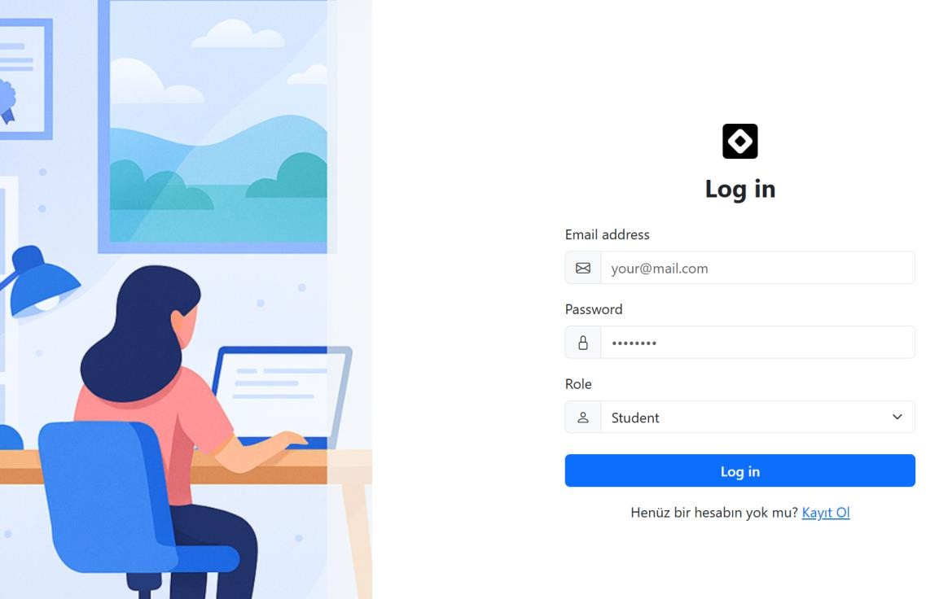
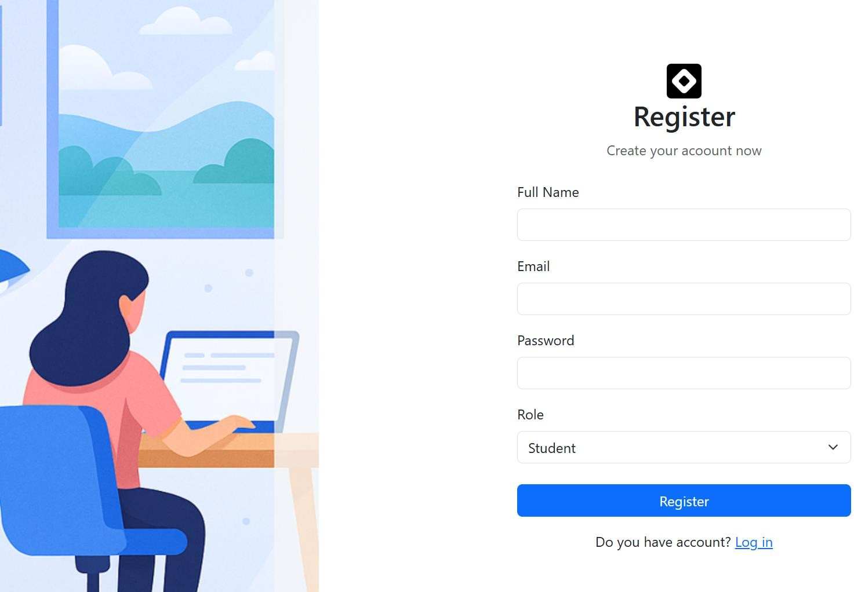
2. Page Structures
Authentication Pages
pages/auth/Login.jsx – User Login
pages/auth/Register.jsx – New User Register

Slide 21
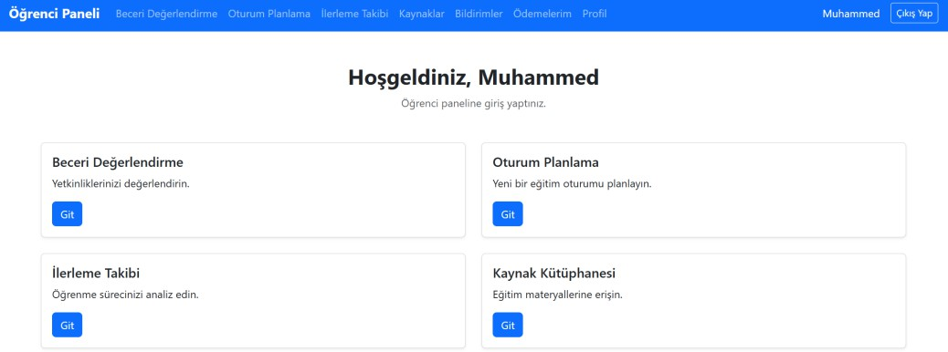
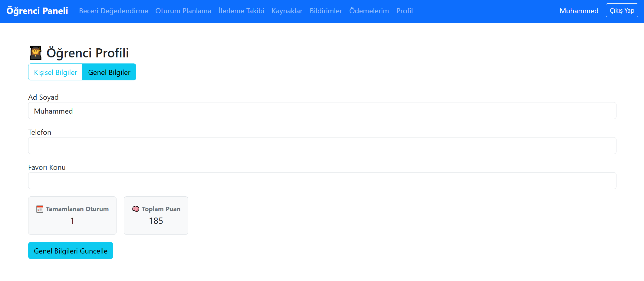
Student Pages
pages/student/Home.jsx - Main dashboard
pages/student/Profile.jsx – Profile Management

Slide 22
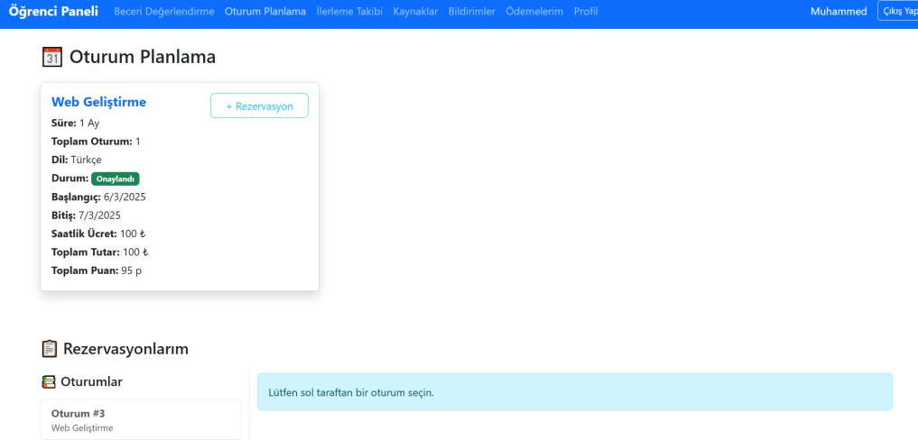
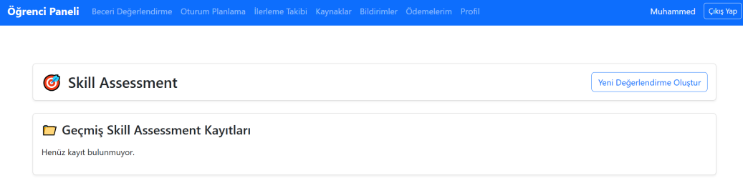
Student Pages
pages/student/SessionBooking.jsx - Session and Reservation Planning
pages/student/SkillAssessment.jsx - Skill Assessments pages

Slide 23
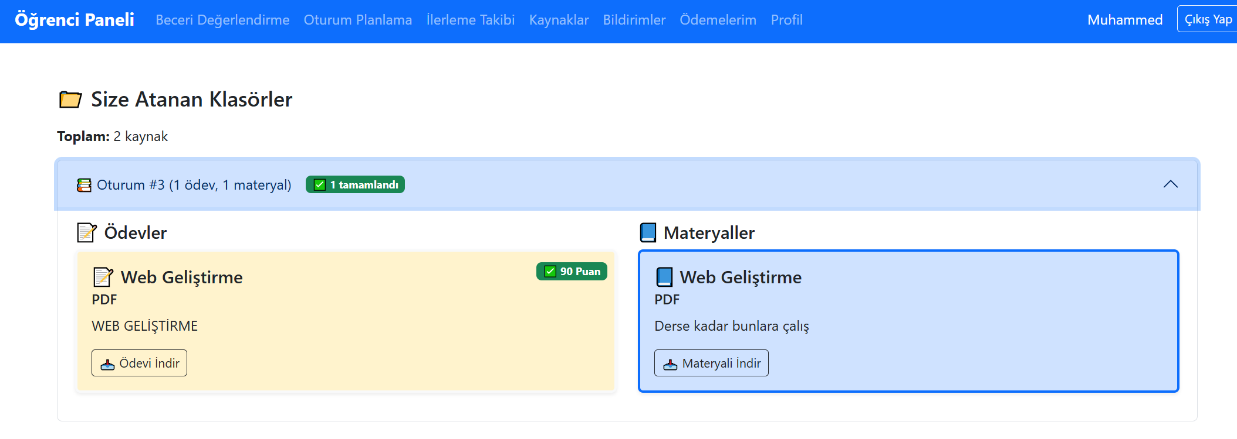
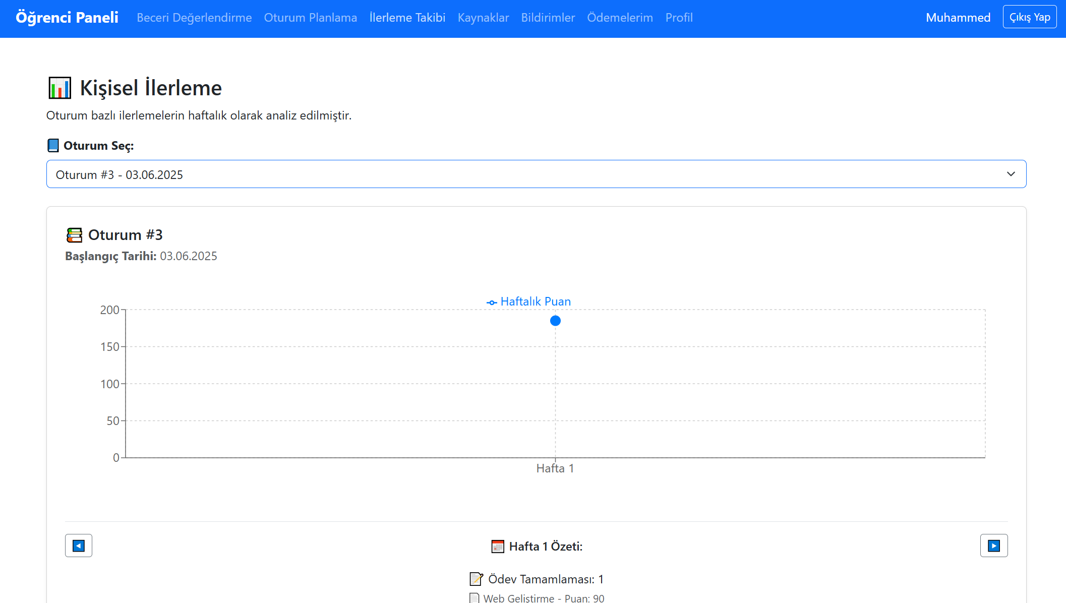
Student Pages
pages/student/ResourceLibrary.jsx – Resource Library
pages/student/ProgressTracking.jsx – Progress Tracking
pages/student/Payments.jsx – Payment Method
(Not implemented yet)
pages/student/Alerts.jsx – Notifications
(Not implemented yet)

Slide 24
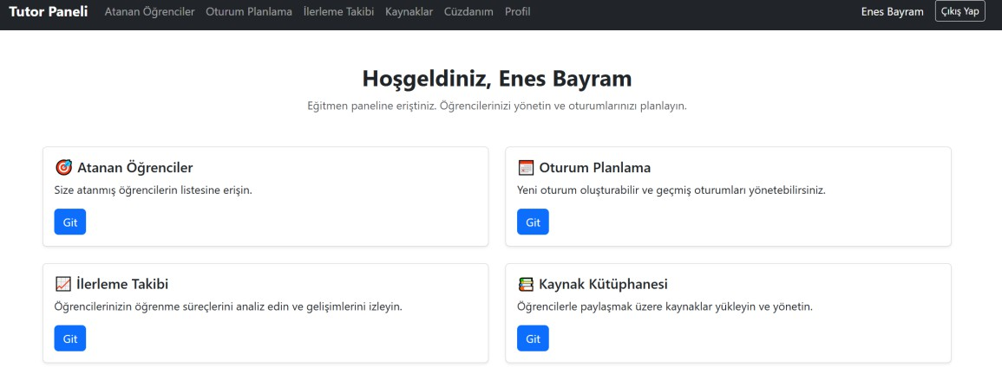
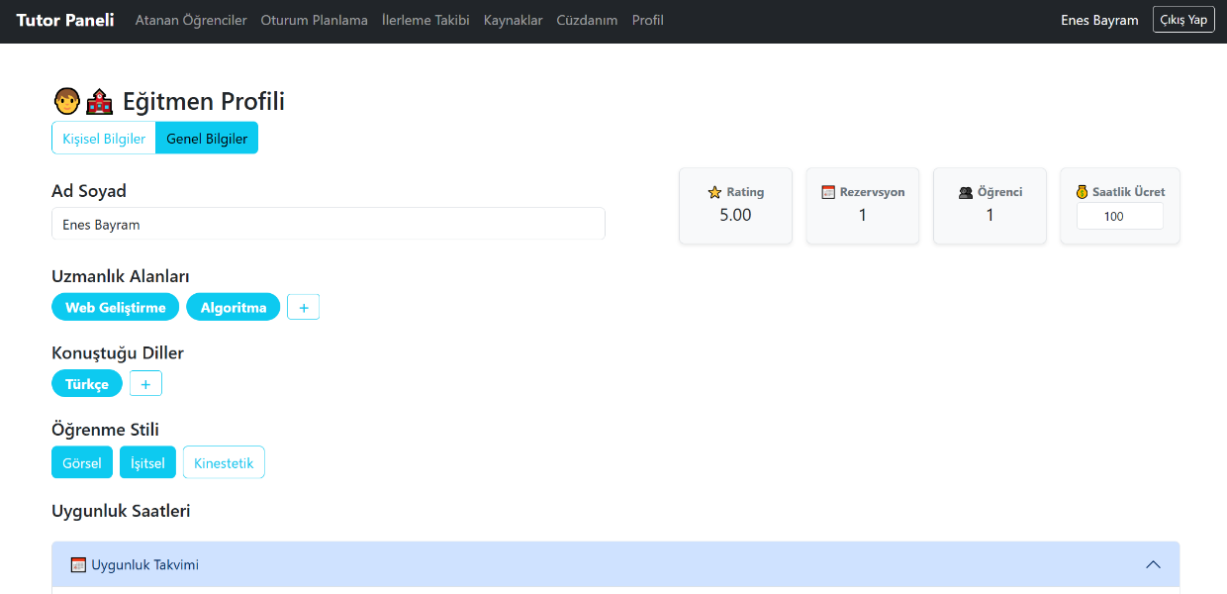

Tutor Pages
pages/tutor/Home.jsx - Main dashboard
pages/tutor/Profile.jsx - Profile Management
pages/tutor/AssignedStudents.jsx – Assigned Students page

Slide 25
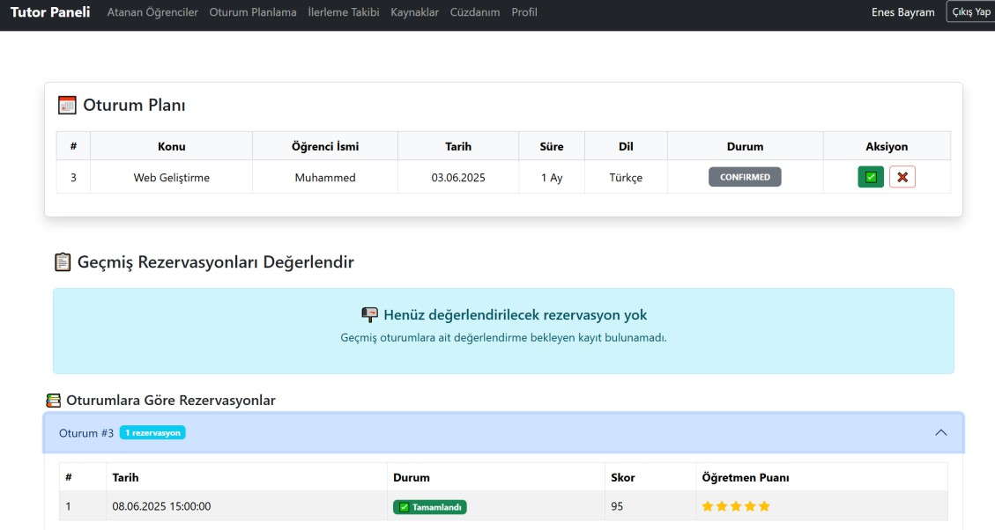
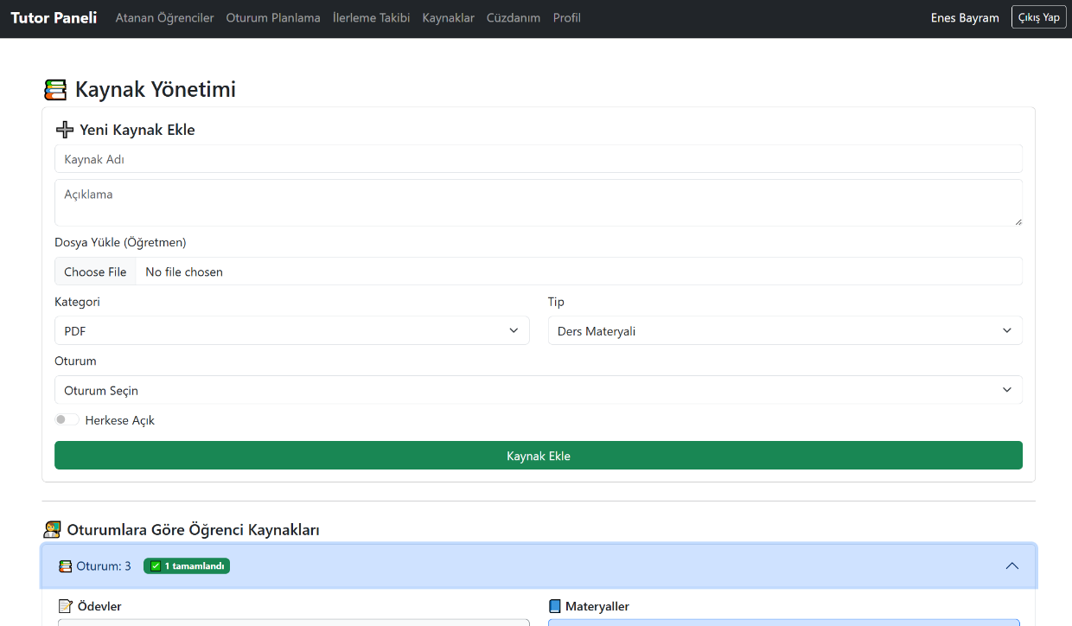
Tutor Pages
pages/tutor/SessionBooking.jsx – Session Planning
pages/tutor/ResourceLibrary.jsx – Resource Management

Slide 26
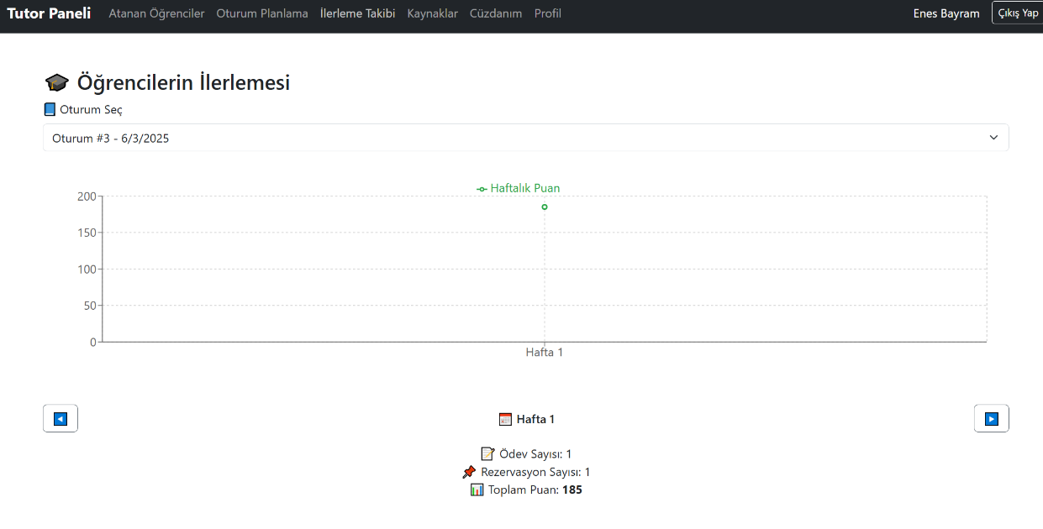
Tutor Pages
pages/tutor/ProgressTracking.jsx
-Progress Tracking
pages/tutor/Payments.jsx – Payment Tracking (Not implemented yet)

Slide 27
Admin Pages (Not implemented yet)
pages/admin/Home.jsx – System Summary
pages/admin/UserManagement.jsx – User Management
pages/admin/SystemSettings.jsx – System Settings
pages/admin/AttendanceAlerts.jsx - Attendance Notifications

Slide 28
3. Component Hierarchy
Common Components(Common)
components/common/
├── Alert.jsx # Notification messages
├── Loader.jsx # Loading animation
└── Modal.jsx # Pop-up Windows
Navigation Components
components/navbar/
├── AdminNavbar.jsx # Admin navigation
├── StudentNavbar.jsx # Student navigation
└── TutorNavbar.jsx # Tutor navigation
Student-Specific Components
components/student/
├── MiniAvailabilityGrid.jsx # Availability calendar
├── RatingModal.jsx # Rating modal
├── ReservationTable.jsx # Reservation table
└── SessionCard.jsx # Lesson card

Slide 29
Tutor-Specific Components
components/tutor/
├── profile/
│ ├── AvailabilityGrid.jsx # Set availability
│ ├── ExpertiseTopicEditor.jsx # Expertise areas
│ └── LanguageEditor.jsx # Languages Settings
├── resource/
│ ├── GroupedByStudent.jsx # Group by student
│ ├── MyResources.jsx # My Resources
│ └── ResourceForm.jsx # Resource upload form
└── sessionBooking/
├── GroupedBySessionReservations.jsx # Reservation groups
├── SessionListByTutor.jsx # Session list
└── SessionReservationEvaluation.jsx # Evaluation form

Slide 30
4.Rol Bazlı Arayüzler
Student Main Interface
Features:
• Dashboard – Progress charts and summary insights
• Session Booking – Select tutor and schedule session
• Resource Access – Download PDFs, videos, and materials
• Skill Assessment – Personalized evaluations
• Payment System – Secure payment transactions
Design Principles:
• Simple and user-friendly interface
• Visual feedback (progress bars, badges)

Slide 31
Tutor Interface
Key Features:
• Student Management – Assigned students and their details
• Resource Management – Materials and assignments
• Availability Setup – Flexible scheduling
• Progress Tracking – Student performance reports
• Income Tracking – Payment and earning reports
Design Principles:
• Productivity-focused layout
• Multitasking capability
• Detailed analytical views
Admin Interface
Key Features:
• System Management – Platform settings
• User Control – Account management and moderation
• Analytics Dashboard – Overall platform metrics
• Alert System – System notifications
Design Principles:
• Comprehensive control panel
• Approval mechanisms for critical operations
• Detailed logging and reporting

Slide 32
Testing Section
Our Testing Strategy:
In the project, we developed unit tests for the backend services we wrote. These tests were designed to verify whether each service performs its functionality correctly. Each service was tested independently, with external dependencies mocked (e.g., repository and mappers).
Services We Wrote Tests For:
StudentService
TutorService
ResourceService
SessionService
SessionReservationService
SkillAssessmentService
AuthService
AdminService

Slide 33
Testing Tools We Used:
  JUnit 5: Test framework
  Mockito: To create mock objects
  Spring Boot Test: To write integrated tests with Spring dependencies

