Slide 1

Movie Box-office Prediction based on early critic vote
Amin Khoeini
Data Science Career Track Capstone Project September 2021 Cohort

Slide 2




Problem
In era of social media, movie audience opinion shift. People no longer seek the critics opinion about movie from prestigious magazine like Cahiers du Cinéma.
IMDB and Rotten Tomato became the platform that audience use to evaluate movies and have the means to glorify or destroyed a movie.
Squid Game as an example.
In this era, Can critics votes that given before the release of the movie, still predict the box-office of the movie?

Slide 3
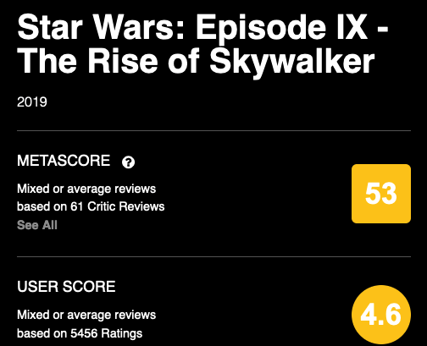
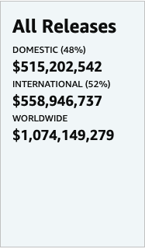
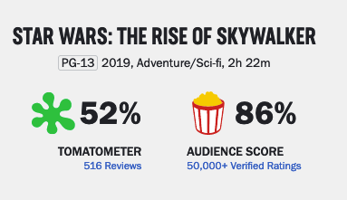
Goal and utility:
First, make a model to predict the box-office using all the votes information. Critics and Audience from three website.
Then to see the impact of the critics vote, make a model just using those vote and see can it predict the box-office or a close range for it.

Slide 4
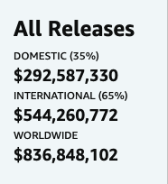
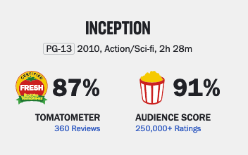
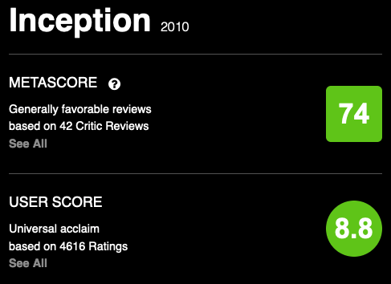
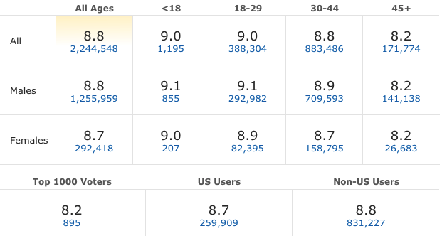
Data
Mojo
Rotten Tomatoes
Metacritic
IMDB
All Time Gross
Critics Votes Average
Critics Votes Number
Audience Votes Average
Audience Votes Number
Critics Votes Average
Critics Votes Number
Audience Votes Average
Audience Votes Number
Audience Votes Average
Audience Votes Number
Male Audience Vote Average
Male Audience Vote Number
Female Audience Vote Average
Female Audience Vote Number
U.S.A Audience Vote Average
U.S.A Audience Vote Number
Non-American Audience Vote Average
Non-American Audience Vote Number

Slide 5
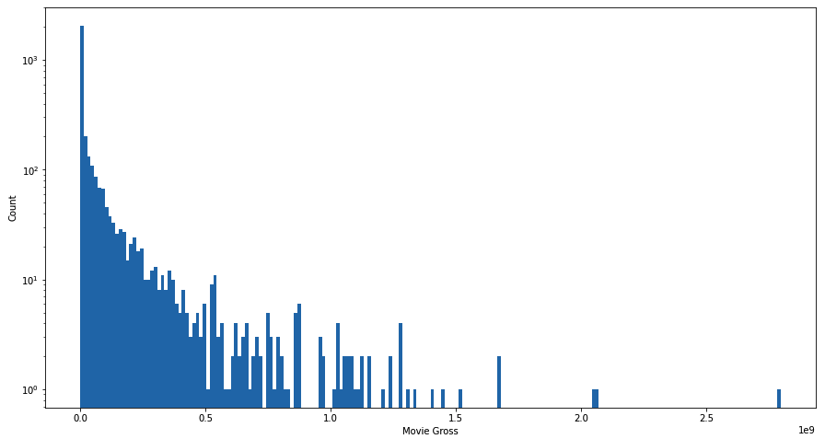
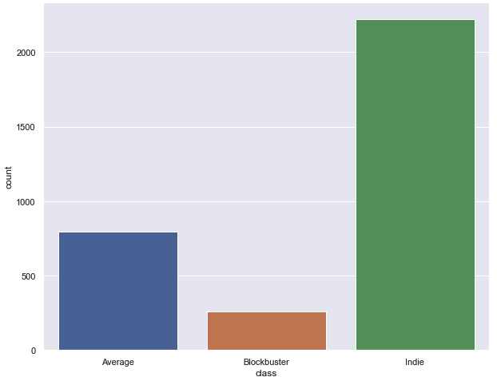
Data Exploration : Box-Office
Box-Office Buckets :
Indie Less than 25 million dollars.
Blockbuster More than 250 million dollars.
Average Between 25 and 250 million dollars
Movie Box-Office have a big range and is a discontinuous value.

Slide 6
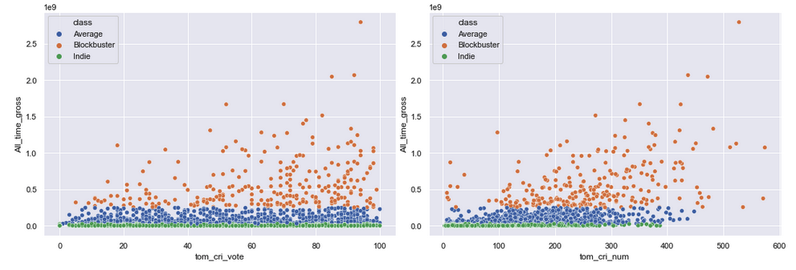
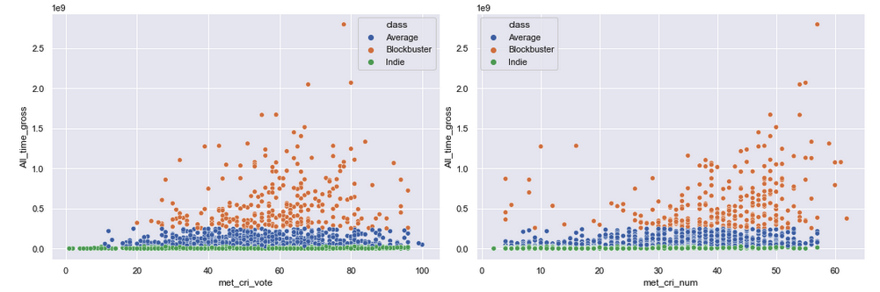
Data Exploration: Critics Vote
Number of vote has a linear correlation with box-office.
Vote average has less importance.
Rotten Tomatoes' critic votes more and has more correlation .

Slide 7
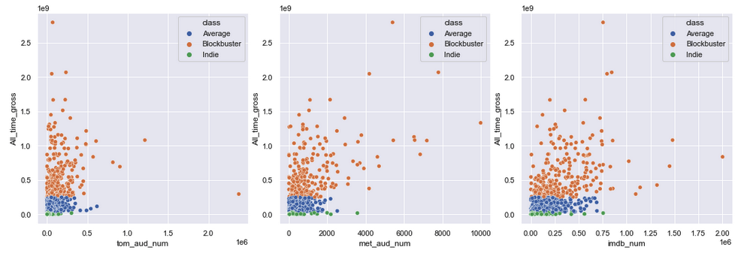
Compare with Audience Vote
Obviously audience vote are more related with the box-office.
Model that only use critics vote will perform worse.

Slide 8
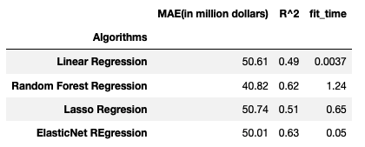
ML Algorithms:
MAE as the accuracy metric over RMSE because it's more robust against the outliner. The smaller the MAE, the more accurate the prediction.
Random Forest Regressor clearly performed better in comapre to others.

Slide 9
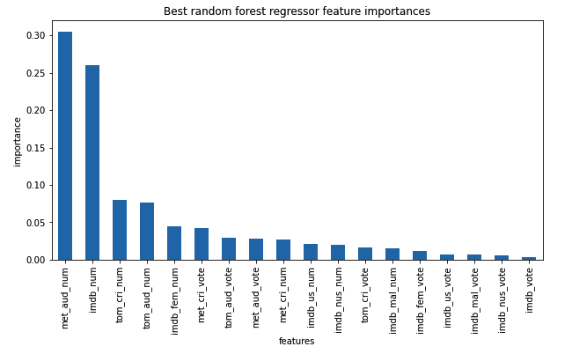
Vote Features Importance
Traine the model with the whole data, shows the some of audience features are most important.
Some Critics features also have high importance.
We can expect some performance by just critics votes.

Slide 10
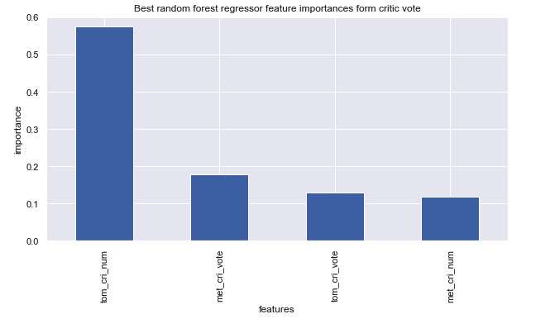
Critics Model
Rotten Tomatoes vote number has the most weight in critics model, prediction is heavily depends on that.
Each movie that received more votes on this website from critics, regardless of what the actual vote was, will perform better in box-office according to this model.

Slide 11
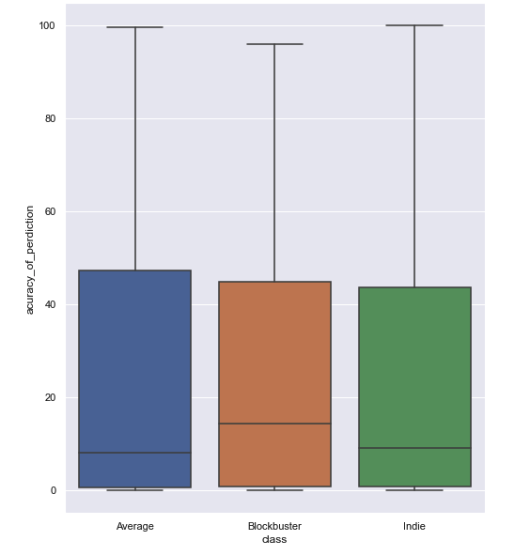
Critic Model
Create a metric by using the absolute error of the prediction and the actual box-office of each film .
Range between 5% to 45% .
Early vote of the critics can predict the box-office of the film by 5 to 45 percent accuracy.
Low mostly because of the nature of the box-office as a large range of discontinuous values.

Slide 12
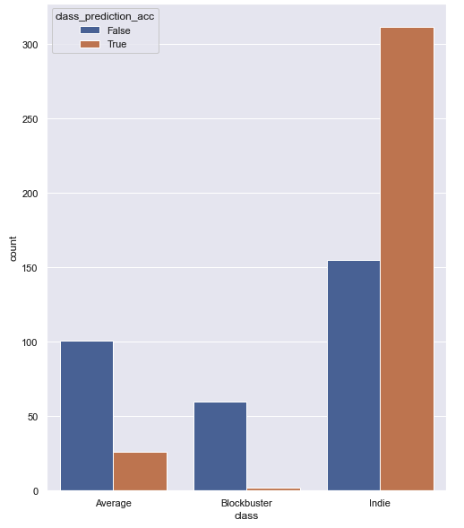
Critic Model
This model can predict the bucket that movie will end up in.
Especially for the Indie class, by looking at the critics early vote, model can assume with good certainty that the movie is going to sell less than 25 million dollars.

Slide 13

Prediction for 2021 movie
The model predicts that Dune will collect 966 Million dollars at box-office.
in reality ends up with only 400 million dollars.

Slide 14

Prediction for 2021 movie
Directed by Ridly Scott, popular stars such as Al Pacino and Lady GaGa,
Only sells 100 million dollars in box-office.
People simply don't like it, or because of pandemic restriction people still hesitated to go back to theaters.
Critics vote high for this film, and that is why the model predict 450 million dollars box-office for this film.

Slide 15

Prediction for 2021 movie
Adored by critics in festivals and on average got more than 90% positive vote.
Outside of the festivals, did not get enough
The model predict 2 million dollars in box-office.
Bergman Island ends up with only 700 thousand dollars.

Slide 16
Future Improvement
While early critics vote showed to be a decent factor in this prediction, but it is not enough for having a very accurate prediction.
More information:
How many time people google the name of the film.
How many time people tweet about the film or even know.
The advertisement budget of the movie.
Beside these three website there are others that critics submit their vote there. Although these are the most popular one but more data will help the prediction for sure.
The data I gathered was for years between 2010 and 2019 and only have 3000 rows. If I be able to gathered more data for all years available on those website and be able to merge them correctly together, my model would have a better performance.

