Slide 1
ACTIVITIES BY SINDH GOVERNMENT UNDER PRMI November 2023
Government of Sindh Investment Department Project Implementation Unit (PIU) Competitive & Livable City of Karachi (CLICK)

Slide 2
PROVINCIAL OSS

Slide 3
PROVINCIAL OSS
List of Departments to be Integrated
Sr. No | Department
1 | Industries and Commerce Department
2 | Labour & Human Resource Department
3 | Sindh Environment Protection Agency
4 | Sindh Employees Social Security Institution (SESSI)
5 | Sindh Revenue Board (SRB)
6 | Sindh Food Authority (SFA)
7 | Health Department
8 | Sindh Health Care Commission
9 | Energy Department
10 | School Education Department
11 | College Education Department
12 | Excise, Taxation and Narcotics Control Department
13 | Board of Revenue Sindh
14 | Agriculture Department
15 | Sindh Building Control Authority (SBCA)
16 | Local Government Department

Slide 4
List of Departments Integrated So Far (RLCOs)
Partnership Registration (Industries Department)
Employer Registration (SESSI)
Shop Registration (Labour Department)
Professional Tax (Excise, Taxation & Narcotics Control Department)
The above agencies were automated front end under World Bank’s KNIP Project and the Sindh Business Registration Portal was developed by PITB; The SBRP is being managed by Doing Business Reforms Implementation Unit (DBRIU) headed by Director DBRIU

Slide 5
Upcoming Automations of RLCOs
Improvement of Business Climate and City Competitiveness Component of Competitiveness and Livable City of Karachi Project (World Bank)
The PIU CLICK SID is entrusted with Business Process Re-Engineering and Automation of RLCOs of 16 Departments mentioned on Slide 3;
So far, the Consolidated Business Registry (CBR) has been finalized;
232 RLCOs across 16 Departments have been identified; 132 RLCOs are being prioritized;
For Simplification/Modernization and Automation, AS-IS Mapping of 16/16 departments has been done;
Validation of modernized mapping is being conducted and 15/16 Depts have validated;
Re-Engineering of 16/16 Departments completed;
The Re-Engineered RLCOs will be automated and already automated rlcos will be integrated into Sindh Business One Stop Shop by an IT firm;
The IT firm will be onboard by April-May 2024; Operationalizing to start from Aug 2024;
The S-BoSS will be functionalized completely across 16 departments by Dec 2025;

Slide 6
Upcoming Automations of RLCOs
Interim Automations:
Process mapping of following licenses completed; Automation assigned to PITB under SID contract:
Jan-June 2023
Registration of Food Businesses (Sindh Food Authority) by PITB
Registration of Drug License (Health Department) by PITB

Slide 7
Upcoming Automation/ Integration of Departments
Sindh Business One Stop Shop---A portal to provide regulatory approval of 232* RLCOs across 16 departments will be integrated among each other as well as with Federal Agencies in consultation with Provincial Cabinet.
List of RLCOs and Departments is mentioned in the Consolidated Business Registry being provided along with the Presentation.
* The No. of Licenses to be covered/automated under CLICK ongoing phase to be limited to 100-130 licenses due to timelines constraints as project closing date is June 30th 2024.

Slide 8
RLCOs Mapping Exercise

Slide 9
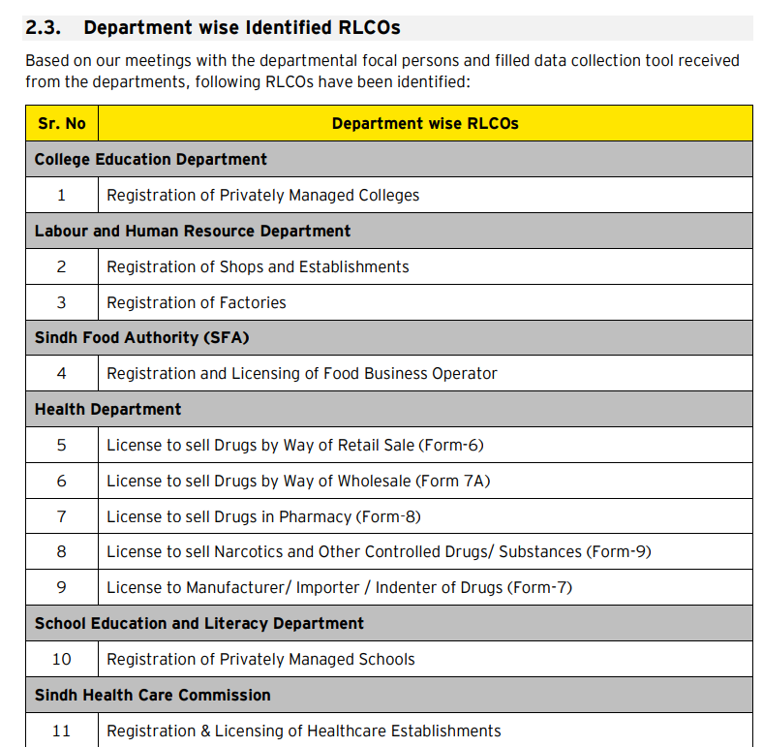
Department wise RLCO Mapping list
List of 140/232 licenses is shared below; while the complete list of RLCOs is being compiled in final stages and will be shared shortly too;

Slide 10
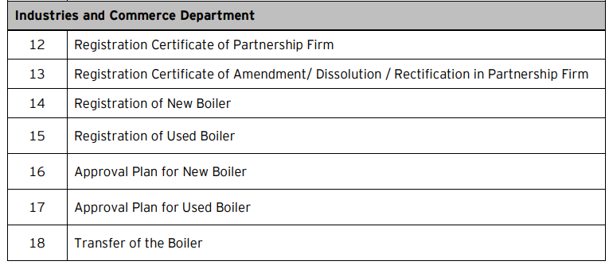
Department wise RLCO Mapping list

Slide 11
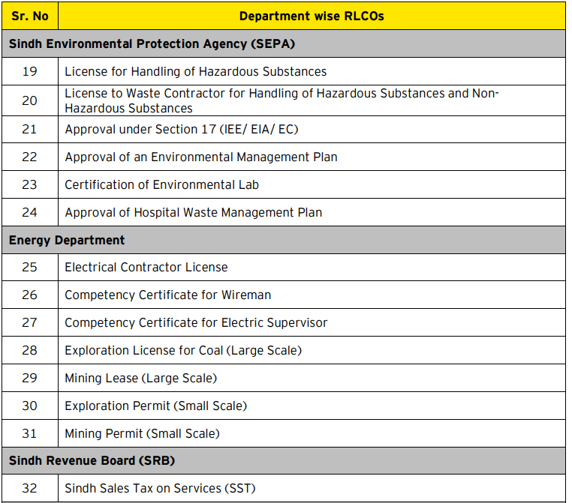
Department wise RLCO Mapping list

Slide 12
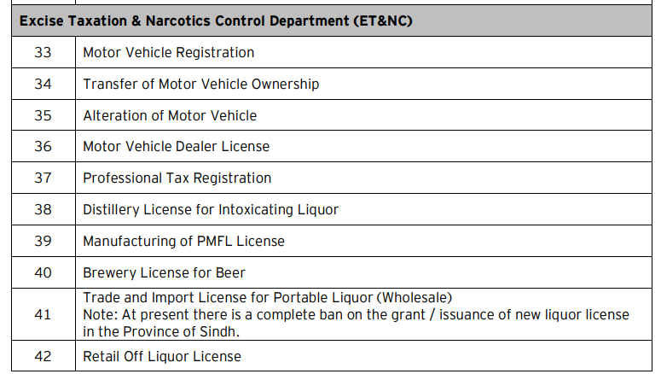
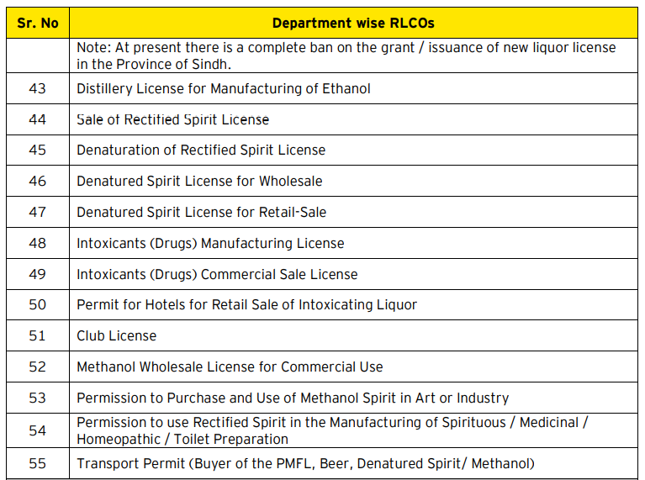
Department wise RLCO Mapping list

Slide 13
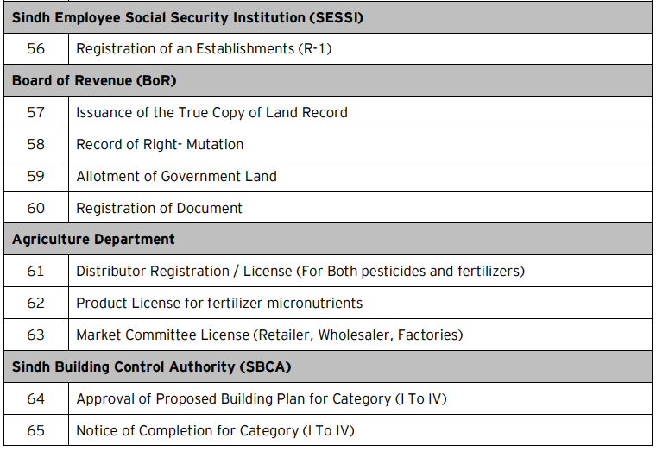
Department wise RLCO Mapping list

Slide 14
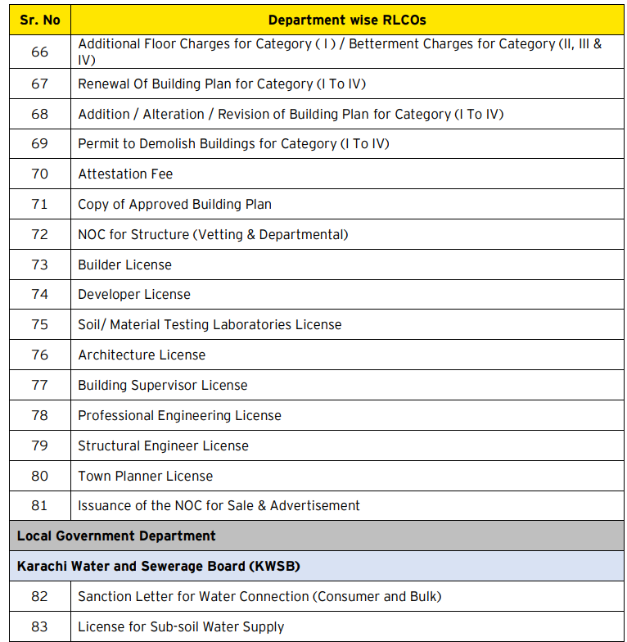
Department wise RLCO Mapping list

Slide 15
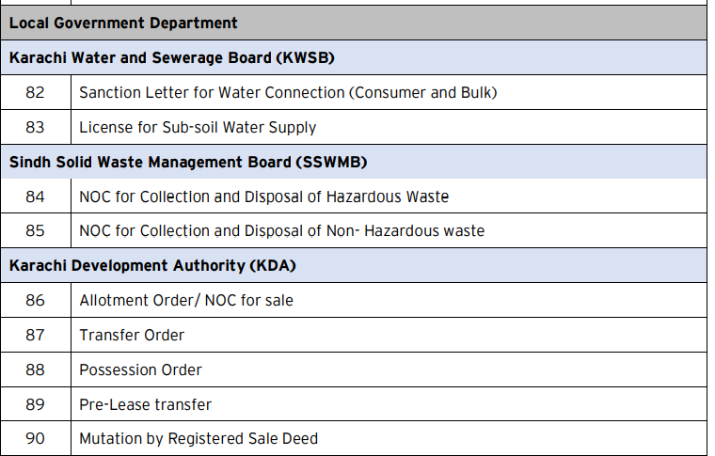
Department wise RLCO Mapping list

Slide 16
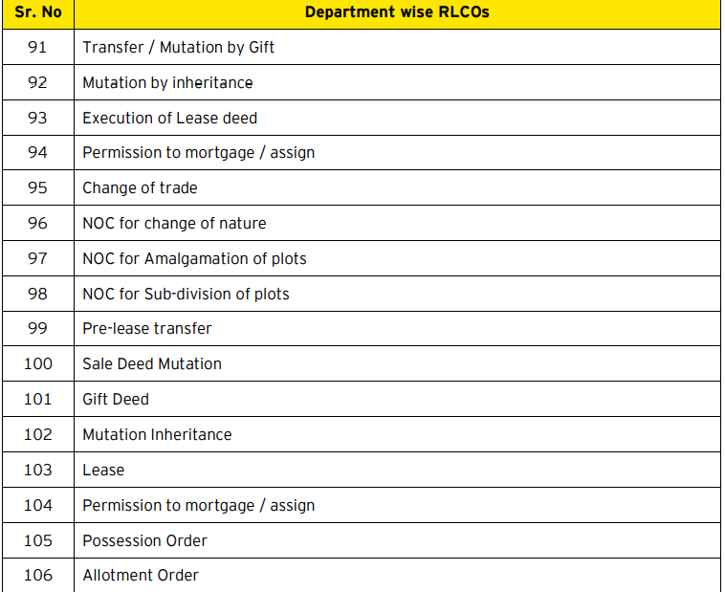
Department wise RLCO Mapping list

Slide 17
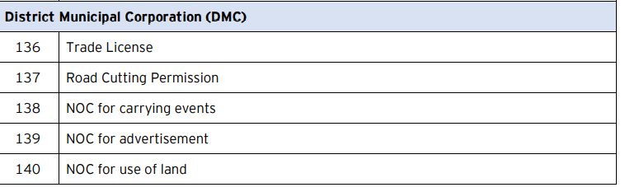
Department wise RLCO Mapping list

Slide 18
Provincial Working Groups/PIU
Project Implementation Unit, CLICK, Sindh Investment Department is functional with its Specialists, i.e. Senior Manager (BPR), Communication Specialist, Procurement Specialist, Sr. Automation Specialist and Legal Specialist;
A Provincial Steering Committee on Regulatory Modernization and Automation is constituted to steer the progress under To-Be (Re-Engineering) exercise & Automation into S-BOSS

Slide 19
Reforms Implemented under PRMI
Under PRMI, CLICK PIU, Sindh Investment Dept being focal department on PRMI has received Appreciation Letter from President of Pakistan on the launch of Asaan Karobar Web-Portal on behalf of Chief Secretary Sindh having completed 19 reforms for simplification, elimination and modernization in Sindh:
Implemented Reforms:
Drug License Validity extended from 2 to 5 years.
Auto Workshop License validity extended from 1 to 3 years
Fisheries License Validity extended from 1 to 3 years.
Online & Timely registration of partnerships within seven (07) days
Online portal for building plan approvals.
20% to 10% reduced Apprenticeship requirement for SMEs.
Special Commercial bench to expedite commercial dispute resolution
Alternate Dispute Resolution introduced via amended CPC; Arbitrators onboard;
Online Case Management System introduced.
Multiple inspections/assessments eliminated by SESSI.
Multiple inspections eliminated by SBCA
Timely Drug Liscense issuance enforced;
Time-based issuance of NOCs/Permits for Construction Permits
Time for environmental assessment reduced by SEPA.
Reduction in frequency of assessments/audits by SESSI.
Automatic NTN registration of partners /businesses
Elimination of Spittoon requirement
Elimination of Whitewashing Requirement
Fixing timelines for registration of factory

Slide 20
Reforms Underway under PRMI
Contracts awarded to PITB
Automation of Drug License (Delayed)
Automation of Food License (Partially implemented)
Multiple Inspection System (Recently Awarded)
E-Registration for Online Verification of Registration Title (Recently Awarded)

Slide 21
Business Process Re-Engineering Elimination/Simplification/Modernization
b) Under the CLICK Project, the elimination, simplification and modernization of RLCOs to start after approval of Re-Engineering which is in final stages;
c) Draft To-Be Report of 15/16 Departments (for elimination, simplification and modernization) submitted EY;
d) Private Sector Consultation conducted with KCCI, FPCCI, OICCI, PBC, SMEDA, Industrial Associations, etc.
e) Elimination, Simplification and Modernization suggestions under To-Be Report incorporated;

Slide 22
FUTURE PLANS

Slide 23
Upcoming Automation/ Integration of Departments
Procurement of Services of IT firm for S-BoSS Operationalization by March-April 24
Operationalization of 16 Departments/Agencies under S-BoSS by Dec 2025
Integration with Federal P-BoSS

Slide 24
Thanks

