Slide 1
Student Enrollment System
Demo • Features • OOP • Requirements • UML • Achievements

Slide 2
System Overview
Java Swing desktop app built in IntelliJ
Modules: Students, Courses, Enrollments, Grades, Reports
MySQL backend via JDBC (Connector/J)
Menu-driven UI with forms & tables

Slide 3
Tech Stack & Architecture
Languages & Tools
  • Java 17+/25 (JDK)
  • Swing/AWT for GUI
  • JDBC (MySQL Connector/J)
  • MySQL Server & Workbench
  • JUnit (optional)
Architecture
  • Model: Student, Course, Enrollment, Grade
  • DAO for CRUD, Service for rules
  • UI: JFrame/JPanel forms
  • Config: DatabaseConnection (Singleton)

Slide 4
Key Features & Functionality
Student registration & profile management
Course catalogue + per‑semester enrollment
Grade recording & completion tracking
Student report with summary stats
Input validation & error handling

Slide 5
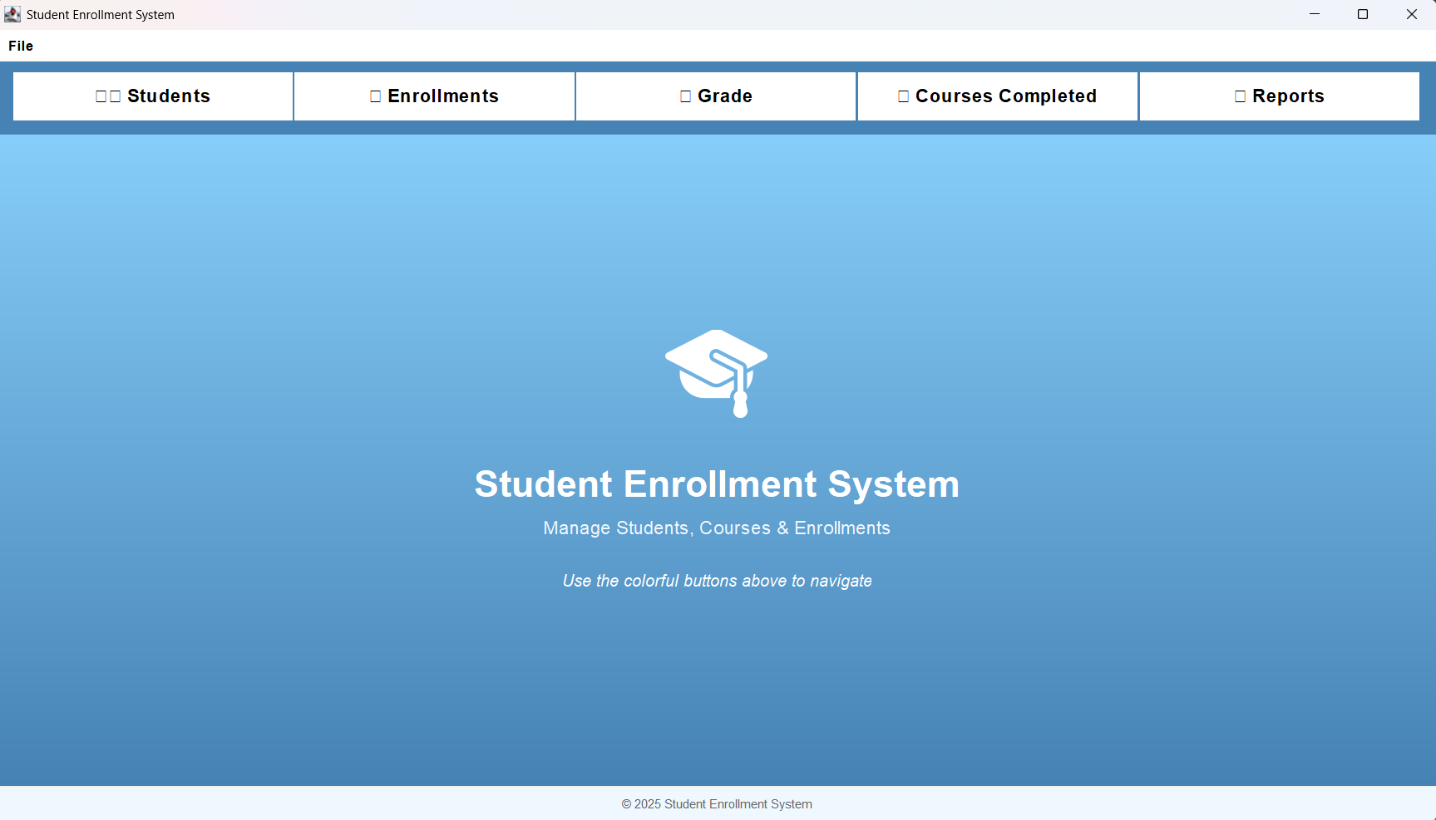
Home & Navigation

Slide 6
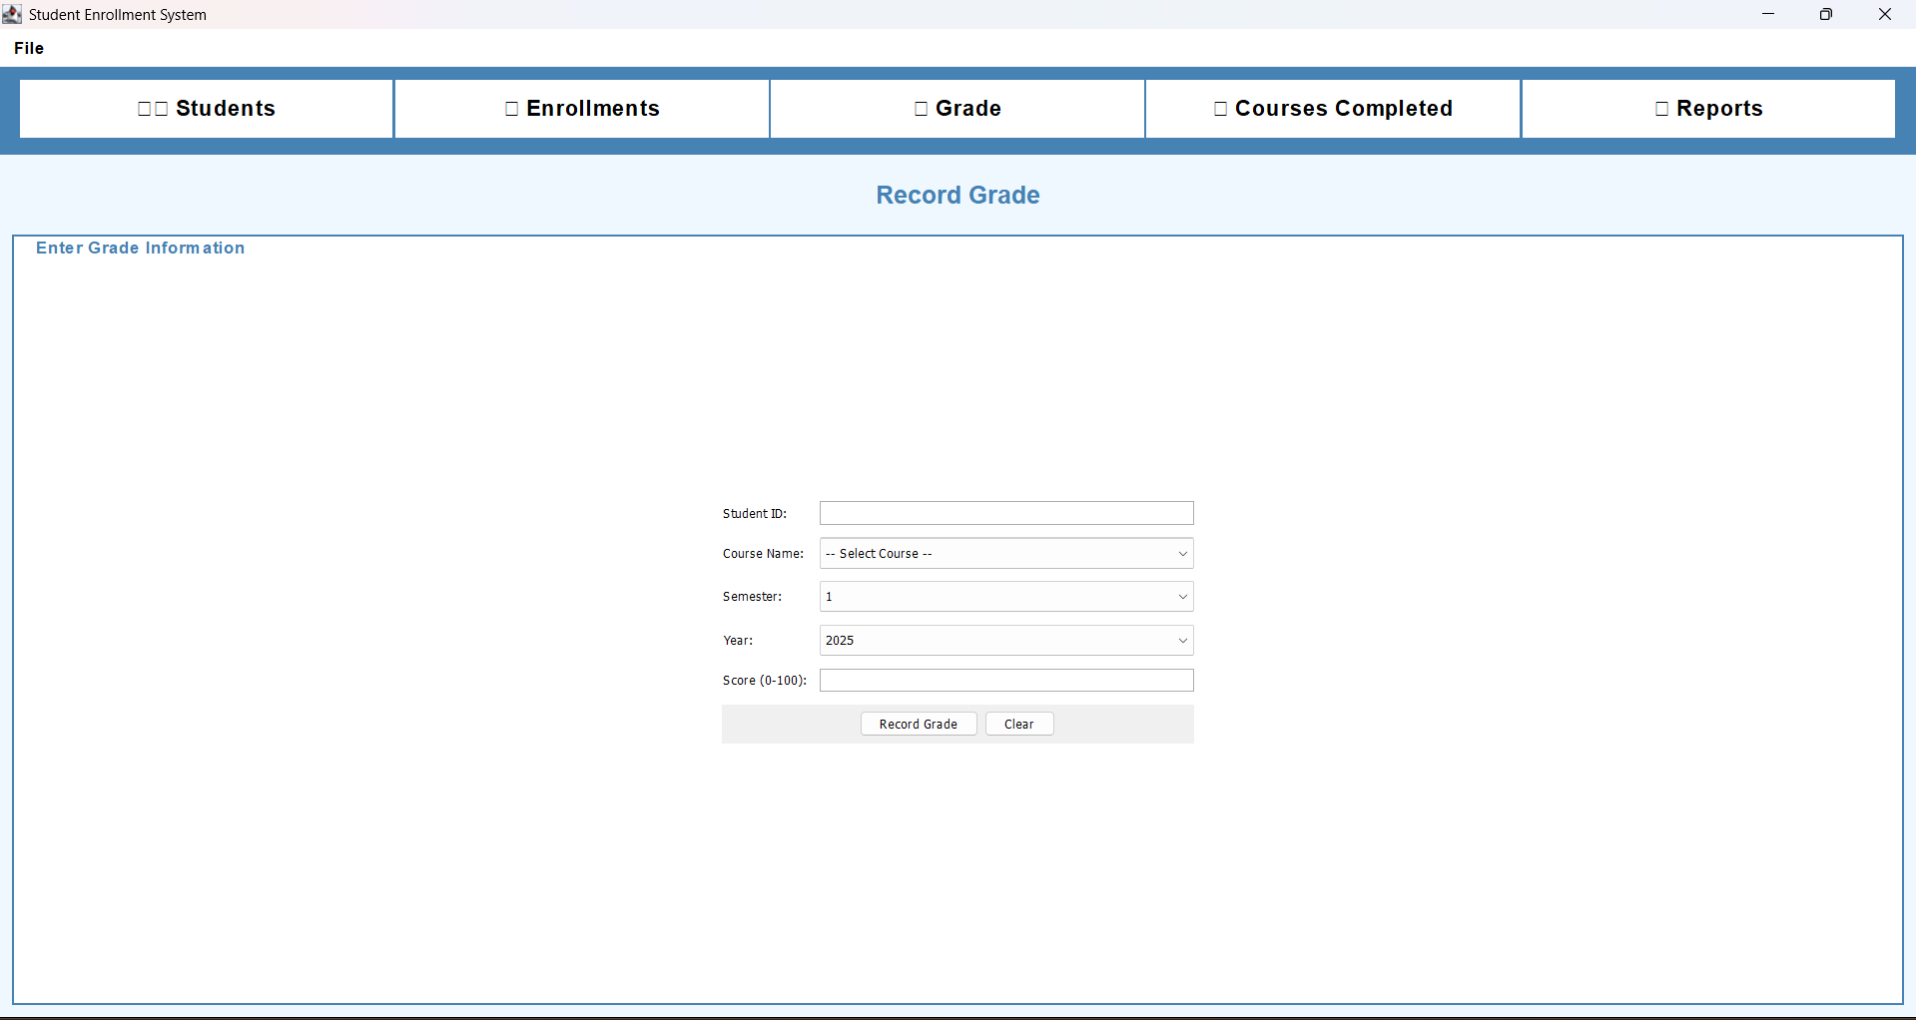
Student Management – Register & List

Slide 7
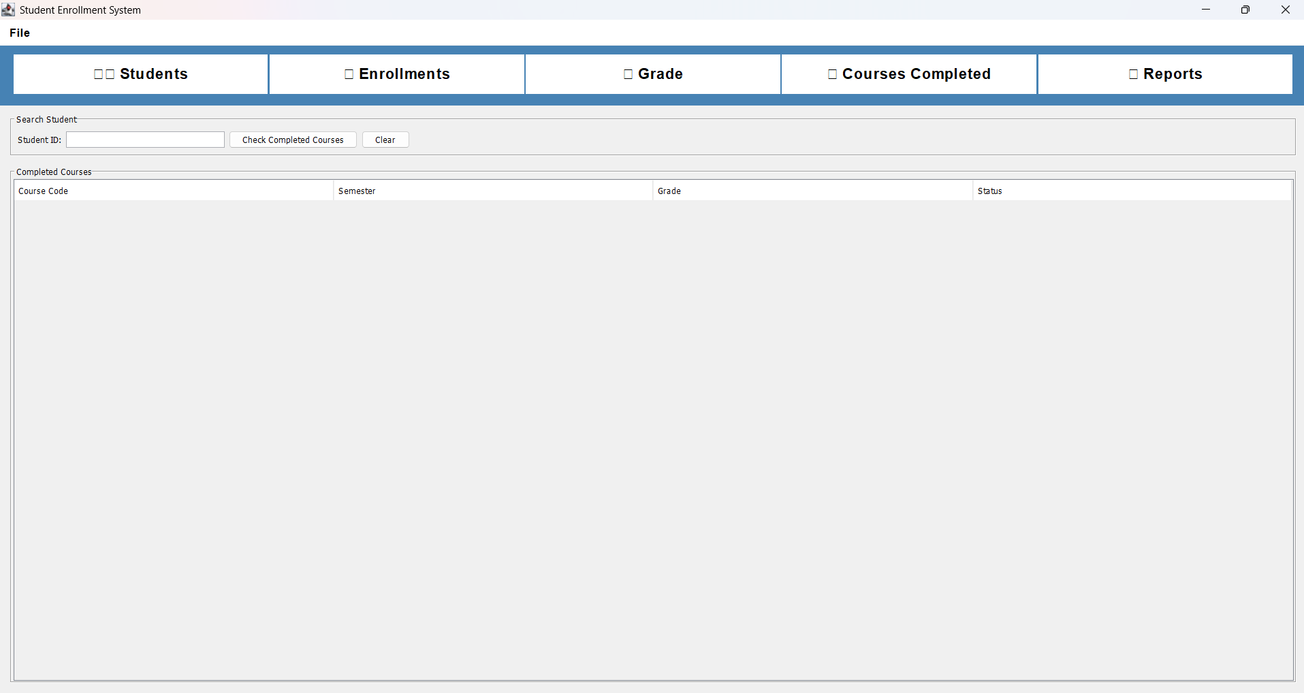
Enrollment Management – Enroll per Semester

Slide 8
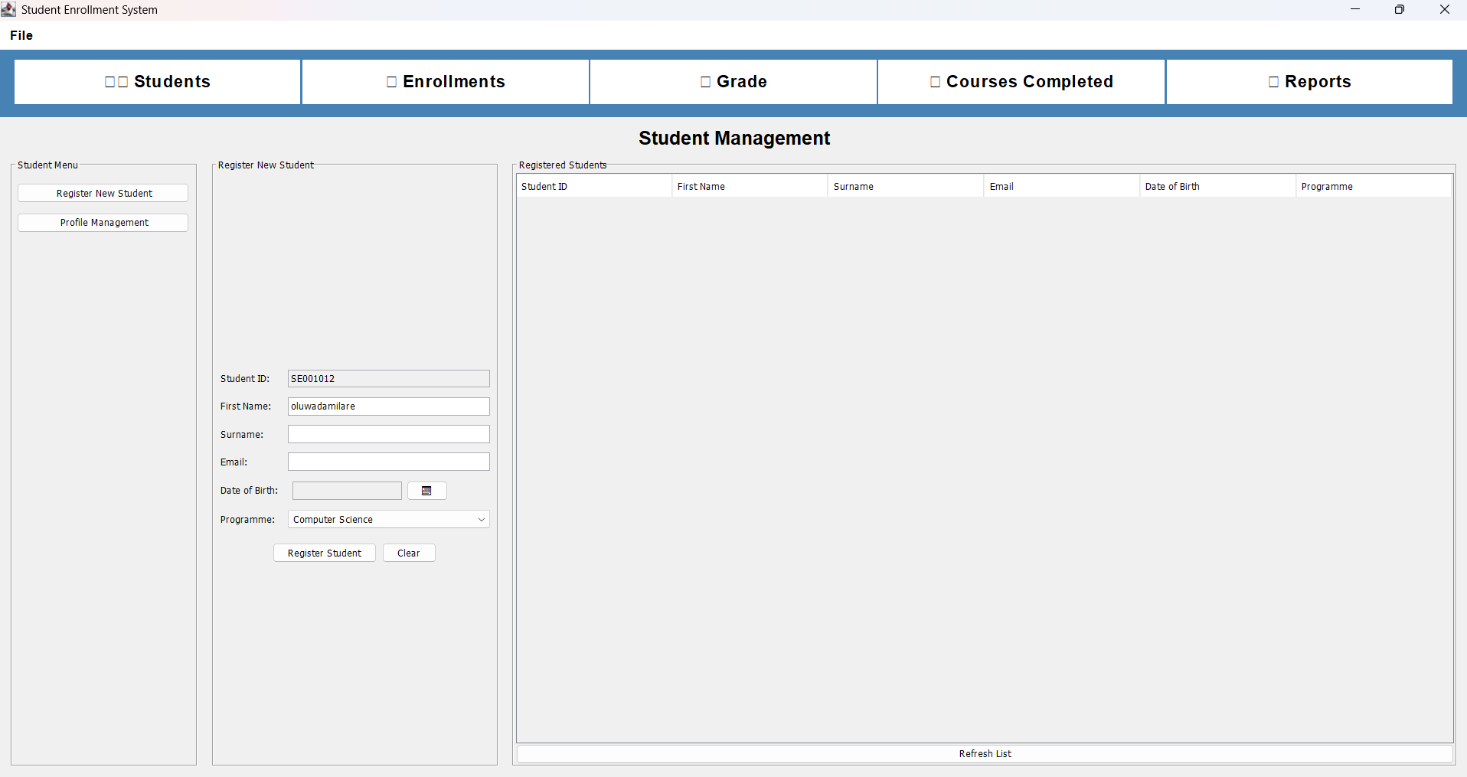
Grades – Record a Score

Slide 9
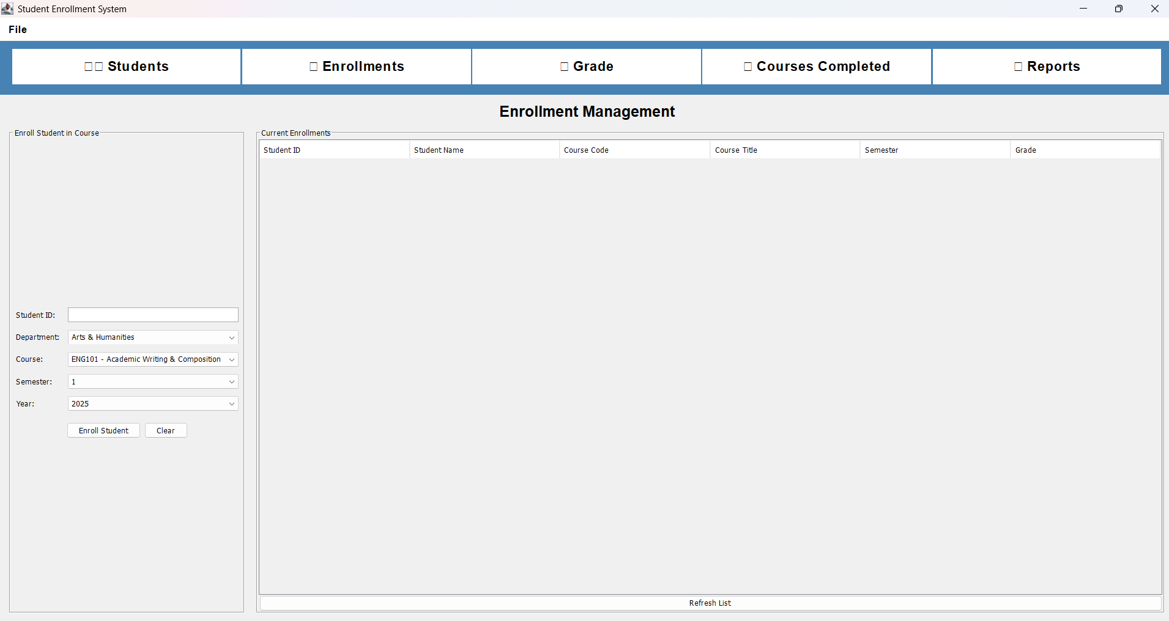
Courses Completed – Completion Status

Slide 10
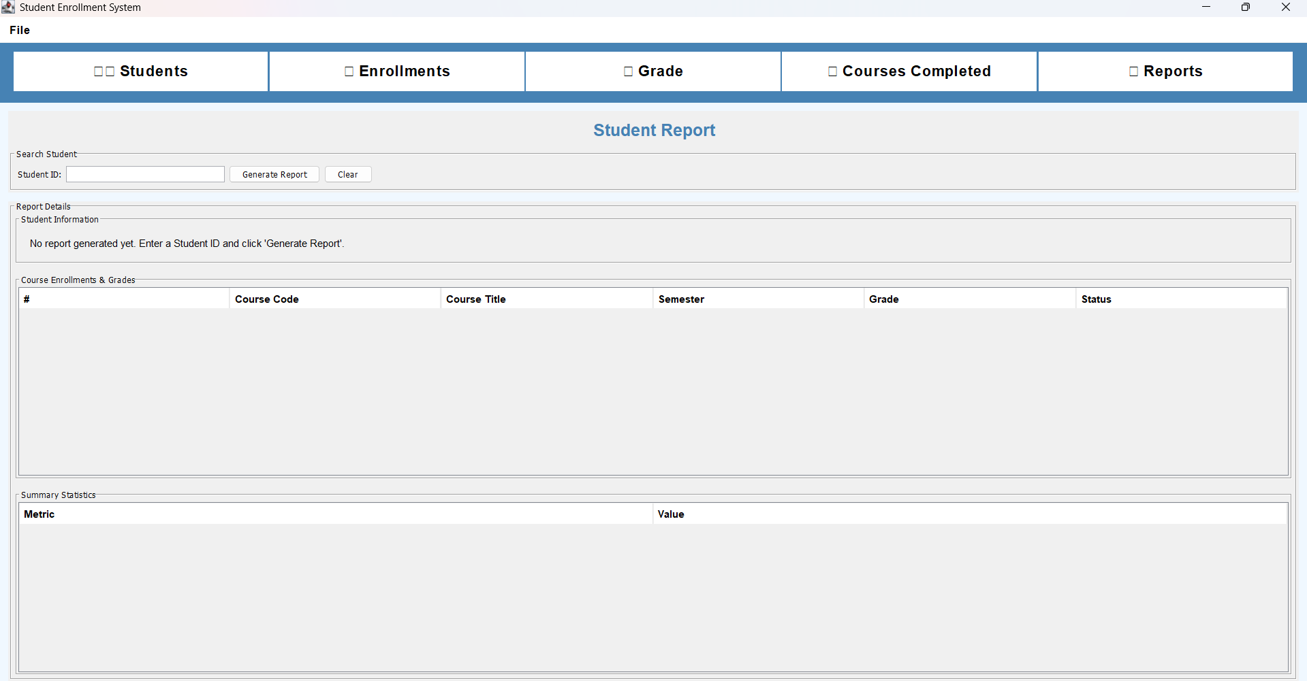
Student Report – Enrollments & Summary

Slide 11
OOP Concepts Implemented
Encapsulation & Validation
  • Private fields + getters/setters
  • Setters validate inputs (e.g., credits > 0)
Abstraction, Inheritance, Polymorphism
  • DAO interfaces hide DB details
  • Optional Person → Student inheritance
  • ActionListeners & DAO implementations

Slide 12
Requirements Validation (Inputs → Outputs)
Register student → appears in Students list & DB
Enroll student (no duplicates) → shows in Enrollments
Record grade (0–100) → reflected in Grades & completion
Generate report by Student ID → enrollments, grades, status

Slide 13
Database Snapshots (MySQL Workbench)
(screenshot missing)
Screenshot_students_db.png
(screenshot missing)
Screenshot_grades_db.png
(screenshot missing)
Screenshot_enrollments_db.png
(screenshot missing)
Screenshot_courses_db.png

Slide 14
UML – High Level
Classes: Student, Course, Enrollment, Grade, DAOs, Services, DatabaseConnection
Relations: Student 1..* Enrollment *..1 Course; Enrollment 0..1 Grade
Layers: model, dao, service, ui
Sequence: UI → Service → DAO → DB → UI refresh

Slide 15
Challenges / Debugging
MySQL installation & password reset (Windows)
JDBC driver not found → added connector JAR
Read‑only files in IntelliJ
PK/FK constraints & duplicates

Slide 16
Solutions & Achievements
DAO + Service architecture, prepared statements
User‑friendly validation and feedback
Working CRUD + reports + completion logic
Clean UI, ready for roles/auth

Slide 17
Future Work
Login/roles (admin/lecturer/student)
Search filters & pagination
Export to CSV/PDF
Unit tests & CI
Dockerized DB & distribution

Slide 18
Q / A
Thanks!

