Slide 1

Final Project Movie Revenue Prediction Model (Based on Budget)
Amin Sundrani, Hideaki Kaneko

Slide 2
Motivation
Movies, Movies, Movies☺
IMDB (Most commonly used Movie review Website) (e.g. Avg Vote, Released Year, Budget ….)
Hypothesis: Looking for Co-Relation between “Budget” & “Revenue”
Machine Learning Model: To apply the Linear Regression Model between “Budget” & “Revenue” to create Prediction Model
Application: Based on the Predication Model, Formulate strategy for Filmmakers/Investors?

Slide 3
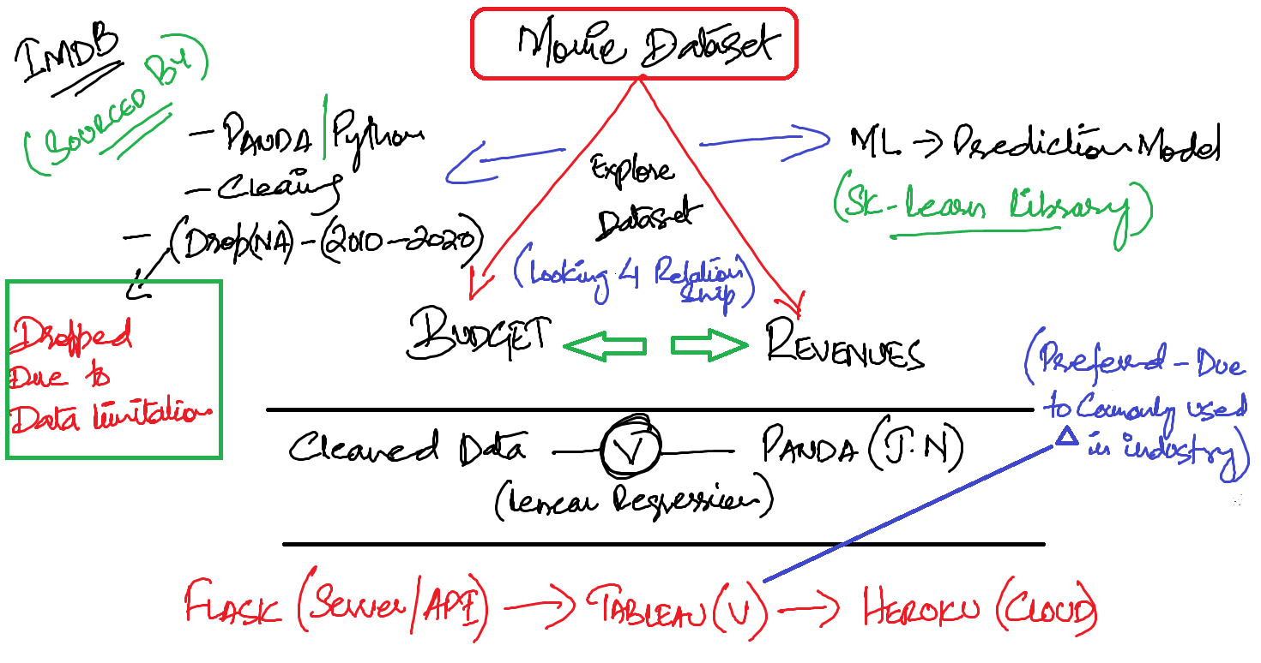
Idea Sketch
Movies Movies Movies ☺
From IMDb, we could get lots of data related to movies (e.g. Avg Vote, Released Year, Budget ….)
Hypothesis: There might be some co-relation between “Budget” & “Revenue” of the movies.
Machine Learning Application: Could we apply the Linear Regression Model to the relation between “Budget” & “Revenue” and create Prediction Model?
Application: Based on the Predication Model we’ve created, could we formulate strategy for filmmakers or investors?

Slide 4
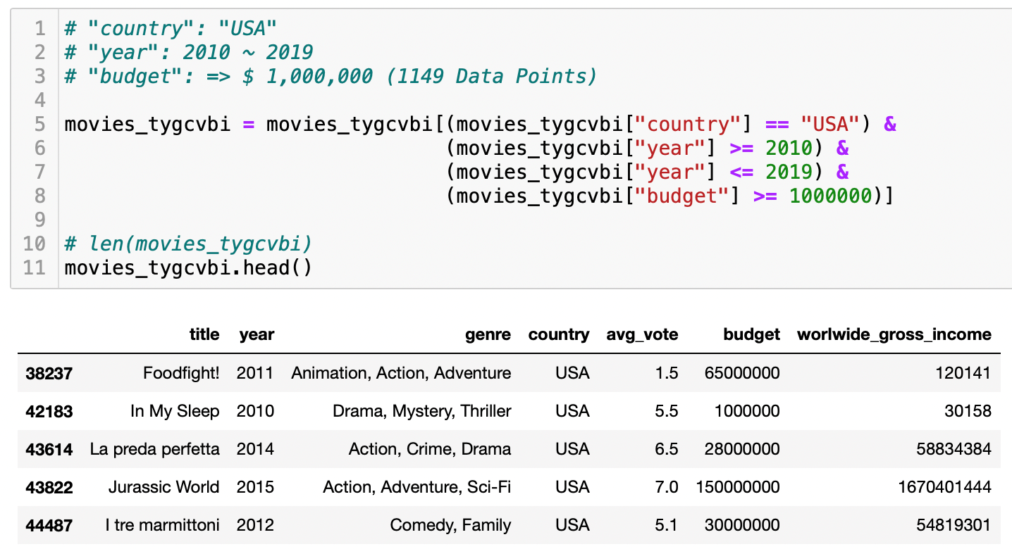
Data Clean-up
DATASOURCE
Kaggle Data scraped from IMDb (85,854 movies data, csv file)
DATA CLEAN_UP (PANDAS)
Country: United States
Year of the Release: 2010 ~ 2019
Budget: $1,000,000 =<

Slide 5
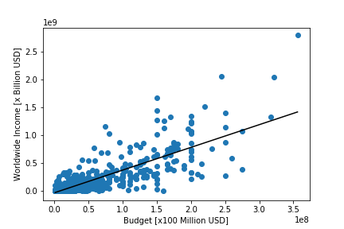
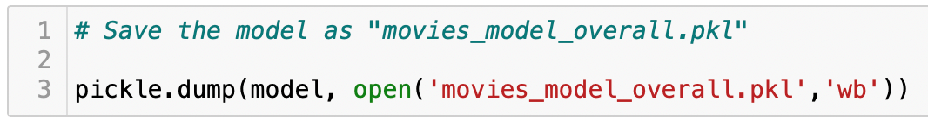
Machine Learning Model
MODEL CREATION
Module: scikit-learn
Type: Linear Regression Model
Variables: “budget” & “Income”
VERIFICATION
Split to “Train” & “Test” Data (train test split)
MSE (Mean Squared Error): 2.31 x 10¹⁶
R² (R-Squared): 0.62
SAVE & LOAD MODEL
.PKL format using (PICKLE/JOBLIB)

Slide 6
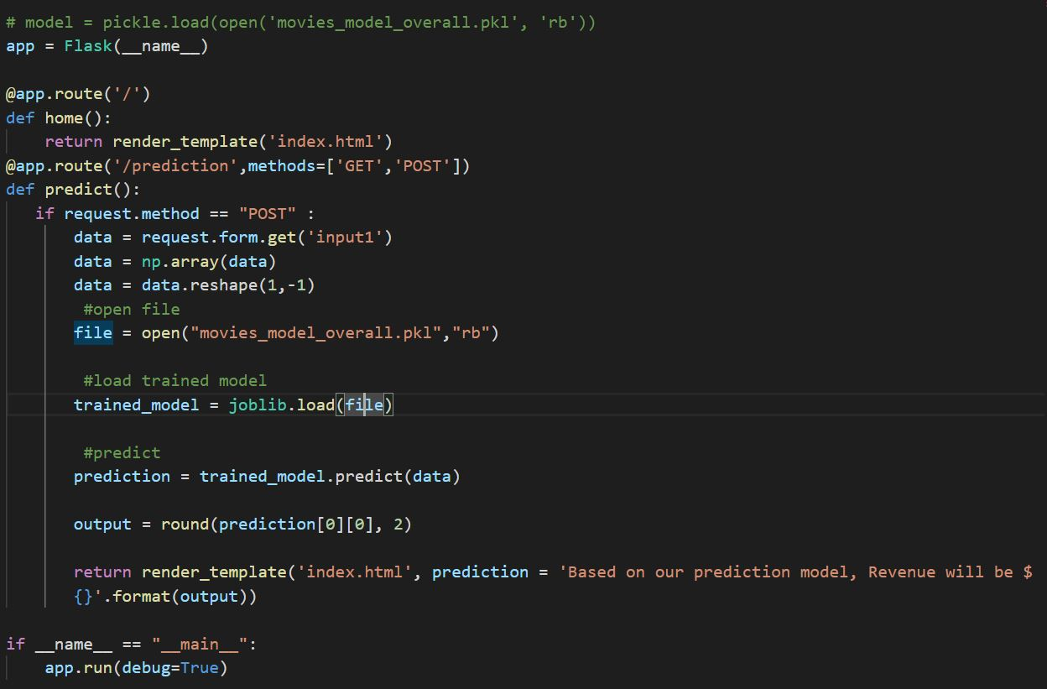
FLASK/TABLEAU/HEROKU
API
Form Model Used (METHOD : POST)
INPUT
Using Budget to Predict Revenue
TABLEAU
Budget, Income, Profit, ROI
Budget and Avg Rating
Budget vs Income
HEROKU
Deployed App using HEROKU

Slide 7
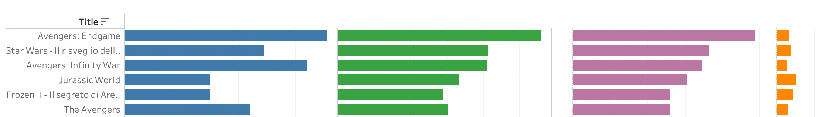

Conclusion
RELATIONSHIP
There is co-relations between “BUDGET” & “INCOME” of the movies and Machine Learning Model can apply to that.
More budget, more profit (Return In
Investment) of the movies are mostly less
than 6.
Although there are some outliers, in most case
it doesn’t scale 100 times or so.
It could be considered as “Great Success” if it
exceeds ROI = 6.5
Top 30 Profit Movies Avg ROI = 6.4
Top 100 Profit Movies Avg ROI = 5.7
22 out of 30 movies are Disney related
$$Gross Profit=\left(Gross Income\right)−(Budget)$$
$$ROI=\frac{\left(Gross Profit\right)}{(Budget)}$$

Slide 8
Competition
Avoid competition with Disney in high budget movies.
Budget below 100M
Realistic Target (ROI)
ROI Target should be around 4 ~ 6
Setting ROI Target as 20< is unrealistic.
Target Genre(“Horror” or “Thriller”)
30 x movies (ROI > 10)
18 out of 30 movies are “Horror” or
“Thriller” movies
Strategies

Slide 9
Machine Learning Model
Model is trained based on whole movie data.
ML Model based on specific genre
might contribute more precise forecast.
(e.g. ML Model for Horror Movie)
Movie Industry (Transformation)
Due to the COVID-19 Pandemic, Movie
Industry itself is changing (Simultaneous
Release of Movie both Online Platform &
Theatre. e.g. Disney, Netflix, Stan etc)
Structure of the business model itself
might change. In that case, ML Model
based on last decade doesn’t always
applicable to future status.
Vulnerabilities

Slide 10

QUESTIONS ?

