Slide 1
Obesity, Obesity, Obesity
Tacklin’ Obesity in ‘Merica
Team Members: Amin , FX, Narisara, Rajesh

Slide 2
Project Introduction
What classifies someone as Obese?
Body Mass Index (BMI) of over 30 _{[2]}
What causes Obesity?
Complex, combination of behavior and genetics
What we are looking for?
Gathered data from various sources to identify the strength of the relationship between obesity and it’s contributing factors.
What we will be covering?
Fast Food restaurants availability, public transport availability, physical activeness, and general public’s age group in the 50 states of United States of America.
Why?
Obesity is serious because it is associated with poorer mental health outcomes and reduced quality of life. Obesity is also associated with the leading causes of death in the United States and worldwide, including diabetes, heart disease, stroke, and some types of cancer.

Slide 3
Scope of Data and Research
Dataset Time to be 2019
All analysis and data to contain data of all the 50 states in USA, not including Federal District (District of Columbia) and Territories (American Samoa, Guam, Northern Mariana Islands, Puerto Rico, US Virgin Islands)
Average of Walkable distance - Public transport (Get total for each state)
Fast food -Include all restaurants in Number of restaurants per state (Heat Map number of Restaurant vs Obesity)
Age group (18-65+), Income groups ranging from (lower $25K to $75K or more), Ethnics groups and Gender (Male and Female)
Physical activity facilities to focus on Gyms, Physical activeness (Meeting CDC requirements -Achieving at least 150 minutes a week of moderate-intensity aerobic physical activity or 75 minutes a week of vigorous-intensity aerobic physical activity and engage in muscle-strengthening activities on 2 or more days a week)

Slide 4
Data Sources
https://open.cdc.gov/apis.html
https://data.world/health/childhood-obesity-in-theus/workspace/file?filename=obesity_child_age.csv
https://www.americashealthrankings.org/explore/annual/measure/obesity/state/ALL
https://www.bts.gov/browse-statistical-products-and-data

Slide 5
Research Questions
The more accessible the fast-food restaurant the higher the obesity rate
The higher the population, the more the Fast food restaurants, hence higher the obesity rate
Is there any relation between mode of commute and obesity?
How many are walking for their day-to-day need?
The higher rate of physical activeness, the lower the obesity rate
The greater number of gyms in a state, the lower the obesity rate
Older generation tend to have higher rate of obesity than younger generation
The higher income, the lower obesity rate

Slide 6
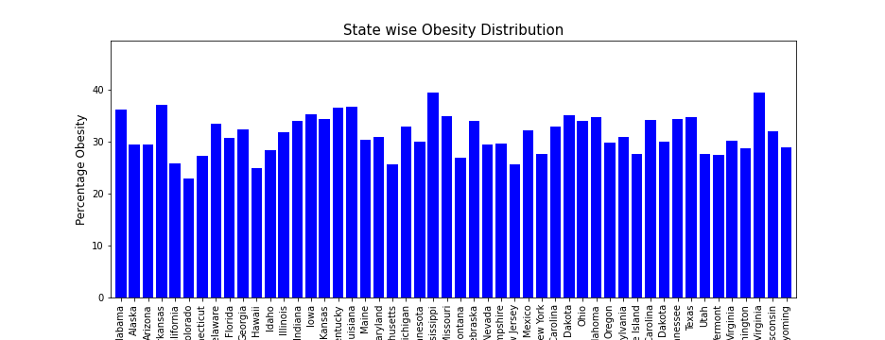
Distribution of obesity rate across USA. Average Rate of Obesity : 31.5%

Slide 7
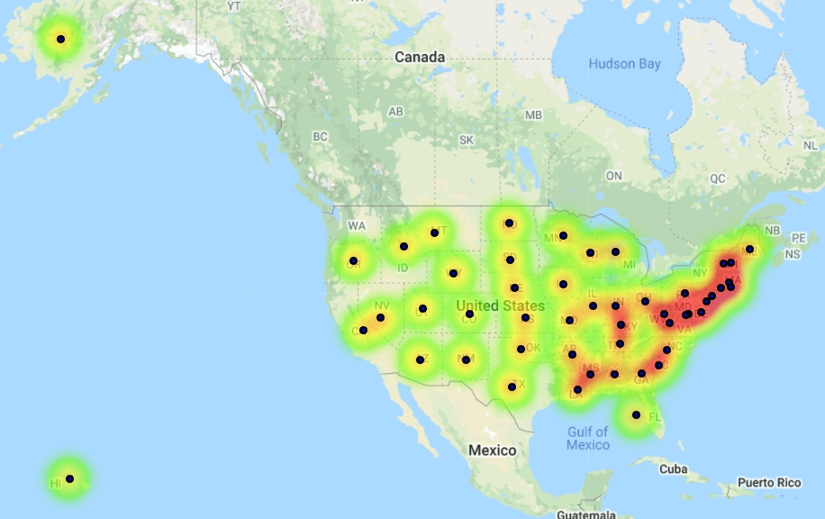
Obesity Heatmap

Slide 8
FACTS (Obesity):
Studies have shown that this rise of obesity among the world population could be attributed to an increase in calorie intake coupled with lack of adequate physical activity.
Results from the analysis of data from the National Health and Nutrition Examination Survey indicate increases in quantity and energy density of foods consumed in the United States.
Studies have shown that in the US per capita calorie intake increased by more than 300 kilocalories (kcal) among the entire population from 1985 through 2002. The numbers have only risen over the past decade.

Slide 9
FASTFOOD FACTS (US STUDY):
In 2018-19, the National Center for Health Statistics reported that 36.6% of adults consumed fast food on a given day. This means that, daily, one out of three Americans will choose to visit a fast-food restaurant. The alarming data from the National Health and Nutrition Examination Survey, released by the CDC
Annual Fast-Food Revenue in the US is $110 Billion
A Third of Children Eat Fast Food on a Daily Basis
The Fast-Food Consumption Rate Hasn’t Changed in 15 Years
Children See 3-5 Fast Food Ads Per Day
The dangers of regular fast food consumption are widely known. This often-processed food, which is high in fat, sugar, and empty calories, is historically linked to obesity, heart disease, diabetes, digestive issues, and even cancer. However, even an infrequent consumption of fast food may exacerbate gastroenterological problems, turning them into a disorder such as GERD.

Slide 10
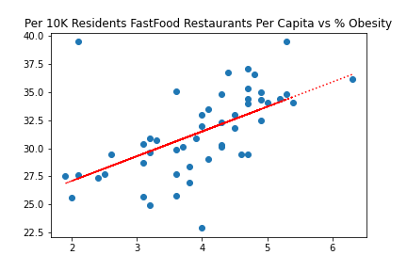
RELATIONSHIP (OBESITY VS FAST FOOD)
The correlation between both factors is 0.75
The correlation between both factors is 0.75
The Scatter Chart Shows the relationship
between the Fast-food Restaurants availability
for every 10K Residents (Capita)
The more accessible the fast-food restaurant
the higher the obesity rate
Availability of Fast-Food Restaurants are one
of many factors behind the higher obesity among
the states in US
The correlation between both factors is 0.75

Slide 11
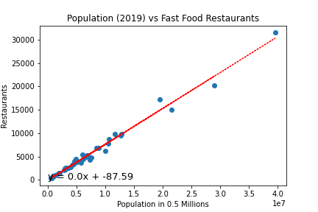
RELATIONSHIP (POPULATION VS FAST FOOD RESTAURANTS)
The correlation between both factors is 0.75
The correlation between both factors is 0.75
The Scatter Chart Shows the relationship
between the increase in Fast-food Restaurants
vs increase in population
The more accessible the fast-food restaurant
the higher the obesity rate
Increasing in the Number of Fast-Food Outlets has
a significant role in higher Obesity rate
The correlation between both factors is 0.99

Slide 12
CONCLUSION / RESULTS
According to the Food Institute’s analysis of data from the Bureau of Labor Statistics, millennials alone spend 45 percent of their budget’s food dollars on eating out. In comparison to 40 years ago, the average American family now spends half their food budget on restaurant food.
Today, more than 2 in 3 adults in the United States are considered overweight or obese. More than one-third of children ages 6 to 19 are also considered overweight or obese.
The growth of fast food in America seems to coincide with the growth of obesity in the United States. Hence, The Obesity Action Coalition (OAC) reports that the number of fast-food restaurants in America has doubled since 1970. The number of obese Americans has also more than doubled
Despite efforts to raise awareness and make Americans smarter consumers, one study found that the amount of calories, fat, and sodium in fast-food meals remains largely unchanged.
As Americans get busier and eat out more frequently, it could have adverse effects for the individual and America’s healthcare system.

Slide 13
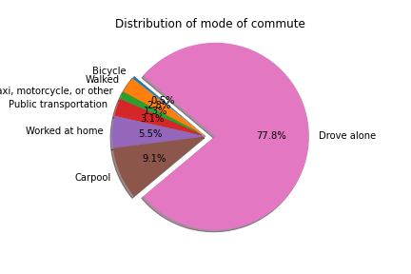
Distribution of Mode of Commute
Pie Chart show the distribution of Mode of commute.
87.9% of the population drive to work alone or used car pool.
3.1% uses public transport for work.
Distribution shows lack of confidence in
public transport by commuters.
FIGURE 1

Slide 14
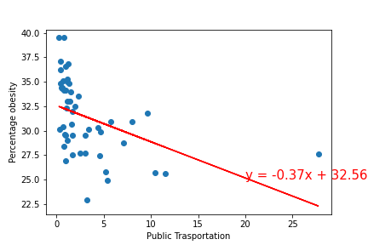
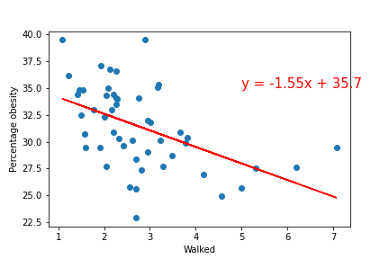
Regression plot Public Transport and walking
The correlation coefficient between Obesity and Public transport is -0.43
The correlation coefficient between Obesity and Walked is -0.49
Figure 2
Figure 3

Slide 15
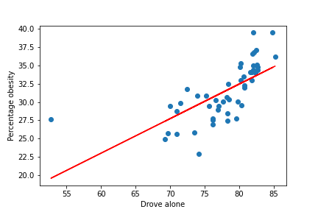
Regression plot Drove Alone
The correlation coefficient between obesity and Drove alone is 0.68
Figure 4

Slide 16
Reference
Based on the study conducted by Li Ming Wen and Chris Rissel on Inverse associations between cycling to work, public transport, and overweight and obesity:
Findings from a population based study in Australia link : https://www.sciencedirect.com/science/article/abs/pii/S0091743507003714
Health Promotion Service, Sydney South West Area Health Service, Level 9, King George V Building, Missenden Road, Camperdown, NSW 2050, Australia Methods.
The study was conducted using data from a representative sample of 6810 respondents who reported being in the workforce, extracted from the 2003 New South Wales Adult Health Survey, Australia. Logistic regression modeling adjusted for potential confounders.
1. Population using public transport to work were significantly less likely to be overweight and obese. 2. It is clearly visibly that there is a moderate negative correlation between the use if public transport and the obesity rate. 3. It is clearly visibly that there is a strong positive correlation between the use of personal vehicle and the obesity rate.

Slide 17
Result
Data on mode of commute and obesity are used to generate above analysis report for all the states in America.
Figure 1 show the distribution of mode of commute in different states and clearly shows the preferred mode of commute is drive alone or carpool, which constitute for 87.9% of the total population.
Most of the studies conducted regarding the relationship between obesity and walkability show a negative correlation. To confirm this hypothesis, we have included one of the study conducted by Li Ming Wen and Chris Rissel.
Figure 2,3,4 shows the correlation between use of public transport, walking and drive to commute verses obesity, and based on Li Ming Wen and Chris Rissel we can confirm that use of Public transport and walkability have a moderate negative correlation and driving has high positive correlation.

Slide 18
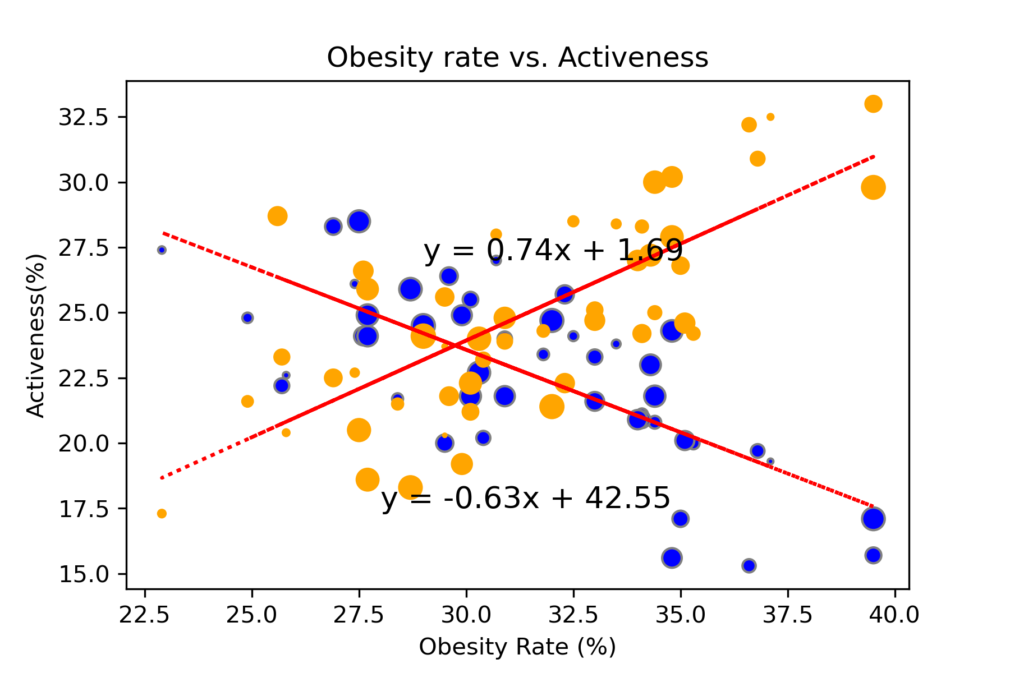
The higher rate of physical activeness, the lower the obesity rate
One of the causes of Obesity defined by the CDC is due to physical inactivity.
Both physical activeness and inactiveness have a strong (but not perfect) relationship between Obesity rate (Both with R value ±0.73)
This proves that state residents that meets the CDC's physical activeness requirements have a lower obesity rate, hence proving the hypothesis to be true.

Slide 19
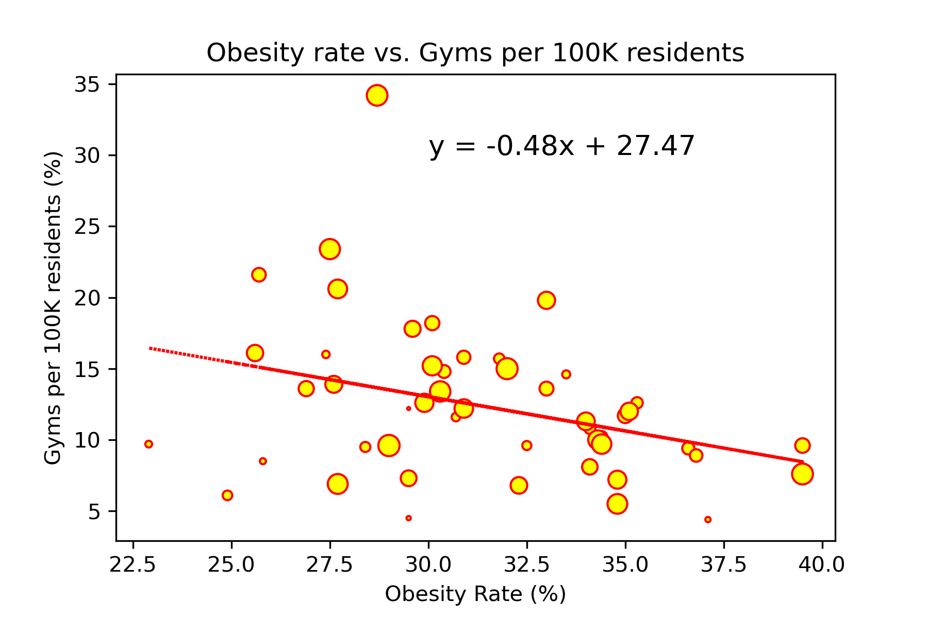
The greater number of gyms in a state, the lower the obesity rate More gyms, more active, hence lower obesity?
Washington
Relationship between the Obesity Rate of a state and available Gyms per 100K state residents is a low negative (weak) with the R-value of -0.34.
Despite having more gyms per 100K state residents, it has not much affect on the obesity rates in a state.
To support this observation, the state with the highest % of gyms per 100K residents (Washington) still have a higher rate of Obesity compared to those with less gyms available (Colorado, Hawaii)
Colorado
Hawaii

Slide 20
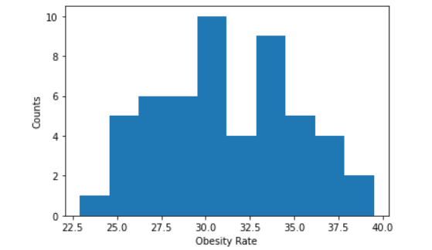
Obesity rate by Age, Gender, Ethic and Income
Using Central tendency to describe the dataset
Mean value is 31.28653846153846
Median value is 30.9
Mode is ModeResult(mode=array([29.5]), count=array([3]))
Variance using Numpy module is 14.662318786982244
Standard deviation using Numpy module is 3.8291407374216795
NormaltestResult(statistic=0.4934206529646011, pvalue=0.7813670020801041)
z-scores values are [-0.4665638 1.28317601 ....-0.67548796 0.18632419 2.14498816 -0.5971414 ]

Slide 21
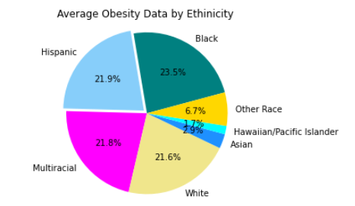
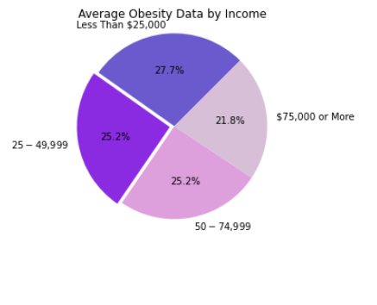

Slide 22
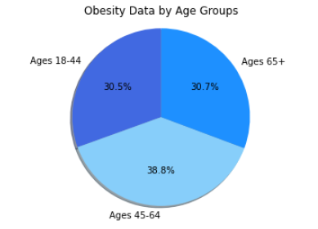
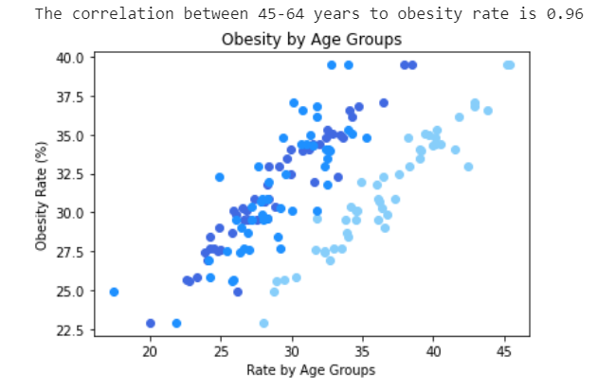
Age Group

Slide 23
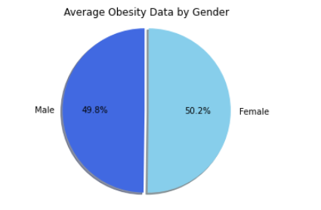
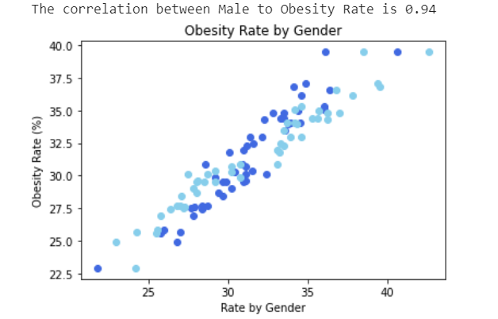
Gender group

Slide 24


THANK YOU Questions?

