Slide 1
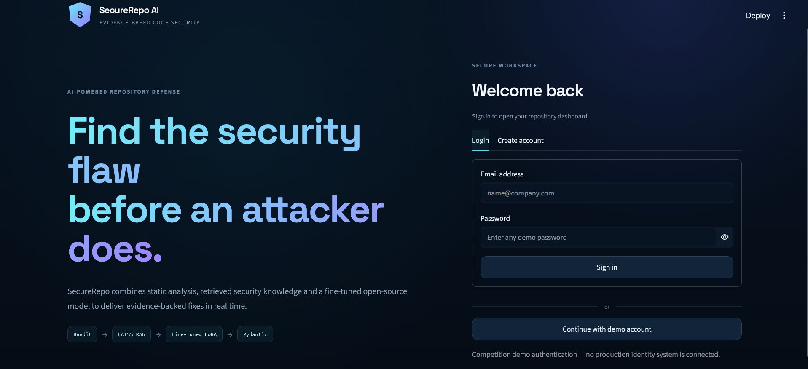
SECUREREPO AI / OPENING
TIPS HINDAWI CHALLENGE / 2026
AI-POWERED PYTHON SECURITY REVIEW
SecureRepo AI
Find the security flaw before an attacker does.
An explainable first-pass reviewer for public Python repositories—grounded in scanner evidence, retrieved guidance, and a fine-tuned open-source model.
WORKING END-TO-END PROTOTYPE
AMIN TARIG AMIN ABBAS
Tips Hindawi Challenge · June–July 2026
BANDIT → FAISS RAG → FINE-TUNED QWEN → STREAMLIT
AI-SUPPORTED SECURITY REVIEW
01
Notes:
Vibe coding helped me build faster, but it exposed a gap: security review often falls behind the speed of generation. I built SecureRepo AI to close that gap for public Python repositories. A user submits a GitHub URL, and the system combines scanner evidence, retrieved security guidance, and my fine-tuned open-source model into a clear first-pass report. It is designed to help developers review sooner—not to replace a security professional.
[Sources]
- /workspace/scratch/f15a04397186/README.md
- /workspace/scratch/f15a04397186/assets/screenshots/01-login.png
[/Sources]

Slide 2
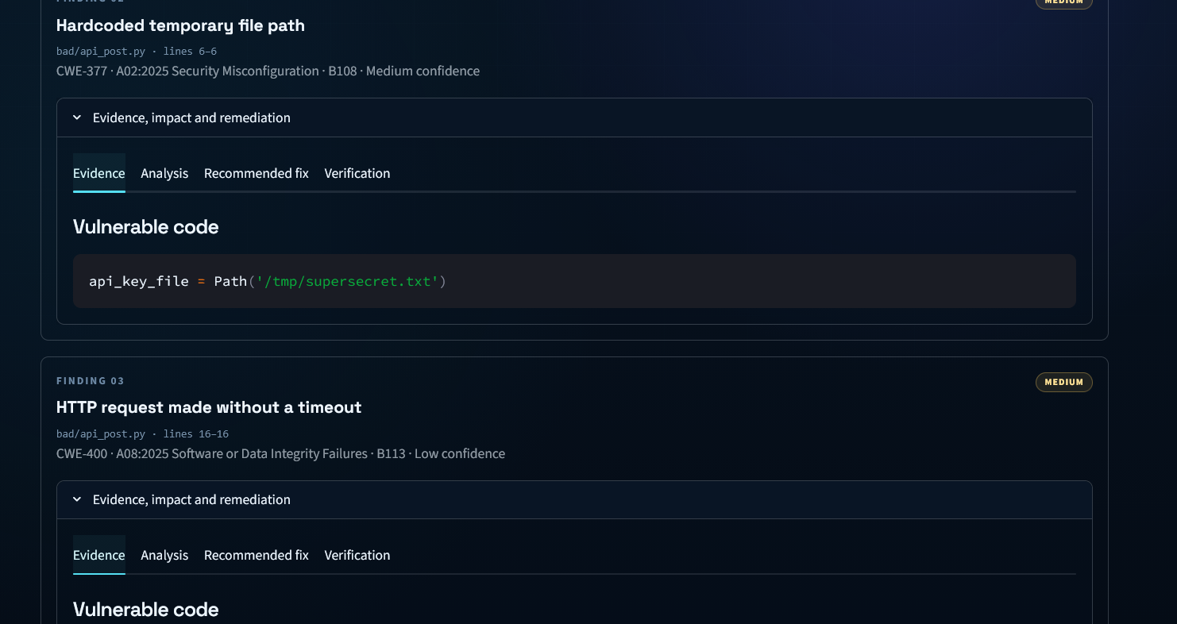
SECUREREPO AI / THE PROBLEM
TIPS HINDAWI CHALLENGE / 2026
THE GAP I SAW
Vibe coding moved faster.
Security review did not.
Static scanners can flag patterns. Developers still need context, prioritization, and a safe fix they can understand.
THE REAL PROBLEM
Turning a scanner clue into evidence, explanation, and a reviewable remediation.
SCANNER CLUES NEED CONTEXT BEFORE THEY BECOME USEFUL
AI-SUPPORTED SECURITY REVIEW
02
Notes:
The challenge was not simply to add another scanner. Bandit can surface valuable clues, but a beginner may still ask: is the clue supported by the code, why does it matter, and what should I change? I also did not want to send an entire repository to a general model and treat the response as a verdict. SecureRepo AI focuses on the space between static evidence and a practical developer decision.
[Sources]
- /workspace/scratch/f15a04397186/README.md
- /workspace/scratch/f15a04397186/assets/screenshots/08-multiple-findings.png
[/Sources]

Slide 3
SECUREREPO AI / BUILD STORY
TIPS HINDAWI CHALLENGE / 2026
HOW I BUILT IT
I built the model before I built the interface.
01
TRAIN
02
PUBLISH
03
PRODUCTIZE
1,200 examples
QLoRA adapter
Evidence-first app
800 vulnerable · 400 safe
20 Python security families
Fine-tuned Qwen3-4B with Unsloth
Uploaded to Hugging Face
Bandit · FAISS RAG · Pydantic
FastAPI · ngrok · Streamlit
TRAINING BEHAVIOR → PUBLISHING THE ADAPTER → BUILDING THE PRODUCT
AI-SUPPORTED SECURITY REVIEW
03
Notes:
I started with model behavior. I fine-tuned Qwen3-4B-Instruct-2507 with Unsloth and QLoRA on 1,200 curated synthetic examples: 800 vulnerable and 400 safe, across 20 Python security families. I then uploaded the trained LoRA adapter to Hugging Face. After that, I productized it with Bandit evidence, FAISS retrieval, Pydantic schema validation, a FastAPI backend, and the Streamlit experience.
[Sources]
- /workspace/scratch/f15a04397186/SecureRepo_AI_Dataset/manifest.json
- /workspace/scratch/f15a04397186/SecureRepo_AI_Dataset/dataset_card.md
- https://huggingface.co/AminTariq/securerepo-qwen3-4b-lora
[/Sources]

Slide 4
SECUREREPO AI / REPOSITORY PIPELINE
TIPS HINDAWI CHALLENGE / 2026
READ-ONLY ANALYSIS
Every repository passes through six evidence-first stages.
01
02
03
04
05
06
INTAKE
DISCOVER
SCAN
GROUND
REVIEW
DELIVER
Public GitHub URL
Readable Python files
Bandit static clues
Code + FAISS RAG
Fine-tuned Qwen
Pydantic → Streamlit
Validate the URL
and shallow-clone
Ignore environments,
builds, and symlinks
Flag candidates and
prioritize risky files
Build focused context and
retrieve security guidance
Verify evidence, explain
impact, suggest a fix
Validate structure, stream,
save history, export JSON
READ-ONLY REVIEW
Repository code is inspected for evidence—never imported or executed.
KAGGLE GPU BACKEND → FASTAPI + NGROK → LOCAL STREAMLIT
AI-SUPPORTED SECURITY REVIEW
04
Notes:
A public GitHub URL enters the Streamlit app and reaches the Kaggle FastAPI backend. SecureRepo validates the URL, creates a temporary shallow clone, discovers readable Python files, and runs Bandit to produce static clues and prioritize likely risky files. For each selected file, it prepares focused code context and retrieves relevant guidance from FAISS. That evidence goes to my fine-tuned Qwen model, which explains the issue and proposes a safer change. Pydantic validates the output structure, while FastAPI streams progress and the assembled report to Streamlit. Repository code is never executed.
[Sources]
- /workspace/scratch/f15a04397186/SecureRepo_AI_Backend_Only.ipynb
- /workspace/scratch/f15a04397186/securerepo_frontend/app.py
[/Sources]

Slide 5
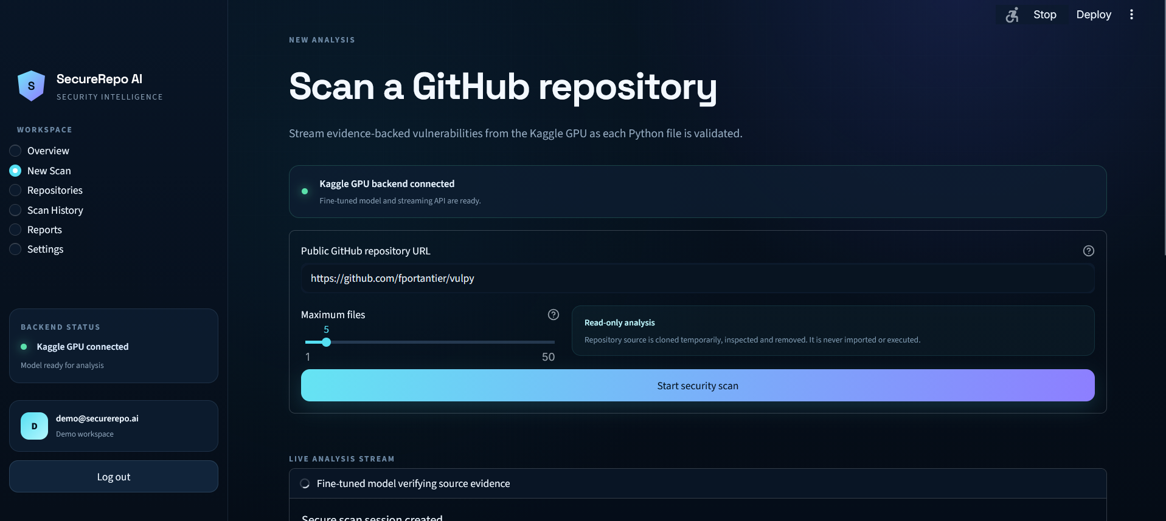
SECUREREPO AI / LIVE DEMO / START
TIPS HINDAWI CHALLENGE / 2026
THE USER EXPERIENCE
One URL starts a live, read-only review.
01
Paste a public GitHub URL
Direct repository links only.
02
Choose the review size
Select 1–50 Python files for model review.
03
Watch progress stream live
Scanner clues and AI-supported findings arrive as events.
KAGGLE GPU BACKEND CONNECTED
AI-SUPPORTED SECURITY REVIEW
05
Notes:
The front end stays intentionally simple. I paste a public GitHub repository URL, choose how many Python files to review, and start the scan. The local Streamlit app sends the request to the Kaggle backend. Bandit runs first, then newline-delimited events stream back live, so the user can follow progress rather than waiting on a blank page.
[Sources]
- /workspace/scratch/f15a04397186/assets/screenshots/03-new-repository-scan.png
- /workspace/scratch/f15a04397186/SecureRepo_AI_Backend_Only.ipynb
- /workspace/scratch/f15a04397186/securerepo_frontend/app.py
[/Sources]

Slide 6
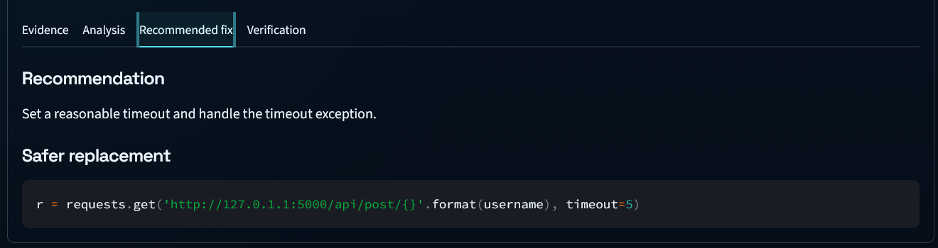
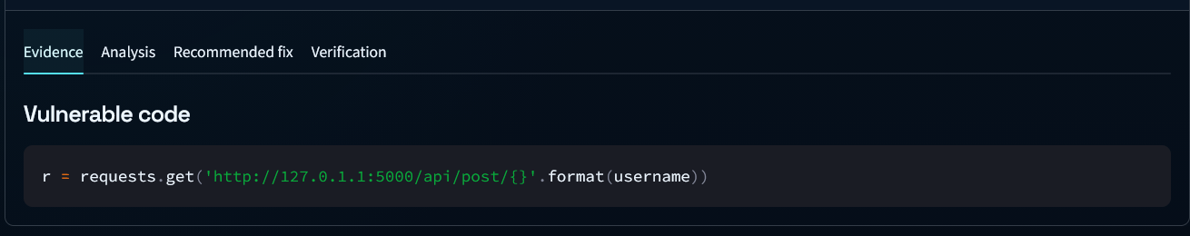
SECUREREPO AI / LIVE DEMO / FINDING
TIPS HINDAWI CHALLENGE / 2026
EVIDENCE-FIRST OUTPUT
Evidence stays attached to every fix.
EVIDENCE → ANALYSIS → RECOMMENDED FIX → VERIFICATION
01 / VULNERABLE EVIDENCE
02 / REVIEWABLE REMEDIATION
→
r = requests.get(url.format(username))
r = requests.get(url.format(username), timeout=5)
The vulnerable expression remains visible beside the finding.
The safer replacement remains ready for human review.
AI-SUPPORTED SECURITY REVIEW
06
Notes:
This is where the product becomes actionable. The finding keeps the exact file, line range, and vulnerable code visible, so the output stays tied to evidence. The model then explains the impact and proposes safer replacement code. The developer can move through evidence, analysis, the recommended fix, and verification without losing the source context that created the finding.
[Sources]
- /workspace/scratch/f15a04397186/assets/screenshots/04-live-vulnerability-evidence.png
- /workspace/scratch/f15a04397186/assets/screenshots/06-recommended-fix.png
- /workspace/scratch/f15a04397186/securerepo_frontend/app.py
[/Sources]

Slide 7
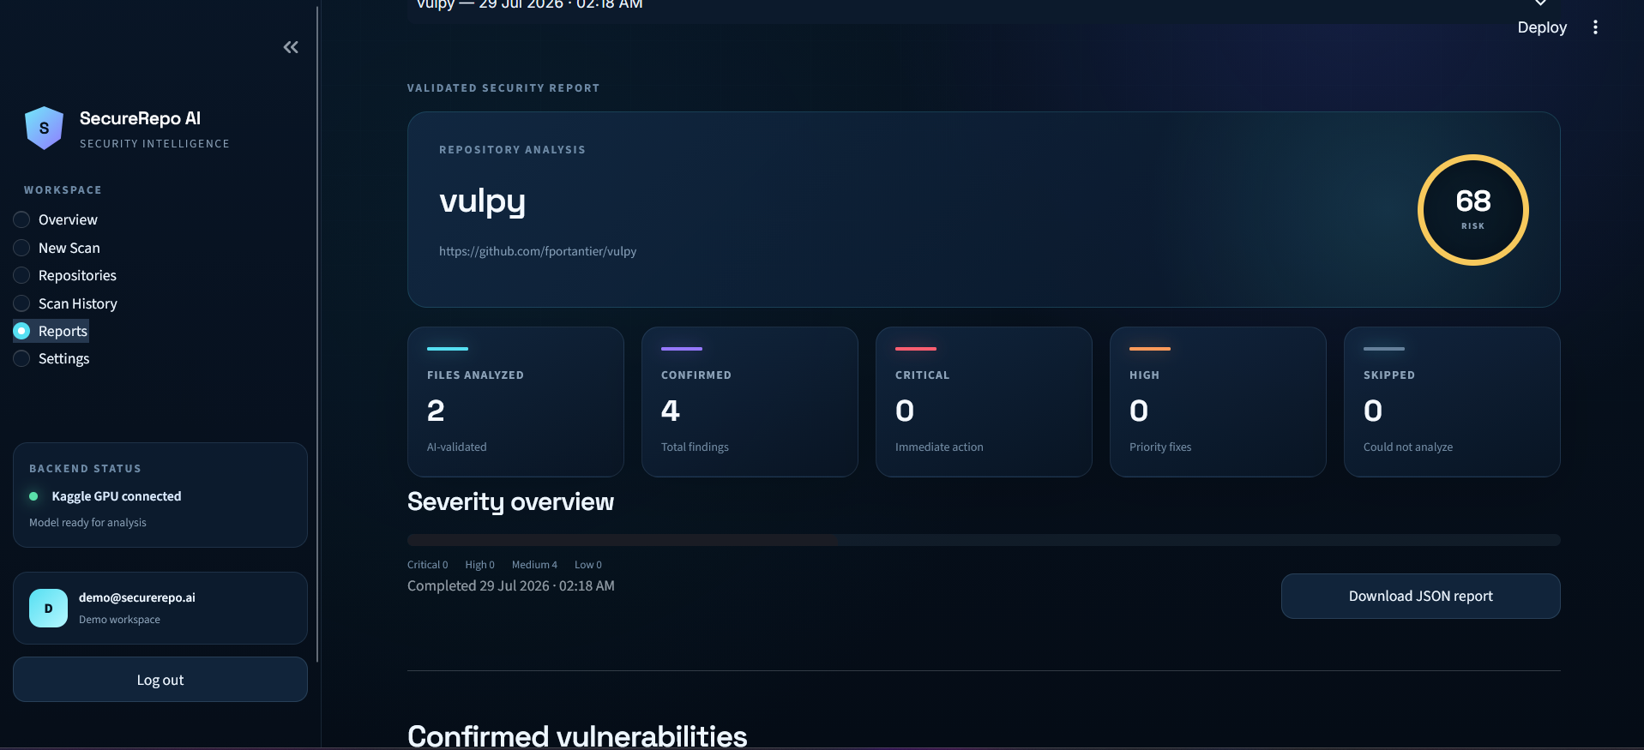
SECUREREPO AI / LIVE DEMO / REPORT
TIPS HINDAWI CHALLENGE / 2026
REUSABLE OUTPUT
One scan becomes a reusable security report.
WHAT THE USER KEEPS
01
Repository risk summary
02
AI-supported findings with evidence
03
Local scan history
04
Downloadable JSON output
PYDANTIC VALIDATES STRUCTURE—NOT FACTUAL TRUTH.
AI-SUPPORTED SECURITY REVIEW
07
Notes:
The completed view aggregates the reviewed files into one report. It shows the repository risk score, files analyzed, severity summary, and AI-supported findings with their evidence and proposed remediation. Reports are stored locally and can be exported as JSON. I describe the result as schema-validated: Pydantic checks that the required fields and types are present, but it does not prove that every finding is objectively true.
[Sources]
- /workspace/scratch/f15a04397186/assets/screenshots/11-validated-security-report.png
- /workspace/scratch/f15a04397186/securerepo_frontend/app.py
- /workspace/scratch/f15a04397186/README.md
[/Sources]

Slide 8
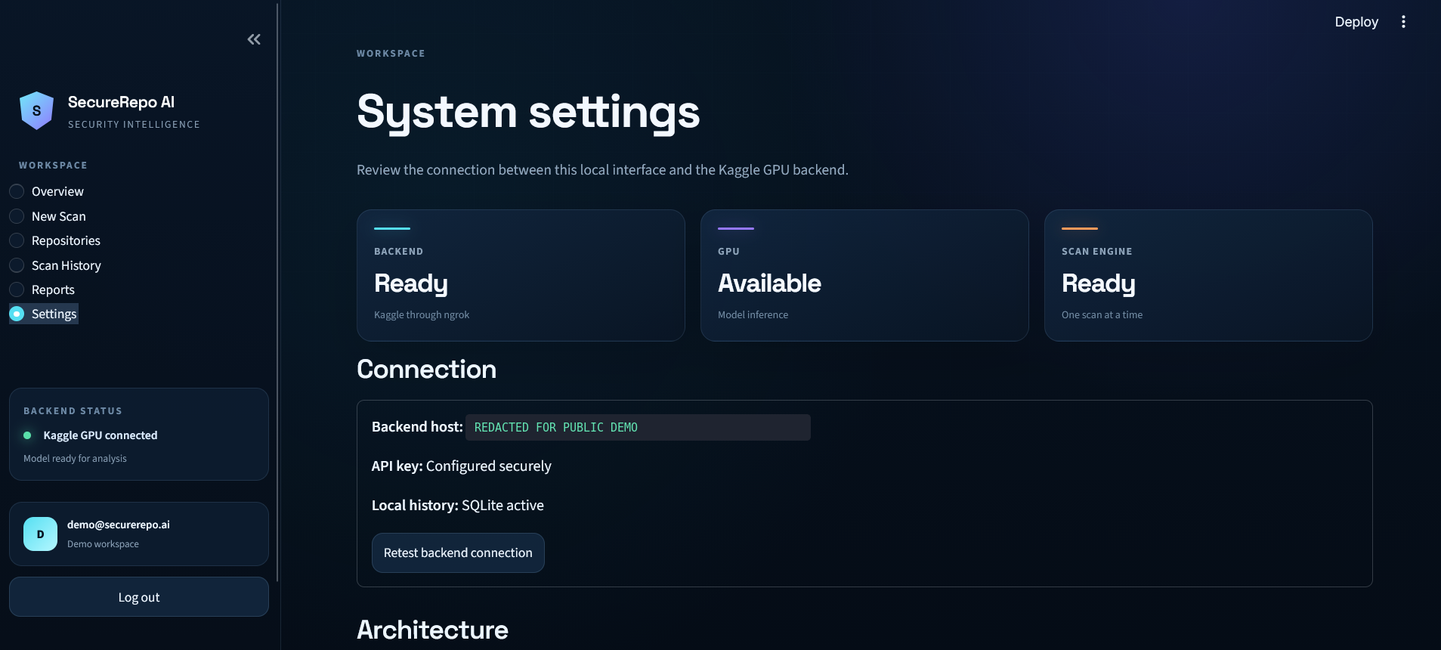
SECUREREPO AI / CLOSING
TIPS HINDAWI CHALLENGE / 2026
RESPONSIBLE BY DESIGN
Review sooner.
Keep humans in the
loop.
SecureRepo AI is a first-pass reviewer—not a final verdict.
NEXT
Formal benchmark · more languages
private repositories · permanent deployment
github.com/AminTariq/SecureRepo-AI
AI-SUPPORTED SECURITY REVIEW
08
Notes:
SecureRepo AI is a working end-to-end prototype, but the claim stays deliberately limited. It is a first-pass review and learning tool—not a professional audit or proof that a repository is secure. The next steps are a formal benchmark, support for more languages and private repositories, and a permanent backend. The principle is simple: review sooner, and keep human security judgment in the loop.
[Sources]
- /workspace/scratch/f15a04397186/README.md
- /workspace/scratch/f15a04397186/SecureRepo_AI_Dataset/dataset_card.md
- /workspace/scratch/f15a04397186/assets/screenshots/12-system-settings.png
- https://github.com/AminTariq/SecureRepo-AI
[/Sources]

