Slide 1
MODULE-4

Slide 2
Cyberspace
Cyberspace refers to the virtual computer world and more specifically, an electronic medium that is used to facilitate online communication.
With the advancement and popularity of e-commerce and e-business, it has become important for companies and organizations to protect their intellectual property rights online.
These days cyber crimes are not only limited to committing fraud and identity thefts but extend to copyrights and trademarks infringement as well.

Slide 3
Cyberspace
Intellectual property owners must be aware of new forms of intellectual property infringement. These include
Linking
“Linking” allows a website user to visit another website on the Internet without leaving that particular website.
For example, A makes a homepage for his website, and on the homepage he places some advertisements, from which he can make some money and it contains links to various subordinate pages. Then, B creates his website, which contains links to A’s subordinate pages. This is called deep linking. Because of this, the website visitors to B’s site will be able to gain access to A’s material, without even visiting or seeing A’s advertisements.

Slide 4
Cyberspace
2. Framing
Framing is a method of splitting one window into two or more screens. A web page can be inserted into a frame, and that portion of the screen will remain static as a user moves through other web pages. This method is called "framing," because it allows a webmaster to send an individual through numerous web pages while retaining the appearance and the utility of the frame inserted. Web browsers allow web authors to divide pages into “frames”. A frame is an independently controllable window on a website through which pages from another website can be viewed. Since it is possible for a site to call a frame’s contents from a different location, a programmer might frame another’s web content beneath his own navigation or banners. This allows him to use creative content owned by another entity to sell banner advertising on its on site. A typical use of frames is to have one frame containing a selection menu and another frame that contains the space where the selected (linked to) files appear.
Example: John starts a site devoted to auto racing news called John’s RacingVision. He offers a number of links to racing industry Web magazines like Autosport, whose content he displays within a frame on his site. When users click on “Read Autosport News,” for example, the content from the Autosport site is displayed within John’s RacingVision website, in a frame. When the user reads Autosport’s news, the user’s computer is still connected to John’s website, not Autosport’s.

Slide 5
Cyberspace
3. Meta-tagging
Meta tagging is a technique in which a word is inserted in the keywords field of the site in order to increase the chances of a search engine returning the site, even though the site may have nothing to do with the word which was inserted. Trademark infringement occurs when companies include in their own websites meta tags containing the names or descriptions of other companies. For example, Coca Cola used the keyword “Pepsi” in its meta tags, now the web surfers who used search engines in order to obtain information about Pepsi would be directed to Coca Cola’s web site due to these meta tags.

Slide 6
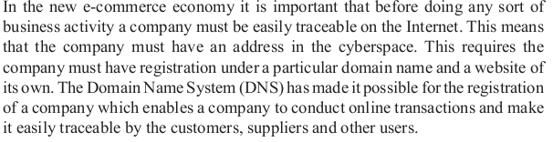

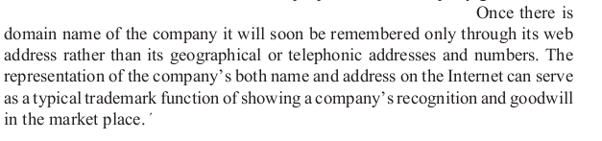
Relevance of domain names in IPR

Slide 7
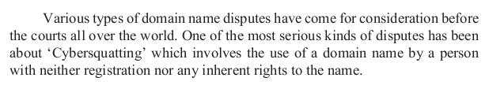
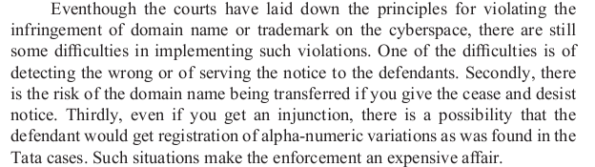
Deception by Squatting in Cyberspace

Slide 8
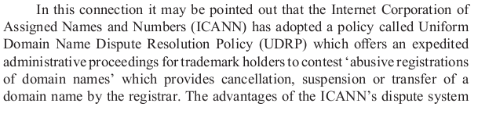

Deception by Squatting in Cyberspace

Slide 9
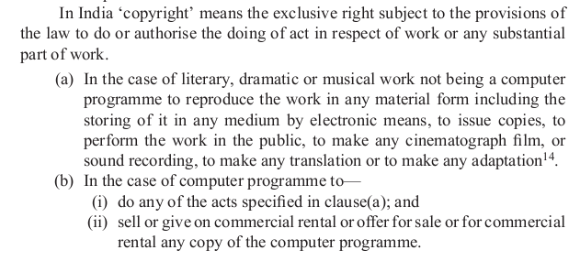
Protection of copyright in Cyberspace

Slide 10
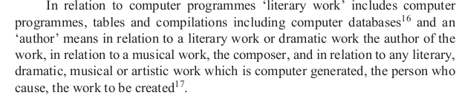
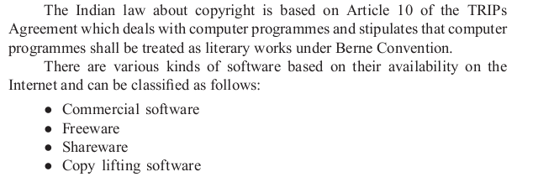
Protection of copyright in Cyberspace

Slide 11

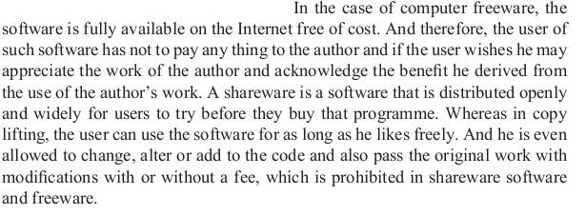
Protection of copyright in Cyberspace

