Slide 1
Module 2 Software Copyright

Slide 2
Syllabus
Software Copyright–Introduction – Need of software copyright – classification of software according to copyright
–software auditing –copyright notice – transfer of copyright.

Slide 3
SOFTWARE COPYRIGHT-INTRODUCTION
Affects anyone using a computer and most particularly businesses.
Primary source is – Copyright, Designs and Patents Act 1988.
Terms: Software, hardware, source code, object code
Software copyright is similar to any other sort of copyright. But different in certain aspects.
Copyright law gives a programmer a high degree of control over the program they creates.
The permission of the rights owner is necessary to run the program
Permission is necessary for ‘copying’.

Slide 4
Software piracy is the known name for the copyright violation or Infringement of original software. It is nothing but the reproduction, copying of someone’s original work without their consent in an unauthorized manner.
examples of software infringement:
Downloading the software or programs from the internet is a typical example of Infringement. Third parties upload the software on the internet for free or at very few charges.
End-user piracy. The end-users, utilizing the unlicensed software on their systems are the violators.
Many times, the computer dealers pre-install software on the systems even before the sale. Also, some dealers use one licenced copy of the software for many systems. This is also a form of copyright infringement.
The sale of illegal duplicate copies of software is the most common violation of copyright.

Slide 5
In a broad sense, software or programs are the set of instructions given to the computer to perform certain operations. The process falls under the category of literary work.
As per The Indian Copyright Act, 1957, section 2 (O), you can protect your work of the software coding and programming from reproducing, copying, translating, or adapting. It is the Intellectual Property Right in India.
All the graphics, audio, videos, and coding used in the software are protected under the act.
The Indian Copyright Act protects the owner’s (of software, program) economic and moral rights by providing validation, ownership, and royalties for the developed software.
As per the act if anyone copies the original work without the owner’s permission, then the Registrar of copyrights has authority to send the notice of Infringement and further legal action is taken against the violator.

Slide 6
However, the following activities do not constitute software copyright infringement,
Making backup copies by the owner of software/program as a safety measure against loss or damage.
Creating software copies for personal use only.
To study the information and future scope of the software (intimating owner).
To test the feasibility, functionality of the software.

Slide 7
Need of software copyright
If someone infringes on your copyright.Then, suddenly, the protection is no longer automatic. It’s up to you to file a lawsuit in federal court and to convince the judge to order the other party to stop the infringement and compensate you for your losses.
But you can’t file a law suit unless you have registered the copyright with the copyright office
If you want to register in a hurry, when an infringement occurs , then you have to pay extra for the registration.
If you register the work before the infringement occurs or within three months of the date of work is published, you can recover standard damages in addition to actual damages like attorney fees, court costs and statutory damages.

Slide 8
Classification of Software according to copyright
4 broad classifications
Commercial
Shareware
Freeware
Public Domain

Slide 9
Commercial Software
These software are like windows, Mac which can be purchased to use.
It is a type of software that can be used in one computer.
User is not allowed to sell it or rent it or modify it.
They possess license.
2. Shareware Software
Shareware is a type of proprietary software which is initially shared by owner for trial use at little or no cost with usually limited functionality or incomplete documentation but which can be upgraded upon payment.
This is a software which are available for short term (trial version) but if you need for long term you have to buy license.
3. Freeware Software
It is a software which is available freely
This means one can get the license for this software without paying.
Code is made free for use
4. Public domain
It is a type of software in which no copyright law is applied.
They do not have license.
One can get it from websites or some software seller without any license agreement.
One can copy, resell and give rent to this software.
No restriction is applied to this type of software.

Slide 10
Software Auditing
Audit means an independent examination of a software product or processes to assess compliance with specifications, standards, contractual agreements, or other criteria.
A software audit consist of taking stock of all software used by the business, examin ing the license terms of the software and ensuring that the business is in compliance.
The terminology, Audit in the field of software can relate to any of the following:
A software Quality Assurance, where the software is audited for quality
A software licensing audit, where a user of software is audited for licence compliance
A Physical Configuration Audit (PCA) is the formal examination to verify the configuration item's product baseline
Objectives of Audit:
The aim of a conducting software audit is to provide an independent evaluation of the software products and processes to applicable standards, guidelines, plans, and procedures against compliance.

Slide 11
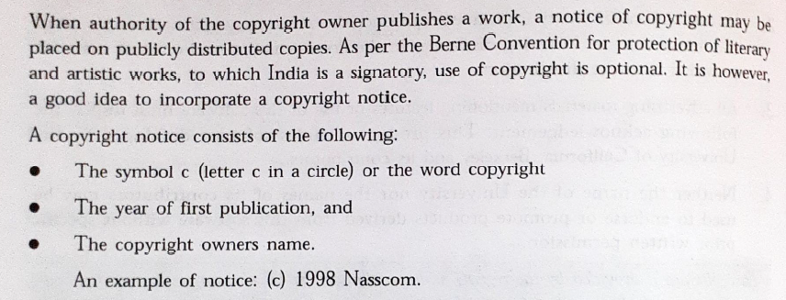
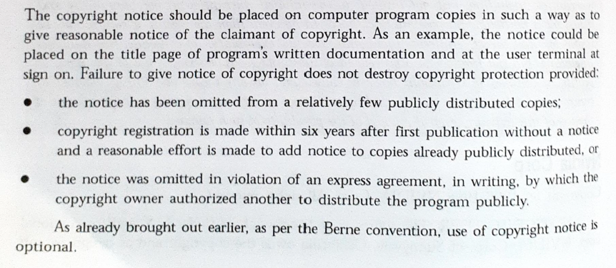
Copyright Notice

Slide 12
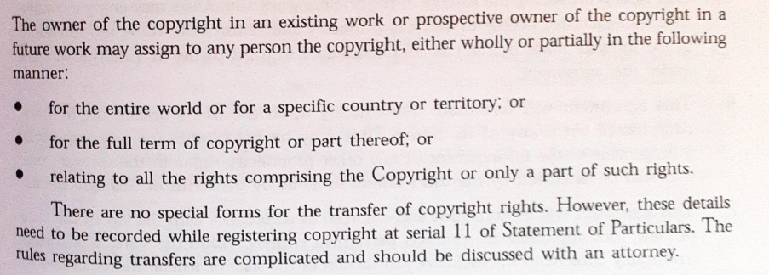
Transfer of Copyright

Slide 13
Copyright procedure
Registration Procedures for Filing Copyright
An application for copyright registration contains three essential elements: a completed application form, a nonrefundable filing fee, and a nonrefundable deposit—that is, a copy or copies of the work being registered and “deposited” with the Copyright Office.
A copyright registration is effective on the date the Copyright Office receives all required elements in acceptable form, regardless of how long it takes to process the application and mail the certificate of registration.
The time needed to process applications varies depending on the amount of material the office is receiving and the method of application.
Option for registering copyright software
Online Registration
Registration with Fill-In Form CO (copyright office)
Registration with Paper Forms

Slide 14
Requirements for Registration Of Copyright Software
Computer Programs without Trade Secrets
1. For published or unpublished computer programs, send one copy of identifying portions of the program (first 25 and last
25 pages of source code) reproduced in a form visually perceptible without the aid of a machine or device, either on paper or in microform, together with the page or equivalent unit containing the copyright notice.
For a program less than 50 pages in length, send a visually perceptible copy of the entire source code.
Where an applicant is unable or unwilling to deposit source code, he/she must state in writing that the work as deposited in object code contains copyrightable authorship.
The Office will then register the work under its rule of doubt since it has not determined the existence of copyrightable authorship.

Slide 15
4.When a computer program is embodied in a CD-ROM, ordinarily the entire CD-ROM package must be mailed to the Copyright Office, including a complete copy of any accompanying operating software and instructional manual.
If registration is sought for the computer program, the deposit should also include a printout of the first 25 and last 25 pages of source code for the program.
Computer Programs Containing Trade Secrets
First 25 and last 25 pages of source code with portions containing trade secrets blocked out; or
First 10 and last 10 pages of source code alone, with no blocked out portions; or
First 25 and last 25 pages of object code plus any 10 or more consecutive pages of source code, with no blocked-out portions; or
For programs 50 pages or less in length, entire source code with trade secret portions blocked out.

Slide 16
Whenever Portions Of Code Are Blocked Out, The Following Requirements Must Be Met:
the blocked out portions must be proportionately less than the material remaining; and
the visible portion must represent an appreciable amount of original computer code.
Effective Date of Registration
A copyright registration is effective on the date the Copyright Office receives all the required elements in acceptable form.
The time the Copyright Office requires to process an application varies, depending on the amount of material the Office is receiving.

