Slide 1
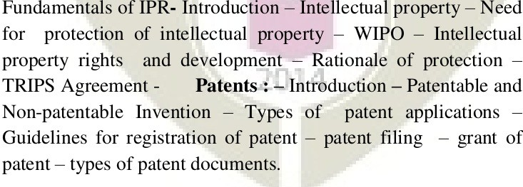
Module 1

Slide 2
Index
Introduction
Need for protection of intellectual property
Intellectual property
WIPO
Intellectual property rights and development
Rationale of protection
TRIPS Agreement

Slide 3
Introduction
▶ The most important feature of any property is that the proprietor or the owner may use the property as he wishes and that nobody else can lawfully use his property without his authorisation
▶ Generally speaking, there are three kinds of properties
Movable property
Immovable property
Intellectual property

Slide 4
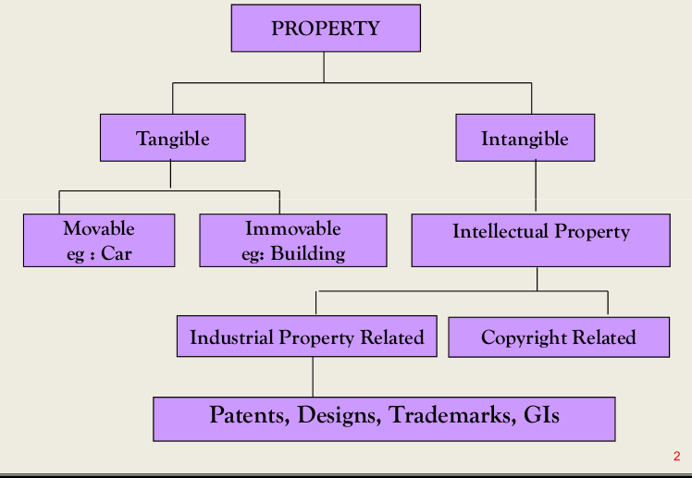
Introduction

Slide 5
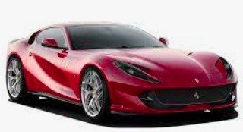
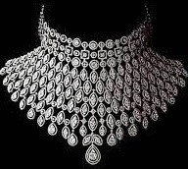

1) Movable Property
Property consisting of movable things such as a camera or a car, which no one except the owner of the camera or car may use these objects
This is legal situation, which is called an exclusive right, belonging to the owner, to use his own property
▶
▶
▶
Naturally, the owner is free to authorize others to use his property
Such authorisation is legally necessary and use without the owner's authorisation would be illegal
▶

Slide 6
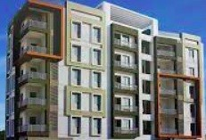


2) Immovable Property
Immovable property includes land and building, which is permanently fixed
▶
▶
Certain limits exist in exercising the right
For example, the owner of a piece of land is not always free to construct a building of whatever dimensions he wishes, but must respect the applicable legal requirements and administrative formalities while constructing a building on the piece of the land
▶

Slide 7
3) Intellectual Property
▶ Intellectual property is the creation of the human mind, the human intellect and hence called "intellectual property“
▶ Intellectual property is an asset and, as such, it can be bought. sold, mortgaged, licensed, exchanged or given away like any other form of the property
▶ Further, by acquiring a legal right over the property, the creator of the intellectual property seeks to ensure that he has exclusive right over it and that the property can be put to use by others only with his consent
▶ Ownership of IPR is a source of national wealth and mark of an economic leadership in the context of the global market scenario

Slide 8


Intellectual property (IP) refers to creations of the mind: inventions, literary and artistic works, and symbols, names, images, and designs used in commerce.

Slide 9

Creativity is the ability to
Think / come up with new idea design new “inventions” produce “works of art”
solve problems in new ways, or develop a new idea based on an “original” knowledge.
novel, or unconventional approach.
➢
➢
➢
➢

Slide 10

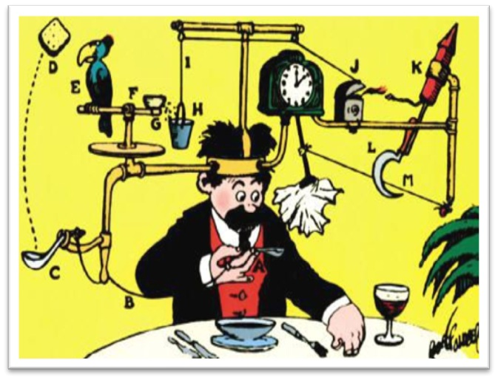

Think Away From The Box

Slide 11
Intellectual property description for the
IPR
is a broad categorical set of intangible assets
owned and legally protected by a company or individual from outside use or implementation without consent.
An intangible asset is a non-physical asset that a company or person owns.

Slide 12
IPR
●
Intellectual property is an umbrella term for a set of intangible assets or assets that are not physical in nature.
Intellectual property is owned and legally protected by a person or company from outside use or implementation without consent.
Intellectual property can consist of many types of assets, including trademarks, patents, and copyrights.
Intellectual property infringement occurs when a third party engages in the unauthorized use of the asset.
Legal protections for most intellectual property expire after some time; however, for some (e.g., trademarks), they last forever.
●
●
●
●

Slide 13
Need for protection of intellectual property
▶ Any property has to be protected in order to save it from an unauthorized use
▶ Similarly, Intellectual Property Rights also need to be protected from infringement
▶ The rationale for protection of IPR are IPRs relates to new ideas, new technology, new products and evolution of knowledge

Slide 14
Need for protection of intellectual property
To provide an incentive to individuals for new creations
▶ To accord(grant/give) due recognition to the creators and inventors
▶ To ensure material reward for intellectual property
▶ To make available genuine and original products

Slide 15
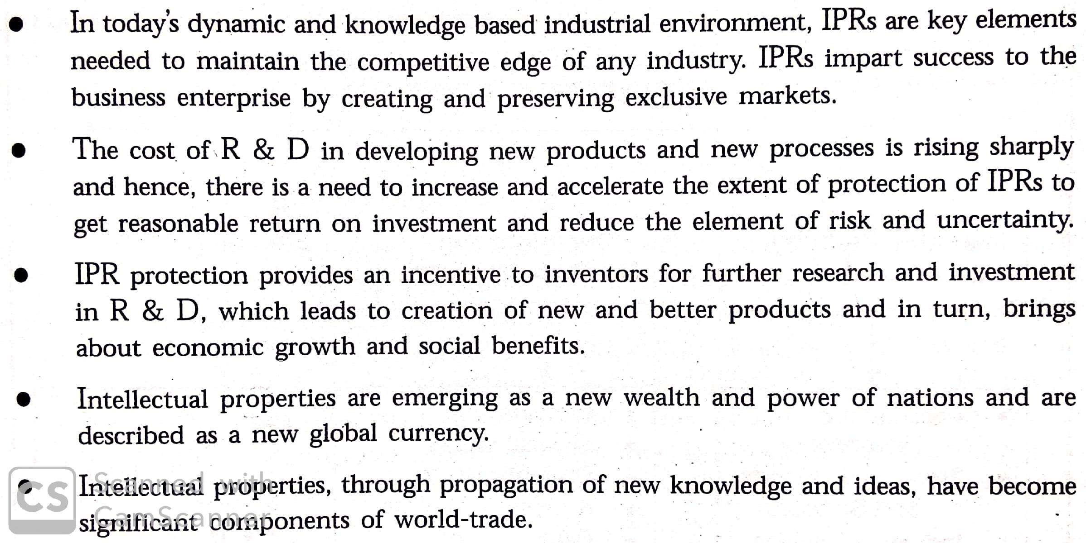
Need for protection of intellectual property

Slide 16
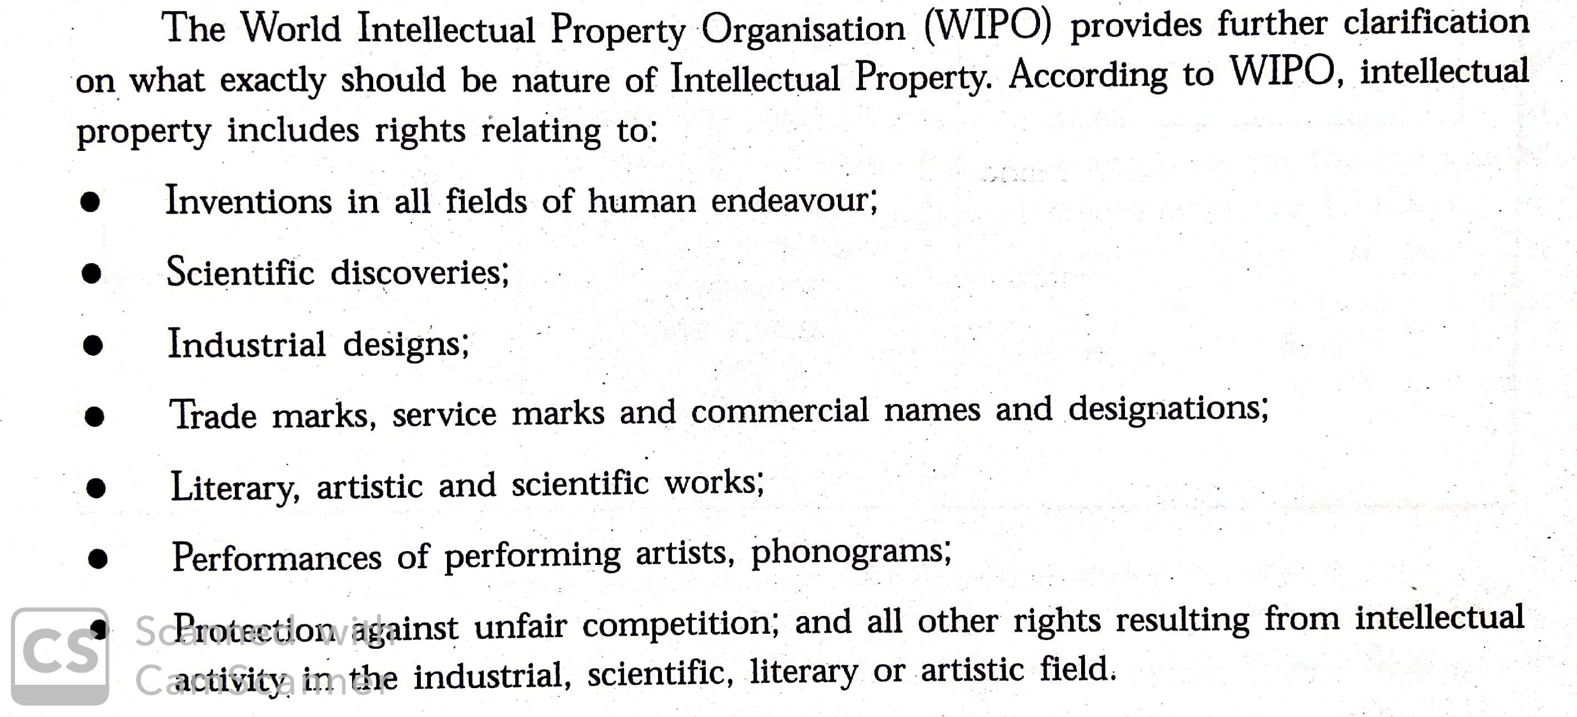

Slide 17
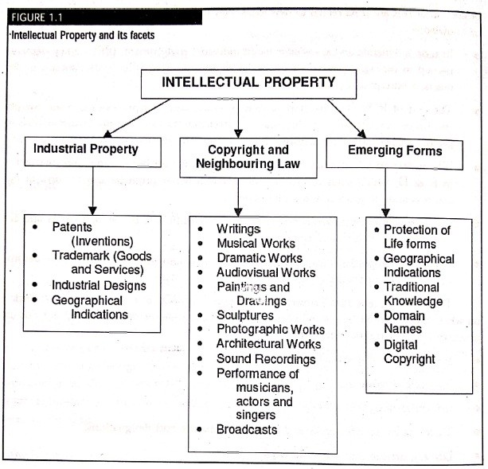
Intellectual property facets (types)

Slide 18
I. Industrial Property
▶
Industrial property can be classified as,
Patents (Inventions)
Trademarks (Goods and services)
Industrial designs
Geographical indications

Slide 19

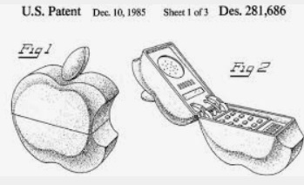
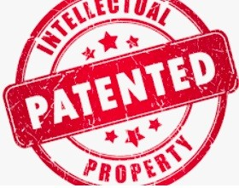
1) Patents (Inventions)
It means a grant of some privilege, property or authority made by government or the sovereign authority of the country to one or more individuals
▶
A patent is a monopoly right to the exclusive use of an invention, granted to the inventor
▶
This right is granted only for a limited period called the term of the patent
▶

Slide 20
The inventor has to apply for a patent for the invention to the patent office along with his application disclosing the complete invention in the form of complete specification
This complete specification is published by the patent office immediately on deciding that a patent may be granted
▶
▶
The purpose of this system is to encourage Inventions by promoting their protection and utilization so as to contribute to the development of industries, which in turn provides better facilities to the society
▶
Once published, the copy of the patent specification is available for inspection for the general public
▶

Slide 21


2) Trademarks (Goods and services)
A trademark as such is a property, which is also termed as industrial property
▶
One make of soap should be distinguishable from another make, one hair oil is to be distinguished from another and so on
▶
A manufacturer wants his goods to be distinctively identified to assume and assure quality, utility, price
▶
For that identification he desires that the goods should be branded by a brand name by a word mark in the form of a label
▶
▶
A trademark is a visual symbol in the form of a word or a label

Slide 22
A trademark is a visual representation attached to goods for the purpose of Indicating their trade origin
▶
➢
Indicates the origin of goods and services
A visual symbol such as a Word, Name, Logo, Label,Monogram, Slogan etc
Illustrative examples of trademarks are KODAK, for photographic goods, APPLE for computers, WILLS for cigarettes
➢
▶
Where a trademark is used as in connection with services, it may be called service mark
▶
For example, hotels, restaurants, airlines, tourist agencies, laundries and cleaners use service marks
▶

Slide 23
3) Industrial designs
▶
An Industrial design is an outcome of inventive activity External features apealing to eye
Initially mentally conceived and then put on a drawing board, followed by the mechanics of giving a concrete shape to the basic new idea in the design
Then finally contriving a method for mass manufacturing the same, to put forth a product in the market for the benefit of the consumer
As a general rule, to be able to be registered a design must meet one or more of the following basic requirements, depending on the law of the country the design must be new, original and have Individual character
▶
▶
▶
▶

Slide 24
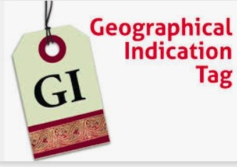
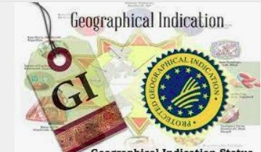
4) Geographical indications
▶
Qualities and characteristics of certain goods attributable to some
geographical locations and reputable to “as produce of certain region” come under Geographical Indications
Identifies agricultural, natural or manufactured goodsoriginating
from a definite territory in India
▶
For example - Darjeeling Tea, Alfanso Mangoes, Nagpur Santras,
China silk, Dhaka muslin, Venetian glass, Coramandal pearls etc.

Slide 25

II. Copyright and Neighbouring Rights
Copyright as defined in the Oxford English Dictionary, is an exclusive right granted by law for a certain term of years to an author, composer, etc. to print. publish and sell copies of his original work
▶
Copyright Act generally gives the owner of copyright the exclusive right to do and to authorize others to reproduce the work in copies
▶
Eg :- Musical, dramatic, choreographic works, audiovisual works etc.
▶

Slide 26
Copyright protects "original works of authorship"
Copyrightable works include literary works,
▶
▶
musical
works,
dramatic works, choreographic works, pictorial, graphic, and sculptural works, motion pictures and other audiovisual works;, sound recordings and architectural works
Copyright protects all creations of the human mind whatever their form or merit and regardless of the audience they are destined for
▶
Neighbouring rights (rights neighbouring to copyright) were created for three categories of people who are not technically authors: performing artists, producers of phonogrammes, and those involved in radio and television broadcasting
▶

Slide 27
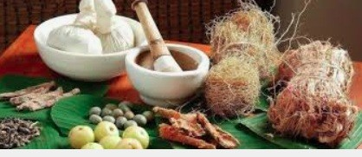


III.Emerging Forms
xxxxxxxxxxxx
Traditional Knowledge
Traditional Knowledge Digital Library
Digital Copyright
Domain Name

Slide 28
1) Traditional Knowledge
▶
TK Generally refer to the matured longstanding traditions and practices of certain regional, Indigenous or local communities
It also encompasses the wisdom, knowledge, and teachings of these communities
Some forms of traditional knowledge are expressed through stories, legends, folklore, rituals, songs and even laws
Recently, international attention has turned to intellectual property laws to preserve, protect and promote their traditional knowledge Three broad approaches to protect traditional knowledge have been developed
Protecting traditional knowledge as a form of cultural heritage
Protection of traditional knowledge as a collective human right
Taken by WTO and WIPO
▶
▶
▶
▶

Slide 29
2) Traditional Knowledge Digital Library
▶
TKDL is a collaborative project between National Institute of Science Communication and Information Resources (NISCAIR), Council of Scientific and Industrial Research, Ministry of Science & Technology and Department of AYUSH, Ministry of Health and Family Welfare, which is being implemented at NISCAIR
An inter-disciplinary team of Traditional Medicine (Ayurveda, Unani, Siddha. Yoga) experts, patent examiners, IT experts, scientists and technical officers are involved in creation of TKDL for Indian Systems of Medicine
▶

Slide 30
The project TKDL involves documentation of the knowledge available in public domain on traditional knowledge from the
▶
existing literature related to Ayurveda, Unani and Siddha in digitized format in five international languages, which are English, German, French, Japanese and Spanish
Traditional innovative systematic
Knowledge Resource Classification (TKRC), an
of to
▶
structured classification system for the arrangement, dissemination and retrieval
purpose related
medicinal plants

Slide 31


3) Digital Copyright
▶
Over the centuries copyright law - originally tailored to the technology of print
Now it is yet again challenged by the advance of digital technologies These represent something completely new in respect of the fact that they allow the entire information (text, sound and visual) to be
generated, altered and used by and on one and the same device irrespective of whether it is provided online or offline
As a result, creators of Intellectual property are afraid of an increase in the unlawful reproduction of works
Also Internet service providers (ISP) a well as private and public (libraries, archives etc.) content providers are confronted with a variety of problems
▶
▶
▶
▶

Slide 32

4) Domain Name
The domain name in the online world, just like the trade name in the offline world, serves to identify the goods/services provided by the company
▶
▶
To access a website, one requires a web address
This web address comprises of domain names
As the number of internet users increased, the importance of domain name also increased
One of the primary areas is domain names, which has been legal protection equal to that of a trademark
▶
▶
▶

Slide 33

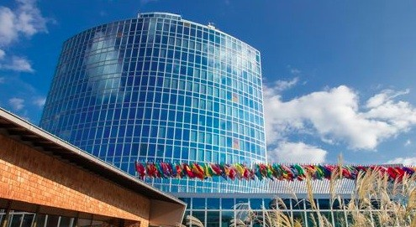
WIPO

Slide 34
WIPO (World Intellectual Property Organization)
▶ International organization (UN) dedicated to promoting the use and protection of works of the human spirit
▶ These work - Intellectual property - are expanding the bounds of science and technology and enriching the world of the arts
Headquarters in Geneva, Switzerland
193 countires as member states
▶ WIPO plays an important role in enhancing the quality as well as creating real wealth for nations
Manages all IPs.
Training through Academy

Slide 35
▶ Core Activities of WIPO
Development of international IP laws and standards
This includes development of international laws and treaties regarding patents, trademarks, industrial designs, geographical indications and copyright and related rights
WIPO is also working with member states (193 countries) to explore IP issues in the area of traditional knowledge, traditional cultural expressions and genetic resources
WIPO handles the administration of 26 international treaties (16+ on industrial property, 7+ on copyright)

Slide 36
2) Delivering global IP protection services
WIPO administers fee-based services, agreements
based on international
Which enable users in
member countries to file (PCT), and international
international registrations
applications for patents
fortrademarks (Madrid System), designs (Hague System), and
appellations of origin (Lisbon System)
WIPO administers four IP classification systems, which organize the mass of information concering, inventions, trademarks, and industrial designs into indexed, manageable structures for easy retrieval
WIPO’s Arbitration and Mediation Center offers dispute resolution services to business and indiviauals , including domain name disputes

Slide 37
3) Encouraging the use of IP for economic development
WIPO runs a range of programmes aimed at increasing the effective use of IP by developing nations as a tool for economic development
Programmes include,
Technical assistance in support of member countries initiatives to improve their IP legislative
Institutional and human resources framework
Strategies for innovation promotion and IP exploitation
Economic studies and material to inform public policy choices

Slide 38
Intellectual property rights and development
▶
Intellectual property shall include the rights relating to
Literary, artistic and scientific works;
Performances of performing artists, phonograms, and broadcasts;
Inventions in all fields of human endeavour, scientific discoveries; industrial designs;
Trademarks, service marks and commercial names and designations;
Protection against unfair competition and all other rights resulting from internal activity in the industrial, scientific, literacy or artistic fields (World Intellectual Property Rights Treaties, n.d)

Slide 39
Rights
Two Kinds of Rights
Moral Rights
To protect personality of author
Economic Rights
To bring economic benefits
●
CUTS Training Programme 14 Jul 11
54
54

Slide 40
Rationale of protection
▶
Like movable and immovable properties intellectual property is also the result of effort by one or more human beings
Therefore, like the producers of the two other forms of property, the creators of intellectual property also have the right to insist on payment for the product of their labour or for the labour itself
▶
▶
Remuneration for creation of intellectual property became economically significant when cheap, multiple copies of a work could be made
It made sense for the creator to be rewarded for his/her intellectual effort and be protected from potential free riders
▶

Slide 41
TRIPS
The TRIPS
Intellectual
(Trade Property
Related Rights)
Aspects of Agreement
came into being with the establishment of the WTO (World Trade Organization) effective from 1st January, 1995.
It was concluded during Uruguay Round of negotions in 1994

Slide 42

❖
TRIPS Agreement
The TRIPS (Trade-Related Aspects of Intellectual Property Rights) Agreement in the Intellectual Property (IP) universe
●
●
Three main Features
Standards Enforcement Dispute settlement
−
−
−

Slide 43
TRIPS Agreement
TRIPS specified
minimum global standards for protecting and enforcing Intellectual Property
Rights(IPR) in all its forms.
While the agreements set out before 1995 did not lay down minimal global standards for patents, TRIPS prescribed this.
Therefore, all members should ensure that their IPR laws meet these minimum global standards pronounced in the TRIPS.
However, TRIPS also allows countries to make their laws with flexibility in their interests.

Slide 44
TRIPS Agreement Coverage
The IPRs covered under the TRIPS are given below:
Copyright and related rights (i.e., the rights of performers, producers of sound recordings and broadcasting organizations)
Trademarks including service marks
Geographical indications including appellations of origin

Slide 45
TRIPS Agreement Coverage
Industrial designs
Patents including protection of new varieties of plants.
Lay-out designs of integrated circuits and
Undisclosed information including Trade Secrets and Test data

Slide 46
TRIPS Agreement features
The TRIPS agreement has three key features:
a)standards:
Under TRIPS, each member country should
provide
minimum standards of protection to all items of the IPRs.
The Articles 2.1 and 9.1 of the TRIPS Agreement rely heavily on the Paris Convention for the Protection of Industrial Property (Paris Convention) and the Berne Convention for the Protection of Literary and Artistic Works (Berne Convention) for these purposes and hence TRIPS Agreement is also called as the “Berne and Paris-plus Agreement”.

Slide 47
TRIPS Agreement
b)Enforcement:
TRIPS lays down
certain general principles for
the
domestic procedures and remedies for
enforcement of the IPRS in member countries.
c)Dispute Settlement:
Members are expected to resolve their trade disputes under the TRIPS obligations subject to the WTO dispute settlement procedures. It was during the end of the uruguay round of talks under the General Agreement on Tariffs and Trade (GATT) in 1994 that the TRIPS Agreement was negotiated.

Slide 48
TRIPS Agreement
TRIPS was promoted by the developed nations led by the USA and supported by the European Union, Japan and other developed nations.
TRIPS was opposed by developing nations led by Korea and Brazil and supported by Thailand, India and Caribbean states.
TRIPS enabled the developed countries link international trade with IPRs for the first time globally.
Subsequently, the scope of the TRIPS Agreement was clarified in the Doha round of talks and was stated in the Doha declaration.

Slide 49
TRIPS Agreement
One of the major criticisms against TRIPS was that it will affect the public health programs.
African Governments had to spend huge sums of money for buying drugs to control AIDS as the IPR granted to such as patents worked against public cause such as this in Africa.
TRIPS allowed flexibility in the national laws of developing countries till 2005. In the case of least developed countries, this transition period was extended to 2013 and until 2013 for pharmaceutical patents which is also likely to be extended.

Slide 50
TRIPS Agreement
▶
It is an international legal agreement between all the member nations of the World Trade Organization (WTO)
The objective of the Agreement was to reduce distortions and impediments to international trade
To ensure that, while effective and adequate protection of Intellectual property rights is needed
Measures and procedures to enforce intellectual property rights do not themselves become barriers to legitimate trade
It concerning the availability, scope and use of Copyrights and Related Rights, Trademarks, Geographical Indications, Industrial Designs Patents, layout designs of Integrated Circuits. Protection of undisclosed infromation and control of Anti-competitive pratcices in conrtactual licences
▶
▶
▶
▶

