Slide 1
Should an AI Agent
Call a Tool, or Refuse?
3,491
33
2
Agent Tasks
Features
Classes
can_answer: 0 | 1
TA: Nagham Dawood
Amina Omari (212958755) · Ossama Ziadat (212608368)

Slide 2
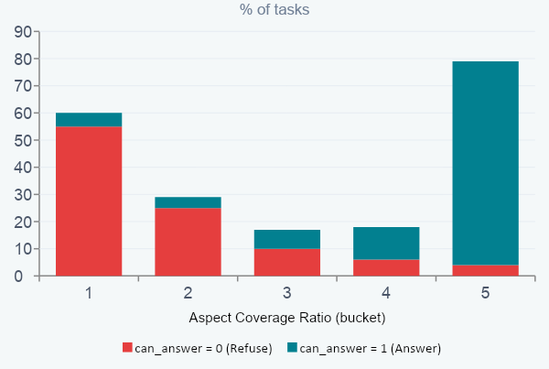
EDA Insight
Aspect Coverage Ratio Separates the Classes
Tasks that can be answered overwhelmingly have ratio near 1.0 — tools match the query topics.
Refusal tasks cluster at 0 — available tools are irrelevant to the query.
Strongest class separator observed in EDA, consistently top feature by importance.

Slide 3
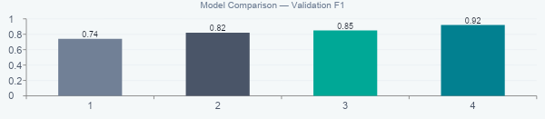
Best Classification Model
Random Forest — Test Set Results
89%
89%
95%
92%
Accuracy
Precision
Recall
F1-Score
0.8857
0.8924
0.9451
0.9180
Hyperparameters: n_estimators = 200 · max_depth = 20

Slide 4
Error Analysis
False Positives Are the Costliest Mistake
False Positive
False Negative
Predict CAN answer · Actually CANNOT
Predict CANNOT answer · Actually CAN
Agent calls a tool that cannot help
May perform harmful actions (e.g. send, book, delete)
Wastes resources and erodes user trust
Harder to recover from in production
Agent refuses a solvable request
User experience suffers — unhelpful AI
No harmful side-effect
User can rephrase and retry
Most Dangerous
Recoverable
Note: The deployed RF has precision 89% < recall 95% — it leans toward recall. A threshold adjustment can shift it toward higher precision (fewer FP) when a conservative production setting is required.

Slide 5
Clustering Insight
K-Means (k=4) — Four Natural Task Groups
C0
C1
C2
C3
Low-Coverage Mixed
Vision Outlier
Moderate-Match / Complex
High-Match / Answerable
Size
1,689
Size
4
Size
1,121
Size
677
Answer Rate
54%
Answer Rate
25%
Answer Rate
75%
Answer Rate
91%
Asp. Cover
0.009
Asp. Cover
0.10
Asp. Cover
0.31
Asp. Cover
0.85
Top Domain
other
Top Domain
vision
Top Domain
other
Top Domain
math
Complexity
low
Complexity
high
Complexity
high
Complexity
medium
Error Profile
TP + TN
Error Profile
TN (tiny)
Error Profile
Mostly TP
Error Profile
Mostly TP
Clustering method: K-Means · Optimal k selected by Silhouette score · Ward Hierarchical chosen k=2 (sil=0.38)

Slide 6
Final Recommendation & Limitation
Dataset Limitation · Suggested Improvement
Dataset Limitation
Suggested Improvement
The can_answer label is synthetically derived from benchmark construction rules — not from new human annotations. Models may learn patterns specific to the benchmark artifacts rather than truly generalising to real-world tool-use reasoning.
Replace strict keyword-based aspect matching with embedding-based cosine similarity between the query and tool descriptions. This would capture semantic equivalences (synonyms, paraphrases) that keyword rules miss, creating far richer and more robust features.
Best Model: Random Forest · Main Metric: F1 · Test F1: ~0.92 · Main Error: False Positives

