Slide 1
CSCI 5922 Neural Networks and Deep Learning: Learning 2
Mike Mozer
Department of Computer Science and Institute of Cognitive Science University of Colorado at Boulder
Notes:
position
audience

Slide 2
Review
Two learning rules
Hebbian learning regression
LMS (delta rule) regression

Slide 3
Limitations of Hebbian Learning
With Hebb learning rule, input patterns must be orthogonal to one another.
If input vector has α elements, then at most α arbitrary associations can be learned.

Slide 4
Limitations of Delta Rule (LMS Algorithm)
To guarantee learnability, input patterns must be linearly independent of one another.
Weaker constraint than orthogonality -> LMS is more powerful algorithm than Hebbian learning.
What’s the downside of LMS relative to Hebbian learning
If input vector has α elements, then at most α associations can be learned.

Slide 5
Exploiting Linear Dependence
For both Hebbian learning and LMS, more than α associations can be learned if one association is a linear combination of the others.
Note: x⁽³⁾ = x⁽¹⁾ + 2 x⁽²⁾ d⁽³⁾ = d⁽¹⁾ + 2 d⁽²⁾
Property of linear systems
example # | x₁ | x₂ | desired output
1 | .4 | .6 | -1
2 | -.6 | -.4 | +1
3 | -.8 | -.2 | +1

Slide 6

The Perils Of Linear Interpolation

Slide 7
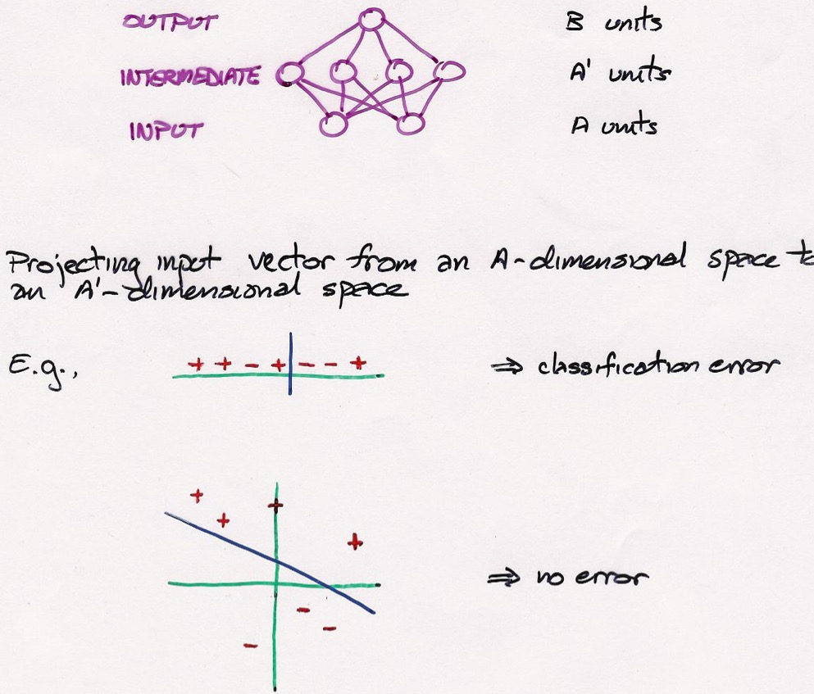
Adding a Layer of Intermediate or Hidden Units

Slide 8
Where We’re Going
Two learning rules for linear models
Hebbian learning regression
LMS (delta rule) regression
Nonlinear model
Perceptron learning rule classification

Slide 9
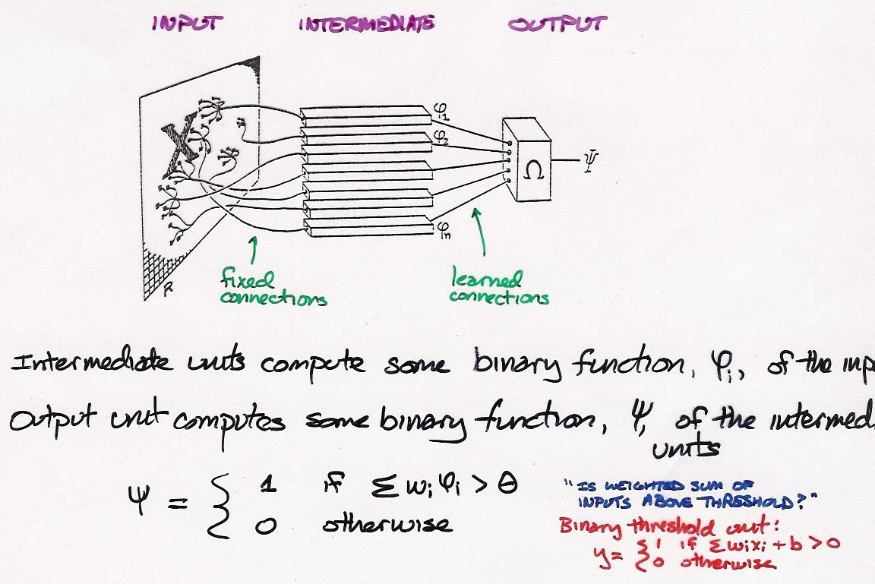
Perceptron Architecture

Slide 10
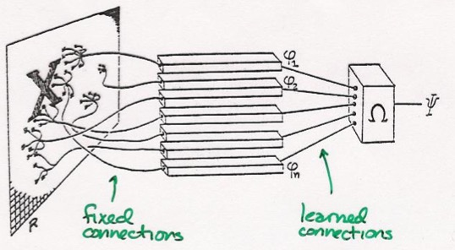
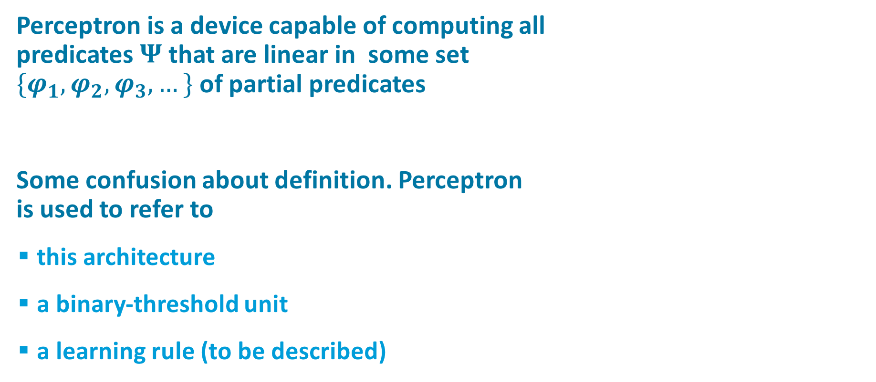
Perceptron
Perceptron is a device capable of computing all predicates $Ψ$ that are linear in some set $\{φ_{1},φ_{2},φ_{3}, …\}$ of partial predicates
Some confusion about definition. Perceptron is used to refer to
this architecture
a binary-threshold unit
a learning rule (to be described)

Slide 11
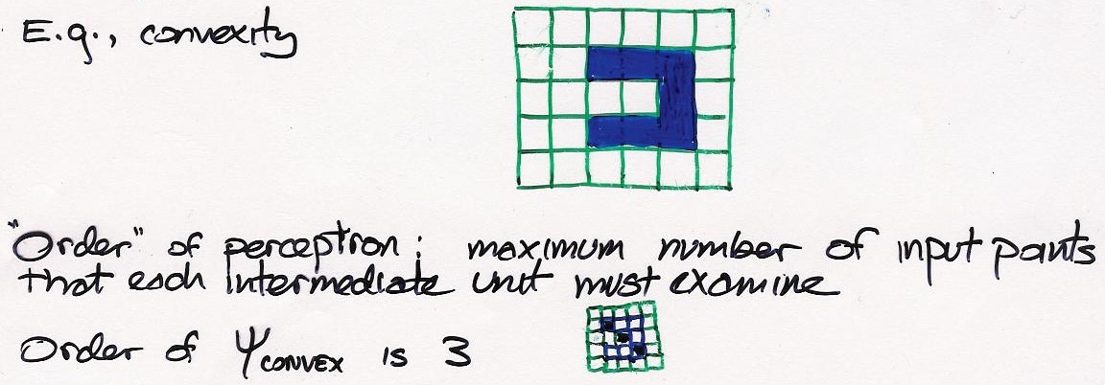
Computational Complexity Analysis of Perceptrons (Minsky & Papert, 1969)

Slide 12
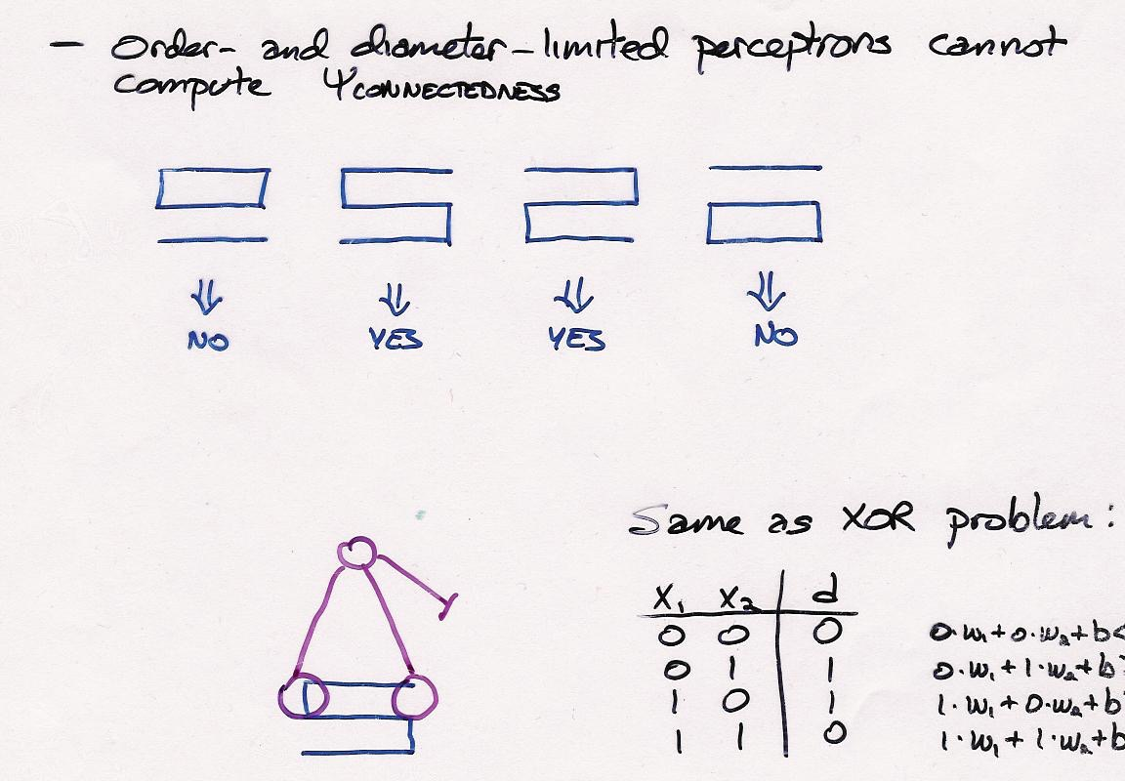
Limitations of Perceptrons (Minsky & Papert, 1969)
proof?

Slide 13
Limitations of Perceptrons
Perceptrons can solve low-order problems
i.e., function depends only on combination of a few input features
Higher-order problems result in a combinatorial explosion
require number of intermediate units exponential in # input features
A high order problem: translation-invariant object recognition
requires intermediate unit for every possible shape in every possible position/orientation/scale
A
A
A

Slide 14





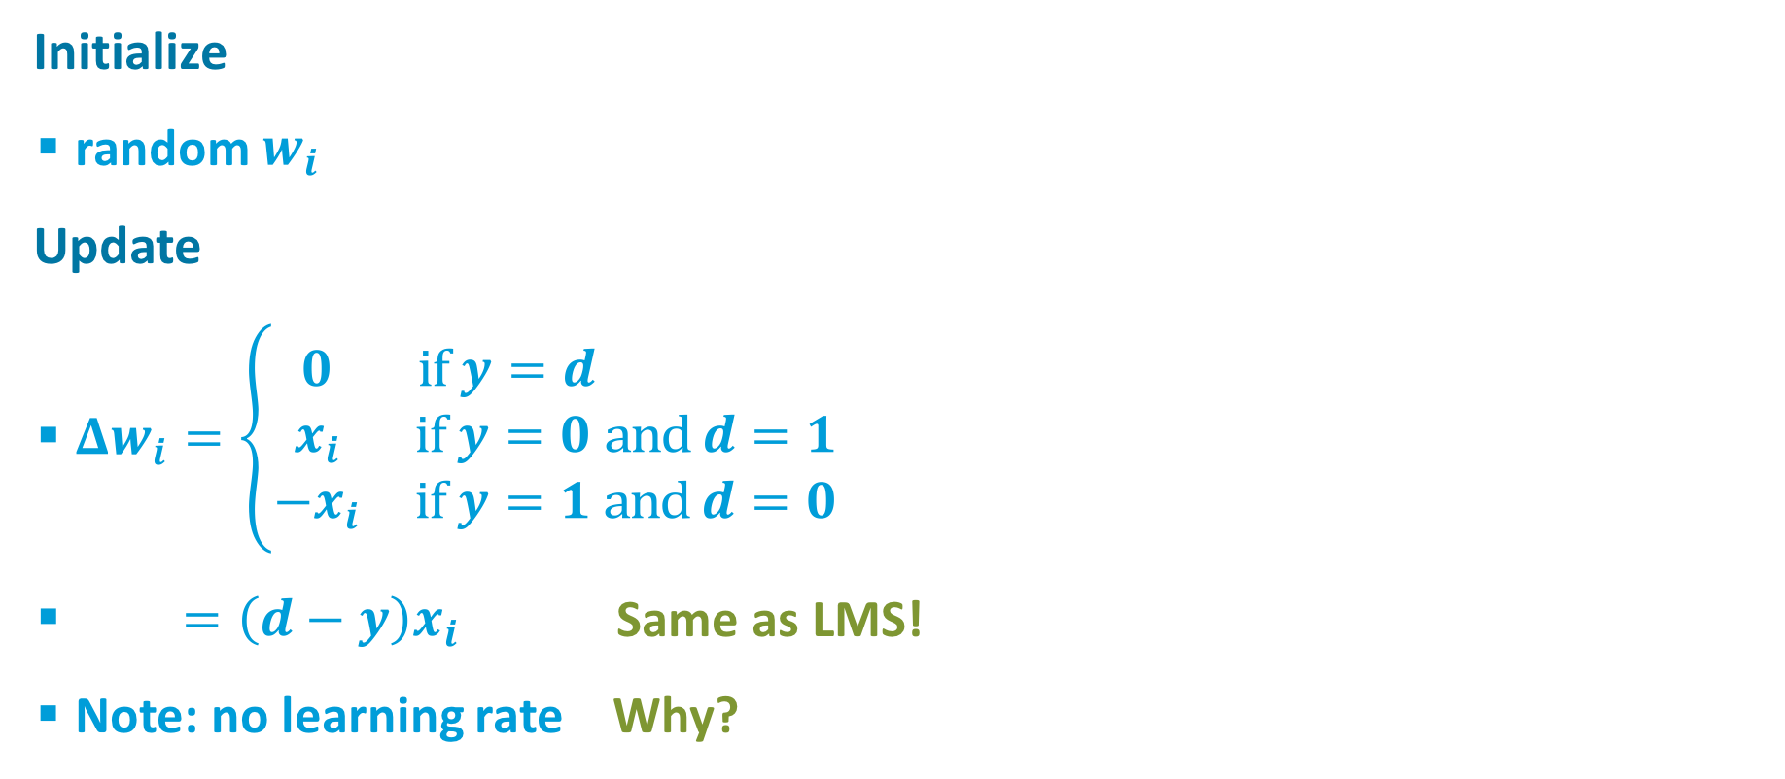
Perceptron Learning Rule (Rosenblatt, 1962)
$$d$$
Initialize
random $w_{i}$
Update
$Δw_{i}=\left\{\begin{matrix}0 & \text{if} y=d \\ x_{i} & \text{if} y=0 \text{and} d=1 \\ −x_{i} & \text{if} y=1 \text{and} d=0\end{matrix}\right.$
$=\left(d−y\right)x_{i}$ Same as LMS!
Note: no learning rate Why?
$$w_{i}$$
$$y$$
$$x_{i}$$
$$y=\left\{\begin{matrix}1 & \sum_{i}{w_{i}x_{i}>0} \\ 0 & \text{otherwise} \end{matrix}\right.$$

Slide 15

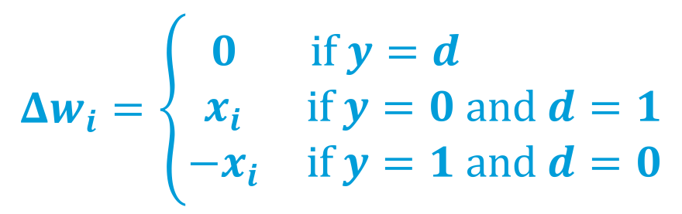

Informal Proof of Perceptron Learning Rule (Rosenblatt, 1962)
Consider case where $y=1$ and $d=0$
$y=1$implies $wx^{T}>0$
$w^{′}=w−x$
Performance will only get better if
$w^{′}x^{T}<wx^{T}$
$\left(w−x\right)x^{T}<wx^{T}$
$xx^{T}>0$
Always true because
$xx^{T}={\left\|x\right\|}^{2}$
$$y=\left\{\begin{matrix}1 & \sum_{i}{w_{i}x_{i}>0} \\ 0 & \text{otherwise} \end{matrix}\right.$$
$$Δw_{i}=\left\{\begin{matrix}0 & \text{if} y=d \\ x_{i} & \text{if} y=0 \text{and} d=1 \\ −x_{i} & \text{if} y=1 \text{and} d=0\end{matrix}\right.$$

Slide 16
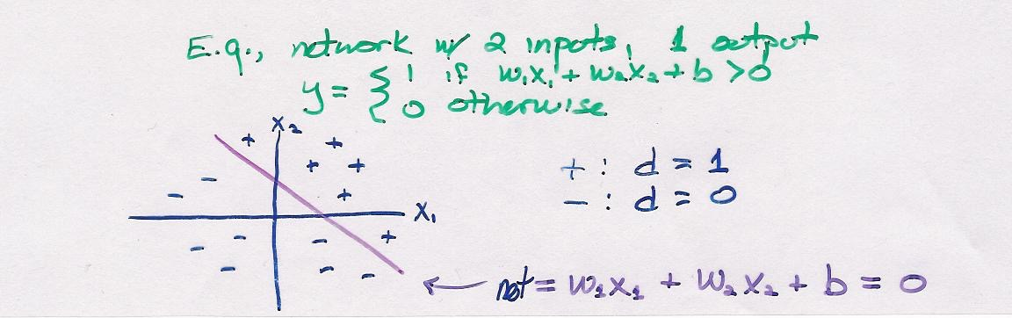
Linear Separability
Perceptron learning rule succeeds if the data are linearly separable
a hyperplane must exist that can separate positive and negative examples
perceptron weights define this hyperplane

Slide 17
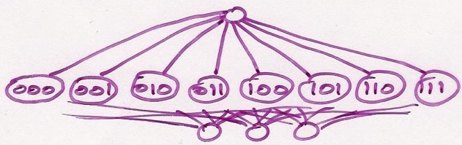
Hidden Representations
Major issue with perceptron architecture: we must specify the hidden representation
Exponential # hidden can always solve problem
But leads to large network + poor generalization
With domain knowledge, we could pick an appropriate hidden representation.
Alternative: learn hidden representation
Problem
Where does training signal come from?
Teacher specifies desired outputs, not desired hidden unit activities.

Slide 18
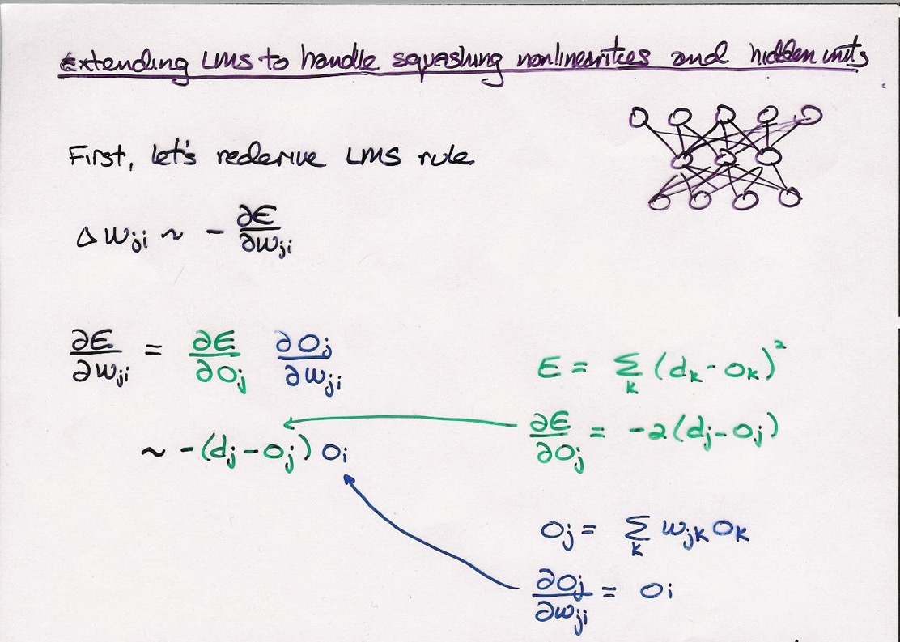
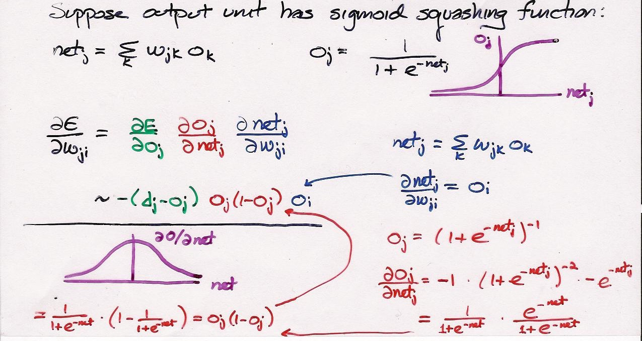

Slide 19
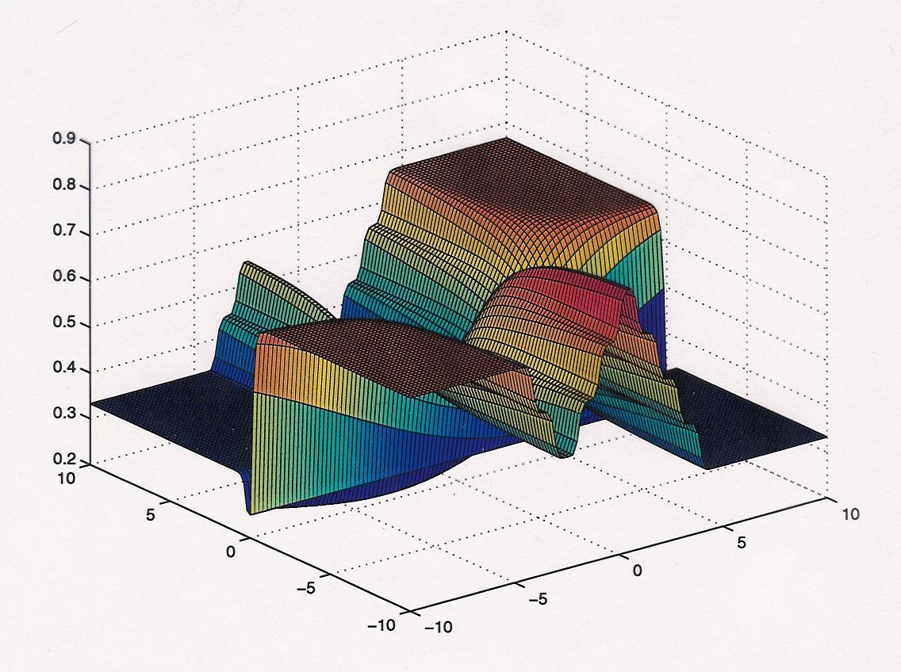
Error Surface For Simple Net With Sigmoid Nonlinearity

Slide 20
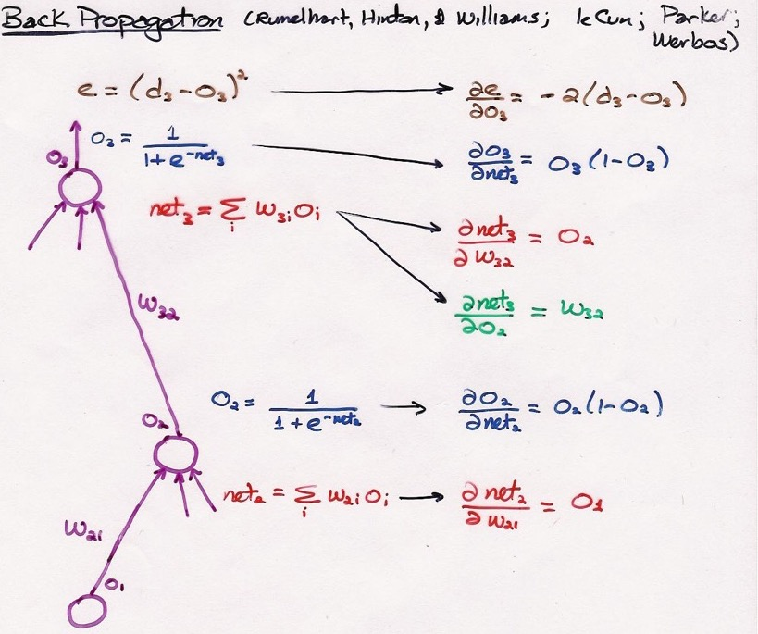
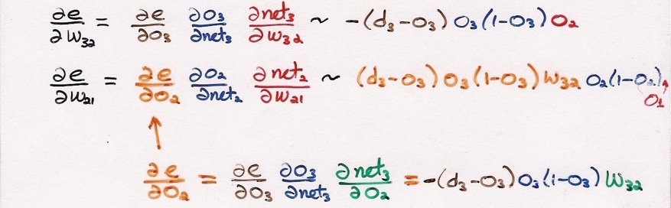

Slide 21
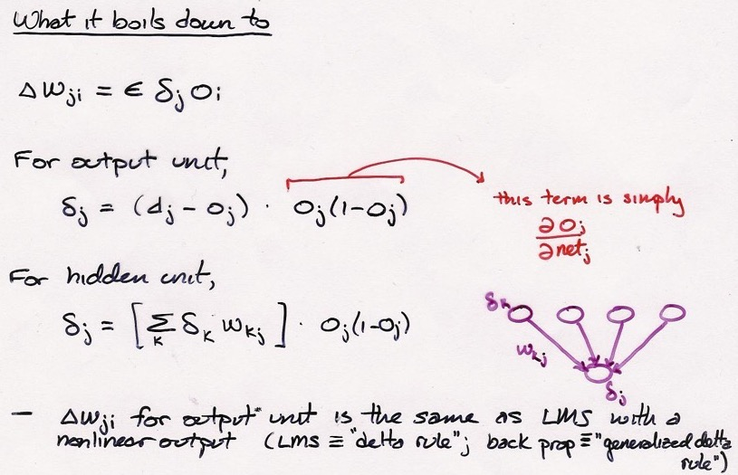
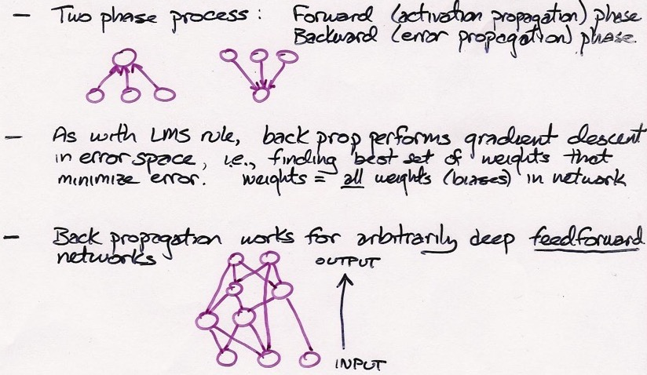

Slide 22
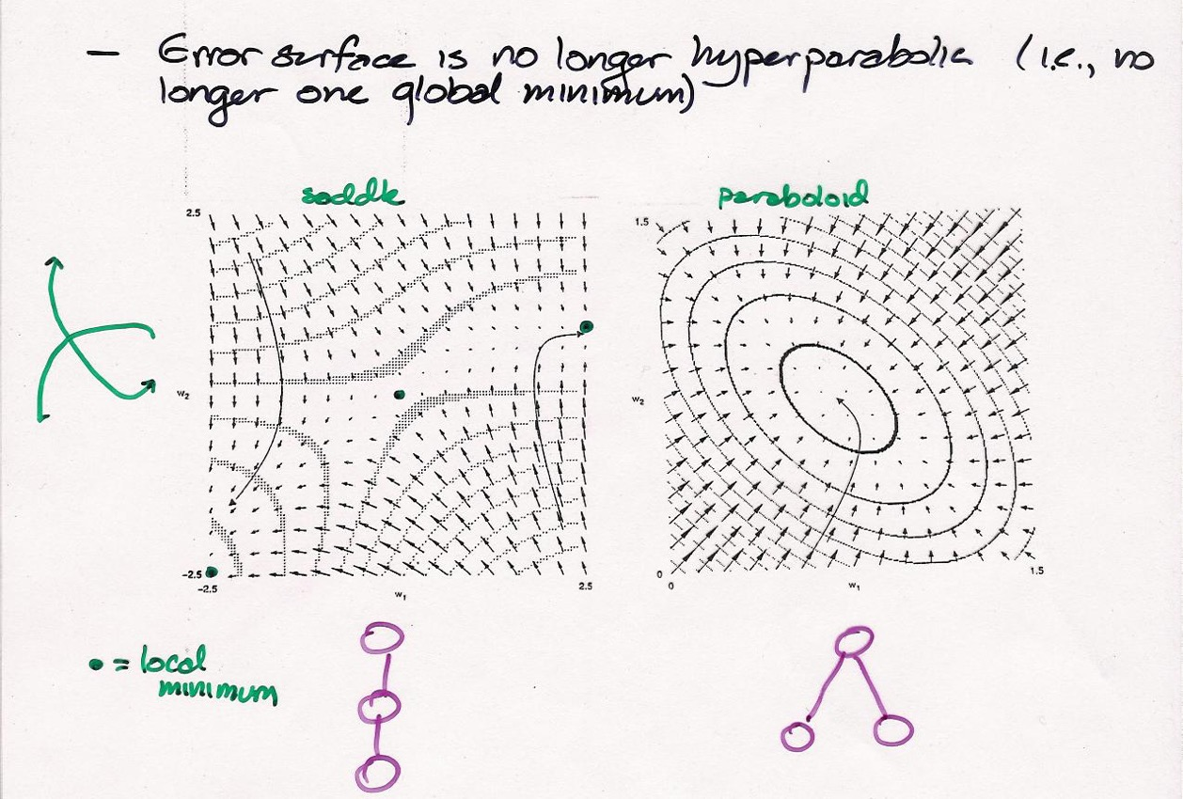

Slide 23
Why Are Nonlinearities Necessary?
Prove
A network with a linear hidden layer has no more functionality than a network with no hidden layer (i.e., direct connections from input to output)
For example, a network with a linear hidden layer cannot learn XOR
z
V
y
W
x

Slide 24
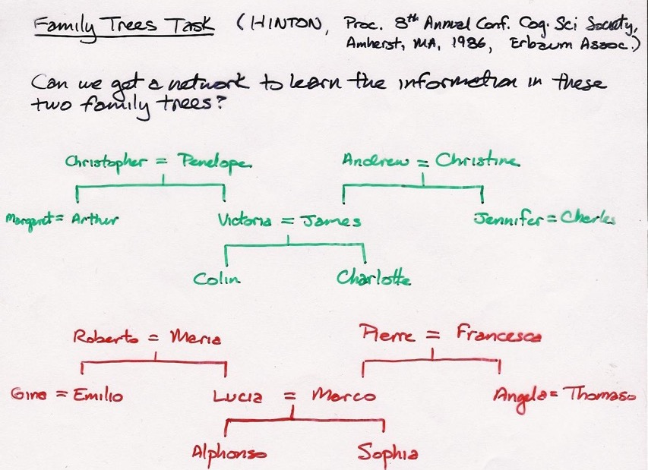
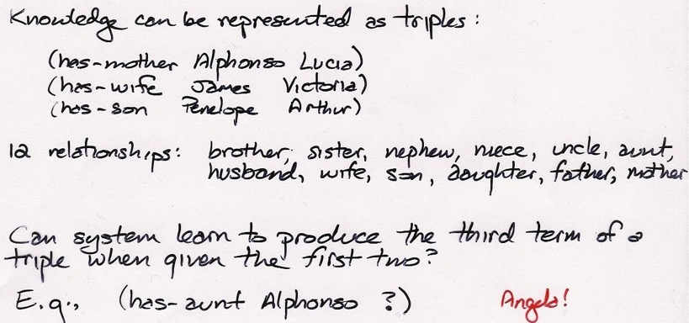

Slide 25
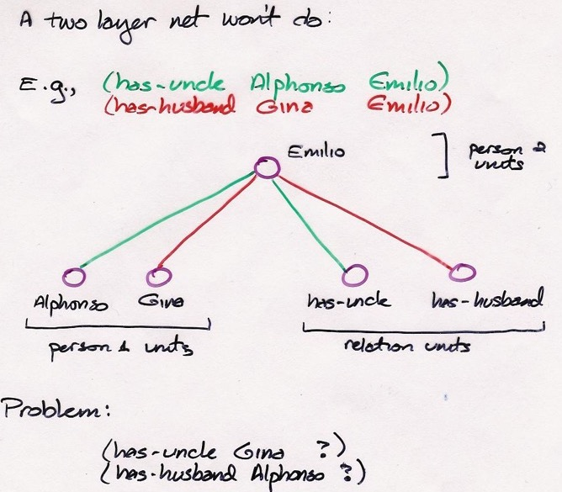

Slide 26
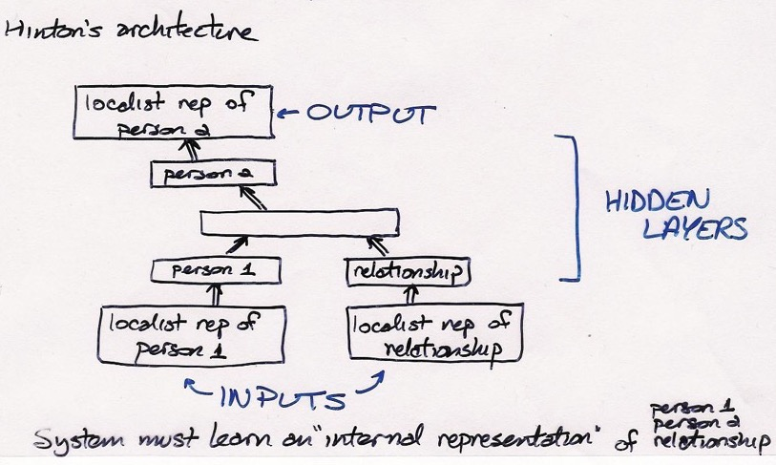

Slide 27
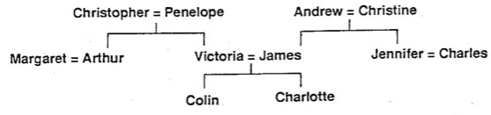
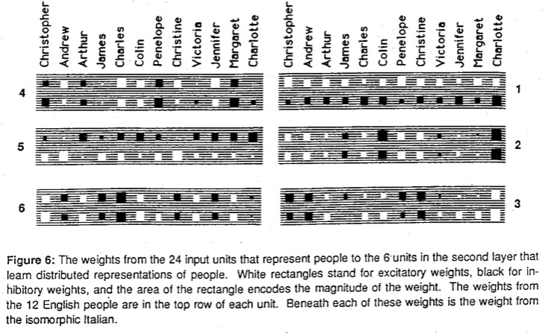
English/
Italian
person 1
units
Generation
branch:
+ = left;
– = right

Slide 28
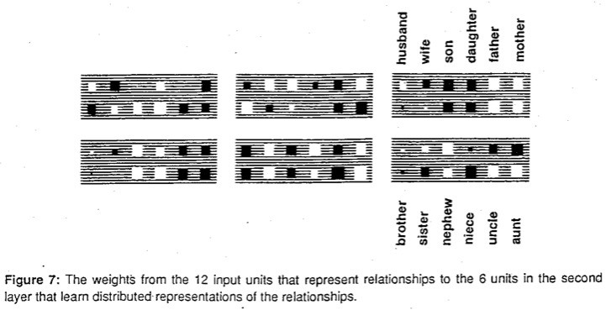
relationship
units
relative age:
+ = younger,
– = older
gender of
person 2

