Slide 1
LLM-based Generation of Product Classifications
An Empirical Design Science Study on Unsupervised Taxonomy Generation
Presented by: Aminah Dodiya
Supervised by: Prof. Dr.-Ing. Kurt Sandkuhl
Course: Applications of Enterprise Modeling

Slide 2
Human vs Machine
Can Large Language Models reliably generate product classifications when the input descriptions vary in quality, origin, and structure; and how does performance change when the text is human‑written versus LLM‑generated?
Sub‑Questions
RQ1: Does Chain‑of‑Thought reasoning improve classification quality?
RQ2: Does synthetic product text reduce extraction accuracy and schema adherence?
RQ3: Which model–prompt combination produces the most reliable taxonomy?

Slide 3
Why the B2B Software Domain Matters
The Domain Dilemma
Key Takeaway: High-velocity evolution challenges traditional taxonomy frameworks.
• No Predefined Blueprint: No static, permanent taxonomy can exist for B2B SaaS.
• Rapid Mutation: Products undergo continuous feature creep and category convergence daily.
The Scientific Opportunity
Key Takeaway: Enterprise SaaS is the ultimate stress test for dynamic extraction.
• The Novelty Anchor: Directly satisfies the research requirement for an unclassified, dynamic domain.
• The Robustness Stress Test: Provides the ultimate environment to evaluate how LLM schemas adapt to hybrid edge cases.

Slide 4
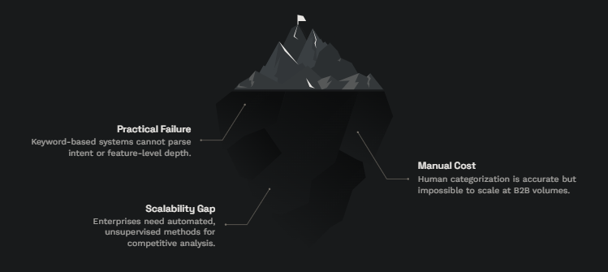
Semantic Ambiguity Problem
Why traditional keyword matching fails to categorize the high-velocity B2B SaaS marketplace effectively

Slide 5
Presentation Roadmap
WHY: Domain drift and Motivation
WHAT: Theoretical Framework & Literature Review
HOW: Engineering the Pipeline & Visual Data Analysis
WHAT IF: Deployment architecture + Future scope

Slide 6
Theoretical Foundations
Author & Year | Core Focus | Key Finding
Nickerson et al. (2013) | Taxonomy Development Method | Defines Mutual Exclusivity (ME) and Collective Exhaustiveness (CE) grounded in a clear Meta-Characteristic.
Gao et al. (2023) | LLM Schema Adherence | Demonstrates that complex prompt instructions degrade under low-parameter or high-speed hardware backends.
Wei et al. (2022) | Chain-of-Thought & Formatting | Proves that encouraging step-by-step reasoning significantly improves logical accuracy and token generation depth in scaled LLM.
Manning et al. (2024) | Semantic Compression Anomalies | Proves rapid LLM summarization causes detail loss; explains extraction degradation on synthetic text.

Slide 7
Methodological Design & Data Engine
Data: 5 handwritten expert seeds + 25 synthetic LLM profiles
Prompts: Prompt A vs. Prompt B
(Direct JSON) vs. (CoT Reason-First)
Models: OpenAI vs. Groq
(gpt‑4.1‑mini) vs. (llama‑3.3‑70b‑versatile)
Temperature = 0.0
Output Buckets: CRM/Ops, Collaboration/IT, DevOps/Data, Infrastructure/Security, ERP/HR, FinTech/Billing
[ ingestion ] → [ LLM ] → [ normalization ] → [ metrics ]

Slide 8
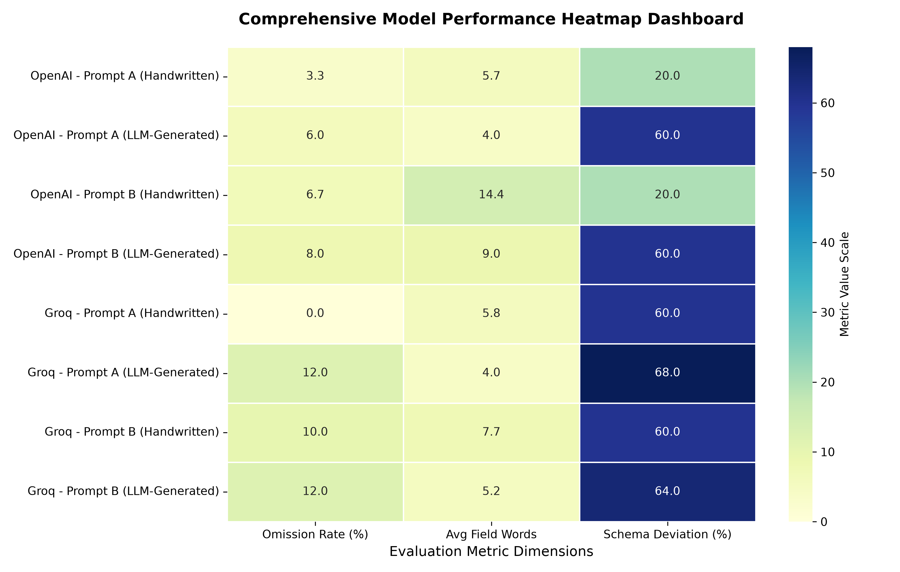
Empirical Benchmark: Comprehensive Model Performance
Notes:
How phase. This examines all 8 experimental combinations across our 3 taget metrics.
3 major system insight standout
1 intense blue box; humen -> AI generated text, formatting error spikes 60 & 68 -> (severe error penalty)
2 light green block -> verbosity leak (14.4)
3 the bootom rows -> consistat color pattern showing superior structure stability
Let’s break these metrics down individually, starting with…

Slide 9
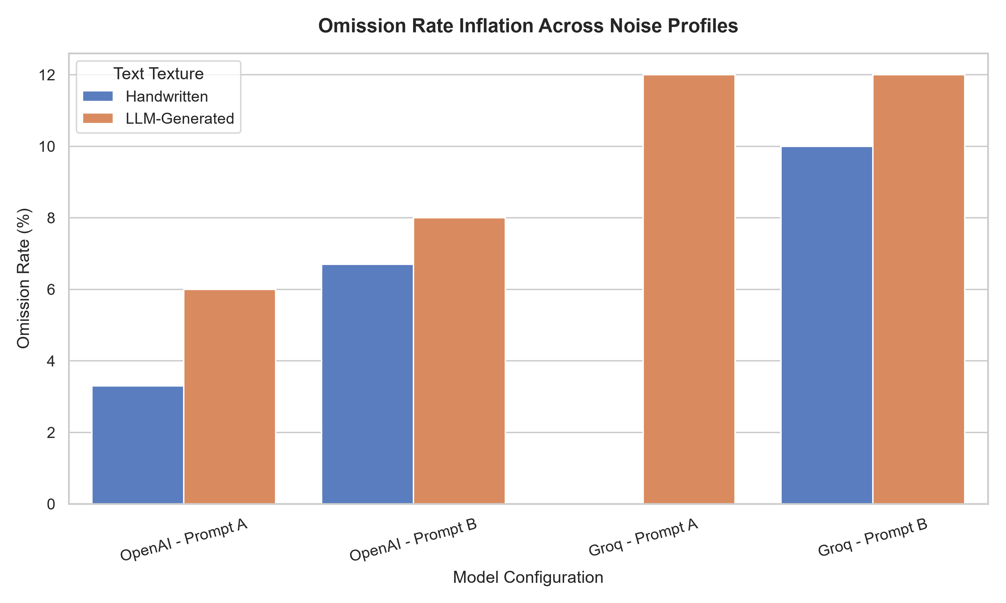
Collective Exhaustiveness Under Stress

Slide 10
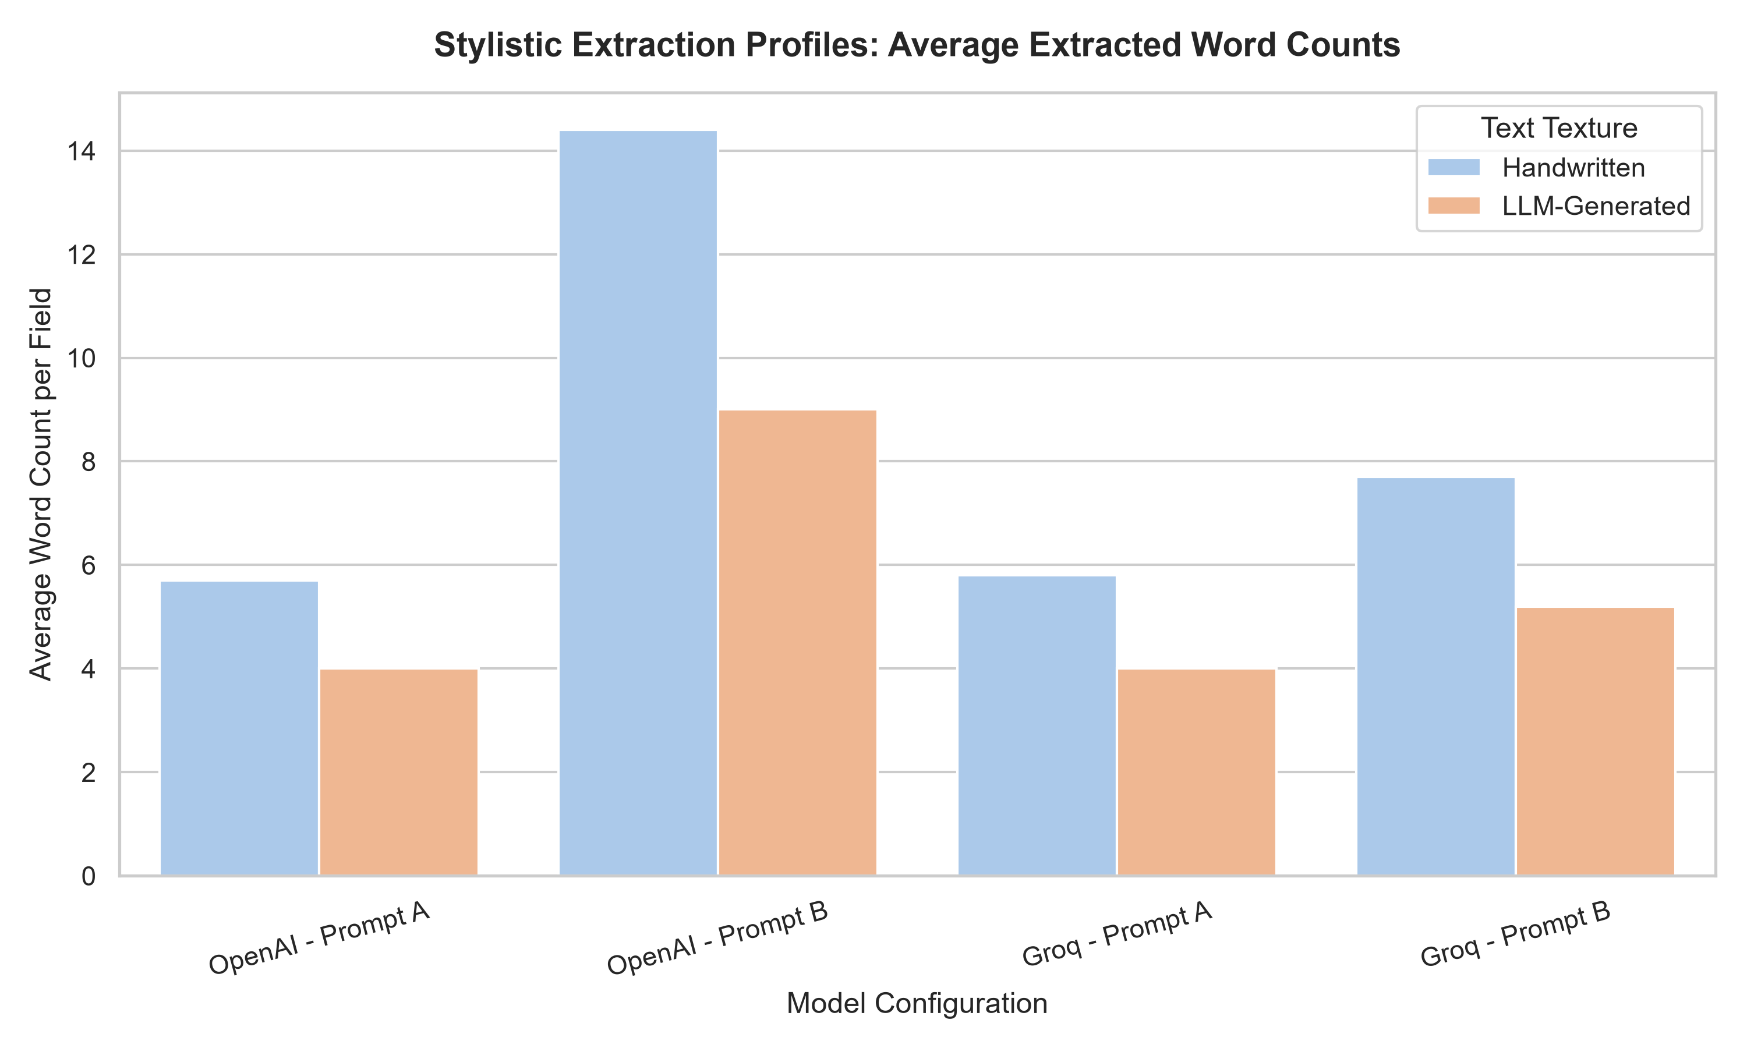
Word Count Analysis: Measuring Semantic Bloat

Slide 11
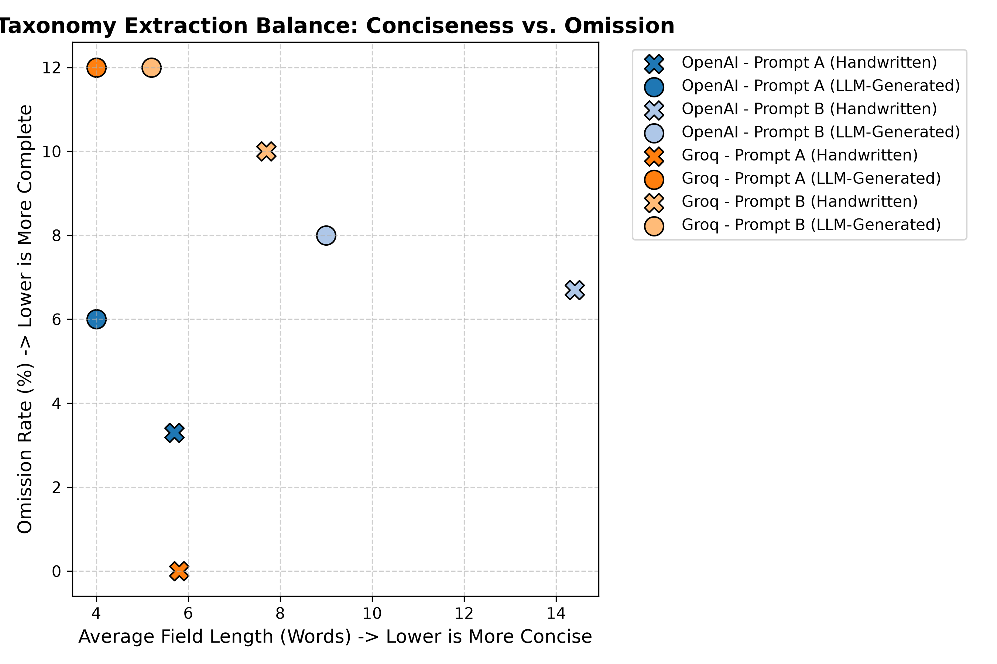
Mapping the Pareto Frontier: Omission vs. Length

Slide 12
What If We Deploy This Tomorrow?
Dual-Route Architecture
Route 1: Production Datatags
Key Takeaway: Fast, concise, database-compliant.
• Stack: Prompt A (Direct) + compact instruction models.
• Focus: High parsimony, zero narrative bloat, strict schema adherence.
Route 2: Exploratory Discovery
Key Takeaway: Deep extraction for R&D.
• Stack: Prompt B (CoT) + flagship open-source / proprietary models.
• Focus: Rich feature discovery and evidence logging at the cost of higher length.

Slide 13
Limitations & Future Work
1. Project limitation
Current results are limited to a test batch of 30 B2B software profiles; broader testing is required.
2. Future Scope
Expanded Model Scale: Testing open-source weights (e.g., Llama-3-70B, Mistral, DeepSeek) under identical data texture conditions.
Multi-Modal Textures: Evaluating OCR-extracted handwritten documents alongside native text.
Automated Post-Processing: Developing real-time fuzzy schema alignment algorithms to reduce schema deviations to 0%.

Slide 14
References
[1] Nickerson, R. C., Varshney, U., & Muntermann, J. (2013). A Method for Taxonomy Development in Information Systems. European Journal of Information Systems.
[2] Wei, J., Wang, X., Schuurmans, D., Bosma, M., Ichter, B., Xia, F., ... & Le, Q. V. (2022). Chain-of-Thought Prompting Elicits Reasoning in Large Language Models. ArXiv.
[3] Gao, L., Ma, X., Lin, J., & Callan, J. (2022). Precise Zero-Shot Dense Retrieval without Relevance Labels. ArXiv.
[4] Manning, C. D., Barak, O., & Gupta, A. (2024). Semantic Compression in Large Language Models: Limits of Abstraction Under Token Constraints. ArXiv.

Slide 15
Thank you

