Slide 1
AUTOMATIC EVENT DETECTION FROM NATURAL TEXT IN BANGLA LANGUAGE

Slide 2
SUPERVISOR AND TEAM MEMBERS
Supervisor
Team Members
Md Mohsin Uddin Arif
Senior Lecturer,
Department of CSE,
East West University
Amina Khatun Mim (2015-3-60-023)
Chandika Gupta Paik (2015-2-68-079)
Sumaiya Barsha (2015-2-60-118)

Slide 3
CONTENT OVERVIEW
Introduction
Motivation
Challenges
Dataset Overview
Baseline Models
Deep Learning Models
Experimentation
Result overview
Drawbacks
Future Work
Reference

Slide 4

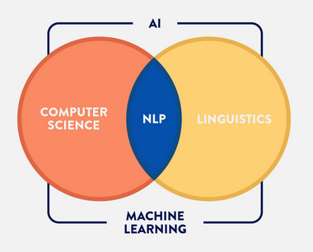
INTRODUCTION
Natural Language Processing
Aims to gain knowledge on how human beings uses language and apply that knowledge on tools and techniques so that computers can understand and manipulate natural languages for a desired task

Slide 5
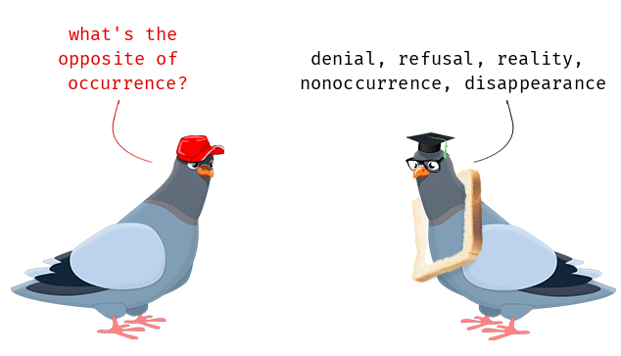
INTRODUCTION cont..
Event Detection in NLP
A process of detecting any notation that can indicate a meaningful occurrence in a given natural text

Slide 6
INTRODUCTION cont..
Event Detection in NLP
“পাকিস্তানের করাচিতে একটি যাত্রীবাহী বিমান বিধ্বস্ত হয়েছে”
What is the meaningful occurrence here?
-> “একটি যাত্রীবাহী বিমান বিধ্বস্ত হয়েছে”
So detecting that chunk of sentence is enough to detect an event in a sentence

Slide 7
INTRODUCTION cont..
Disaster Monitoring
Decision Making Tool
Use of Event Detection
Personal Event Manager
Personalized News System
Emergency Event Notification
Business Process Optimization

Slide 8
INTRODUCTION cont..
Approaches for Event Detection in NLP
Sentence level information pattern
Hybrid Neural Network combining Bi-LSTM and CNN
Structured learning approach for temporal relations
Bi-directional Recurrent Neural Network
Data driven text mining etc.
None specifically for Bengali Language

Slide 9

MOTIVATION
No existing work on Event Detection for Bengali language
Deep learning methods for Event Detection in Bengali language
Very few works with the basic machine learning approaches in this area
Analyzing the relation between words for forming an event notation

Slide 10
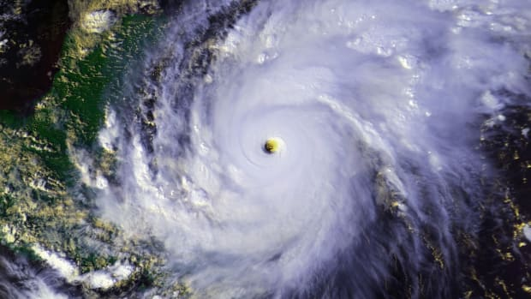
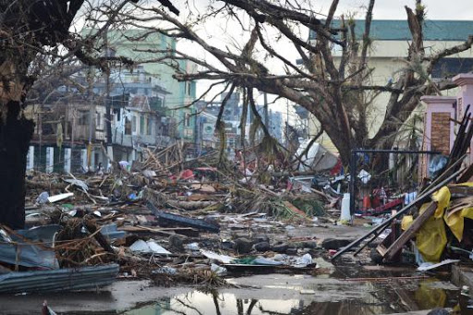
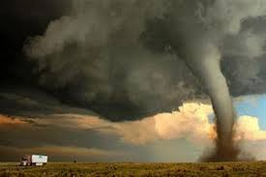



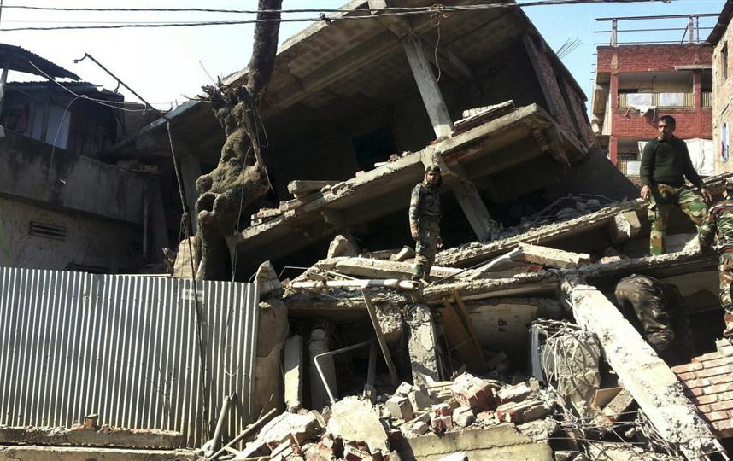
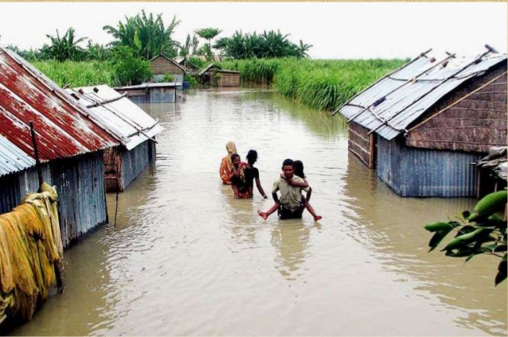
MOTIVATION
Applications…
Disaster Monitoring
Personal Event Manager
Business Process Optimization

Slide 11

CHALLENGES
Specific Dataset
No pre-trained model is available
Very few resources for Bengali language

Slide 12
DATASET OVERVIEW
2nd Predecessor | 1st Predecessor | Word | 1st Successor | 2nd Successor | Word Vector (32 dimensions) | Class
NULL | NULL | পাকিস্তানের | করাচিতে | একটি |  | Not Event
NULL | পাকিস্তানের | করাচিতে | একটি | যাত্রীবাহী |  | Not Event
পাকিস্তানের | করাচিতে | একটি | যাত্রীবাহী | বিমান |  | Not Event
“পাকিস্তানের করাচিতে একটি যাত্রীবাহী বিমান বিধ্বস্ত হয়েছে”
The pattern of relation between the words in a sentence can easily be studied in this format

Slide 13
DATASET OVERVIEW cont..
Event or Not Event Tag For a Token
Tagging has been done manually
Biases in the tagging for human error
Event
“পাকিস্তানের করাচিতে একটি যাত্রীবাহী বিমান বিধ্বস্ত হয়েছে”
Not Event

Slide 14
BASELINE MODELS
Naïve Bayes
Random Forest
Basic Machine Learning
Support Vector Machine
Support Vector Classification
Decision Tree
Multiclass Perceptron

Slide 15
DEEP LEARNING MODELS
Recurrent Neural Network (RNN)
Deep Learning
Long Short Term Memory (LSTM)
Convolutional Neural Network (CNN)
Gated Recurrent Unit (GRU)

Slide 16
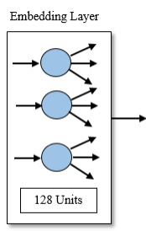
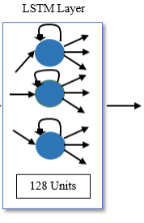
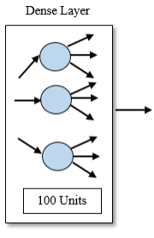
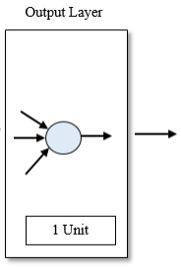
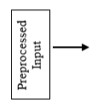

DEEP LEARNING MODELS cont..
Long Short Term Memory (LSTM)

Slide 17
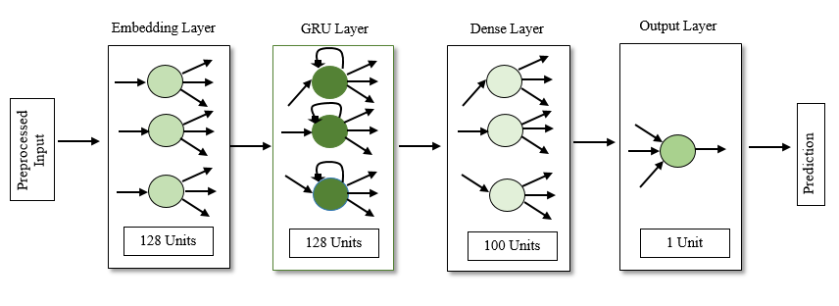
DEEP LEARNING MODELS cont..
Gated Recurrent Unit (GRU)

Slide 18
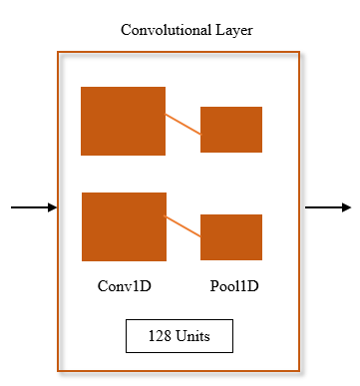
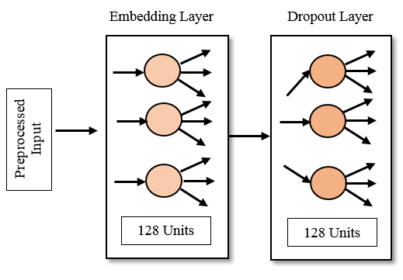
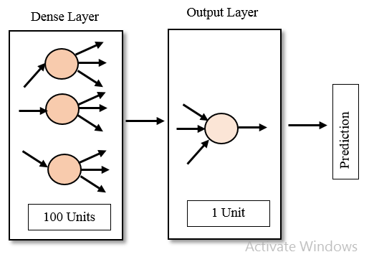
DEEP LEARNING MODELS cont..
Convolutional Neural Network (CNN)

Slide 19



EXPERIMENTATION
Experiment with Extra Feature
Prediction from a network as an extra feature
Data Preprocessing
Data source & Validation
Data Cleaning
Data Transforming
Adding contextual meaning
Bengali newspaper and books
5-fold cross validation

Slide 20
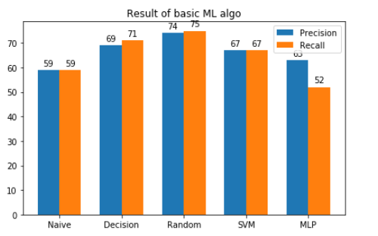
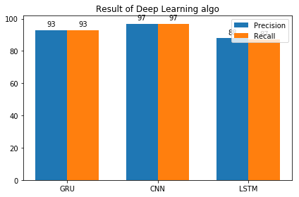
RESULT OVERVIEW
Precision Recall of Basic ML algorithms
Precision Recall of Deep Learning algorithms

Slide 21
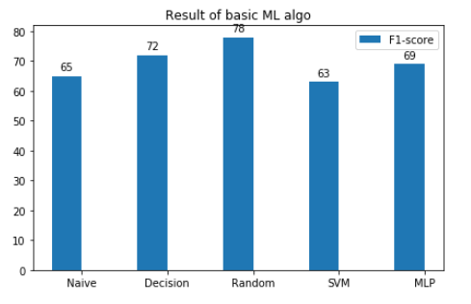
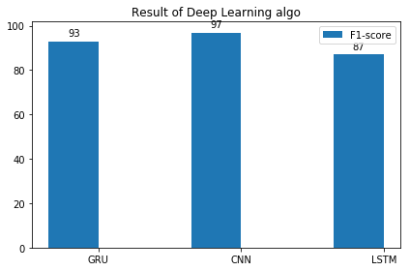
RESULT OVERVIEW cont..
F1-score of Basic ML Algorithms
F1-score of Deep Learning Algorithms

Slide 22
DRAWBACKS
Single Word Event Detection problem
Biases in Tagging
Few data samples

Slide 23
FUTURE WORK
Lemmatization
Stemming
More Features
eg: NER tag, POS tag
Multiclass Event Detection
Relation between them
More Data Samples

Slide 24
REFERENCES
Shasha Liao and Ralph Grishman. 2010. Using Document Level Cross-Event Inference to Improve Event Extraction. Association for Computational Linguistics, pages 789–797.
Reza Ghaeini, Xiaoli Z. Fern, Liang Huang, Prasad Tadepalli. Event Nugget Detection with Forward-Backward Recurrent Neural Networks. Association for Computational Linguistics, 2018
Heng Ji and Ralph Grishman. 2008. Refining Event Extraction through Cross-Document Inference. Association for Computational Linguistics, pages 254–262.
McClosky D, Surdeanu M, Manning C D. Event extraction as dependency parsing. In: Proceedings of the 49th Annual Meeting of the Association for Computational Linguistics: Human Language Technologies, Portland, 2011. 1626–1635
K, Jauhar S K, Li H Y, et al. A structured distributional semantic model for event co-reference. In: Proceedings of the 51st Annual Meeting of the Association for Computational Linguistics, Sofia, 2013. 467–473
Li Q, Ji H. Incremental joint extraction of entity mentions and relations. In: Proceedings of the Association for Computational Linguistics, Baltimore, 2014. 402–412
Nguyen T H, Grishman R. Event detection and domain adaptation with convolutional neural networks. In: Proceedings of the 53rd Annual Meeting of the Association for Computational Linguistics, Beijing, 2015. 365–371
Xiaocheng FENG, Bing QIN & Ting LIU. A language-independent neural network for event detection. Science China 2018
Hector Llorens, Estela Saquete, Borja Navarro-Colorado. TimeML Events Recognition and Classification:Learning CRF Models with Semantic Roles. Proceedings of the 23rd International Conference on Computational Linguistics (Coling 2010), pages 725–733,Beijing, August 2010

Slide 25
THANK YOU FOR YOUR PATIENCE!
ANY QUESTIONS?

