Slide 1

SAFE BITE
AMINA PM
MES24MCA-2004
Department of Computer Applications
MES College of Engineering, Kuttippuram
20/08/2025

Slide 2
PRODUCT OWNER HYDERALI K ASSISTANT PROFESSOR DEPARTMENT OF COMPUTER APPLICATIONS MES COLLEGE OF ENGINEERING, KUTTIPPURAM

Slide 3
TABLE OF CONTENTS
Introduction
Objective
Existing System
Proposed System
Motivation
Functionalities
Module Description
Developing Environment
Sprint Backlog
Product Backlog
User Story
Project Plans
Data Flow Diagrams
ER Diagram

Slide 4
SAFE BITE
ML project SAFE BITE uses CNN-based image recognition to analyze food photos, detect potential allergens in real-time, and cross-reference them with users' allergy profiles.
Food allergies are rising globally, with even trace amounts causing life-threatening reactions, yet ingredient information remains unreliable in restaurants and unpackaged foods.
Provides instant, accurate risk assessment to prevent allergic reactions when traditional labeling fails, transforming food safety for allergy sufferers.

Slide 5
SAFE BITE
By comparing recognized ingredients with a user’s personalized allergy profile, the system ensures that risk detection is both accurate and tailored to individual needs.
The application not only warns users about unsafe food but also suggests safer alternatives, making the eating experience more confident and stress-free.
Overall, SAFE BITE bridges the gap between awareness and action by empowering individuals to make safe food choices in any environment, whether at home, school, or while traveling.

Slide 6
OBJECTIVES
To provide real-time allergen detection using food image analysis and ingredient mapping.
To deliver personalized safety alerts based on each user’s allergy profile.
To enhance user experience by offering safe food alternatives and a scan history, ensuring long-term awareness and better dietary decisions.
To ensure data privacy and scalability, enabling future expansion to more foods and allergens.

Slide 7
EXISTING SYSTEM
At present, people rely mainly on food labels or menus to identify allergens, but these are often incomplete or unavailable.
Unpackaged food, such as street food or homemade dishes, rarely comes with detailed ingredient information.
Current systems lack proper integration with personalized allergy profiles, meaning they cannot give tailored, immediate warnings to users.

Slide 8
PROPOSED SYSTEM
SAFE BITE introduces an image-based allergen detection system that analyzes food photos captured or uploaded by the user.
The system maps the identified food to a database of known ingredients and then cross-checks them with the user’s allergy profile.
If allergens are found, the user immediately receives a warning notification, preventing accidental intake.
In addition to alerts, the system suggests safe alternatives so users can choose safer food options confidently.

Slide 9
MOTIVATIONS
Food allergies are on the rise globally, making safe food choices a daily challenge for millions of people.
Even small amounts of hidden allergens can cause severe health risks, leading to fear and uncertainty while eating outside.
Existing solutions such as food labels, menus, or barcode scanners are often incomplete, unreliable, or inconvenient.

Slide 10
FUNCTIONALITIES
USER
Registration & Login
Allergy Profile Management
Food Image Upload/Scan
Allergen Detection
Safe Food Suggestions
Scan History
Profile & Privacy

Slide 11
FUNCTIONALITIES
ADMIN
User Management
Allergen Database Management
Food Image Upload/Scan
System Monitoring
Safe Food Suggestions
Content & Suggestions Management
Security & Privacy Oversight

Slide 12
MODULE DESCRIPTION
User Module
Registration & Login
Users can create an account, securely log in, and manage their profile.
Allergy Profile Management
Users can add, edit, or delete allergens to personalize their detection experience.
Food Image Upload/Scan
Allows users to capture or upload food images for analysis.

Slide 13
MODULE DESCRIPTION
Allergen Detection & Alerts
Matches detected ingredients with the allergy profile and generates safe/unsafe alerts.
Safe Food Suggestions
Suggests alternative allergen-free food options when risks are detected.
Scan History
Stores and displays previously scanned items with date, time, and results.

Slide 14
MODULE DESCRIPTION
Admin Module
User Management
View, edit, or delete users, and reset passwords for account recovery.
Allergen Database Management
Add, update, or remove allergens and their ingredient mappings.

Slide 15
MODULE DESCRIPTION
System Monitoring
Track system usage, scan frequency, and server performance.
Content & Suggestions Management
Maintain and update the list of safe food alternatives.

Slide 16
DEVELOPING ENVIRONMENT
Operating System :Windows / Linux
Front End : HTML, CSS, JavaScript
Back End : Python (Django)
Database : SQLite
IDE & Tools : VS Code

Slide 17
USER STORY
User Story ID | As a type of User | I want to | So that i can
1 | ADMIN | Login | access the admin dashboard.
2 | USER | Registration | access the system for the first time.
3 | USER | Login | access my account and manage my allergy profile
4 | ADMIN | User Management | update their details or remove inactive accounts.
5 | USER | Allergy Profile management | accurately detect unsafe foods for me.
6 | USER | Food-Image Upload/Scan | analyze its ingredients for allergens.
7 | USER | Allergen Detection | avoid unsafe meals.

Slide 18
USER STORY
User Story ID | As a type of User | I want to | So that i can
8 | ADMIN | Safe Food Suggestions | analyze their preferences and improve services.
9 | USER | Suggests alternative food | find safe options to eat.
10 | USER | Scan History | track what was safe or unsafe before.
11 | ADMIN | Content Management | ensure smooth scheduling.
12 | ADMIN | Report | view user reports.
13 | USER | PRIVACY | control how my data is used.
14 | ADMIN | system Monitoring | Improve the detection

Slide 19
PRODUCT BACKLOG
ID | NAME | PRIORITY <high/medium/low> | ESTIMATE (Hours) | STATUS <Planned/In progress/Completed>
1 | REGISTRATION | High | 5 | In progress
2 | LOGIN | High | 5 | In progress
3 | Allergy Profile Management & Detection | High | 20 | Planned
4 | Safe Food Suggestions | High | 10 | Planned
5 | History | MEDIUM | 10 | Planned

Slide 20
PROJECT PLAN
User StoryID | Task Name | Start Date | End Date | Days | Status
1 | SPRINT 1 | 11/08/2025 | 21/08/2025 | 15 | In Progress
7 |  | 11/08/2025 | 21/08/2025 |  | In Progress
8 |  | 11/08/2025 | 21/08/2025 |  | In Progress
2 | SPRINT 2 | 30/08/2025 | 11/09/2025 | 15 | Planned
3 |  | 06/09/2025 | 11/09/2025 |  | Planned
4 |  | 30/08/2025 | 11/09/2025 |  | Planned
5 |  | 06/09/2025 | 11/09/2025 |  | Planned

Slide 21
PROJECT PLAN
User StoryID | Task Name | Start Date | End Date | Days | Status
6 | SPRINT 3 | 27/09/2025 | 07/10/2025 | 15 | Planned
9 |  | 23/09/2025 | 05/10/2025 |  | Planned
14 |  | 23/09/2025 | 05/10/2025 |  | Planned
10 | SPRINT 4 | 16/10/2025 | 25/10/2025 | 15 | Planned
11 |  | 14/10/2025 | 28/10/2025 |  | Planned
12 |  | 14/10/2025 | 28/10/2025 |  | Planned
13 |  | 16/10/2025 | 25/10/2025 |  | Planned

Slide 22
SPRINT BACKLOG
Backlog tem | Status And Completion Date | Original Estimation in Hours | Day 1 hrs | Day 2 hrs | Day 3 hrs | Day 4 hrs | Day 5 hrs | Day 6 hrs | Day 7 hrs | Day 8 hrs | Day 9 hrs | Day 10 hrs
SPRINT 1
Login & Registration | 19/08/2025 | 5 | 0 | 1 | 2 | 0 | 0 | 0 | 1 | 0 | 0 | 0
Allergy Profile Management | 21/08/2025 | 5 | 0 | 0 | 0 | 0 | 1 | 0 | 0 | 0 | 1 | 0
Food – Image Detection | 21/08/2025 | 5 | 0 | 0 | 0 | 1 | 0 | 0 | 1 | 0 | 0 | 2
SPRINT 2
Allergen Detection | 11/09/2025 | 12 | 0 | 1 | 2 | 2 | 1 | 0 | 2 | 0 | 0 | 1
Food Suggestions | 11/09/2025 | 5 | 0 | 0 | 0 | 0 | 0 | 0 | 0 | 0 | 1 | 2

Slide 23
SPRINT BACKLOG
Backlog tem | Status And Completion Date | Original Estimation in Hours | Day 1 hrs | Day 2 hrs | Day 3 hrs | Day 4 hrs | Day 5 hrs | Day 6 hrs | Day 7 hrs | Day 8 Hrs | Day 9 hrs | Day 10 hrs
SPRINT 3
Profile & Privacy | 05/10/2025 | 12 | 1 | 0 | 2 | 0 | 0 | 2 | 2 | 1 | 0 | 1
User Management | 07/10/2025 | 6 | 0 | 0 | 0 | 0 | 1 | 0 | 0 | 0 | 0 | 1
SPRINT 4
ystem Monitoring | 28/10/2025 | 4 | 1 | 0 | 0 | 0 | 1 | 1 | 0 | 0 | 0 | 0
Content & Suggestions Management | 25/10/2025 | 6 | 0 | 0 | 2 | 0 | 0 | 0 | 0 | 1 | 0 | 2
TOTAL |  | 60 | 2 | 2 | 8 | 3 | 4 | 3 | 6 | 2 | 2 | 9

Slide 24
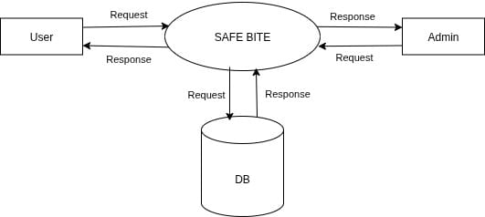
DATA FLOW DIAGRAM
LEVEL 0

Slide 25
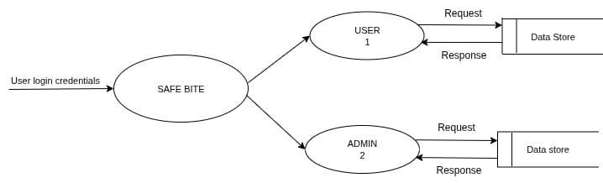
DATA FLOW DIAGRAM
LEVEL 1

Slide 26
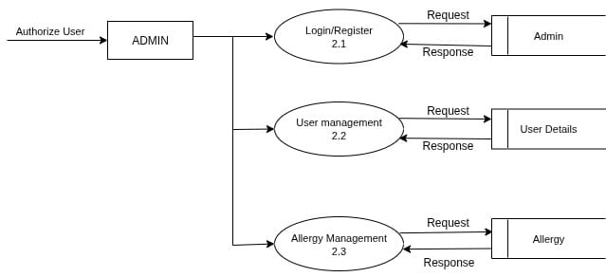
DATA FLOW DIAGRAM
LEVEL 2 Admin

Slide 27
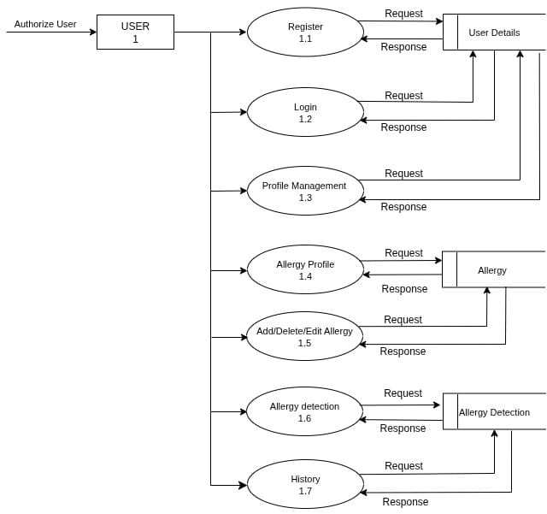
DATA FLOW DIAGRAM
LEVEL 2 User

Slide 28
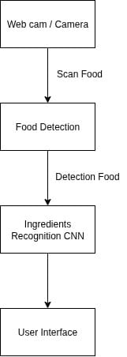
DATA FLOW DIAGRAM

Slide 29
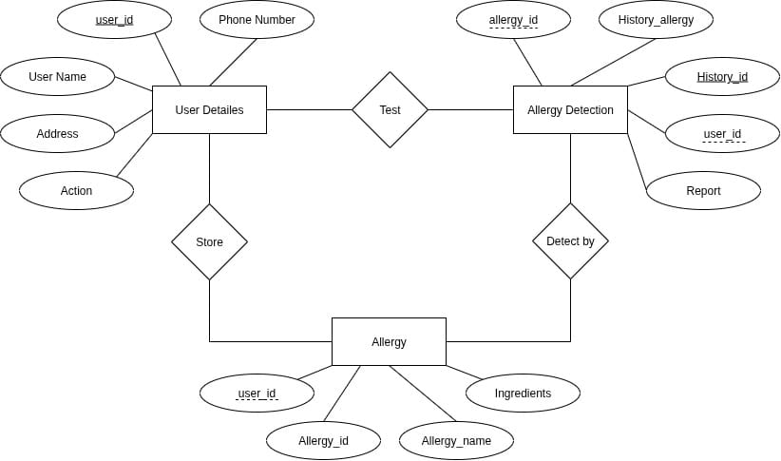
ER DIAGRAM

Slide 30
THANK YOU

