Slide 1
Git Hub Desktop

Slide 2
Installation
Before you set up GitHub Desktop, you must already have a GitHub
https://desktop.github.com/
download, run, follow the prompt
Set up connection to GitHub: upper-right corner of the app -> Options -> Add GitHub account -> type your credentials

Slide 3

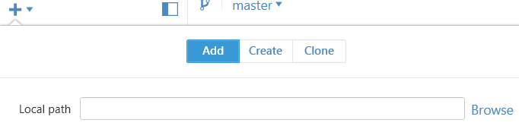
Add local repo
Right upper corner

Slide 4
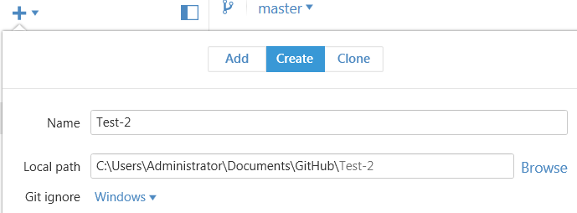
Create local repo

Slide 5
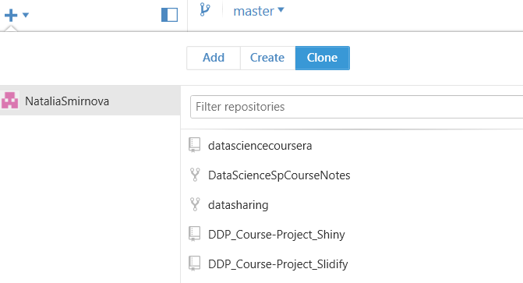
Clone repo

Slide 6

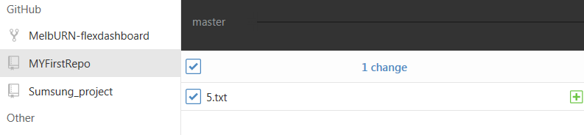
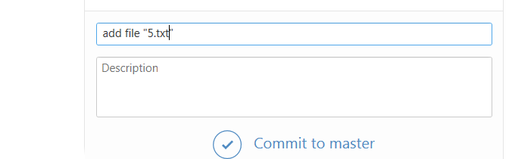
Changes

Slide 7
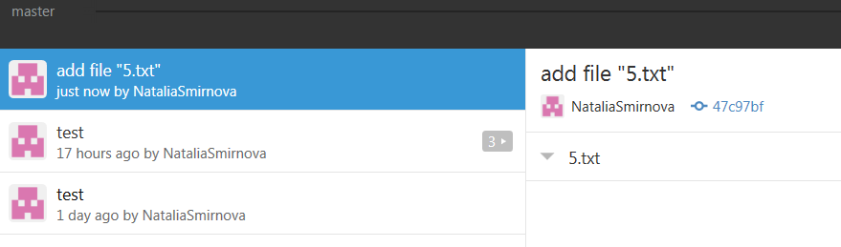
History

Slide 8
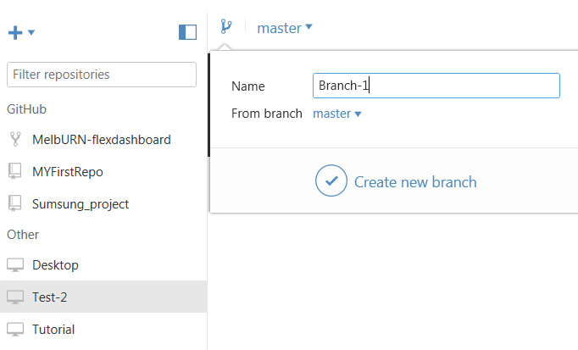
Branches

Slide 9
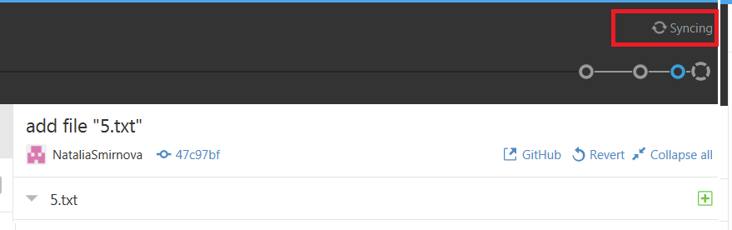
Push changes to remote

Slide 10
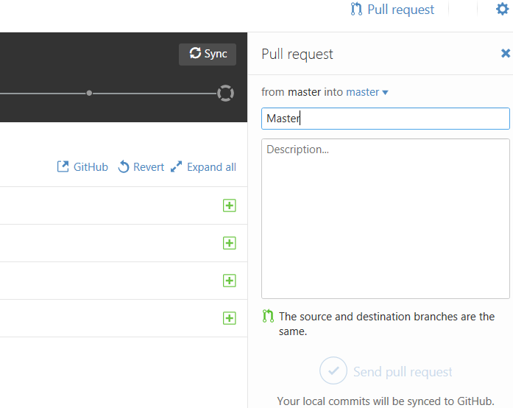
Pull request

Slide 11
Useful links
https://desktop.github.com/
https://help.github.com/desktop/guides/

