Slide 1

IT4100 – SQA Assignment 1 – Unit testing with Junit
2022-SQA-G40

Slide 2
Book inventory handling system for a library

Slide 3
Introduction
This system is Book inventory handling system for a library.
The library is essential for all university students since they can read printed materials, and this application was developed simply to meet specified needs.
To achieve the criteria, the following implementation consists primarily eight functions, each of which has ten test cases.

Slide 4
All Functional requirements
Identified by |  | Functional requirement
Name | Student Id
Rasuni Wageesha H.A | IT19015040 | Book registration(adding book)
 |  | Store borrow book details
Perera B.A.A.W.S | IT19015422 | Member registration
 |  | Store return book details
Thennakoon T M B C K | IT18077698 | Book purchase for library
Bates R S |  | Book supplier management
Senanayaka S.A.M.A.B.M | IT19011608 | Yearly Census Checking
 |  | Stock manager details management

Slide 5
IT19015040 |Rasuni Wageesha H.A
Information Technology
IT19015040 | Rasuni Wageesha H.A | SQA – G40

Slide 6
Functional Requirements Identified in Task 2.1
Book registration(Adding Book).
Store borrow book details.

Slide 7
Test plan created in Task 2.2
Function Name | Test Case ID | Test Case Description | Pre-Conditions | Test Procedure | Test Inputs | Expected Result | Actual Result | Test Result | Comments
Book Registration(Adding Book) | 01 | Check Calculate No of copies |  | Get Book registration details. | Enter Publisher=P1 | valid
Calculate approved leaves | 02 | Validate Category |  | Get the books category. | Enter Book keep Limit=8 | Valid
Calculate approved leaves | 03 | Validate return day |  | Get return date | Enter date = 2021/02/12 | Valid
Calculate approved leaves | 04 | Validate author |  | Get Authors Names | Enter ISBM no=tt12 | Valid
 | 05 | Validate Title |  | Get Book Title | Enter Rack number=7 | Valid

Slide 8
Function Name | Test Case ID | Test Case Description | Pre-Conditions | Test Procedure | Test Inputs | Expected Result | Actual Result | Test Result | Comments
Store borrow book details | 06 | Validate Publisher |  | Get Publishers | Enter Publisher=P1 | Valid
Calculate monthly attendance | 07 | Validate Number of Book that user can Keep |  | Get Book keep limit | Enter Book keep Limit=8 | Valid
Calculate monthly attendance | 08 | Validate Book Limit |  | Get Borrow Borrow | Enter Borrow Book=4 | Valid
Calculate monthly attendance | 09 | Validate ISBN |  | Get ISBM number | Enter ISBM no=tt12 | Valid
 | 10 | Validate Rack Number |  | Enter rack Number | Enter Rack number=7 | Valid

Slide 9
Junit test cases in 4.1

Slide 10
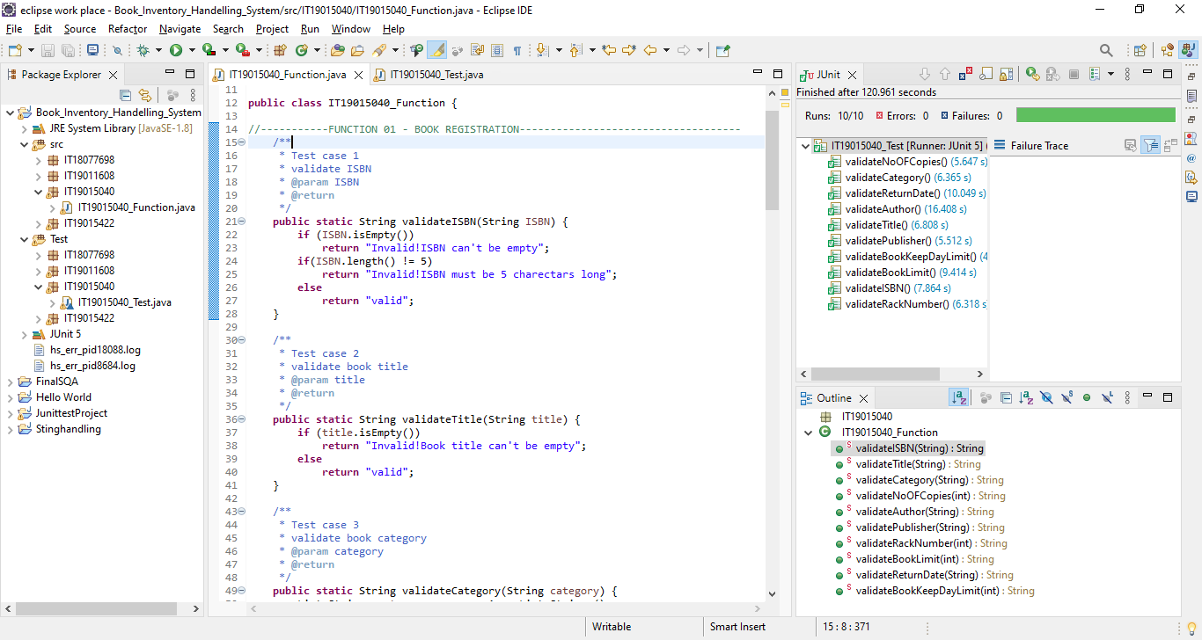

Slide 11
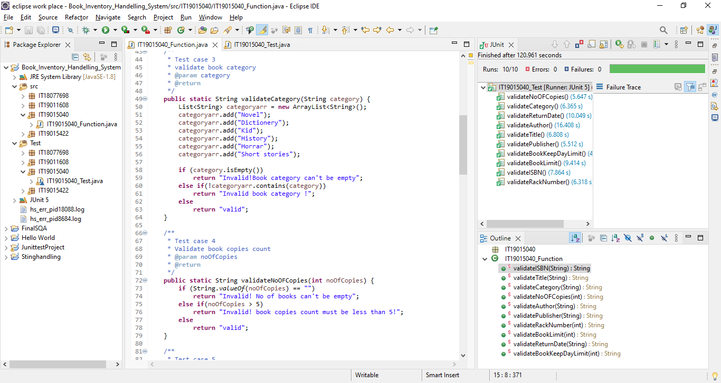

Slide 12
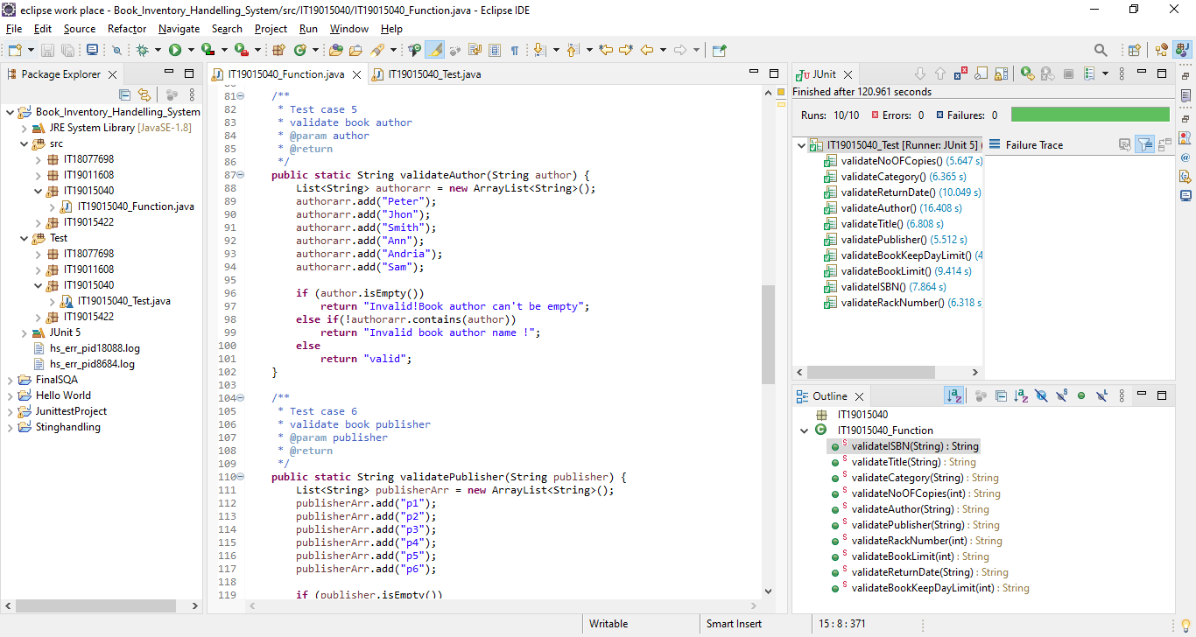

Slide 13
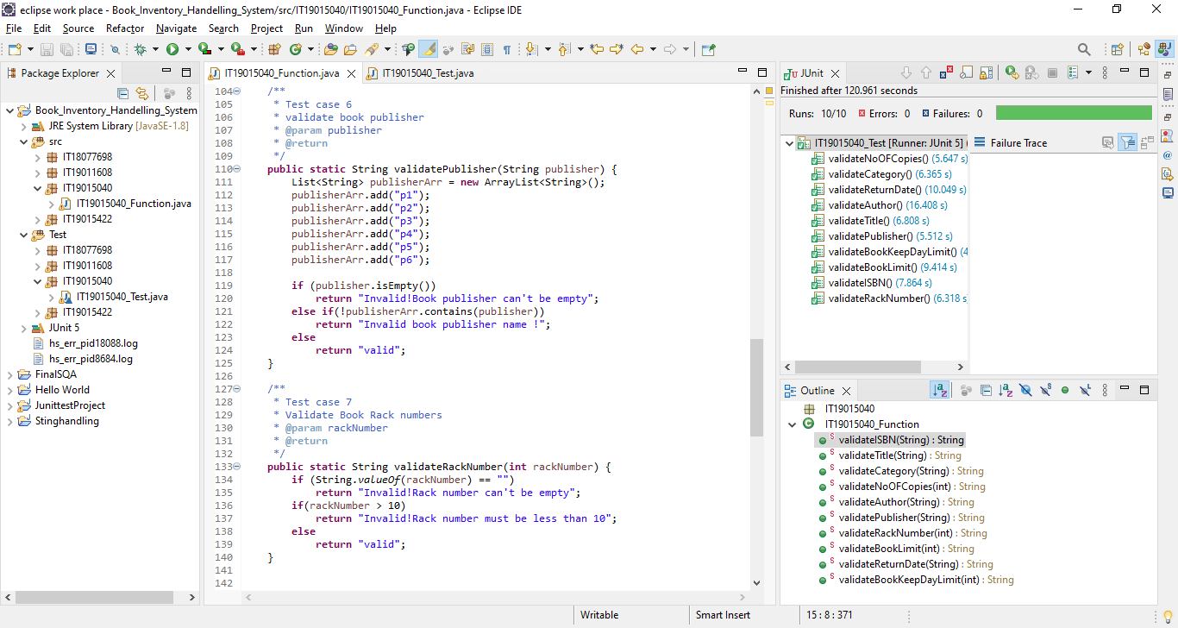

Slide 14
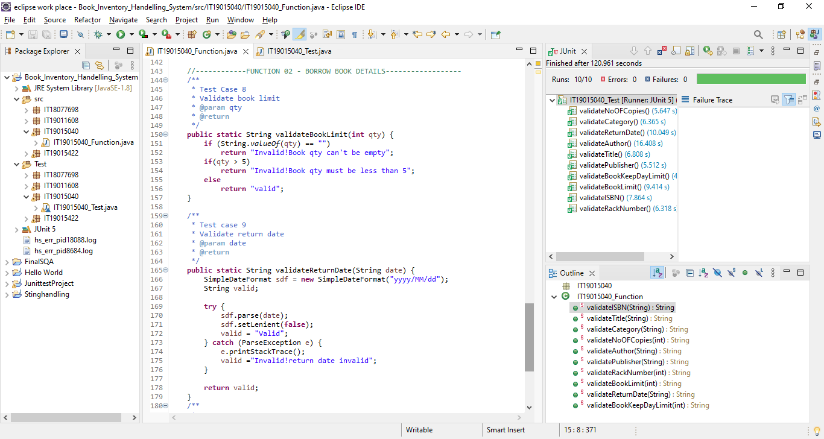

Slide 15
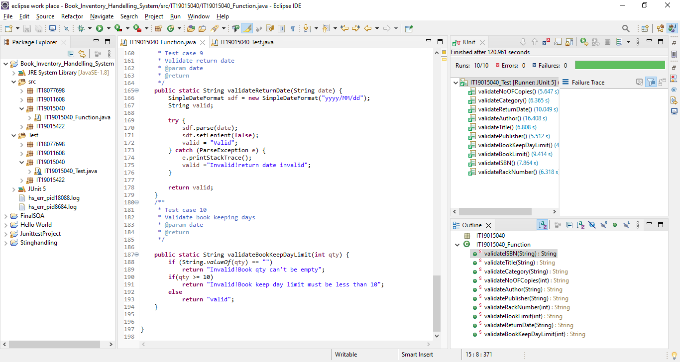

Slide 16
Test results in 4.2
Function Name | Test Case ID | Test Case Description | Pre-Conditions | Test Procedure | Test Inputs | Expected Result | Actual Result | Test Result
Book Registration(Adding Book) | 01 | Check Calculate No of copies |  | Get Book registration details. | Enter the book count=5 Less than 5 | valid | valid | Pass
Calculate approved leaves | 02 | Validate Category |  | Get the books category. | Enter Books Category=Novel | Valid | Valid | Pass
Calculate approved leaves | 03 | Validate return day |  | Get return date | Enter return date=2021/12/03 Date format | Valid | Valid | Pass
Calculate approved leaves | 04 | Validate author |  | Get Authors Names | Enter Authors Name=Peter | Valid | Valid | Pass
 | 05 | Validate Title |  | Get Book Title | Enter Title=Harry Potter | Valid | Valid | Pass

Slide 17
Function Name | Test Case ID | Test Case Description | Pre-Conditions | Test Procedure | Test Inputs | Expected Result | Actual Result | Test Result
Store borrow book details | 06 | Validate Publisher |  | Get Publishers | Enter Publisher=P1 | Valid | Valid | Pass
Calculate monthly attendance | 07 | Validate Book Keep Limit |  | Get Book keep limit | Enter Book keep Limit=8 | Valid | Valid | Pass
Calculate monthly attendance | 08 | Validate Book Limit |  | Get Book Borrow | Enter Borrow Book=4 | Valid | Valid | Pass
Calculate monthly attendance | 09 | Validate ISBN |  | Get valid ISBM | Enter ISBM no=tt12 | Valid | Valid | Pass
 | 10 | Validate Rack Number |  | Enter rack Number | Enter Rack number=7 | Valid | Valid | Pass

Slide 18
Conclusion
The key objective of this presentation was to demonstrate how to use Java JUnit to test the University library with functional requirements. Test cases provide a concept of how to accomplish a task and what the ultimate result will be, and they can aid in predicting the outcome of specific tasks. The above-mentioned test cases provide an example of the type of outcome that must be obtained for a specific activity. Finally, this implementation explains to us how to conduct JUnit testing using Eclipse.

Slide 19
IT19015422 |Perera B.A.A.W.S
Information Technology
IT19015422 | Perera B.A.A.W.S | SQA – G40

Slide 20
Functional Requirements Identified in Task 2.1
Member registration
Store return book details

Slide 21
Test plan created in Task 2.2
Function Name | Test Case ID | Test Case Description | Pre-Conditions | Test Procedure | Test Inputs | Expected Result | Actual Result | Test Result | Comments
Member registration | 01 | Validate Return Date |  | Get date | Enter get date=2021/03/24 | Valid
Calculate approved leaves | 02 | Validate Member Id |  | Get Members id | Enter Member ID=tt123 | Valid
Calculate approved leaves | 03 | Validate Address |  | Get address details | Enter address=Malabe | Valid
Calculate approved leaves | 04 | Validate Gender |  | Get gender | Enter gender=female | Valid
 | 05 | Check calculate Fine Per Day |  | Get fine details | Enter fine details=50 | Valid

Slide 22
Function Name | Test Case ID | Test Case Description | Pre-Conditions | Test Procedure | Test Inputs | Expected Result | Actual Result | Test Result | Comments
Store return book details | 06 | Validate Registered Date |  | Get registered date details | Enter registered date=2021/03/13 | Valid
Calculate monthly attendance | 07 | Calculate Register Fine |  | Calculate Fine | Enter Calculate register fine = 50 | Valid
Calculate monthly attendance | 08 | Validate Contact Number |  | Get number details | Enter contact number=0712346789 | Valid
Calculate monthly attendance | 09 | Validate Member Name |  | Get member details | Enter Member Name=Sara | Valid
 | 10 | Calculate Late Cost |  | Get calculate late cost | Enter Late cost=100 | Valid

Slide 23
Junit test cases in 4.1

Slide 24
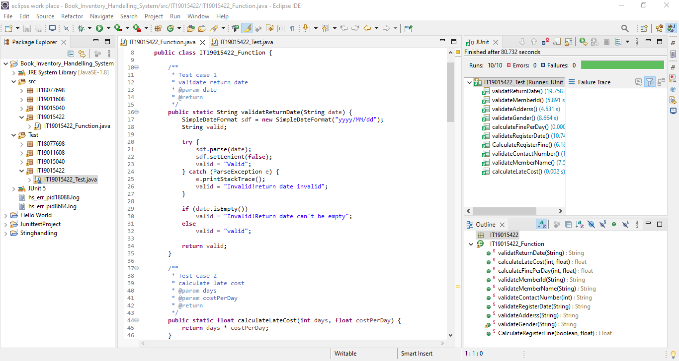

Slide 25
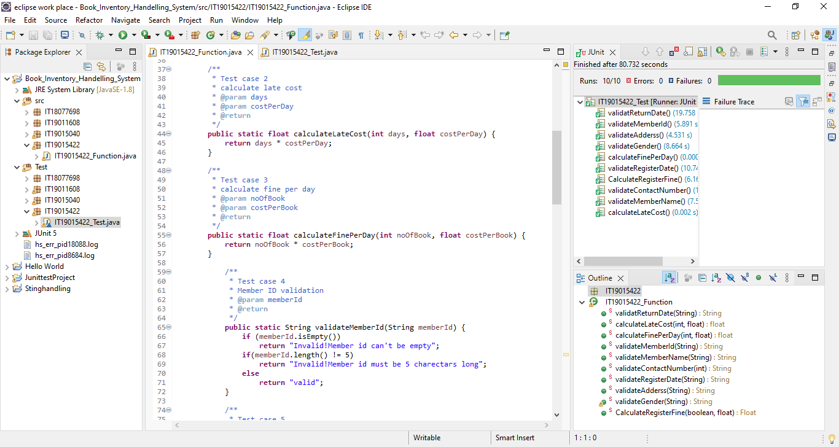

Slide 26
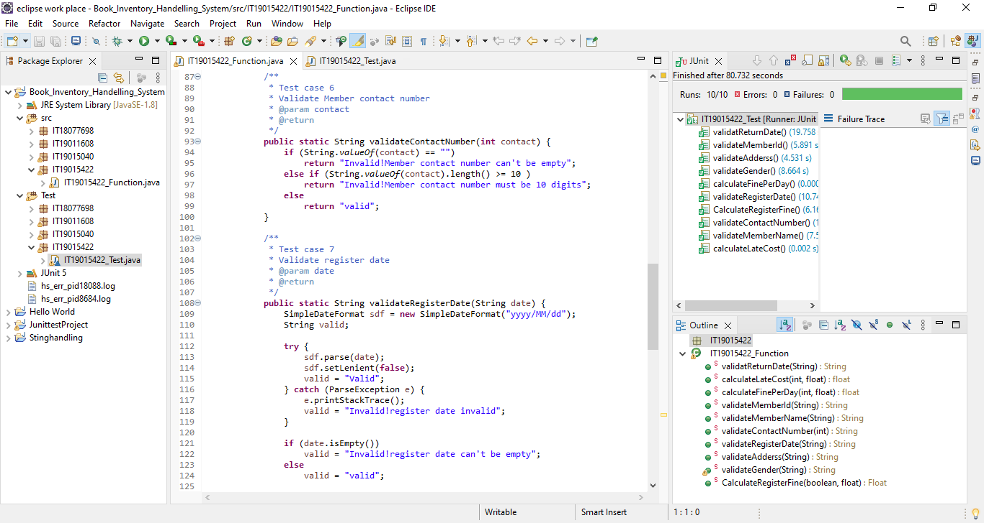

Slide 27
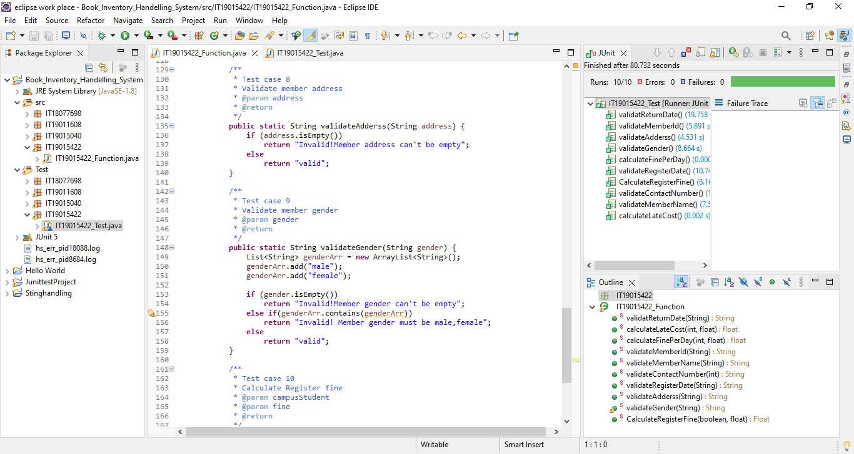

Slide 28
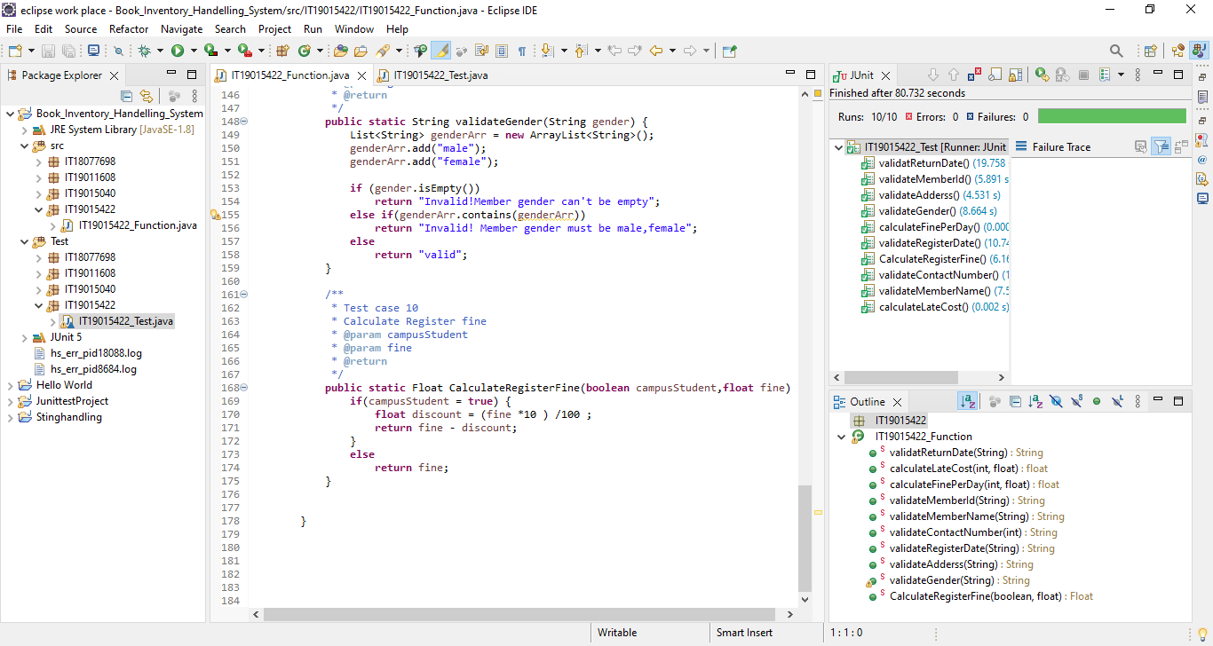

Slide 29
Test results in 4.2
Function Name | Test Case ID | Test Case Description | Pre-Conditions | Test Procedure | Test Inputs | Expected Result | Actual Result | Test Result
Member registration | 01 | Validate Return Date |  | Get date details | Enter get date=2021/03/24 | Valid | Valid | Pass
Calculate approved leaves | 02 | Validate Member Id |  | Get Members id | Enter Member ID=tt123 | Valid | Valid | Pass
Calculate approved leaves | 03 | Validate Address |  | Get address details | Enter address=Malabe | Valid | Valid | Pass
Calculate approved leaves | 04 | Validate Gender |  | Get gender | Enter gender=female | Valid | Valid | Pass
 | 05 | Check calculate Fine Per Day |  | Get fine details | Enter fine details=50 | Valid | Valid | Pass

Slide 30
Function Name | Test Case ID | Test Case Description | Pre-Conditions | Test Procedure | Test Inputs | Expected Result | Actual Result | Test Result
Store return book details | 06 | Validate Registered Date |  | Get registered date details | Enter registered date=2021/03/13 | Valid | Valid | Pass
Calculate monthly attendance | 07 | Calculate Register Fine |  | Calculate Fine | Enter Calculate register fine = 50 | Valid | Valid | Pass
Calculate monthly attendance | 08 | Validate Contact Number |  | Get number details | Enter contact number=0712346789 | Valid | Valid | Pass
Calculate monthly attendance | 09 | Validate Member Name |  | Get member details | Enter Member Name=Sara | Valid | Valid | Pass
 | 10 | Calculate Late Cost |  | Get calculate late cost | Enter Late cost=100 | Valid | Valid | Pass

Slide 31
Conclusion
The key objective of this presentation was to demonstrate how to use Java JUnit to test the University library with functional requirements. Test cases provide a concept of how to accomplish a task and what the ultimate result will be, and they can aid in predicting the outcome of specific tasks. The above-mentioned test cases provide an example of the type of outcome that must be obtained for a specific activity. Finally, this implementation explains to us how to conduct JUnit testing using Eclipse.

Slide 32
IT18077698 |Thennakoon T M B C K
Information Technology
IT18077698 | Thennakoon T M B C K | SQA – G40

Slide 33
Functional Requirements Identified in Task 2.1
Book purchase for library
Book supplier management

Slide 34
Test plan created in Task 2.2
Function Name | Test Case ID | Test Case Description | Pre-Conditions | Test Procedure | Test Inputs | Expected Result | Actual Result | Test Result | Comments
Book purchase for library | 01 | Check calculate delivery cost |  | Get delivery cost | Enter cost = 1800 | Valid
Calculate approved leaves | 02 | Validate book suppliers date |  | Get supplier dated | Enter date=2022/09/19 | Valid
Calculate approved leaves | 03 | Validate Purchased reference no |  | Get purchased bill no | Enter purchased bill = AA123 | Valid
Calculate approved leaves | 04 | Validate no of Books purchased |  | Get no of purchased book | Enter books=4 | Valid
 | 05 | Calculate book discount |  | Get discount details | Enter discount = 10% | Valid

Slide 35
Function Name | Test Case ID | Test Case Description | Pre-Conditions | Test Procedure | Test Inputs | Expected Result | Actual Result | Test Result | Comments
Book supplier management | 06 | Calculate final amount |  | Get final amount | Enter final amount =1700 | Valid
Calculate monthly attendance | 07 | Purchased booked tracked |  | Get purchased book track | Get track no=PR123 5 characters include | Valid
Calculate monthly attendance | 08 | Validate company name |  | Get company name | Enter any company name = SLIIT | Valid
Calculate monthly attendance | 09 | Validate Book purchased date |  | Get valid purchased date | Enter purchased date =2021/03/28 Day format | valid
 | 10 | Validate store supplier id |  | Get supplier id | Enter supplier id = sid124 Only 6 characters | Valid

Slide 36
Junit test cases in 4.1

Slide 37
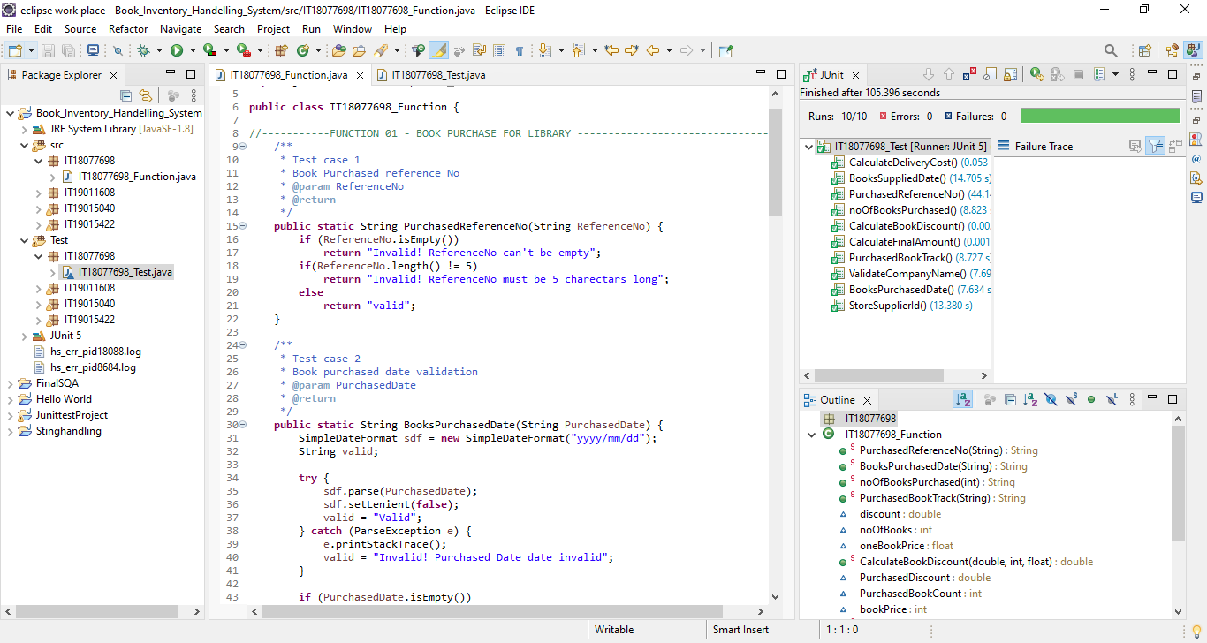

Slide 38
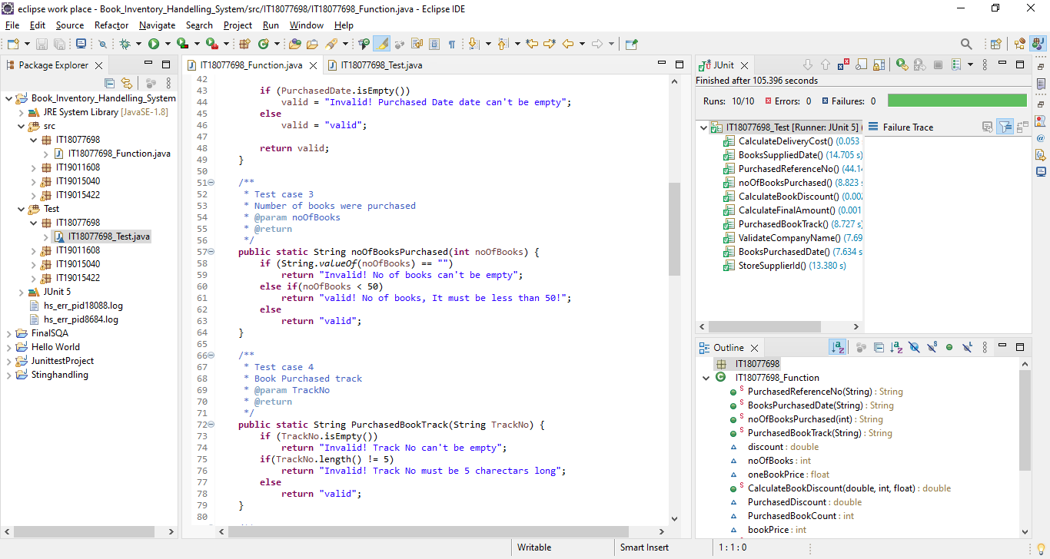

Slide 39
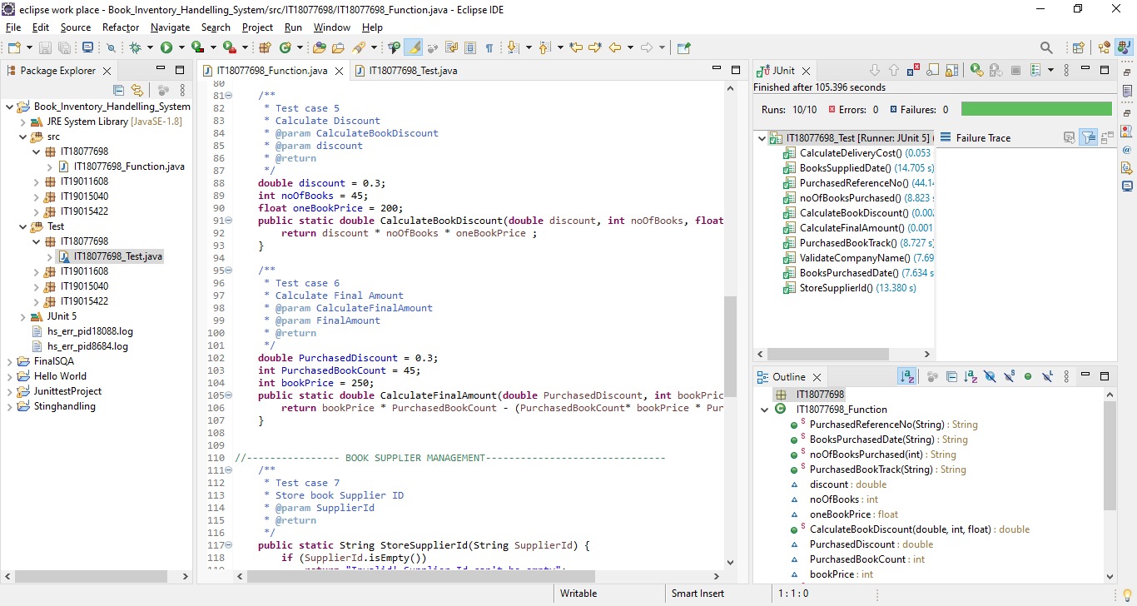

Slide 40
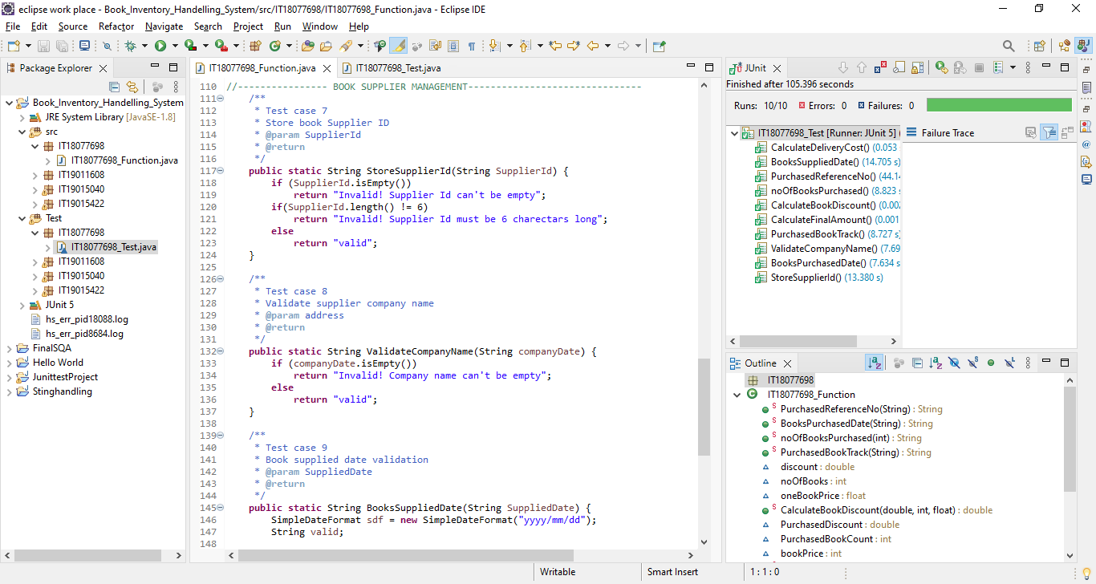

Slide 41
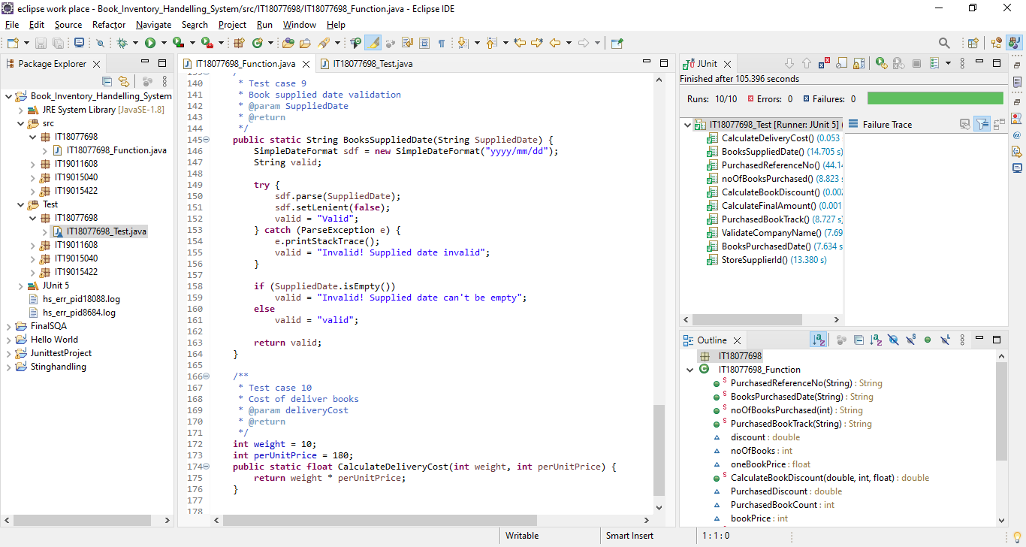

Slide 42
Test results in 4.2
Function Name | Test Case ID | Test Case Description | Pre-Conditions | Test Procedure | Test Inputs | Expected Result | Actual Result | Test Result
Book purchase for library | 01 | Check calculate delivery cost |  | Get delivery cost | Enter cost = 1800 | Valid | Valid | Pass
Calculate approved leaves | 02 | Validate book suppliers date |  | Get supplier dated | Enter date=2022/09/19 | Valid | Valid | Pass
Calculate approved leaves | 03 | Validate Purchased reference no |  | Get purchased bill no | Enter purchased bill = AA123 | Valid | Valid | Pass
Calculate approved leaves | 04 | Validate no of Books purchased |  | Get no of purchased book | Enter books=4 | Valid | Valid | Pass
 | 05 | Calculate book discount |  | Get discount details | Enter discount = 10% | Valid | Valid | Pass

Slide 43
Function Name | Test Case ID | Test Case Description | Pre-Conditions | Test Procedure | Test Inputs | Expected Result | Actual Result | Test Result
Book supplier management | 06 | Calculate final amount |  | Get final amount | Enter final amount =7800 | Valid | Valid | Pass
Calculate monthly attendance | 07 | Purchased booked tracked |  | Get purchased book track | Get track no=PR123 5 characters include | Valid | Valid | Pass
Calculate monthly attendance | 08 | Validate company name |  | Get company name | Enter any company name = SLIIT | Valid | Valid | Pass
Calculate monthly attendance | 09 | Validate Book purchased date |  | Get valid purchased date | Enter purchased date =2021/03/28 Day format | Valid | Valid | Pass
 | 10 | Validate store supplier id |  | Get supplier id | Enter supplier id = sid124 Only 6 characters | Valid | Valid | Pass

Slide 44
Conclusion
The key objective of this presentation was to demonstrate how to use Java JUnit to test the University library with functional requirements. Test cases provide a concept of how to accomplish a task and what the ultimate result will be, and they can aid in predicting the outcome of specific tasks. The above-mentioned test cases provide an example of the type of outcome that must be obtained for a specific activity. Finally, this implementation explains to us how to conduct JUnit testing using Eclipse.

Slide 45
IT19011608 |Senanayaka S.A.M.A.B.M
Information Technology
IT19011608 | Senanayaka S.A.M.A.B.M | SQA – G40

Slide 46
Functional Requirements Identified in Task 2.1
Yearly census checking
Stock manager detail management

Slide 47
Test plan created in Task 2.2
Function Name | Test Case ID | Test Case Description | Pre-Conditions | Test Procedure | Test Inputs | Expected Result | Actual Result | Test Result | Comments
Yearly census checking | 01 | Validate working hours |  | Get working hours | Enter working hours=9 | Valid
Calculate approved leaves | 02 | Validate available book count |  | Get book count | Enter available book=9 | Valid
Calculate approved leaves | 03 | Validate available no of copies |  | Get available no of copies | Enter no of copies=8 | Valid
Calculate approved leaves | 04 | Validate Book Name |  | Get book name | Enter book name=book1 | Valid
 | 05 | Validate damage book count |  | Get damage book count | Enter damage book count=6 | Valid

Slide 48
Function Name | Test Case ID | Test Case Description | Pre-Conditions | Test Procedure | Test Inputs | Expected Result | Actual Result | Test Result | Comments
Stock manager detail management | 06 | Check calculate loss |  | Get loss | Enter loss=175 | Valid
Calculate monthly attendance | 07 | Validate contact number |  | Get contact numbers | Enter contact number=0723457898 | Valid
Calculate monthly attendance | 08 | Validate stock manager name |  | Get stock | Enter stock managers names= | Valid
Calculate monthly attendance | 09 | Validate rack number |  | Get rack numbers details | Enter rack numbers= peter | Valid
 | 10 | Validate store keeper id |  | Get store keeper id | Enter store keeper ids =EID123 | Valid

Slide 49
Junit test cases in 4.1

Slide 50
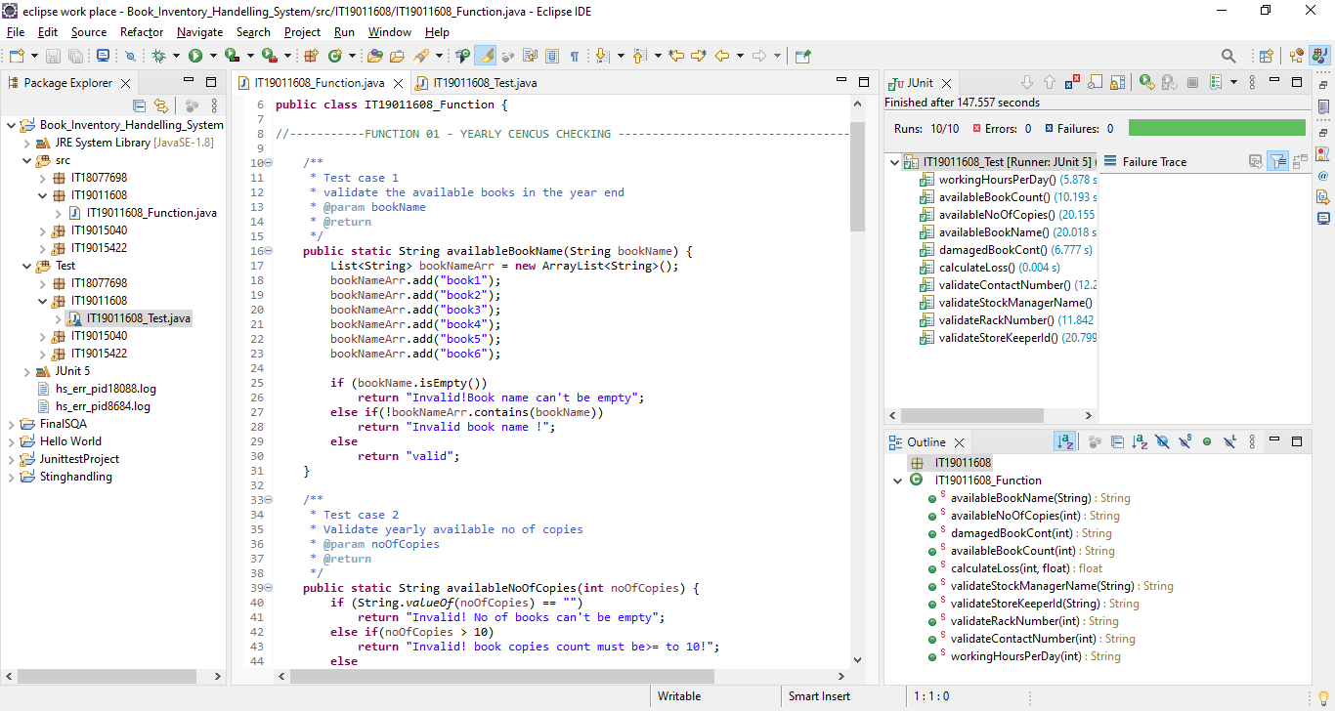

Slide 51
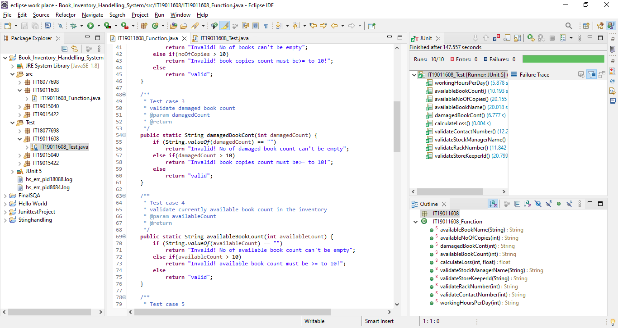

Slide 52
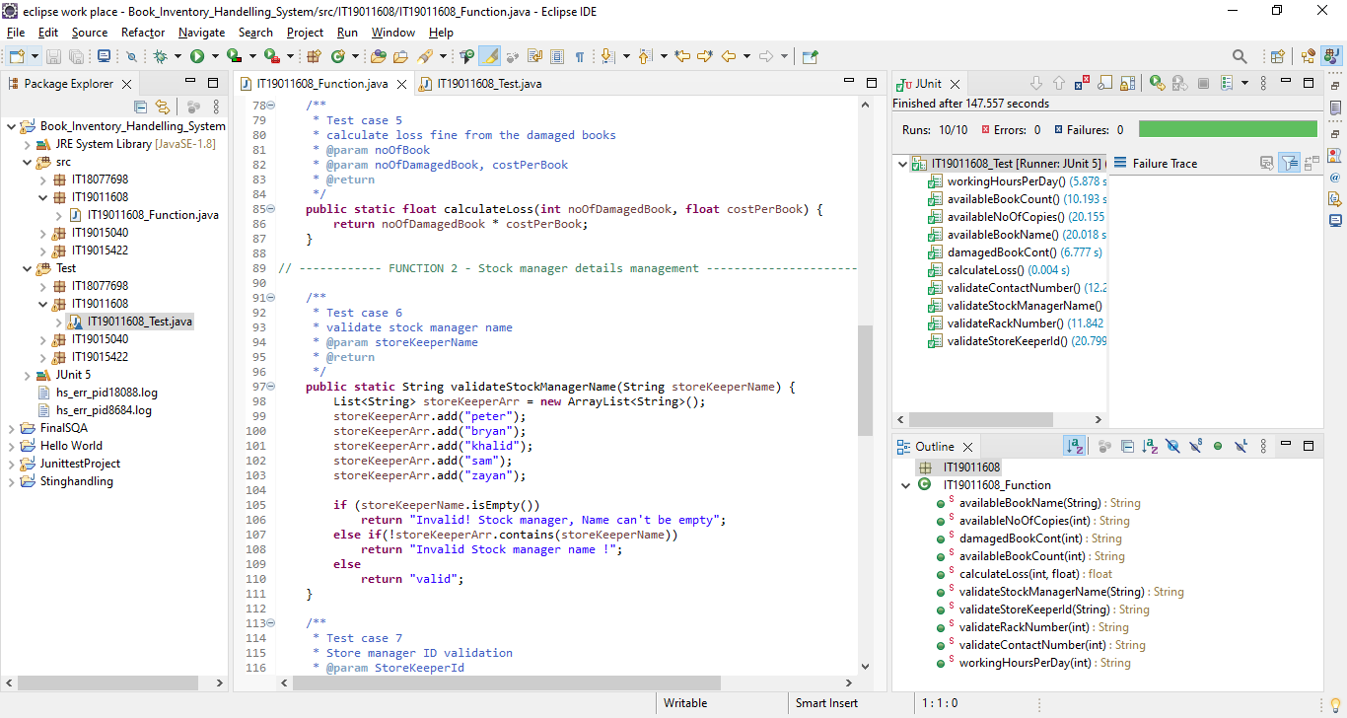

Slide 53
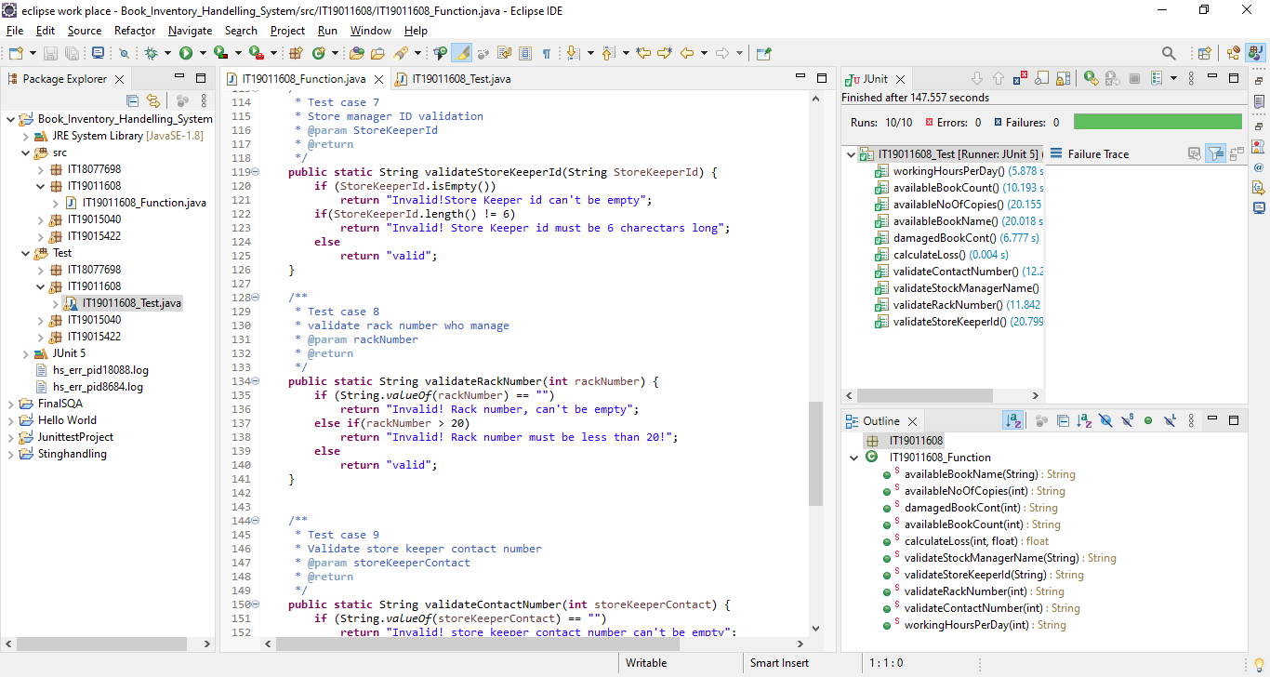

Slide 54
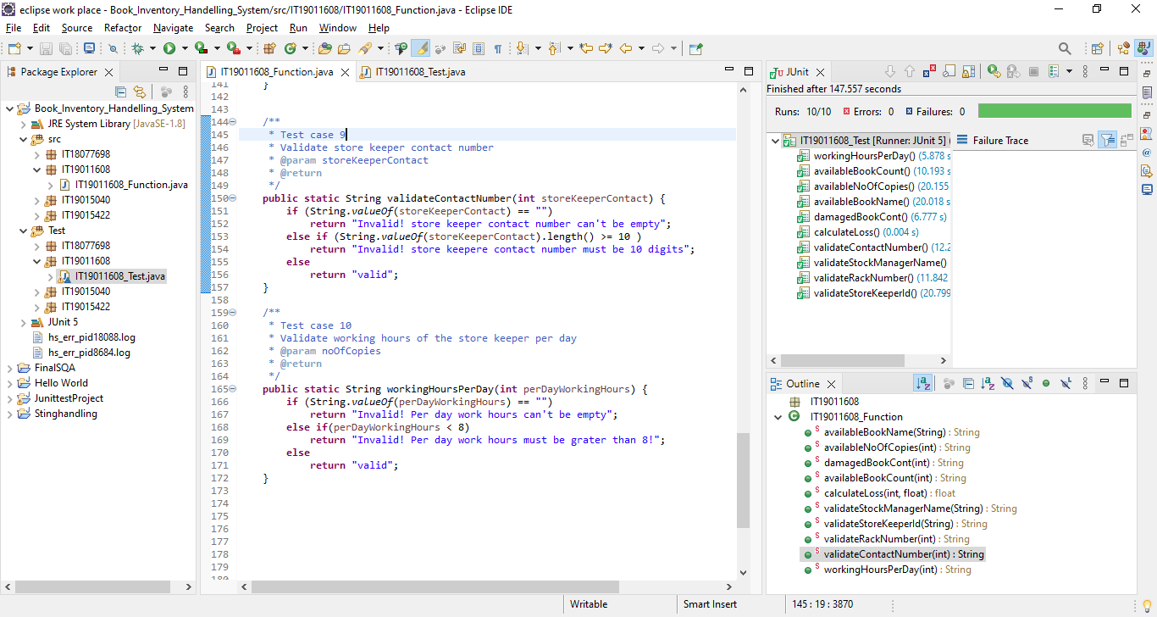

Slide 55
Test results in 4.2
Function Name | Test Case ID | Test Case Description | Pre-Conditions | Test Procedure | Test Inputs | Expected Result | Actual Result | Test Result
Yearly census checking | 01 | Validate working hours |  | Get working hours | Enter working hours=9 | Valid | Valid | Pass
Calculate approved leaves | 02 | Validate available book count |  | Get book count | Enter available book=9 | Valid | Valid | Pass
Calculate approved leaves | 03 | Validate available no of copies |  | Get available no of copies | Enter no of copies=8 | Valid | Valid | Pass
Calculate approved leaves | 04 | Validate Book Name |  | Get book name | Enter book name=book1 | Valid | Valid | Pass
 | 05 | Validate damage book count |  | Get damage book count | Enter damage book count=6 | Valid | Valid | Pass

Slide 56
Function Name | Test Case ID | Test Case Description | Pre-Conditions | Test Procedure | Test Inputs | Expected Result | Actual Result | Test Result
Stock manager detail management | 06 | Check calculate loss |  | Get calculations of loss | Enter loss=175 | Valid | Valid | Pass
Calculate monthly attendance | 07 | Validate contact number |  | Get contact numbers | Enter contact number= 0723457898 | Valid | Valid | Pass
Calculate monthly attendance | 08 | Validate stock manager name |  | Get stock | Enter stock managers names= | Valid | Valid | Pass
Calculate monthly attendance | 09 | Validate rack number |  | Get rack numbers details | Enter rack numbers= peter | Valid | Valid | Pass
 | 10 | Validate store keeper id |  | Get store keeper id | Enter store keeper ids =EID123 | Valid | Valid | Pass

Slide 57
Conclusion
The key objective of this presentation was to demonstrate how to use Java JUnit to test the University library with functional requirements. Test cases provide a concept of how to accomplish a task and what the ultimate result will be, and they can aid in predicting the outcome of specific tasks. The above-mentioned test cases provide an example of the type of outcome that must be obtained for a specific activity. Finally, this implementation explains to us how to conduct JUnit testing using Eclipse.

