Slide 1

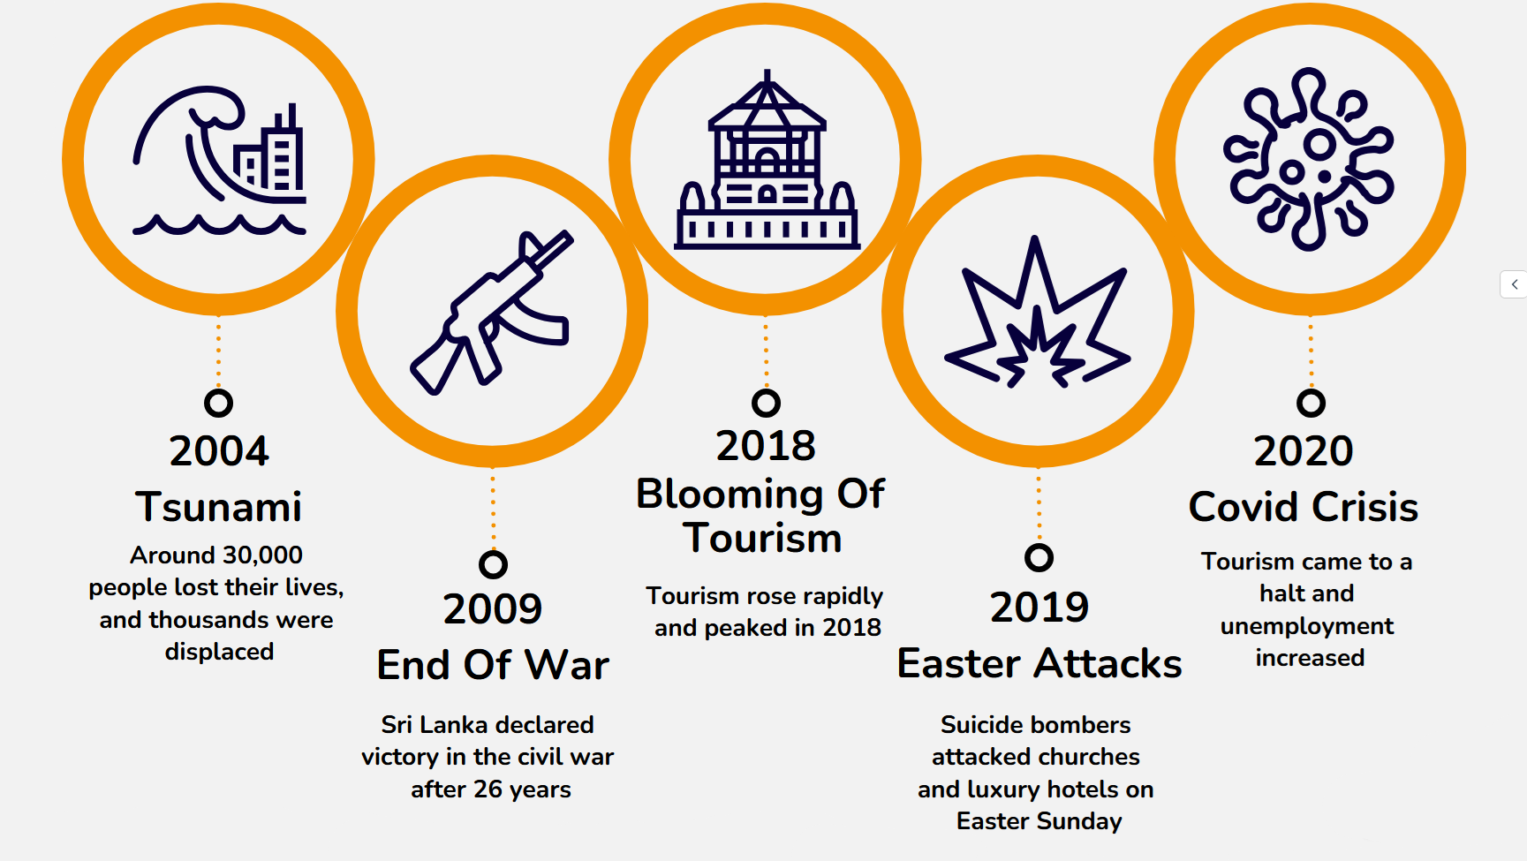
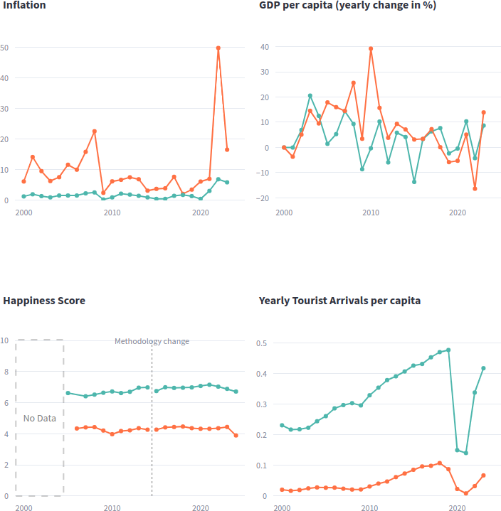
Visualization Project
Summary
Sri Lanka‘s Journey:
A Comparative Study with Germany
Motivation
Highlight how the Sri Lankan crises are a result of mismanagement and external shocks, affecting everyday life since 2000
Assist in assessing personal safety and economic stability in Sri Lanka and Germany
What Sri Lanka went through...
Target Persona (Arjun)
35 years old, married
IT specialist in Munich
Considers moving back to Sri Lanka
Challenges:
Concerned about social and economic conditions, and future developments in Sri Lanka.
Goals:
Wants to assess the current economic landscape and recent progress.
Comparison in Data
Data Used from Germany and Sri Lanka
Happiness Score
According to World Happiness Report
GDP (Gross Domestic Product)
Yearly rate of change
Tourism
Number of tourists coming to the country
Inflation Rates
Amindu De Silva
Dominic Kreuz
Felix Haas
Saruni Fernando
Faculty of Computer Science
„Storytelling with Interactive Data Visualizations“ – Winter Term 2024/2025
Prof. Dr. Markus Breunig

