Slide 1
The Battle of the Neighborhoods (New York Vs Toronto)
Applied Data Science Capstone by IBM/Coursera

Slide 2
Introduction (Business Problem):
Toronto and New York are the famous places in the world. They are diverse in many ways. We want to explore how much they are similar or dissimilar in aspects from a tourist point of view regarding food, accommodation, beautiful places, and many more. Both are multicultural as well as the financial hubs of their respective countries.

Slide 3
Data:
For this problem, we will get the services of Foursquare API to explore the data of two cities, in terms of their neighborhoods. The data also include the information about the places around each neighborhood like restaurants, hotels, coffee shops, parks, theaters, art galleries, museums ... . We selected one Borough from each city to analyze their neighborhoods. Brooklyn from New York and Central Toronto from Toronto. We will use “Clustering” to segment the neighborhoods with similar objects based on each neighborhood data. This will help to locate the tourist’s areas and hubs, and then we can judge the similarity or dissimilarity between two cities on that basis.

Slide 4
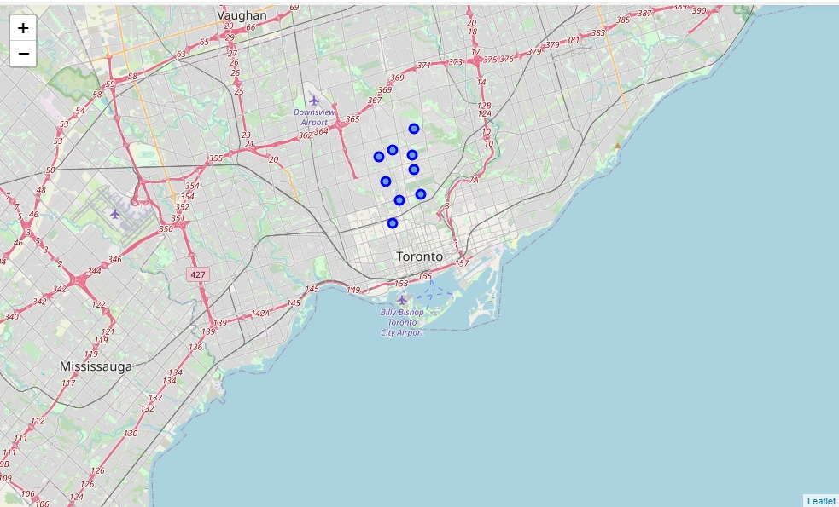
VISUALIZATION
Central Toronto
Before Clustering

Slide 5
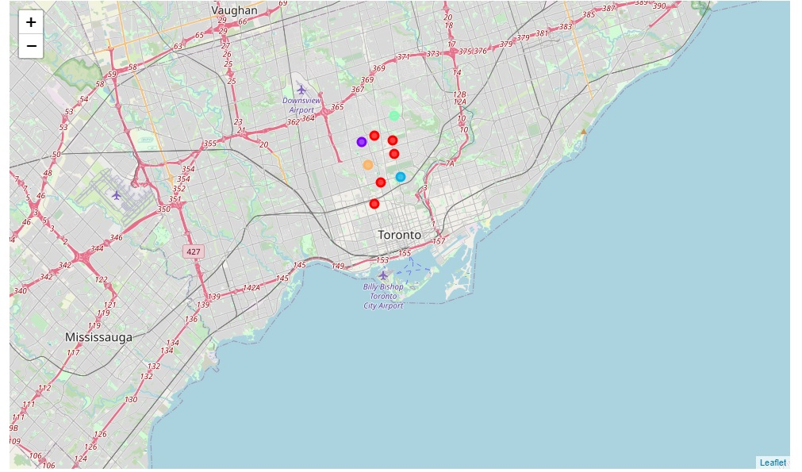
After Clustering

Slide 6
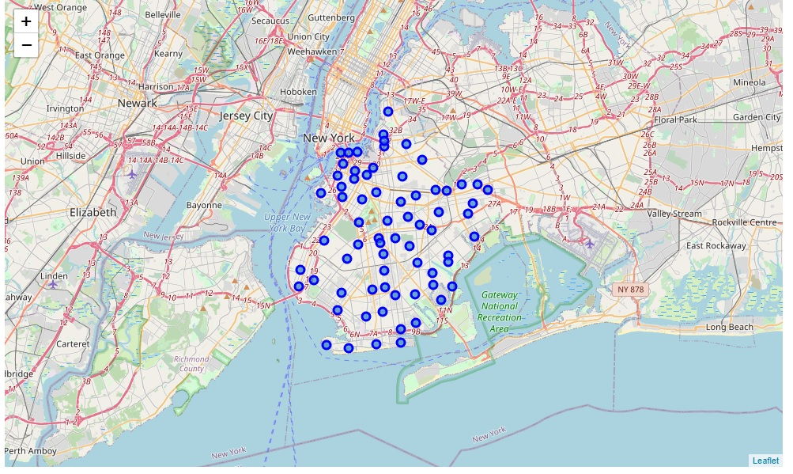
Brooklyn
Before Clustering

Slide 7
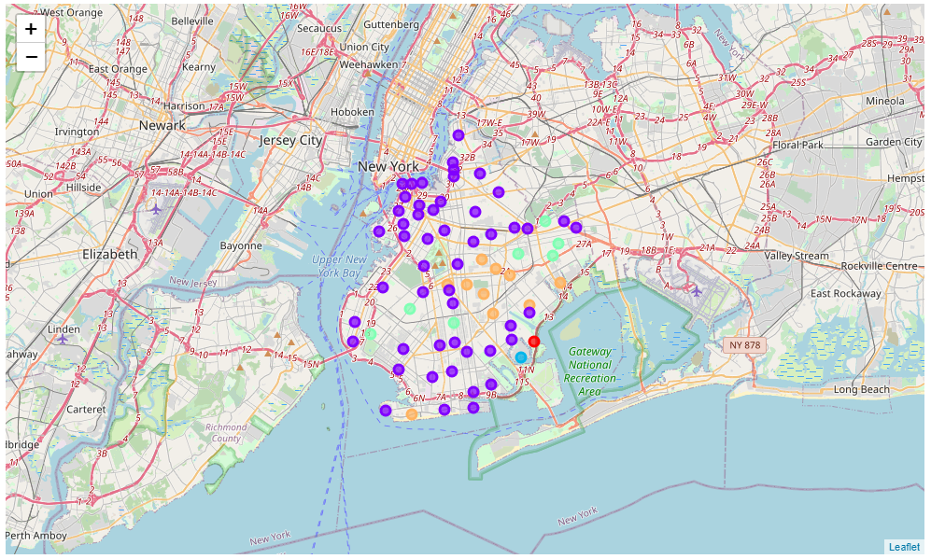
After Clustering

Slide 8
Results and Discussion:
After clustering the data of the respective neighborhoods, both cities (Boroughs) have venues which can be explored and attract the Tourists. The neighborhoods are much similar in features like Theaters, opera houses, food places, clubs, museums, parks etc. As far as concern to dissimilarity, it differs in terms of some unique places like historical places and monuments. When we compare the tourist places, we observe that the park place is only situated in Central Toronto and the Monument or landmark venue is in Brooklyn neighborhoods. Similarly, Airport facility, Harbor, Sculpture garden and Boat or ferry services are also available in central Toronto while venues like Nightlife, Climbing gym and Museums are present in Brooklyn. As far as concern to recommendations, we recommend Brooklyn Neighborhoods will be considered first to visit for more nightlife and fun.

Slide 9
Conclusion:
The Central Toronto and Brooklyn neighborhoods have more like similar venues. As we know that, every place is unique in its own way, so this argument is present in both neighborhoods. The dissimilarity exists in terms of some different venues and facilities but not on a larger extent

