Slide 1
DawaLink
A REAL PHARMACY QUESTION, MADE EASIER · OCTOBER 2026
“3afak wach kayn Doliprane 1g f Rabat?”
The product promise
Understand the request
Confirm the exact catalogue item
Prepare an editable enquiry
The pharmacy supplies the real stock answer.
A customer wants a clear answer about one exact medicine pack. DawaLink helps them identify it and prepare a useful pharmacy question—in Darija, Arabic or French.
Local-first · 9,908 imported catalogue rows · free/open-source runtime · no hosted AI or paid API
DawaLink · local-only core · technical implementation
01

Slide 2
User story · from uncertainty to a useful question
THE EXPERIENCE
Customer need
As a person looking for a medicine, I want to explain what I need in my own language, so I can identify the right catalogue item and ask a pharmacy clearly without guessing availability.
1 · Explain the need
“3afak wach kayn Doliprane 1g f Rabat?”
The local model extracts intent, medicine, strength and city.
2 · Confirm the pack
DawaLink shows three real 1 G records. The customer compares form and package, then selects ID 563.
3 · Prepare the question
Review the quantity, city and Darija wording. Copy it to contact a pharmacy.
Success means an exact, customer-confirmed product and a useful enquiry. The customer decides what to send; the pharmacy provides the actual stock answer.
DawaLink · local-only core · technical implementation
02

Slide 3
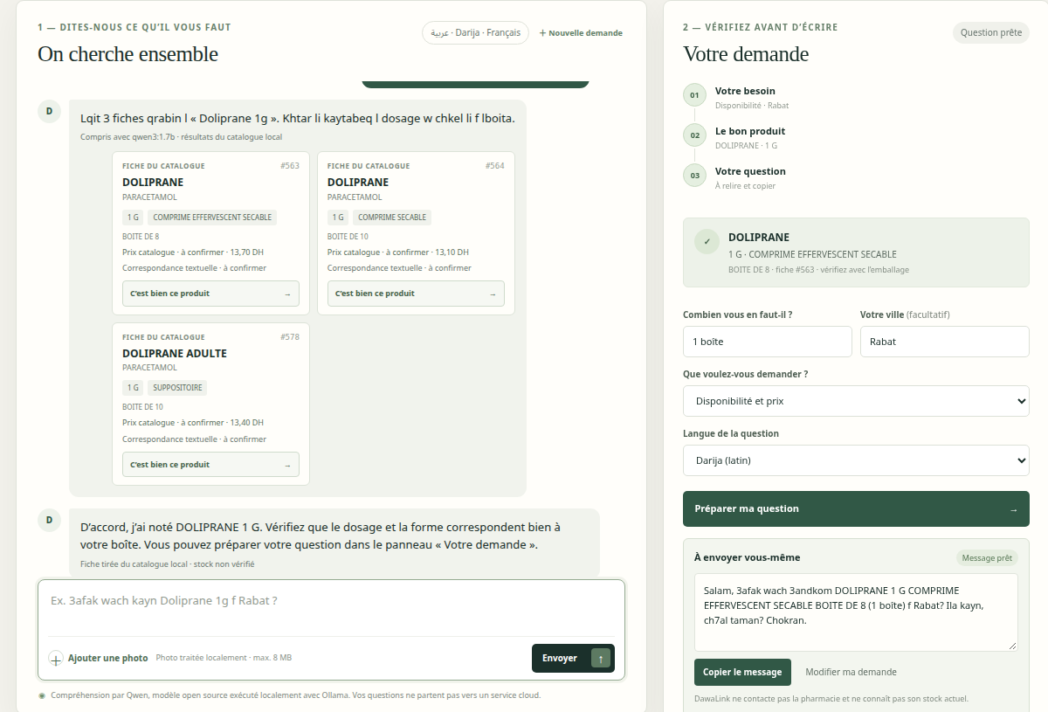
The customer stays in control at every step
OBSERVED LIVE WORKFLOW
Captured from the running app · selected ID 563 · customer copies the message; inventory is not verified.
DawaLink · local-only core · technical implementation
03

Slide 4






Technical architecture · local, grounded, inspectable
RUNTIME DESIGN
ONE DEVICE · LOCAL SERVICES
Browser UI
HTML · CSS · JS
text / photo / confirm
Python WSGI API
app.py · validation
JSON + multipart
DawaLink core
intent grounding
search · request guard
SQLite · FTS5
9,908 records
product facts only
HTTP
JSON
SQL search
photo upload
OCR text
local prompt
Tesseract OCR
optional image text
eng · fra · ara
Ollama runtime
127.0.0.1:11434
local chat API
Qwen3 1.7B
schema-constrained
request extraction
Browser → validated API → local interpretation and retrieval → candidate records → user confirms → editable message to copy
No cloud LLM · no external pharmacy directory · no live inventory · no automatic sending
DawaLink · local-only core · technical implementation
04

Slide 5
The model interprets intent; the catalogue supplies facts
TRUST BOUNDARY
User’s words
“3afak wach kayn
Doliprane 1g
f Rabat?”
Qwen3 structured parse
intent: availability
medicine: Doliprane
strength: 1 G
city: Rabat
SQLite candidates
3 catalogue records
all 1 G
ID 563 selected
BOITE DE 8
The model is a language interface—not a medicine database. Search results are grounded, strength conflicts are filtered, and the customer confirms the exact pack.
DawaLink · local-only core · technical implementation
05

Slide 6
Real catalogue data, with its gaps kept visible
DATA PIPELINE
9,908 source rows
10 original columns
0 duplicate IDs
4,070 brand strings
Missing or unavailable values in supplied export
EPI
9,908 · 100%
Status
1,810 · 18%
PPV
1,098 · 11%
PH
1,098 · 11%
Source CSV
9,908 rows
ingest_data.py
normalize + validate
SQLite · FTS5
atomic rebuild
Provenance matters
Repository export date is unknown. Values are preserved as supplied; historical price fields are not live pharmacy prices. No missing manufacturer, stock or status facts are filled in.
DawaLink · local-only core · technical implementation
06

Slide 7
Search narrows the choice; the customer makes it
CATALOGUE RETRIEVAL
Query | Observed result | What the system uses
doliprene | DOLIPRANE · 1 G | normalized + fuzzy text
AMOXICILLINE | ALFAMOX · 1 G | active ingredient
DOLIPRANE 500 MG | DOLIPRANE · 500 MG | strength agreement
DIACURE | no result | weak lookalike suppressed
Search scores are matching signals, not calibrated probabilities. Similar products remain separate choices; strength and form must be checked.
DawaLink · local-only core · technical implementation
07

Slide 8
Photo identification is an optional local path
IMAGE PROCESSING
1 · Validate file type and size
2 · Preprocess locally
3 · Tesseract reads visible text
4 · Search the same SQLite catalogue
5 · Customer reviews any candidate
Evidence: one real photo spot check
MIT test image showed a foreign-market DiaCURE pack. OCR read ENFANTS / CHILDREN and missed the brand; catalogue result was safely empty.
This is a documented failure case—not a performance claim. A Moroccan product photo benchmark is still needed.
DawaLink · local-only core · technical implementation
08

Slide 9
Small API, clear responsibilities
IMPLEMENTATION
Browser ↔ Python WSGI
GET /api/health
GET /api/medications?q=…
GET /api/medications/{id}
POST /api/assistant/message
GET /api/assistant/status
POST /api/recognize
POST /api/pharmacy-request
GET /api/export
SQLite storage
Original source columns + normalized search keys, source, import timestamp; indexed FTS5 product text.
Enquiry guard
Generation requires a valid catalogue ID. User reviews the product, quantity, city and wording, then copies the message.
DawaLink · local-only core · technical implementation
09

Slide 10
A clear enquiry the customer can review and copy
PRODUCT OUTCOME
Product ID 563 · DOLIPRANE 1 G · BOITE DE 8 · 1 boîte · Rabat · captured in the running app
DawaLink · local-only core · technical implementation
10

Slide 11
What has been verified—and what has not
EVALUATION
Core logic
18 earlier tests passed
6/6 catalogue probes hit top 3
LLM flow
3 live smoke prompts
Darija · Arabic · French
No accuracy benchmark
Photo evidence
1 foreign photo
brand missed
No Morocco benchmark
Scope today: conversational intent extraction, catalogue search, optional text OCR and message preparation. Not present: diagnosis, dosing advice, live prices, stock, pharmacy directory, voice, ordering or automatic messaging.
DawaLink · local-only core · technical implementation
11

Slide 12
Run the same local stack
REPRODUCIBILITY
1 · Load the model
ollama pull qwen3:1.7b
Start Ollama if needed: ollama serve
2 · Prepare and launch
python3 scripts/ingest_data.py
python3 app.py
Open http://127.0.0.1:8000
Ollama serves Qwen3 1.7B on loopback. Tesseract 5 and language packs are optional for image OCR. Model weights are downloaded separately; no paid service is required.
DawaLink · local-only core · technical implementation
12

