Slide 1
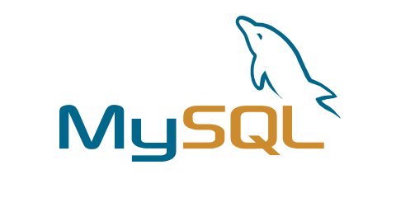
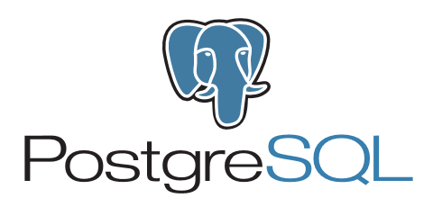
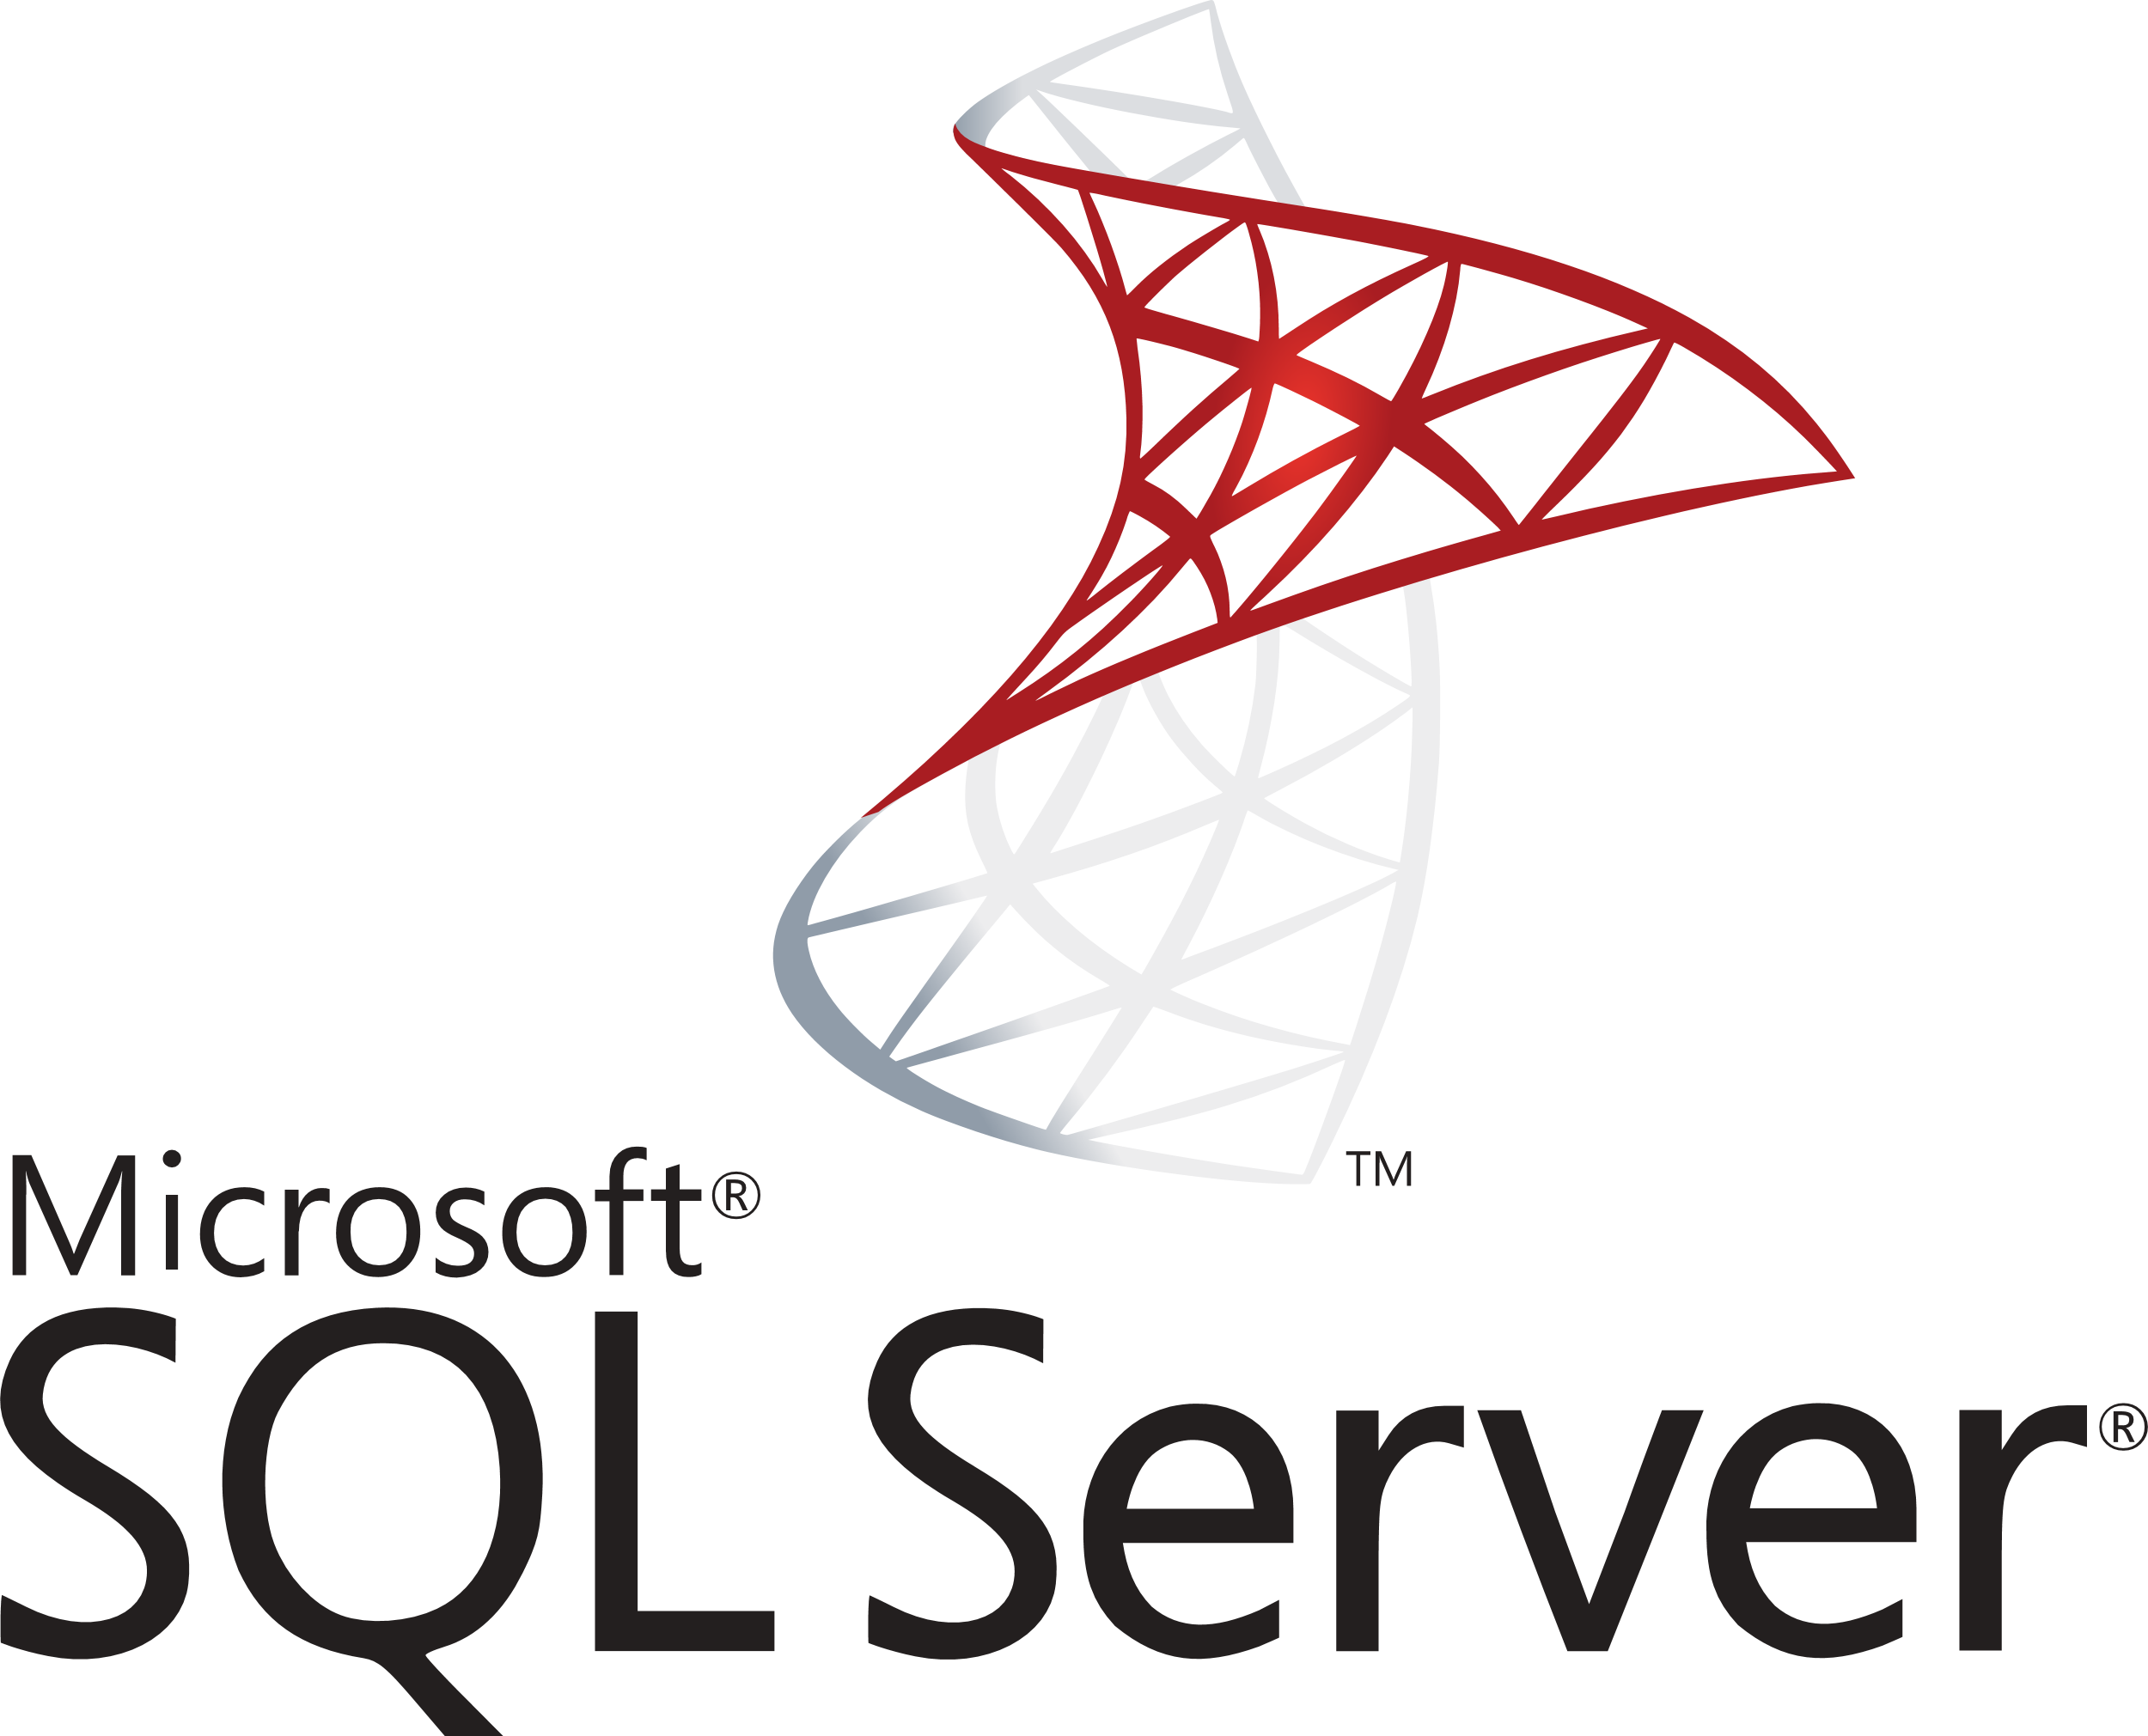
Relational RDBMS
MySQL, PostgreSQL and SQL Server
Amine KACEM GoMyCode - 30/01/2021

Slide 2
MySQL relational database management system
MySQL is an open-source relational database management system (RDBMS).[5][6] Its name is a combination of "My", the name of co-founder Michael Widenius's daughter,[7] and "SQL", the abbreviation for Structured Query Language. A relational database organizes data into one or more data tables in which data types may be related to each other; these relations help structure the data. SQL is a language programmers use to create, modify and extract data from the relational database, as well as control user access to the database. In addition to relational databases and SQL, an RDBMS like MySQL works with an operating system to implement a relational database in a computer's storage system, manages users, allows for network access and facilitates testing database integrity and creation of backups.
Initial release date: May 23, 1995
License: GPLv2 or proprietary
Operating system: Linux, Solaris, macOS, Windows, FreeBSD
Programming languages: C++, C
Developer: Oracle Corporation, MySQL AB, Michael Widenius, Sun Microsystems, David Axmark

Slide 3
PostgreSQL relational database management system
PostgreSQL also known as Postgres, is a free and open-source relational database management system (RDBMS) emphasizing extensibility and SQL compliance. It was originally named POSTGRES, referring to its origins as a successor to the Ingres database developed at the University of California, Berkeley.[13][14] In 1996, the project was renamed to PostgreSQL to reflect its support for SQL. After a review in 2007, the development team decided to keep the name PostgreSQL and the alias Postgres
PostgreSQL features transactions with Atomicity, Consistency, Isolation, Durability (ACID) properties, automatically updatable views, materialized views, triggers, foreign keys, and stored procedures.[16] It is designed to handle a range of workloads, from single machines to data warehouses or Web services with many concurrent users. It is the default database for macOS Server[17][18][19] and is also available for Windows, Linux, FreeBSD, and OpenBSD.
Initial release date: July 8, 1996
License: PostgreSQL License (free and open-source, permissive)
Operating system: FreeBSD, Linux, macOS, OpenBSD, Windows
Programming languages: C
Developer: PostgreSQL Global Development Group, University of California, Berkeley, Free and open-source software

Slide 4
SQL Server relational database management system
SQL Server is a relational database management system developed by Microsoft. As a database server, it is a software product with the primary function of storing and retrieving data as requested by other software applications—which may run either on the same computer or on another computer across a network (including the Internet). Microsoft markets at least a dozen different editions of Microsoft SQL Server, aimed at different audiences and for workloads ranging from small single-machine applications to large Internet-facing applications with many concurrent users.
Initial release date: April 24, 1989;
License: Proprietary software
Operating system: Linux, Microsoft Windows Server, Microsoft Windows
Programming languages: C, C++
Developer: Microsoft Corporation

Slide 5
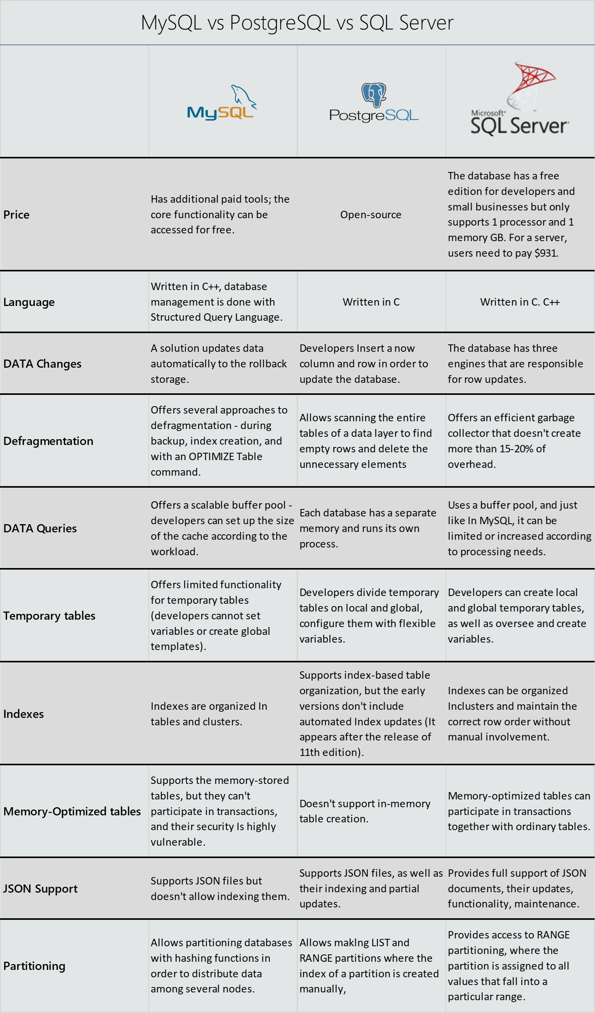
Benchmark MySQL vs PostgreSQL vs SQL Server

Slide 6
Benchmark MySQL vs PostgreSQL vs SQL Server

Slide 7
Benchmark MySQL vs PostgreSQL vs SQL Server

