Slide 1



By
Samelson, de Schietere de Lophem, Aousji and Abah

Slide 2
Table of contents
Introduction
How Does it work?
Firestore VS Realtime database
Firestore
Data type
Data model
Example of document and collection
Features
Firebase storage
Firebase extensions
Firebase authentication
Demo Showcase app

Slide 3
Introduction
Created 2012, acquired by Google in 2014 put in the Firebase platform.
Cloud-hosted No-SQL database.
Data stored in “JSON” and synchronized to every connected client
Create iOS, Android, Web apps in C++,Python, Flutter …

Slide 4
How does it work ?
The clients connect directly to the database in the cloud and don’t have to go through the application’s server.
Application is connected to firebase through web sockets.
The app just sends data to FireStore and it handles saving and syncing across all connected devices / sites.
All data is synced through the single web socket connection.

Slide 5
Realtime vs Firestore
Realtime | Firestore
Stores data as one large JSON tree | Stores data in documents organized in collections
Offline support for iOS and Android | Offline support in iOS, Android and web clients
Deep queries are limited into sorting or filtering | Indexed queries with compound sorting and filtering

Slide 6
Data types
Firestore supports different types of data :
Array
Boolean
Date and time
Text String
Map (keys are always sorted)
Number
Geopoint (Latitude, Longitude)
Reference (to another document)
Null

Slide 7
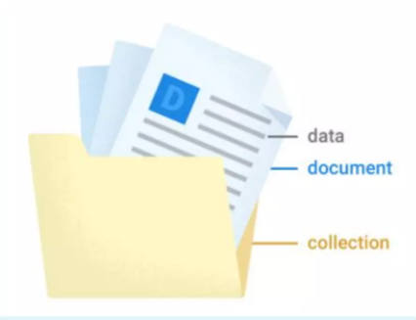
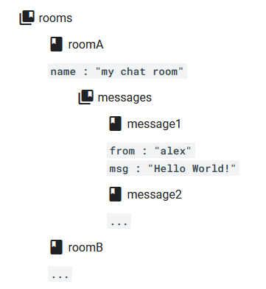
Data Model
No tables, rows and columns.
Document contains key-value pairs data (JSON).
Documents can contain subcollections.

Slide 8
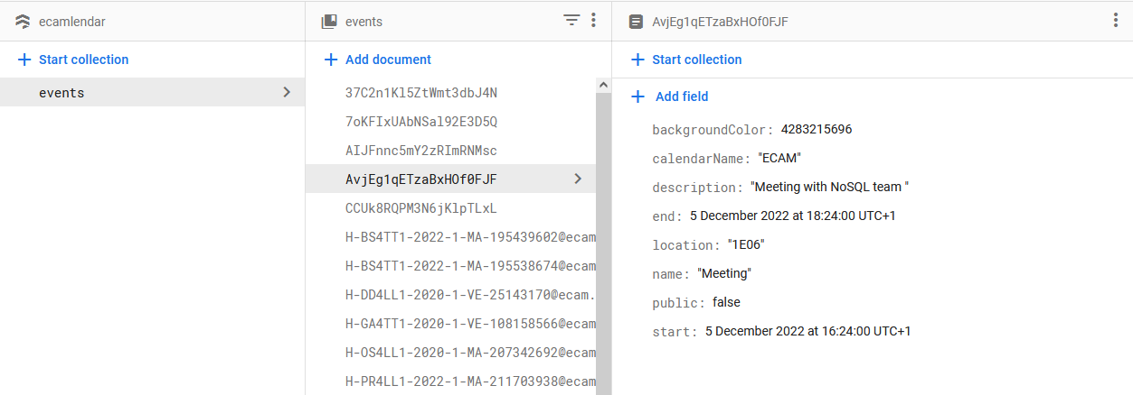
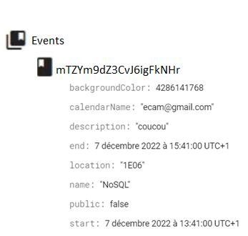
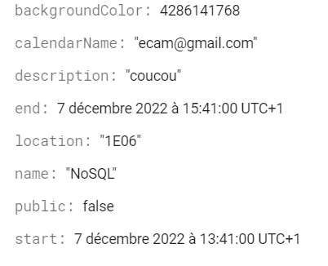
Example of documents and collections
Collections
Documents
Fields
Notes:
Example of a document with its fields.
As it is a NoSQL database, fields can differ between documents. For example, in some event documents, we do not have the location or description field

Slide 9
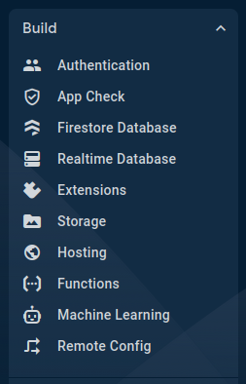
Features
Firebase storage:
Upload files to the cloud so they can be shared to everyone else.
All transfers are performed over a secure connection.
In case the connection is broken they will automatically resume.
Available for iOS, Android and web apps.
Firebase Extensions:
Prepacked solutions that provide extended functionality to the apps.
Example of extensions :
Shorten URLs written to documents in cloud Firestore
Send an email when a document has been added to Firestore
...
Notes:
The firebase platform includes a lot of features, and we will present you 3 of those.
The first one is Storage, used to upload files like images for example …
Then we have the possibility to add extensions …
- ability to Shorten urls
- triggering emails when a specific document has been added
- or even adding payment methods

Slide 10

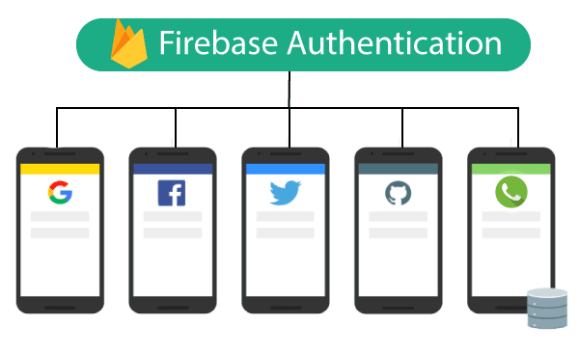
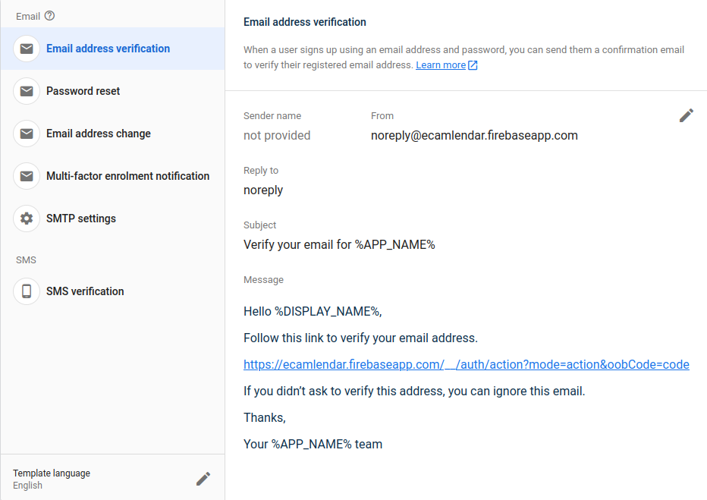
Features
Firebase authentication:
Supports lots of different ways for users to authenticate
Built-in functionality for third party providers
Customizable templates for user creation confirmation
User information contain unique ID which is guaranteed to be distinct across all providers.
Firebase also manage user session.
Password and other sensitive information are crypted
Notes:
And last but not least, Firebase includes an AUTH system

Slide 11

Firebase GUI & Showcase app

Slide 12
Thanks for your attention

