Slide 1
EventHub: UI & API Test Automation
Team Red · Playwright + TypeScript · JUNIA ISEN · Software Quality Assurance · 2 November 2026
MA
Mohamed Amine Bannour
LC
Lilian Clabecq
AF
Amira Foudi
SS
Salma El Sayed
IA
Issraa El Aouni
Notes:
Presenter: Amine. Introduce the team (Team Red, assigned Playwright), the project goal: a maintainable UI + API automation framework that another QA engineer could run and extend.

Slide 2
Results at a glance: 47/47 passing, serial and parallel
10 + 1
8
47 / 47
0 flaky
UI test cases + 1 failure-oriented case
API test cases (CRUD, auth, contract, errors)
report entries passed, 1 worker and 4 workers
141 runs: 6 workers × 3 repeats
What we built
What we will show live
EventHub: our own registration app (UI + REST API) with every mandatory control doing real work
A layered Playwright framework: POM, API clients, fixtures, JSON-schema contracts
Evidence: HTML/JSON/JUnit reports, redacted API logs, parallel timeline
UI and API suites running, serially and in parallel
Data-driven tests: one report entry per data set
Two real failures: root cause, fix and prevention
Notes:
Presenter: Amine. Headline numbers from the real runs on 1 November 2026. Data-driven cases expand into 47 report entries. Stability run: every test 3 times on 6 workers, 141 passed, 0 flaky.

Slide 3
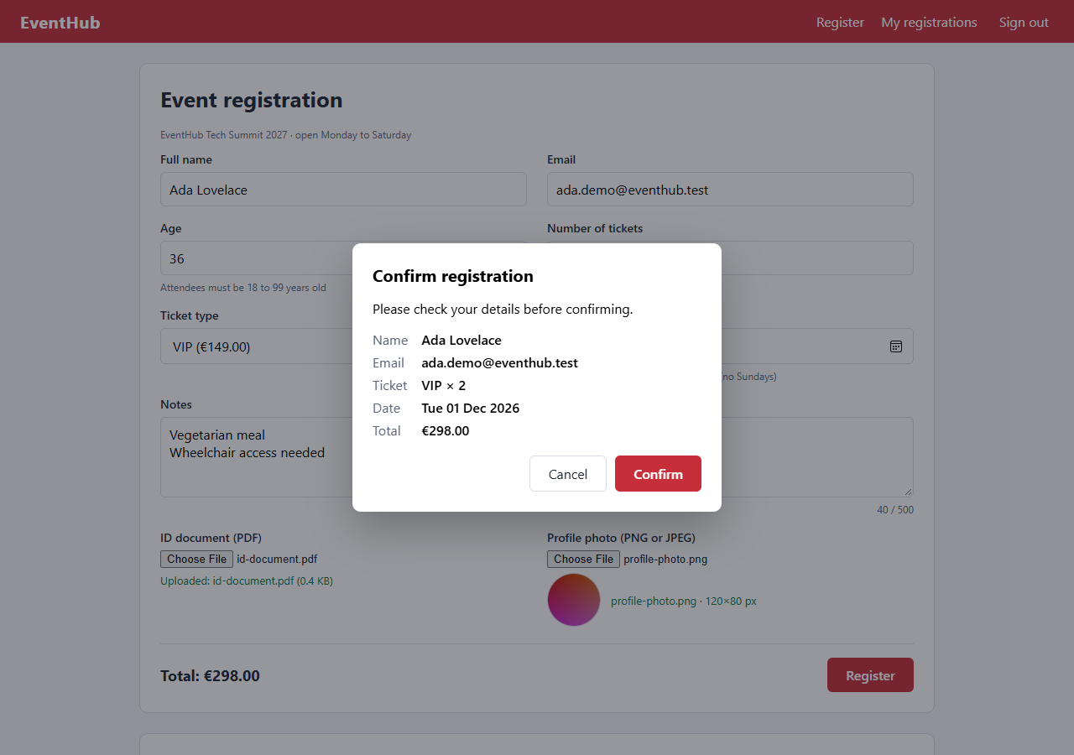
Application under test: EventHub, built for testability
1
Text & number
Name, email, age 18–99, tickets 1–10
2
Text area
Multi-line notes, live counter, 500 limit
3
File & image
PDF ≤ 1 MB; PNG/JPEG ≤ 2 MB, decoded
4
Dropdown & date
Ticket type → price; tomorrow…+365, no Sundays
5
Dialog & dynamic
Modal + confirm(); spinner, toasts, filter
6
REST API
Confirmation dialog over the filled registration form
Bearer auth, CRUD, 400/401/404/409, schema
Notes:
Presenter: Amine. YouTube (assignments 1 and 2) has no upload, date picker or number input for signed-out users, and its terms forbid automation. Public demo sites were unreachable from our network and do not reject bad images or restrict dates. The assignment explicitly allows an app developed by the team. Runs offline: npm run app.

Slide 4
Playwright with TypeScript: why this language
T
Technical fit
M
Maintainability
Playwright is written in TypeScript; its test runner, fixtures, projects and parallel workers are first-class in TS.
Static types catch a broken page-object call or a wrong payload at compile time (npm run typecheck), not mid-run.
E
Team experience
S
Ecosystem
Everyone knows JavaScript from web courses; TypeScript adds safety without a new paradigm.
Ajv for JSON Schema, dotenv for config, the same language as the app under test.
Notes:
Presenter: Amine. Assigned tool: Playwright (Team Red). We chose TypeScript over Python/Java/C#. Justify with technical suitability, maintainability, team experience, ecosystem.

Slide 5
Framework architecture: tests say what, layers say how
tests/ui · tests/api
Scenarios and assertions only: UI-01…UI-10, UI-F01, API-01…API-08
Project structure
app/ application under test
config/ environment (.env)
clients/ API layer
pages/ page objects
components/ reusable UI parts
fixtures/ setup & teardown
test-data/ data sets & files
utils/ schemas, assertions
tests/ui tests/api
scripts/ evidence tooling
docs/ evidence/ reports/
fixtures/test-fixtures.ts
Per-test token, clients, pages, automatic clean-up, execution trace
pages/ + components/
BasePage, LoginPage, RegistrationPage, ConfirmDialog, RegistrationsTable
clients/
BaseApiClient → Auth, Public, Registration clients
test-data/
Factory, JSON/TS data sets, upload files
utils/ + config/
JSON schemas (Ajv), date rules, types, env.ts
Notes:
Presenter: Lilian. Walk the layers top to bottom. Tests never touch selectors or raw HTTP. Fixtures inject clients and pages (dependency inversion) and clean up afterwards.

Slide 6
Design principles and naming conventions
Principle | Where you can see it
Page Object Model | Selectors only in pages/ and components/; a UI change touches one file
Single responsibility | One client per API area, one page object per page, components for dialog and table
Open / closed | New endpoint = new client extending BaseApiClient; auth and evidence inherited
Dependency inversion | Tests receive clients and pages from fixtures, never build them
Encapsulation | BaseApiClient.send() is protected; tests call create / list / remove
DRY | Rules shared by UI and API; one boundary table feeds UI-04 and API-07
Configuration | config/env.ts reads .env; no URLs or credentials in test code
Naming conventions
Test title: <ID> <behaviour> @tags
e.g. UI-05 ID document upload accepts PDFs up to 1 MB… @file
Data sets in the title: UI-03 [DD-02], API-07 [boundary age=17]
Files: kebab-case.spec.ts; classes PascalCase.ts
Locators named after what users see: submitButton, documentStatus
Methods named after intent: register(), uploadPhoto()
Notes:
Presenter: Lilian. Give one concrete example per principle. Naming: IDs in titles link to the test inventory; tags drive subsets such as --grep @regression.

Slide 7
API automation: 8 cases, contract to error handling
ID | Endpoint(s) | Checks | Result
API-01 | GET /health, /ticket-types | Schema, content-type, no-store, request id | Pass
API-02 | POST /auth/token | 200 / 401 / 400; 401 without or with forged token | Pass
API-03 | POST /registrations | 201, Location, schema, server-computed total | Pass
API-04 | GET /registrations/{id} | Equality, email filter, 404 | Pass
API-05 | PUT /registrations/{id} | Updated fields, timestamps, persisted | Pass
API-06 | DELETE /registrations/{id} | 204 empty, then 404 twice | Pass
API-07 | POST (data-driven ×16) | Boundaries and invalid fields → field errors | Pass 16/16
API-08 | POST error handling | 409 duplicate, 400 empty, malformed JSON | Pass
Contract testing
No secrets in code or reports
JSON Schemas with additionalProperties: false: an unexpected or renamed field fails the test and names the field.
Credentials come from .env (git-ignored); evidence replaces auth values with ***REDACTED***.
Notes:
Presenter: Lilian. Every call goes through BaseApiClient, which attaches the request and response to the HTML report with Authorization, password and token redacted. Show one attachment live.

Slide 8
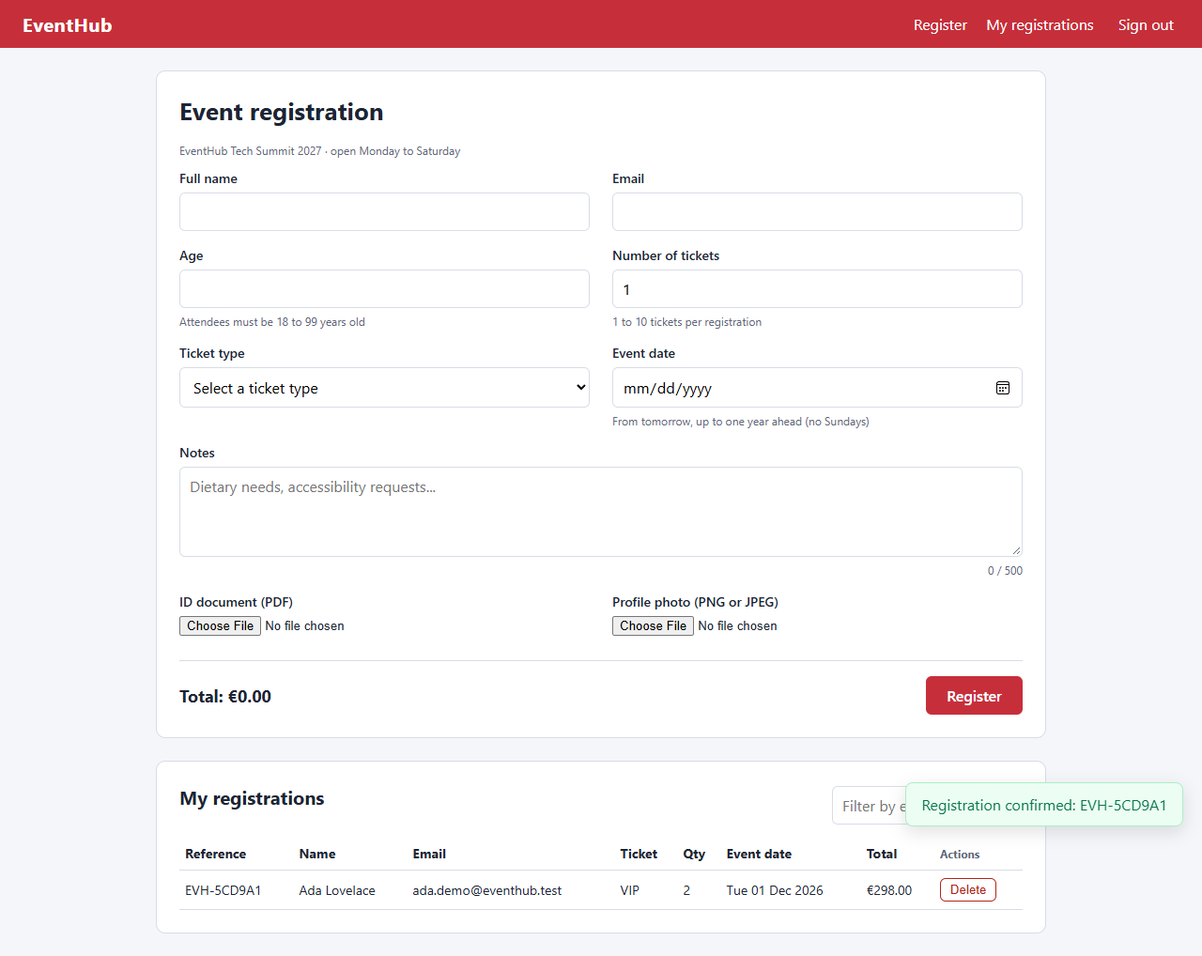
UI automation: 10 cases + 1 failure-oriented, all passing
ID | Scenario | Result
UI-01 | Valid registration → dialog → toast → row → reload → API | Pass
UI-02 | Empty form: 5 required messages, focus, no dialog | Pass
UI-03 | Invalid values (data-driven ×7) | Pass 7/7
UI-04 | Age / tickets boundaries (data-driven ×8) | Pass 8/8
UI-05 | PDF accepted, .txt and > 1 MB rejected | Pass
UI-06 | PNG/JPEG preview; GIF, fake PNG, > 2 MB rejected | Pass
UI-07 | Date window, Sunday rule, formatted date | Pass
UI-08 | Price, counter, list filter update live | Pass
UI-09 | Modal cancel; confirm() dismiss / accept | Pass
UI-10 | Sign-in guard, wrong password, sign-out | Pass
UI-F01 | Duplicate email → 409 shown to the user | Pass
Assertions check what users see: messages, values, upload status, dialog content, URL, title, and the record in the API.
Notes:
Presenter: Amira. Point at UI-01 as the end-to-end flow. Assertions are web-first and retried automatically. Durations from the parallel run.

Slide 9
Locators and synchronisation: stable selectors, no sleeps
1
How we find elements
2
How we wait
Roles and labels first: getByRole("button", { name: "Register" }), getByLabel("Event date")
Stable IDs only for validation messages linked by aria-describedby
No layout-based CSS/XPath, no generated IDs
Rows located by the test's unique email, never by index or shared text
Playwright auto-waiting before every action
Web-first assertions retry until true: expect(locator).toHaveText()
waitForResponse for API calls triggered by the UI
Trace kept on failure: DOM snapshots, network, console
Flaky hunt: --repeat-each=10 --workers=4
Notes:
Presenter: Amira. The server adds 400 to 1200 ms of random latency on purpose, so any missing wait shows up immediately. There is not a single waitForTimeout in the test suite.

Slide 10
Test coverage: every required test type is covered
Test type | UI | API
Positive | UI-01 | API-03, API-05
Negative | UI-02, UI-03, UI-10, UI-F01 | API-02, API-07, API-08
Boundary | UI-04, UI-05, UI-07 | API-07
Field / data validation | UI-02, UI-03 | API-07
File & image validation | UI-05, UI-06 | API-07 (non-PDF)
Date validation | UI-07 | API-07 (past, today, Sunday)
Dynamic elements | UI-08 (+ UI-01 spinner/toast) | –
Dialog handling | UI-09 (+ UI-01, UI-07) | –
State verification | UI-01, UI-09 | API-05, API-06
Regression / smoke | UI-01, UI-10 | API-01
Schema, headers, auth, CRUD | – | API-01…API-06
Approach
Arrange through the API: fast, no UI flakiness
Act and assert through the UI like a user
Confirm state through the API
Assert behaviour, never just that something "is clickable"
Notes:
Presenter: Amira. Recap after the UI and API slides: map each required type to test IDs. Strategy: preconditions through the API (fast, reliable), behaviour verified through the UI, state double-checked through the API.

Slide 11
Data-driven testing: one test, many data sets
test-data/invalid-fields.json
{ "id": "DD-02", "field": "fullName",
"value": "R2-D2",
"expectedError": "Full name may only contain
letters, spaces, hyphens and apostrophes" }
tests/ui/form-validation.spec.ts
for (const row of invalidFields) {
test(`UI-03 [${row.id}] rejects ...`, async ({ registrationPage: ui }) => {
await ui.enterAndBlur(row.field, row.value);
await expect(ui.fieldError(row.field))
.toHaveText(row.expectedError);
});
}
U3
UI-03 · 7 data sets
JSON file: invalid names, emails, age, tickets
U4
UI-04 · 8 data sets
Boundary table: 17/18/99/100, 0/1/10/11
A7
API-07 · 16 data sets
Same boundary table + 8 invalid payloads
Notes:
Presenter: Salma. Show invalid-fields.json, then the for-loop in form-validation.spec.ts, then the report where each data set is its own entry with its ID. Run: npm run test:data-driven.

Slide 12
Independent tests: 2.2× faster in parallel, zero conflicts
1
Own session
Each test requests its own token and browser context
2
Own data
Factory makes a unique email; duplicates fail loudly (409)
3
Own clean-up
Fixture deletes every record the test created, API or UI
4
No shared state
Stability: 141 runs (6 workers × 3 repeats), 0 failed, 0 flaky
No fixed IDs, no execution order, no global counts
Notes:
Presenter: Salma. fullyParallel: true. Same 47 tests: 37.9 s on 1 worker vs 17.0 s on 4 workers, peak 4 tests at once (evidence/parallel-timeline.md). Isolation: own token, unique email per test, fixture clean-up, no fixed IDs, shared views scoped to own data.

Slide 13
Challenges we hit and how we solved them
Challenge | Problem | Resolution
App choice | YouTube and public demo sites lacked required controls or were unreachable | Built EventHub: every control does real work and it runs offline
Async UI | Spinner, toasts and API latency made timing matter | Web-first assertions + waitForResponse; no sleeps
Shared table | Parallel tests all write to the same list | Unique email per test, rows located by email
Changing dates | Fixed dates expire; Sundays are forbidden | Dates computed from today with the app's own rules
Browser download | Chromium download stalled on our network | BROWSER_CHANNEL=msedge option to use an installed browser
Notes:
Presenter: Salma. Be honest about each obstacle and the decision it led to.

Slide 14
Failure 1: the schema, not the API, was wrong
1
Detected
Value | Fixed pattern | Original pattern
1.0.0 | accepted | rejected ✗
10.2.33 | accepted | rejected ✗
1.0 | rejected | rejected
dXdXd | rejected | accepted ✗
d.d.d | rejected | accepted ✗
API-01 failed: version must match pattern "^d+.d+.d+$". The real response was "1.0.0", which is valid.
2
Root cause
In a JS string, "\d" silently becomes "d". The schema demanded letters "d" and accepted anything as separators.
3
Fix
pattern: String.raw`^\d+\.\d+\.\d+$` keeps the backslashes.
The original check failed both ways: it rejected every real version and accepted nonsense.
4
Prevention
Regex in strings always via String.raw; test the test with a known-bad value.
Notes:
Presenter: Issraa. Category: faulty assertion. We did not loosen the expectation; the fixed pattern still rejects bad versions (1.0, dXdXd). Logs in evidence/failure-investigation/01-03.

Slide 15
Failure 2: passed alone, failed in parallel
Original locator (row found by name)
getByRole('row', { name: /Ada Lovelace/ })
Error with 4 workers
strict mode violation: … resolved to 2 elements:
1) EVH-B01C74 Ada Lovelace qa.…
2) EVH-C3BE9F Ada Lovelace qa.…
Fix: locate by the test's unique email
rows.filter({ has: getByRole('cell',
{ name: email, exact: true }) })
3/3
1 of 4
passed alone (1 worker)
failed with 4 workers
Root cause → prevention
Every test uses the default name "Ada Lovelace"; only the email is unique
Fixed in RegistrationsTable.rowByEmail(), plus toHaveCount(1)
Rule: shared views are always scoped to test-unique data
Verified: 47/47 on 4 workers, 141/141 on 6 × 3
Notes:
Presenter: Issraa. Category: incorrect locator showing up as a parallel / test-data problem. .first() would have hidden it and could verify another test's row. Reproduce live: npm run test:failure-demo.

Slide 16
Individual contributions
Mohamed Amine Bannour
App, config, fixtures · Tests: UI-01, UI-10, API-01, API-02
MA
QA lead · architecture
Lilian Clabecq
API clients, schemas, assertions · Tests: API-03, API-04, API-05, API-06
LC
API automation
Amira Foudi
Pages, components · Tests: UI-05, UI-06, UI-08, UI-09
AF
UI page objects & controls
Salma El Sayed
Factory, data sets, parallel isolation · Tests: UI-02, UI-03, UI-04, API-07
SE
Test data, data-driven & parallel
Issraa El Aouni
Failure investigations, reports, docs · Tests: UI-07, UI-F01, API-08, DEMO-01
IE
Reporting & failure analysis
Notes:
Presenter: Issraa. She summarises what each member did; everyone owns 4 tests. Edit this slide if your real split differs - the instructor requires explicit individual contributions.

Slide 17
Lessons learned
1
2
3
Check the response first
Parallel exposes hidden coupling
Design data for isolation
A failing contract test can be a broken test: test the test
Run new tests with --repeat-each before trusting them
Unique data and clean-up make parallel runs safe
Next improvements
Run the suite in CI (GitHub Actions) on every push, sharded across machines
Add Firefox and WebKit projects and accessibility checks (axe-core)
Visual regression snapshots for the form and dialog
Thank you · Questions?
Notes:
Presenter: Issraa. Answer the final challenge question: if the app changes tomorrow, a label change touches one page object; a rule change updates the data tables; a new API field is caught by the strict schema. Then open for questions.

