Slide 1
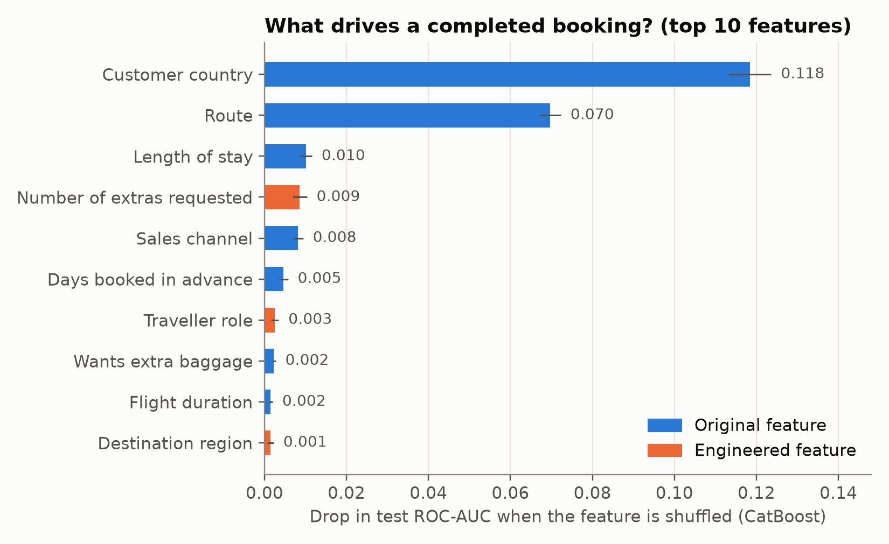
Predicting customer bookings: who completes a booking, and why?
49,281 booking requests · 70/15/15 split · Random Forest, XGBoost & CatBoost tuned on validation · best: CatBoost · scores on unseen test set
0.79
0.37
50%
Key findings
Who books, and where to, dominates. Customer country and route are by far the strongest drivers. Malaysia converts at 35% vs 5% for Australia, our largest market.
Short, near-term trips convert better. Longer stays and bookings made far in advance lower the probability; mobile converts at 11% vs 15% on web.
Engagement and intent signal buying. All 3 extras requested: 19% conversion vs 11% with none. Return-leg bookings convert less (13% vs 17% outbound).
Data, not algorithm, is the limit. Tuned Random Forest, XGBoost and CatBoost all land at 0.793–0.795 test ROC-AUC; richer session data (searches, prices seen) is the next lever.
ROC-AUC on unseen test set
PR-AUC vs 0.15 at random
of bookings captured by
the top 20% scored customers
Recommendation: use the score to prioritise follow-ups on the top 20% of requests (~50% of all bookings), push bundled extras during booking, and investigate the mobile funnel and the Australian market (high volume, low conversion).

