Slide 1
File or Data Object
A
B
C
D
E
Data Block
A
A
A
Triple replication
Stored in different nodes of the storage network

Slide 2
File or Data Object
Split the data object
into k parts
[n,k] erasure
code
A₁
A₂
A_{k}
P₁
P₂
P_{m}
k storage units
add m parity storage units

Slide 3
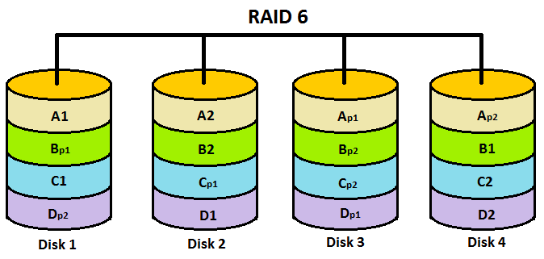

Slide 5
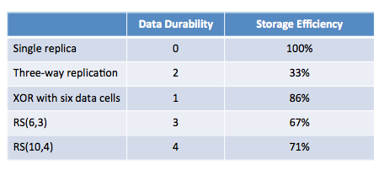
retrofitting EC support into an existing distributed storage system like HDFS, a

Slide 6
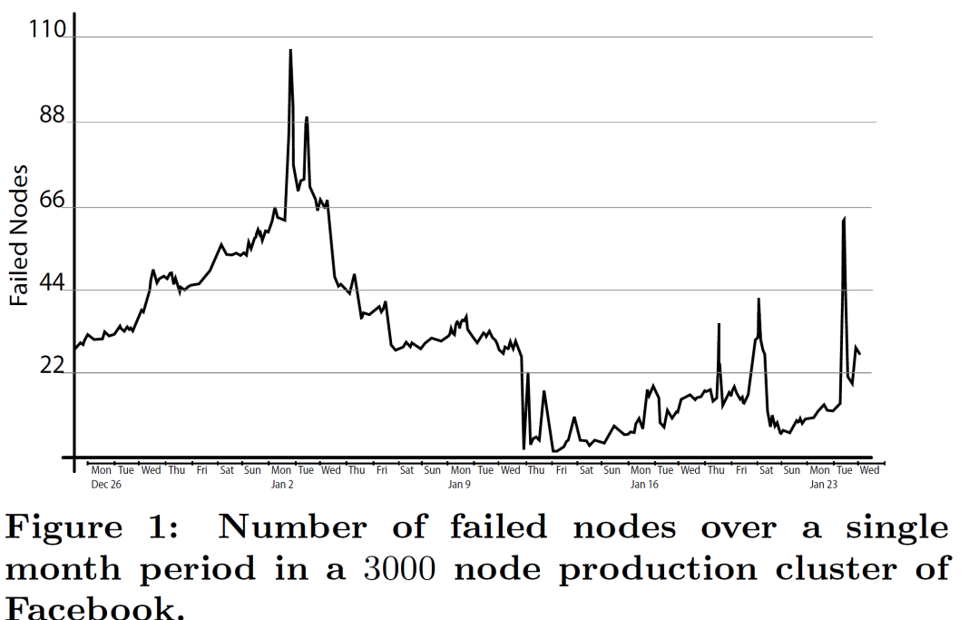

Slide 7
File or Data Object
A
B
C
D
E
Split each block into
k chunks
(k,m) erasure
code
A₁
A₂
A_{k}
P₁
P₂
P_{m}
k data chunks
add m parity chunks

Slide 9
File or Data Object
A
B
C
D
E
Split each block into
k chunks
(k,m) erasure
code
A₁
A₂
A_{k}
P₁
P₂
P_{m}
k data chunks
add m parity chunks

