Slide 1

Prototype to Production:
Mastering the 'Last Mile' with AgentOps
Building Trust, Ensuring Security, Enabling Velocity
"Building an agent is easy. Trusting it is hard."
Based on Google's AgentOps Framework | November 2025

Slide 2




The Last Mile Production Gap
Transitioning a clever demo into a trusted, production-grade system is where 80% of the effort
lies. Skipping these steps leads to business failure, not just technical problems.
Prompt Injection
Data Leakage
Cost Explosion
Silent Failures
Agent manipulated to bypass guardrails and perform unauthorized actions
Unauthorized access to customer data or confidential information
Unexpected cost spikes from runaway token usage without monitoring
Quality degradation that goes unnoticed without proper observability
Key Insight: AgentOps bridges this gap by treating agents like production software—with evaluation, CI/CD, and observability.

Slide 3
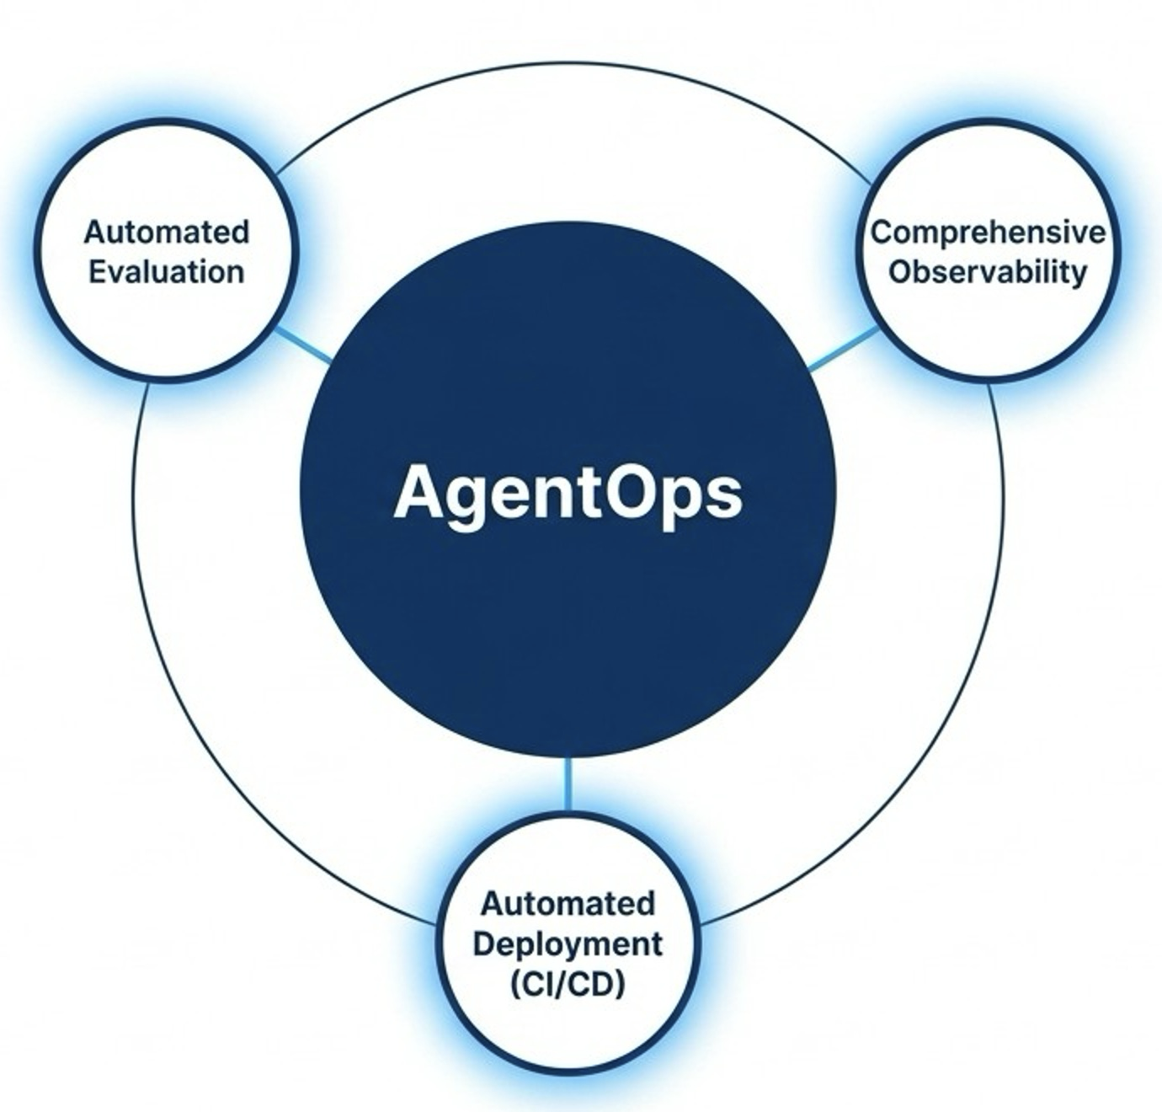
AgentOps: A Lifecycle for Building Trustworthy AI
Three phases that work together in a continuous improvement cycle
Trade manual uncertainty for automated confidence through rigorous evaluation and security.
Manage live systems through continuous observation, action, and evolution.

Slide 4

Evaluation: The Quality Gatekeeper
👤
Gate 1: Pre-PR
🤖
Gate 2: CI/CD Pipeline
Manual Evaluation
Automated Evaluation
Developer runs evaluations locally before creating a pull request to catch obvious issues early.
Triggered on every PR, evaluations run at scale. Changes blocked if quality thresholds aren't met.
Quick feedback loop, catches regressions before code review
Prevents bad changes from reaching production automatically
The Golden Dataset
A curated set of input-output pairs representing critical scenarios. Continuously updated with production failures to ensure past issues never recur.

Slide 5



The Automated CI/CD Pipeline
Phase 1: Pre-Merge CI
Phase 2: Staging
Phase 3: Production
📝
👥
Merge
Approval
Unit tests, linting, fast evaluation checks on every PR
Full evaluation suite, load testing, production-like environment
Gated deployment with canary rollout to real users
Pull
Request
Live
Users
✓
Fast feedback
✓
Thorough validation
✓
Safe deployment
Enabling Tech: Infrastructure as Code (Terraform), GitOps workflows, and secure secrets management

Slide 6
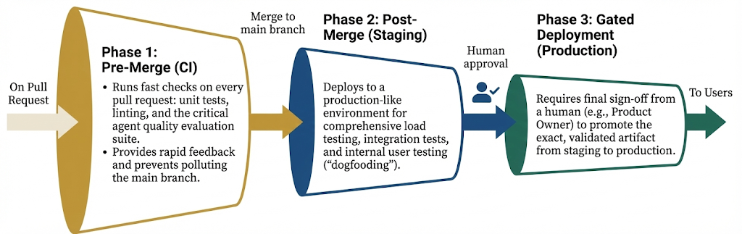
The Automated CI/CD Pipeline
Enabling Tech: Infrastructure as Code (Terraform), GitOps workflows, and secure secrets management

Slide 7
Safe Rollout Strategies
🐤
Canary Deployment
🔄
Blue-Green Deployment
Route a small percentage of traffic (5-10%) to the new version. Monitor closely before expanding.
Run two identical environments. Switch traffic instantly between old (blue) and new (green).
Best for: Gradual validation with real traffic
Best for: Instant rollback capability
⚖️
A/B Testing
🚩
Feature Flags
Split traffic between versions to measure user outcomes and compare performance statistically.
Toggle features on/off without redeploying. Enable for specific users, groups, or percentages.
Best for: Data-driven decisions on new features
Best for: Runtime control and targeting

Slide 8



Building Security from the Start
Three layers of defense against agent-specific risks
📜
🛡️
🔄
1. Policy Definition
2. Guardrails & Filtering
3. Continuous Assurance
Define desired and undesired behaviors in System Instructions—the agent's "constitution" that guides all decisions.
Enforce policies with input/output filtering, PII detection, and Human-in-the-Loop for high-risk actions.
Continuously test against adversarial datasets, conduct Red Teaming, and re-evaluate on every change.
Establish boundaries before deployment
Runtime protection layer
Ongoing validation
Based on Google's Secure AI Framework (SAIF)

Slide 9
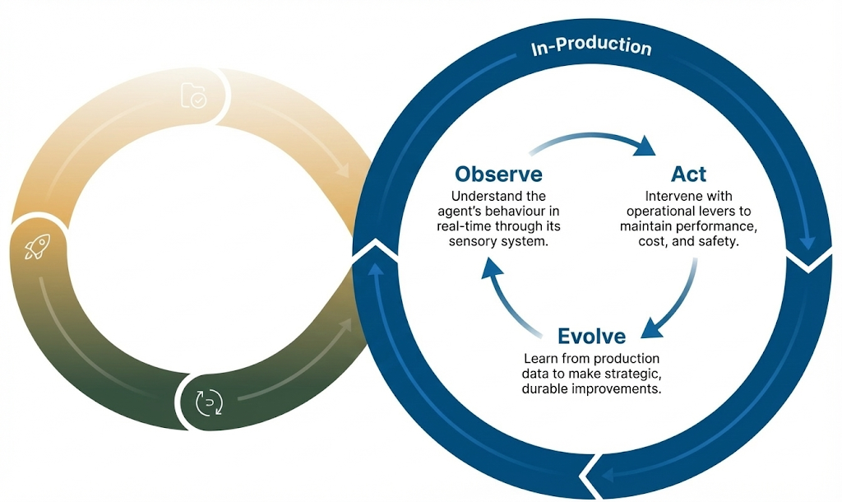
In Production: The Continuous Loop
Managing live agents through observation, action, and evolution
Result: Deploy improvements in hours, not weeks, turning static deployments into continuously evolving products.

Slide 10
Observe: The Agent's Sensory System
Three pillars of observability for AI agents
📋
🔗
📊
Logs
Traces
Metrics
Capture every LLM interaction: prompts, responses, tool calls, and decisions.
Track the complete journey of a request across LLM calls, tools, and services.
Aggregate measurements: latency percentiles, token usage, success rates, and costs.
Enables: Performance analysis, bottleneck detection, and end-to-end visibility
Enables: Alerting, dashboards, trend analysis, and capacity planning
Enables: Debugging, auditing, compliance, and replay for investigation
Standard: OpenTelemetry GenAI semantic conventions (2025) provide standardized instrumentation across all LLM providers.

Slide 11
Act: Levers of Operational Control
💪
System Health Management
🚨
Managing risk
1
Performance
1
Contain
Stateless design / reliable patterns
Isolate the threat immediately
2
Circuit Breakers
2
Triage
Prevent cascading failures
Assess impact and severity
3
Cost Guardrails
3
Resolve
Budget alerts and automatic throttling
Fix root cause, update defenses
Key Insight: Having pre-defined playbooks reduces mean-time-to-resolution (MTTR) from hours to minutes.

Slide 12
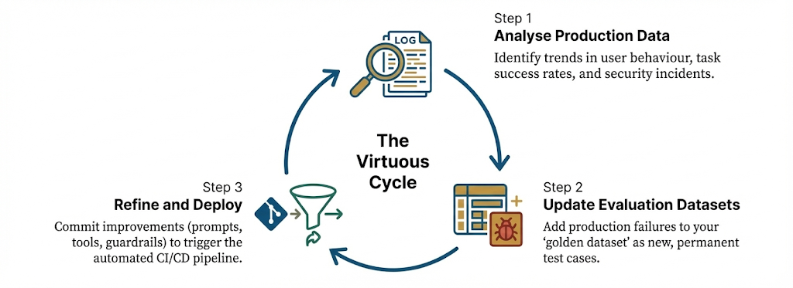
Evolve: Turning Production Failures into Test Cases
The virtuous cycle that ensures problems never recur
1
Example: A retail agent fails on 'similar products' requests. Logs create a new failing test case. An engineer refines the prompt. The change passes the updated evaluation suite and deploys in under 48 hours.

Slide 13
Beyond Single Agents: Scaling with Interoperability
The Challenge
The Solution
🤖
🤖
🤖
🤖
🤖
🤖
Agent A
Agent B
Agent C
Agent A
Agent B
Agent C
Agents exist in silos and cannot collaborate, leading to massive inefficiency and trapped insights.
Standardized protocols enable collaboration and shared capabilities across agents.
MCP (Model Context Protocol)
A2A (Agent2Agent Protocol)
For integrating with simple, stateless tools (e.g., a calculator, a database API)
For collaborating with complex, stateful, intelligent agents that can reason and plan

Slide 14
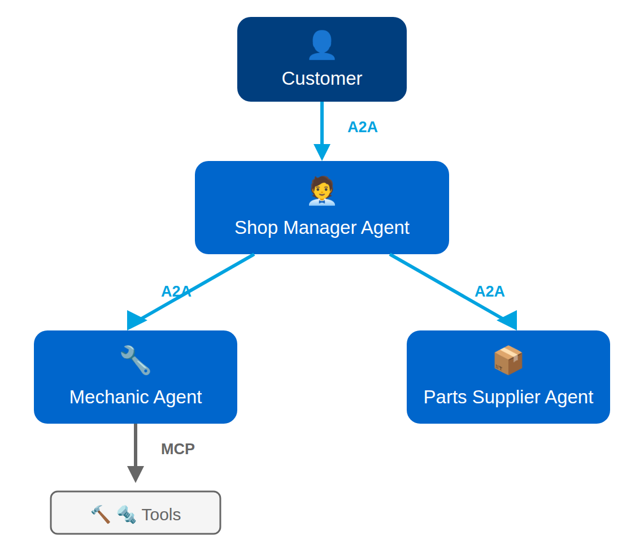
MCP vs A2A: The Auto Repair Shop Analogy
1. Customer → Shop Manager
A2A: "My car makes a weird noise" — requires reasoning and planning
2. Shop Manager → Mechanic
A2A: "Diagnose and fix" — delegates to specialist agent
3. Mechanic → Tools
MCP: "Get torque wrench" — simple, stateless tool call
4. Mechanic → Parts Supplier
A2A: "Need brake pads for BMW" — requires negotiation
Key Takeaway: MCP and A2A are complementary. MCP handles tool integration; A2A handles agent collaboration. Use both at different abstraction levels.

Slide 15
The Complete AgentOps Lifecycle
Development
AI Governance
Staging
Production
Agent Experimentation
Repositories
Automated Testing
Agent Deployment
Evaluation Data
PR
CI/CD Pipelines
Test
Evaluation at Scale
Deploy
Session Memory
RAG / Memory
Agent Registry
Agent Simulation
Observability
AI Security Testing
Tool Registry
Quality Gate ✓
Logs & Traces
Feedback Loop: Production insights feed back into evaluation datasets
AgentOps unifies People (team roles), Process (CI/CD workflows), and Technology (infrastructure)

Slide 16
Your Path Forward with AgentOps
Core Message
Actionable Next Steps
AgentOps transforms the value equation: Instead of ~80% of effort going to infrastructure, invest that effort in what matters—building better agents.
If You're Starting Out:
1
Learn evaluation fundamentals
2
Create your first golden dataset
3
Set up basic CI/CD with quality gates
4
Implement logging and monitoring
"Bridging the last mile is not the final step in a project, but the first step in creating value."
If You're Scaling:
✓
Automate the production → evaluation feedback loop
The Result:
✓
Standardize on A2A and MCP protocols
Deploy improvements in hours, not weeks

