Slide 1
Exploratory Data Analysis
G2M insight for Cab Investment firm
17/07/2022

Slide 2
Executive Summary
In the following presentation we will to analyze two companies in the Cab industry, in order to get a better understanding of the market and make the right decision as to which company XYZ should invest in.

Slide 3
Problem Statement
In our analysis we relied on 4 data files:
Cab_Data.csv: Detailed the transactions (Cost/Revenue/Km traveled…)
City.csv: Gave the number of users by city
Customer_ID.csv: Information about each user (Gender/Age/Income)
Transaction_ID.csv: Connected between the transaction and the user.

Slide 4
As we are dealing with 4 separate files, it is hard to get as much information as if they were all combined in one file. We had to first get a table that groups the data.

Slide 5
Approach
Using Power Query in Excel, we are able to connect between customer ID (in file Customer_ID.csv) and transaction ID (in file Transaction_ID.csv) and file Cab_Data.csv:

Slide 6
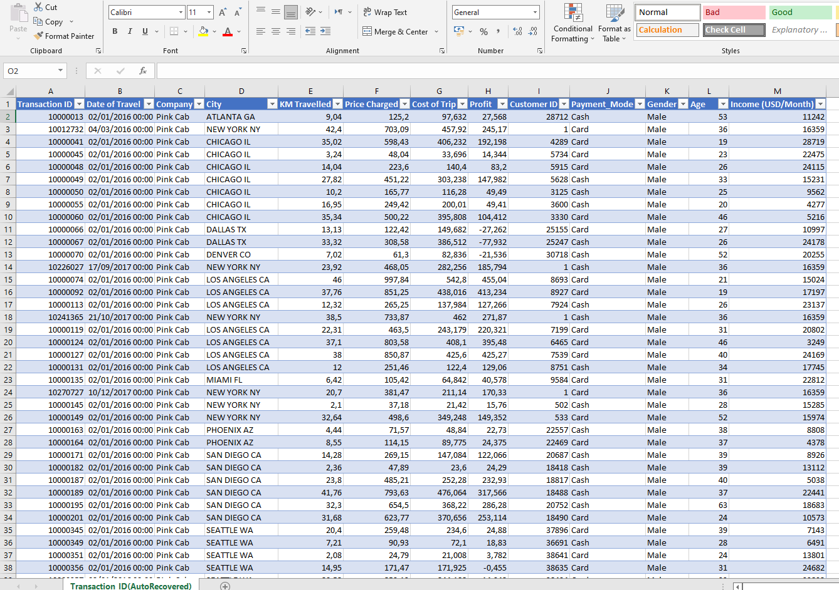

Slide 7
EDA
DATA EXPLORATION:
We have a total of 355,032 data points We also have 4 .csv files:
-Cab_Data.csv: 7 features -City.csv: 3 features -Customer_ID.csv: 4 features -Transaction_ID.csv: 3 features

Slide 8

Profit Analysis

Slide 9
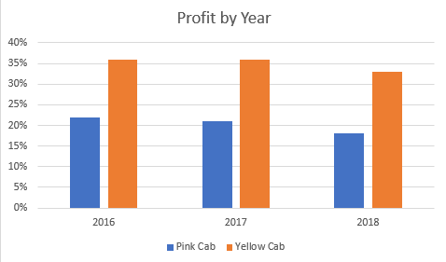

Slide 10
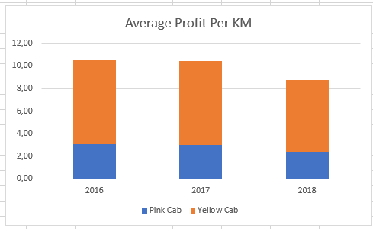

Slide 11
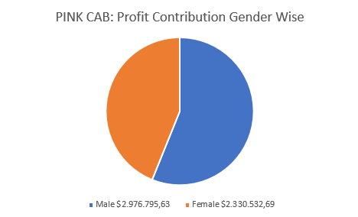
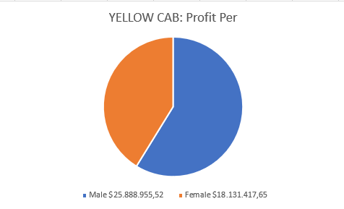
Profit Gender Wise

Slide 12
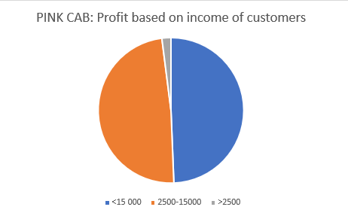
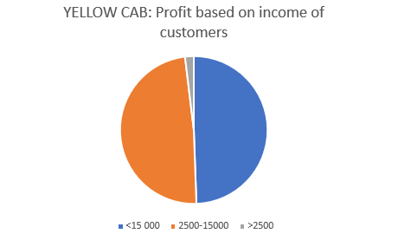
Profit Based on Income of Customers

Slide 13
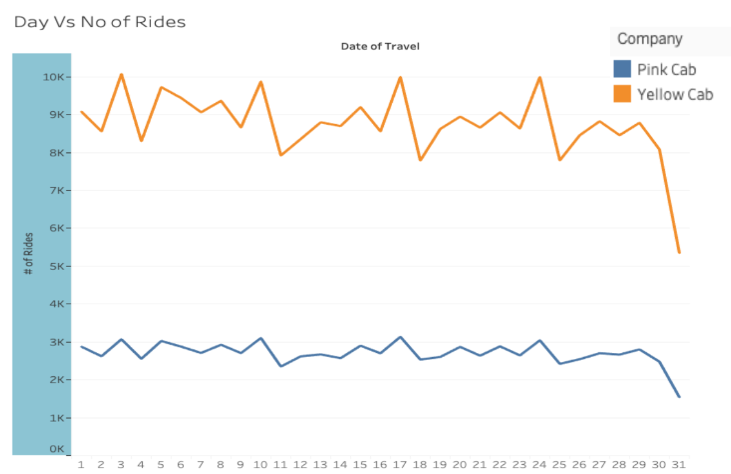
Seasonality of demand

Slide 14
RECOMMENDATIONS
We have evaluated both companies on the following points:
Profit of Previous 3 years: Yellow cab has made around 9 times more profit than Pink Cab did during the period of 2016-2018
Profit by Year: We observed a decline in profit in both companies, nevertheless, Yellow Cab still has a much higher profit percentage each year averaging around 34.6% profit, while Pink Cab only averages 18.97%.
Average Profit Per KM: Yellow Cab profits almost 2.6 more times than Pink Cab does in each km traveled
Profit Gender Wise: Males contribute the most to both companies profits and at around the same percentage.
Profit based on income: By analyzing the data, we observed that customers, in both companies, belong to similar social class. We also notice that both companies make the most profit off of customers with higher income (>15 000).
Seasonality in the demand: We noticed that the demand spikes in both companies on the weekends. However, the demand on Yellow cab services remain significantly higher.
Based on those points, we recommend the investment in Yellow Cab.

