Slide 1
PORTOFOLIO
MUHAMMAD AMIN IQBAAL ALAM, S.KOM

Slide 2
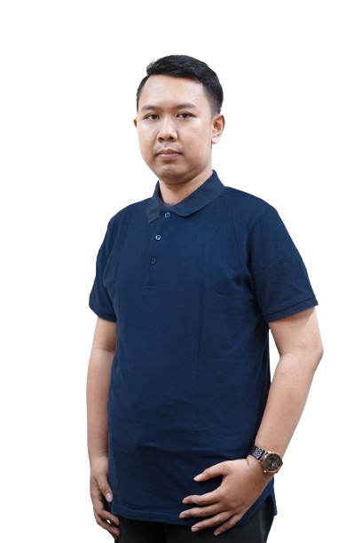
ABOUT ME
I am Muhammad Amin Iqbaal Alam, S.Kom graduate Bachelor Degree of Informatics Engineering Brawijaya University. I have experience in developing software, especially web based. I am a disciplined person, can work in a team or individually and adapt to the environment. Last working at PT. Ako Media Asia (SALT Indonesia)
Portofolio : https://linktr.ee/aminiqbaal
UI/UX Design : http://samiqbaal.pmii.web.id/p/uiux-design.html
Graphic Design : https://drive.google.com/drive/folders/1HcQqB1m-Yt8e0SZOz9GR663g4eem604T?usp=share_link

Slide 3
CONTACT
INSTAGRAM : @SAHABAT.IQBAAL
LINKEDIN : https://www.linkedin.com/in/aminiqbaal/
NO. HP : 085156964141
E-MAIL
OUTLOOK : AMINIQBAAL@OUTLOOK.COM
GMAIL : IQBAAL.PROJECT86@GMAIL.COM

Slide 4
EDUCATION
Informatics Engineering - Brawijaya University
Software Engineer
System Analyst
UI/UX Designer
Software Tester

Slide 5
SKILLS
Software Tools
Softskill
Vue JS
React JS
Figma
PHP
Laravel
Flutter
Android Studio
PostgreSQL
MySQL
SAP
Cava
Navicat
Prisma.io
Draw.io
Corel Draw
Visual Studio Code
CodeIgniter
Good Comunication
Good Analytical
Good Team Work
Good Leadership
Brain Storming
Domain Driven Design
Agile Methodologies
Scrum Methodologies
Team Management

Slide 6
WORK EXPERIENCE
CV. PASTIJADI DIGITAL SOLUTIONS
PT. PATIGENI MITRA SEJATI
RSUD DR. SOETOMO JAWA TIMUR
PT. GARUDA MAINTENANCE FACILITY AERO ASIA
PT. AKOMEDIA ASIA

Slide 7

CV. PASTIJADI DIGITAL SOLUTIONS
SYSTEM ANALYST AND SOFTWARE ENGINEER
Documentation, UI/UX Designer, analysis and testing using Visual Paradigm, Draw.io, Bizagi Modeler, Figma, PHP, Laravel and Selenium
E-commerce Raprima Tempeh
Donation Ponpes Bahrul Maghfiroh
News Portal
Consultation Lawyer

Slide 8

PT. PATIGENI MITRA SEJATI
SOFTWARE ENGINEER (WEB & MOBILE)
Website & Mobile Android / iOS development using PHP, Laravel, Flutter, Trello and MySQL
Website Firecek
Website Sticker Generator
Application Mobile Firecek

Slide 9

RSUD DR. SOETOMO JAWA TIMUR
SYSTEM ANALYST & FRONT END DEVELOPER
Documentation, UI/UX Designer and analysis using Visual Paradigm, Draw.io, Bizagi Modeler, Figma, VueJS, Laravel, Kanban
Company Profile RSUD Dr. Soetomo
Helpdesk ITKI (Instalasi Teknologi Komunikasi dan Informasi)
Sismaker (Sistem Manajemen Keperawatan)

Slide 10

PT. GARUDA MAINTENANCE FACILITY AERO ASIA
SYSTEM ANALYST
Documentation, UI/UX Designer and analysis using Visual Paradigm, Draw.io, PlanUML, Figma, Prisma, DB Diagram
Dashboard Excellent Project Management Stream Unit TV
Excellent Project Management Stream
Budget Realization
Instrumentation Measurement Tools and Equipment
GSMART
Hold Item List
ICT Project Management Office
Tools Management System
Analytic Report Component (ARC)

Slide 11

PT. AKO MEDIA ASIA
SYSTEM ANALYST
Analysist Business Requirement, Technical requirement use Brainstorming Methodology, Documentation SRS, NFT, Pentest, Domain Driven Design, API Contract, Use Case, Sequence Diagram use Visual Studio Code, Draw.io, Postman, PlantUML, Jira
Telkomsel MyOrbit
Recurring by Pulsa
Revamp Homepage (Prepaid & Postpaid Modem)
Revamp Productpage (Prepaid & Postpaid Modem)
Blog
Prepaid Registration I-Setup
Filter Modem
I-Join (Prepaid & Postpaid Modem)
Notification
MSISD Forwarding & Simplify

Slide 12
THANK YOU
Do you have any questions? Please contact me on 085156964141

