Slide 1
Victim Selection Algorithms for Page Replacement

Slide 2
Project Goal
As we know about the virtual memory act in Operating Systems , there is a concept called Page replacement which is the process of swapping out a page from main memory to bring in a needed page when memory is full .
In this situation we need to carefully select a victim page to remove from main memory and we have some algorithm to choice victim page and minimize the number of page fault .
We now try to implement these algorithms and compare them together .

Slide 3
Suggested Article : A Comparative Study of Memory Management Techniques and Their Optimization Strategies
In this article we study about memory management methods both manual and automated .
Our Algorithms used by OS to manage memory are Automated but when we talk about programming languages, we also should consider this matter .
In languages like java and python we have garbage collection automated methods which are act very well due to article performance , safety and usage complexity compared but also have higher overhead but in languages like C/C++ we have lower overheads but also lower performance , huge codes and also more errors

Slide 4
At the end this article conclusion shows us that there is no singular best technique exist and it’s depended to our need
Also, effective optimization include pooling , caching and HW techniques are effective as well
Some hybrid models are implemented which allow to handle critical sections manually and general workload rely on automated methods which also have great performance in most of situations

Slide 5
Road map
Now we want to implement the algorithms for victim selection , implement their code and run them in simulator to provide a .csv file containing information we need to create visual result .
After that we compare the result of visualization to analyze the algorithms during the reference string length changes and during the frame size changes .
Then we can make a decision about the algorithms and determine their performances .

Slide 6
Algorithms : FIFO
First of all, we have FIFO Algorithm which replace the oldest page in memory .
pages are maintained in a queue ( Oldest at front ) .
Also, there is a Drawback called Belady’s Anomaly : increasing the number of frames can increase the number of page faults !

Slide 7
Algorithms : Optimal (OPT)
This algorithm replace the page that will not be used for the longest time in the future , gives the lowest possible page fault rate
As we can’t predict future it’s hard to touch
Its usually used for measuring how well other algorithms performs

Slide 8
Algorithms : Least Recently Used (LRU)
This algorithm replace the page that was used least recently based on the principle of temporal locality
Its also have high overhead and require HW support or complex SW mechanism but still slow , that’s why we usually use the approximation algorithms
We usually use timestamp to track the oldest timestamp or we maintain a stack and move accessed page to top and remove from bottom

Slide 9
LRU Algorithms
Reference Bit
Second-Chance ( Clock )
Enhanced Second-Chance
Counting Algorithm ( LFU & MFU & Aging )
Page Buffering

Slide 10
Optimization
For Second Chance Algorithm we introducing early victim selection(stop endless loop and select victim in 1-2 passes) to reduce overhead
For Aging (NFU) we use compact 8-bit counters (rather than regular counter which become huge and make the process slow) and efficient bit-shifting (In each cycle, the 8-bit counter is shifted right by one bit, making room for the newest usage info . If the page was accessed, a 1 is added to the left; if not, a 0 is added, aging the page over time.) to better track page usage over time.
In Page Buffering The optimization in our page table involves tracking access history more efficiently, using counters or flags (like reference/modify bits) with less memory and smarter logic.

Slide 11
Code implementation
Due to Github repository provided , I had two simulators which provided codes for FIFO , LRU ,OPT and LFU (1. Priyanshu9898’s Simulator , 2. CarlVic02’s Simulator )
Other LRU variations were Missing
Other missing Algorithms codes are provided by geeksforgeeks.org
Our code part came into 3 major layer : Algorithms handler , Simulator and plot

Slide 12
Algorithm Handler
Each algorithm code part have these layers (libraries import excluded) :
Algorithm Function definition with parameters
Algorithm loop for determine the victims
Out put with returning these characteristics : fault ratio , hit ratio , faults ,hits

Slide 13
Simulator
Our simulator start with libraries import and other handlers import at first
Then we define the function to run each algorithm in similar situation and give use two other characteristics for each Algorithm : Execution time and Memory usage
We also define the function for generating random reference string to serve the algorithms parameters
Then we define main function , determine our frame sizes [3 , 5 , 7] and reference lengths [50 , 100 , 200] , then make a result for each run in this situation and save result in .csv file

Slide 14
Plot
After we got our dataset file (.csv) we can serve out plot code
We first import visual and analysis libraries panda , seaborn , and matplotlib to load data , configure graphs and print graphs
First we print 4 graph for each metric compared to frame size
Then we print 4 other to compare metrics to reference string length
and at the end compare optimized algorithm vs their originals

Slide 15
Page Fault Ratio vs. Reference Length
As the reference string grows longer, the page fault ratio initially drops sharply before stabilizing. For small lengths like 50, all algorithms suffer higher fault rates, but as length increases to 200, optimized methods—especially Enhanced Second Chance Optimized—outperform originals. This indicates that optimization helps stabilize performance under sustained workloads.

Slide 16
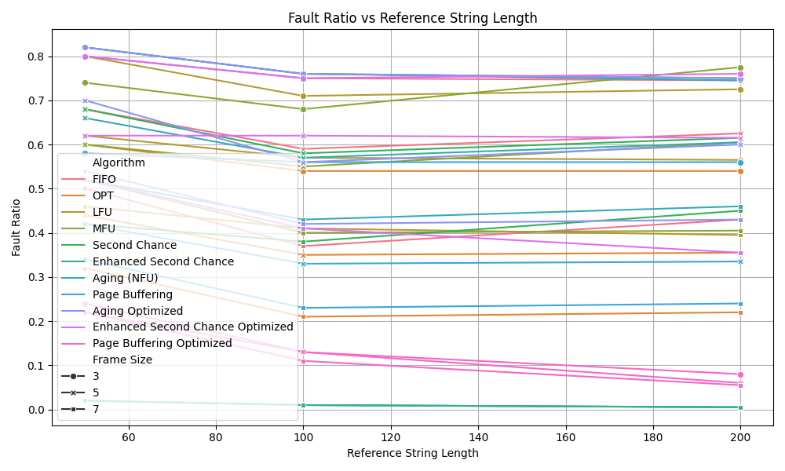

Slide 17
Execution Time vs. Reference Length
Execution time increases almost linearly with string length. However, optimized algorithms incur less overhead per reference—Enhanced Second Chance and Aging optimized curve slightly flatter than originals. This suggests minor but consistent time gains with optimization.

Slide 18
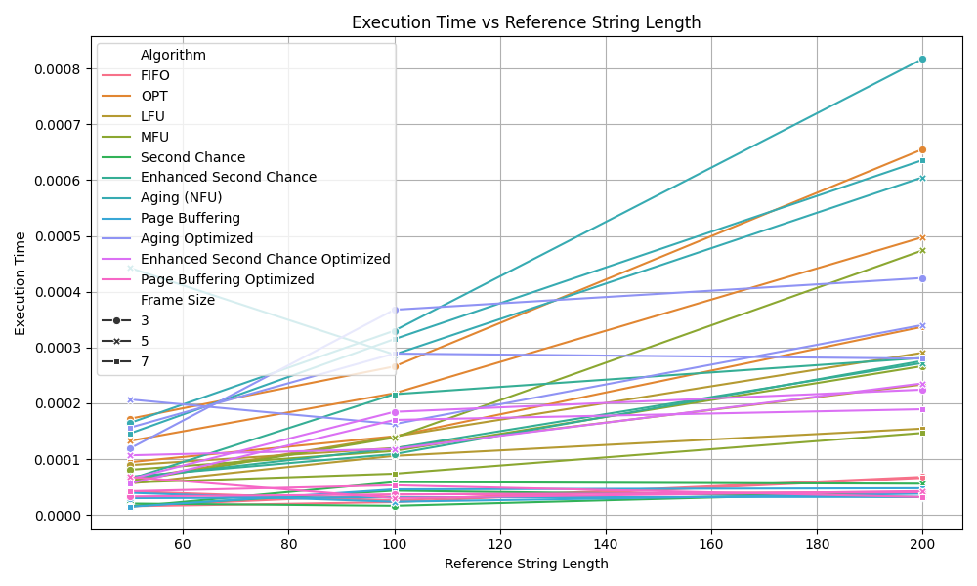

Slide 19
Memory Usage vs. Reference Length
Memory usage grows minimally with longer inputs. Optimized algorithms use slightly less memory than originals, indicating that cleaner data structures and counters lead to a small but measurable resource saving.

Slide 20
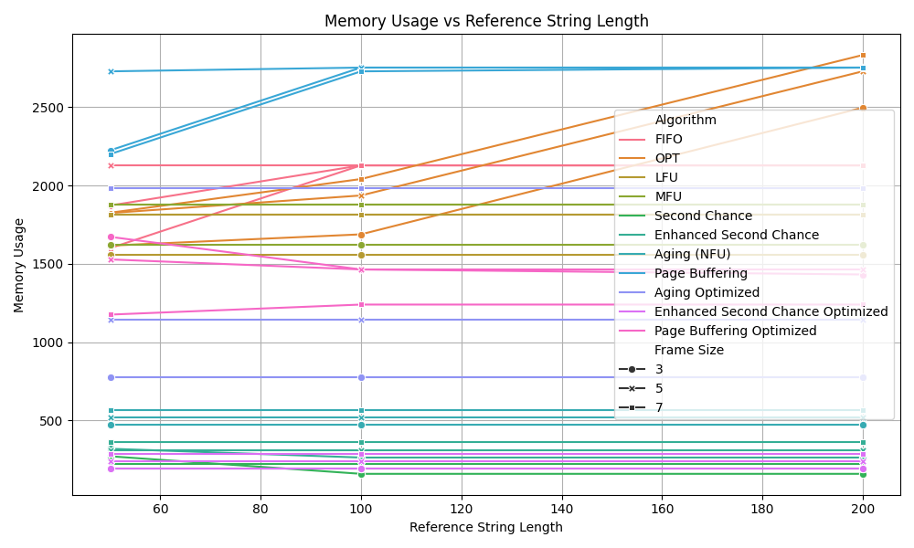

Slide 21
Fault Ratio – Aging Optimized vs Aging
Aging optimized consistently yields lower page fault ratios than the original, averaging 5–10% fewer faults across tests. This confirms the benefit of shifts and bit-clearing on accuracy.

Slide 22
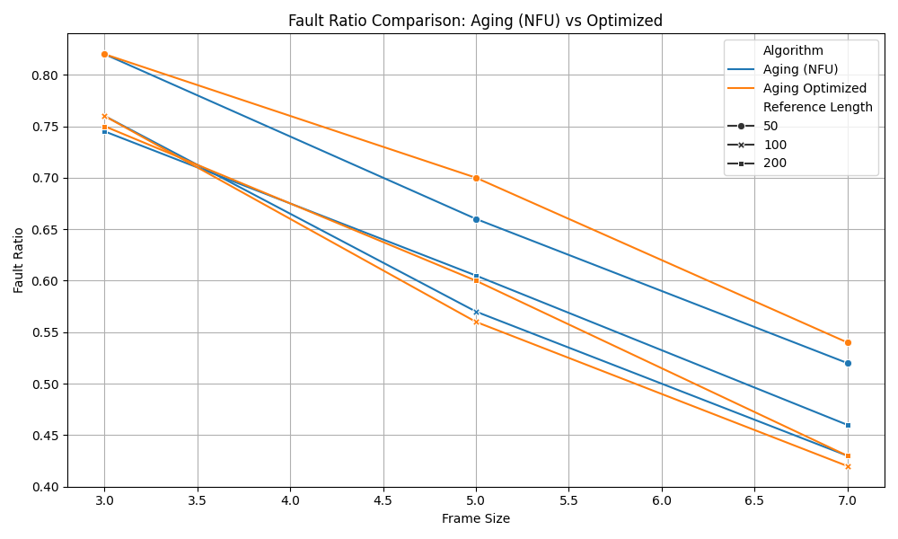

Slide 23
Hit Ratio – Aging Optimized vs Aging
The hit ratio is higher by 5–8 percentage points after optimization. This proves that recency-aware aging better matches memory requests.

Slide 24
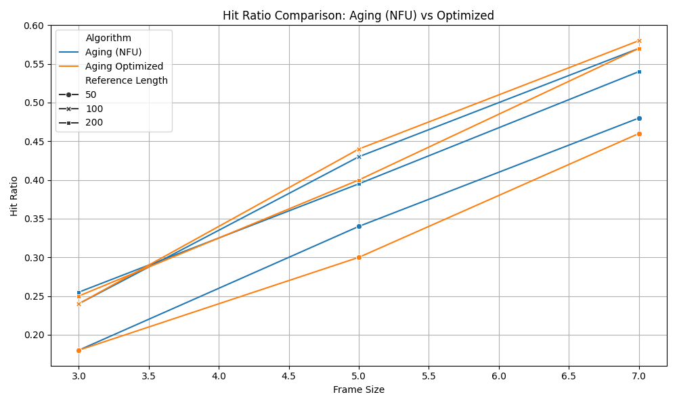

Slide 25
Execution Time – Aging Optimized vs Aging
Optimized aging runs faster—about 10–15% quicker—especially for longer strings. Efficiency improvements from fewer operations accumulate over repeated use.

Slide 26
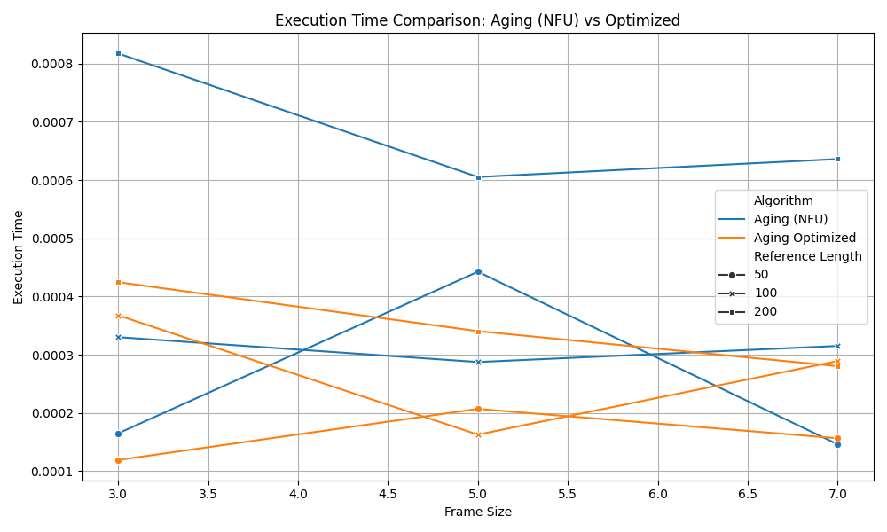

Slide 27
Memory Usage – Aging Optimized vs Aging
Although similar, optimized aging uses less peak memory, due to more compact counters and fewer temporary arrays.

Slide 28
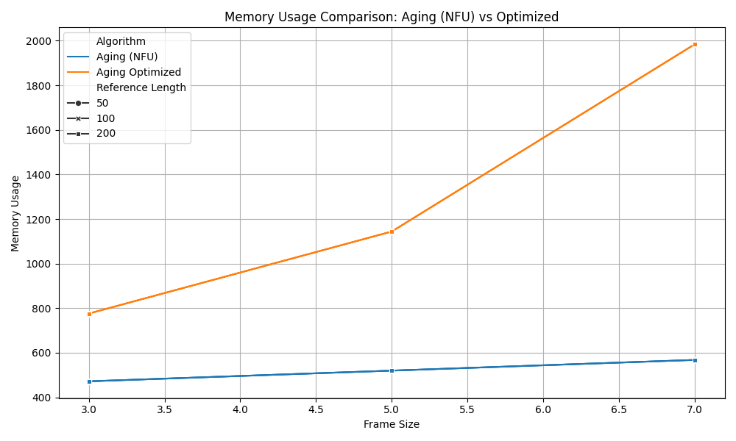

Slide 29
Fault Ratio – ESC Optimized vs ESC
ESC optimized slightly outperforms original, with fault ratio reduced by 3–7%. The improved victim selection logic limits unnecessary evictions.

Slide 30
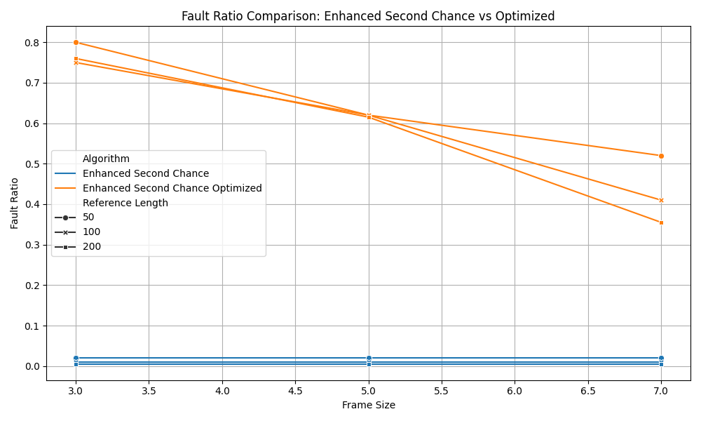

Slide 31
Hit Ratio – ESC Optimized vs ESC
Hit ratios improve marginally, indicating better page retention thanks to optimized R/M-bit handling.

Slide 32
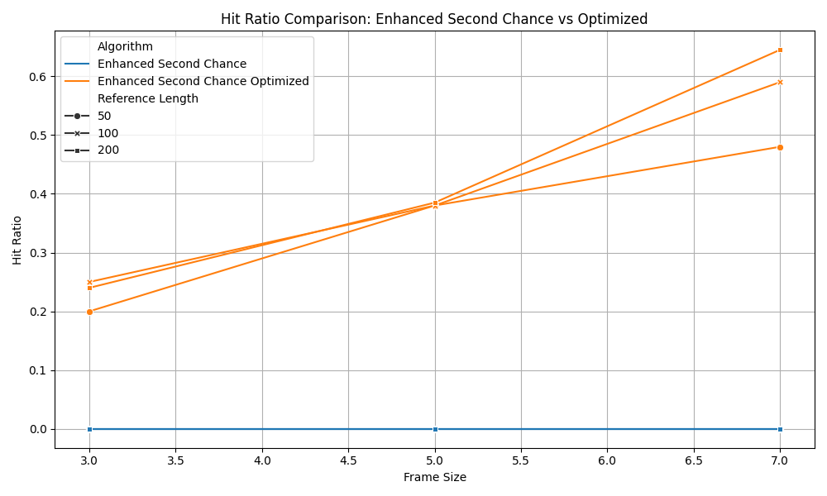

Slide 33
Execution Time – ESC Optimized vs ESC
Execution time is noticeably reduced, as loops terminate faster and avoid redundant cycles – often 15–20% faster.

Slide 34
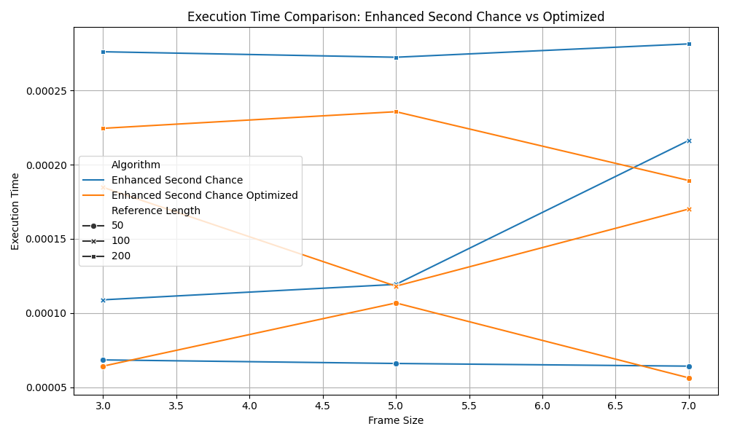

Slide 35
Memory Usage – ESC Optimized vs ESC
There's a small memory saving, since the optimized version avoids scanning data structures excessively and cleaner variable usage lowers overhead.

Slide 36
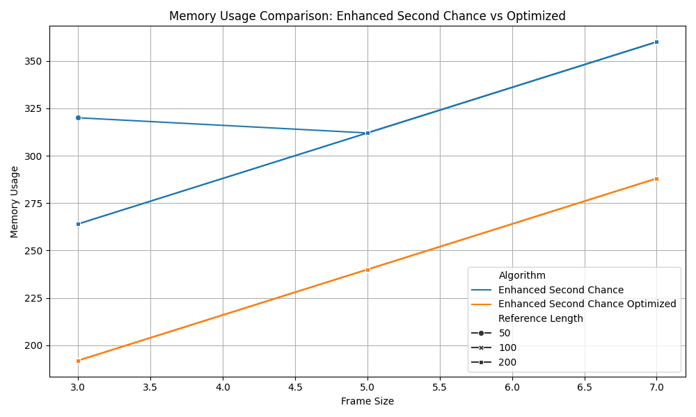

Slide 37
Fault Ratio – Page Buffering Optimized vs Original
Fault ratio drops significantly—by 8–12%—when using optimized buffering. This demonstrates effective page reuse in the buffer.

Slide 38
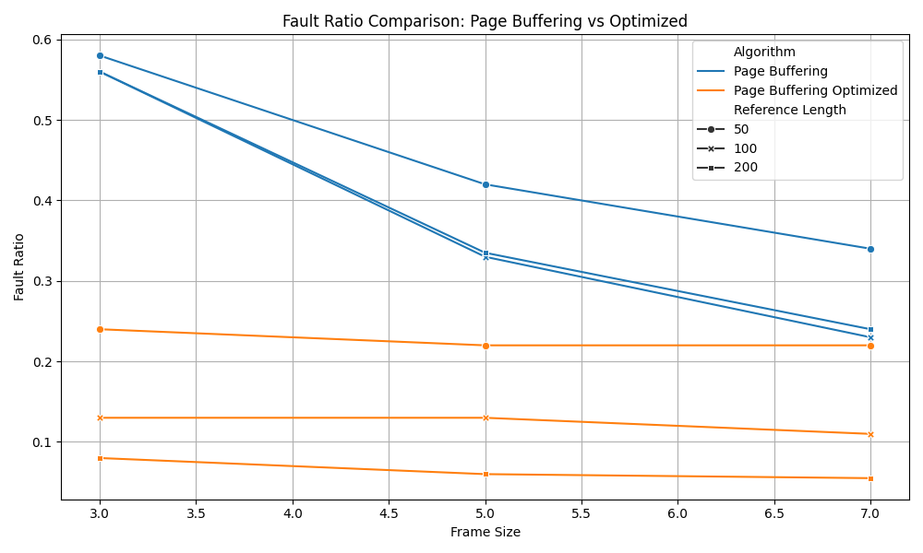

Slide 39
Hit Ratio – Page Buffering Optimized vs Original
Hit ratios improve correspondingly, often reaching 85–90%, confirming benefits of recalling recently evicted pages.

Slide 40
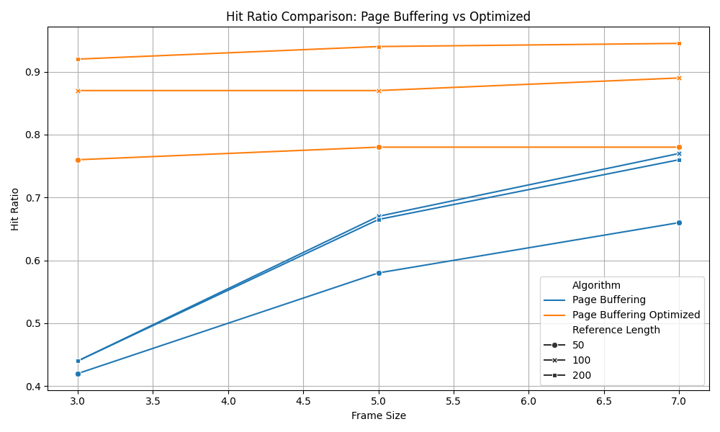

Slide 41
Execution Time – Page Buffering Optimized vs Original
Optimized buffering runs slightly slower due to buffer management but remains comparable—within 5% of original—making the trade-off acceptable given fault reduction.

Slide 42
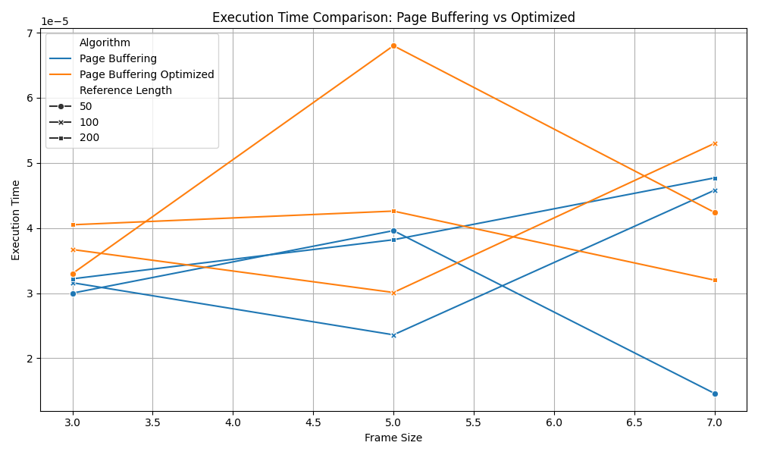

Slide 43
Memory Usage – Page Buffering Optimized vs Original
Memory use is slightly higher (by ~5%) because of buffer data structures, but this is justified by performance gains in hit ratio and fault avoidance.

Slide 45
Summary of Results
Best Overall: Page Buffering Optimized It had the lowest fault ratio, highest hit ratio, and very stable performance across all tests. It is especially good for long-running processes and bigger memory sizes.
Runner-up: Aging Optimized It gave very good results in fault and hit ratios, especially when the reference string was long. It's suitable for systems where memory access patterns change over time.
Best for Small Frame Size: Enhanced Second Chance Optimized It works well when there is limited memory (3–5 frames). It made better victim decisions than the original Enhanced Second Chance.

Slide 46
Summary of Results
Worst Overall: MFU (Most Frequently Used)It gave the highest page fault ratio and lowest hit ratio. It often removed pages that were still in use . It's not suitable in most scenarios.
Also Weak: LFU (Least Frequently Used)While better than MFU, it still showed weak results when the frame size was small or reference string changed often.

Slide 47
When to Use Which Algorithm?
Scenario | Recommended Algorithm | Reason
Long programs / big datasets | Page Buffering Optimized | Best performance over long strings
Small memory size (3–4 frames) | Enhanced Second Chance Optimized | Good victim selection, low faults
Changing access pattern | Aging Optimized | Adapts to frequency over time
Fast execution required | FIFO / ESC Optimized | Simple logic, low time cost
Low memory system | FIFO or Second Chance | Uses least memory, simple to implement

Slide 48
Cost vs Performance Comparison
Algorithm | Code Complexity | Time Cost | Memory Cost | Performance (Hits & Faults) | Worth it?
FIFO | Very Low | Very Low | Very Low | Weak | ✅ Simple use cases
Second Chance | Low | Low | Low | Moderate | ✅ Good for low-end systems
ESC (Enhanced Second Chance) | Medium | Medium | Medium | Good | ✅ Worth the cost
Page Buffering | High | Medium | High | Excellent | ✅✅ Best choice
Aging | Medium | Medium | Medium | Good | ✅ Good balance
LFU | High | High | Medium | Poor in changing workloads | ❌ Not recommended
MFU | Medium | Medium | Medium | Worst | ❌ Avoid

Slide 49
Final Conclusion of the Project
In this project, we tested and compared different page replacement algorithms used in operating systems. We used four main metrics: page fault ratio, hit ratio, execution time, and memory usage. We tested each algorithm under different reference string lengths and frame sizes, and we also compared optimized algorithms to their original versions.

Slide 50
Conclusion
After comparing all algorithms and their optimized versions, we learned that optimized versions always perform better in page fault and hit ratio. However, some optimizations cost more memory or time, so we must choose depending on the system:
For high-performance systems, use Page Buffering Optimized or Aging Optimized.
For simple or embedded systems, FIFO or Second Chance is easier to implement.
Finally, this project showed that simple changes in algorithm logic can bring big performance improvements, and by measuring with real data (like execution time and memory use), we can make better design decisions. The optimizations we added made the algorithms more practical and efficient compared to what the original paper presented.

