Slide 1

UNIVERSITY OF MESSINA
Bachelor's Degree in Computer Science L31 | Data Analysis
Tiered Edge AI Architecture for Cooperative
UAV-Based Industrial Fire Detection
An onboard Sentinel-Scout system prototype
Candidate : Mohammadamin Jahanimajd
Supervisor: Prof. Giovanni Merlino
Academic Year 2025/2026
Notes:
TARGET TIME: 0:20
SPOKEN PASSAGE
Good morning. I designed and evaluated an onboard Sentinel-Scout system prototype for cooperative fire detection. Its main contribution is the integration of two different UAV computers into a traceable detection and verification workflow. I will focus on the measured engineering achievements.
PRIVATE DELIVERY CUE
State the objective, then advance immediately. Do not read the complete thesis title aloud.
PRIVATE STUDY NOTES
Tiered: Two assigned processing roles: initial Sentinel detection and secondary Scout verification.
Edge AI: The two onboard computers perform inference. The ground station provides supervision, not AI inference.
Experimental boundary: The physical trials were stationary with propellers removed. Aerial mission execution used PX4/Gazebo.
Original contribution: Custom integration of heterogeneous platforms, the traceable decision workflow, measured decoder optimization and recorded validation. This does not establish novelty of YOLO, ROS 2 or PX4 themselves.
SHORT ANSWER IF ASKED
The project contribution is the implemented decision workflow across two onboard computers, with measured runtime, resource, network and simulation evidence.
SOURCES
thesis_review/chapters/01_introduction.tex
thesis_review/chapters/09_conclusion.tex

Slide 2
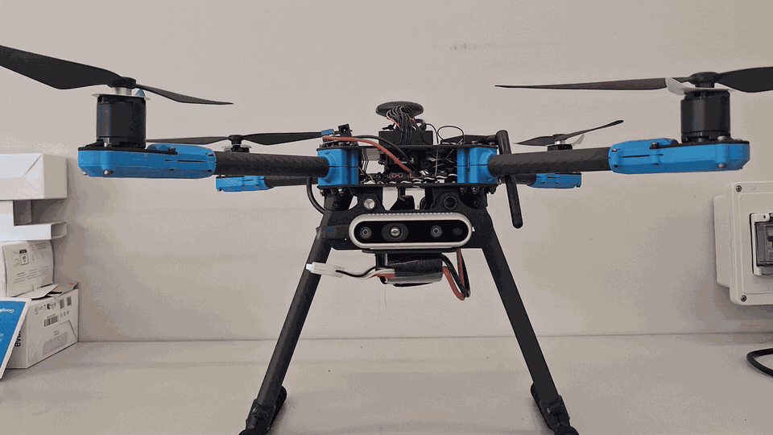
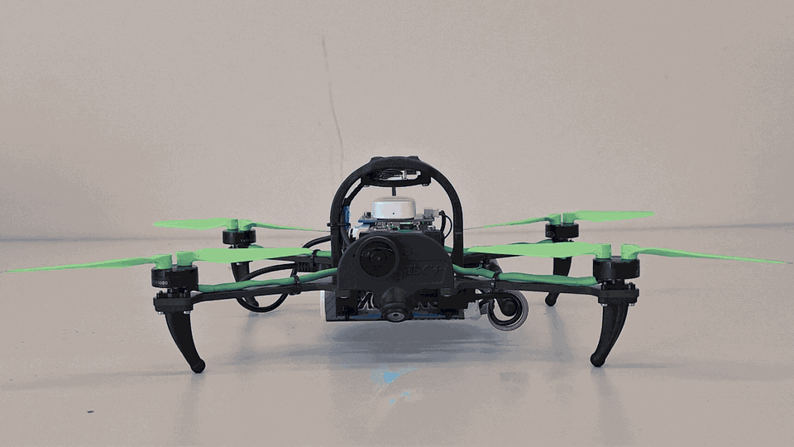
Two-UAV platform and resource constraints
Heterogeneous onboard platforms with separate detection and verification roles
SENTINEL
Customized X500 V2
SCOUT
ModalAI development platform
Continuous detection role
On-demand close verification
D435i stereo hardware + Jetson Nano for onboard RGB inference
High-resolution Sony camera + VOXL 2 for independent inspection
Larger X500 frame carries the sensing, compute and battery package
Compact platform for intended targeted inspection
2
Notes:
TARGET TIME: 0:45
SPOKEN PASSAGE
I customized the X500 Sentinel with a Jetson Nano and D435i camera, including companion power and telemetry integration. The smaller ModalAI Scout uses VOXL 2 and its own camera. Each computer processes its own images, while the Sentinel hosts SwarmNet. Jetson runs ROS 2 Foxy in an L4T container, and Scout runs Foxy natively. The working deployments use compact YOLOv8n for screening and higher-capacity YOLOv8s for verification. Their measured runtime implementations, rather than the later laptop ranking, explain the retained pair.
PRIVATE DELIVERY CUE
Let both hardware GIFs play through the dimension labels while describing the roles. Reference dimensions do not establish measured custom vehicle dimensions or flight endurance.
PRIVATE STUDY NOTES
Sentinel: Customized Holybro X500 V2, Jetson Nano 4 GB, Pixhawk 6C and Intel RealSense D435i.
Scout: ModalAI PX4 development platform with VOXL 2 and an onboard high-resolution camera. The formal September service run used the tracking stream, not 4K hires inference.
Temporal filter: Three consecutive qualifying frames trigger an alert. This suppresses isolated detections but introduces a persistence delay. The thesis did not quantify its net accuracy benefit with a completed common-input ablation.
Verdict and event_id: A verdict is the Scout's confirmation, rejection or error result. Its event_id links it to the correct alert.
Camera scope: D435i includes stereo and inertial hardware, but this experiment evaluated RGB inference. Depth localization and indoor navigation remain separate work.
SHORT ANSWER IF ASKED
The hardware supports the proposed division of roles. Payload, compactness and viewpoint are design motivations, not measured proof of better endurance or maneuverability.
SOURCES
thesis_review/chapters/03_architecture.tex
thesis_review/chapters/05_implementation.tex
defense_presentation/source_evidence_manifest.md
thesis_review/chapters/05_implementation.tex

Slide 3
Correlated decisions and fault containment
Three-frame gating, independent verification and one terminal decision per event
Sentinel
Scout
10 / 10
3 qualifying observations
Post-timeout verdicts rejected
HazardAlert + event_id
0
Fresh local frame
Independent full-frame inference
Additional final decisions
HazardVerdict + same event_id
5 / 5
HazardDecision
CONFIRMED / REJECTED / ERROR / TIMEOUT
Unavailable-Scout events
finalized as TIMEOUT
No ground-station inference. Image-space alerts carry no geographic coordinates.
3
Notes:
TARGET TIME: 0:45
SPOKEN PASSAGE
Three qualifying Sentinel observations create an alert with an event identifier. Scout checks a fresh local frame and returns a verdict with the same identifier. The coordinator emits one terminal decision. Five injected events completed through timeout. All ten post-timeout verdicts were rejected, with zero additional decisions. Separate missing-frame and stale-stream trials each returned five explicit errors without verification on invalid inputs. These are measured software safeguards on stationary hardware.
PRIVATE DELIVERY CUE
Follow the sequence down the left, then point to the right-hand counts. Injection bypassed the vision trigger. State that invalid input produces ERROR, not an ordinary negative verdict.
PRIVATE STUDY NOTES
event_id: Opaque identifier joining one alert, verdict and terminal decision. It is not a target coordinate.
Temporal filter: Three consecutive qualifying inference observations. It rejects isolated observations by design, but its accuracy benefit was not quantified by a common-input ablation.
Idempotence: Repeated or late messages do not create additional terminal decisions for an already finalized event.
Timeout trial: Five synthetic detections injected at the dispatch boundary on the deployed Sentinel node. Scout process was absent. Ten CONFIRMED messages arrived only after final TIMEOUT.
Fail-closed behavior: Missing or stale evidence yields ERROR or TIMEOUT rather than an unverified CONFIRMED decision. This does not prove overall operational safety.
SHORT ANSWER IF ASKED
The measured result is specific containment of injected late, duplicate and missing-input cases. It is not proof of natural network recovery or universal reliability.
SOURCES
thesis_review/chapters/05_implementation.tex
docs/M7_DELAYED_DUPLICATE_VERDICT_FAULT_20260928.md
docs/M7_SCOUT_PROCESS_UNAVAILABLE_FAULT_20260928.md
docs/M7_SCOUT_CAMERA_INTERFACE_FAULT_20260928.md
docs/M7_SCOUT_STALE_STREAM_FAULT_20260928.md

Slide 4
Six-model evaluation on frozen data
AP50-95 on validation and the one-time held-out test set
3,558 / 700 / 733
Train / validation / test images
Grouped sources
Thresholds frozen before test
Best test AP: 0.168
EfficientDet-Lite0
Six detectors evaluated with one fixed protocol and retained source records.
Predictive comparison informs the trade-off study. Earlier YOLO deployments use measured device implementations.
4
Notes:
TARGET TIME: 0:35
SPOKEN PASSAGE
The key finding is ranking instability. EfficientDet moved from last on validation to first on test. A validation winner therefore did not remain the test winner. The earlier YOLO deployments remained the implemented and measured device paths. This comparison supports an evidence-based trade-off study, but it does not establish the best model for either computer.
PRIVATE DELIVERY CUE
Emphasize the ranking reversal rather than narrating dataset counts or every bar. Leave exact counts for readers and questions. Transition to the measured device implementations.
PRIVATE STUDY NOTES
Orange / blue bars: Orange represents validation AP and blue represents held-out test AP. On this slide colors identify splits, not UAVs.
IoU: Intersection over Union: predicted-box intersection area divided by union area with the labelled box.
AP50-95: Average precision averaged over ten IoU thresholds from 0.50 to 0.95. Values range from 0 to 1 and higher is better.
Grouped split: Related source families remain in one split to reduce leakage. The audit reduced leakage risk without proving complete independence.
Single seed: Each candidate used one controlled training seed, so training-run variability was not estimated.
SHORT ANSWER IF ASKED
The six-model study measured predictive behavior. It did not establish the best detector for either computer because the full candidate/device matrix was incomplete.
SOURCES
thesis_review/chapters/04_data-models.tex
thesis_review/chapters/07_results.tex
docs/MODEL_SELECTION_FREEZE_20260809.md

Slide 5
Vectorized decoding reduced pipeline time
Sentinel software experiment and separate device benchmarks
72.1% lower mean pipeline time
EXACT DEPLOYED PIPELINES
58.2 ms
Sentinel YOLOv8n
TensorRT FP16
p95 59.7 ms
999 ms
Scout YOLOv8s
TensorFlow Lite
Sentinel decoding: 148.920 ms to 1.290 ms
p95 1.105 s
8,400 candidates processed with NumPy vectorization
640 x 640 inputs, n = 100 per device
Camera and communication excluded
Separate July runs: 5 warm-ups, 50 measured pipelines each.
5
Notes:
TARGET TIME: 0:55
SPOKEN PASSAGE
Replacing Python loops with vectorized NumPy decoding reduced Sentinel decoding from about one hundred forty-nine milliseconds to one point three. Complete pipeline time fell from two hundred four to fifty-seven milliseconds, a seventy-two percent reduction in that separate experiment. The later deployment benchmark averaged fifty-eight point two milliseconds on Sentinel and nine hundred ninety-nine on Scout, over one hundred measured iterations each. P95 means ninety-five percent of executions completed within that time. TensorRT FP16 supported Jetson screening, while TFLite provided the implemented Scout verification path.
PRIVATE DELIVERY CUE
Point to the before/after bars first, then to the separate deployment figures. These are two experiments with different protocols. Leave precise decimals on screen rather than reading every digit.
PRIVATE STUDY NOTES
Vectorization: NumPy processes many candidate boxes together instead of repeatedly indexing each anchor in Python.
72.1% reduction: 100 x (204.324 - 57.049) / 204.324 = 72.079%. This describes mean complete-pipeline time in serial historical runs, not an accuracy increase or an isolated GPU speedup.
Backend pipeline: Preprocessing, runtime execution and decoding. The benchmark excludes camera capture, ROS 2 and event coordination.
TensorRT / FP16: NVIDIA inference runtime; FP16 uses 16-bit floating-point values. The final Sentinel engine is 640 x 640, distinct from an earlier 416 engine.
TFLite / ONNX: TFLite is the model format/runtime used by the Scout path. ONNX is the portable exchange format used for candidate exports and fidelity checks.
p95: 95% of observations complete at or below this measured latency. It is a percentile, not a confidence interval.
SHORT ANSWER IF ASKED
The measured YOLO implementations matched the intended roles. The later screening did not select universal winners. Higher-capacity YOLOv8s does not automatically imply higher measured accuracy.
SOURCES
docs/M2_DECODER_OPTIMIZATION_20260729.md
docs/M4_HARDWARE_LAB_20260803.md
thesis_review/chapters/07_results.tex

Slide 6
30-minute full-service resource evaluation
30,426 Sentinel frames. No recorded crash, OOM or thermal shutdown.
Sentinel
Scout
Host CPU (%)
Available memory (MiB)
Raw maximum: 67.4 / 60.3%
Raw minimum: 1590 / 4874 MiB
Peak thermal-zone reading (°C)
Swap used (MiB), raw trace
Raw maximum: 51.0 / 48.2 °C
Raw change: +0.922 / 0.000 MiB
CPU, memory and temperature: 1-min means. Swap: raw. Extrema above use unaveraged samples.
6
Notes:
TARGET TIME: 0:50
SPOKEN PASSAGE
Both computers ran the full stationary service stack for more than thirty minutes. Sentinel processed over thirty thousand frames without a recorded crash, out-of-memory termination or thermal shutdown. These plots show how CPU, memory, temperature and swap behaved under the shared workload. Temperatures stayed below fifty-two degrees Celsius, and Sentinel retained about one and a half gibibytes of available memory. These measurements demonstrate sustained service coexistence under the tested conditions.
PRIVATE DELIVERY CUE
Point across the four plots without narrating the averaging or raw-extrema method. Exact values and the display method stay on the slide and in the private definitions. Orange is Sentinel and blue is Scout. Retain the latency and swap qualification in the conclusion.
PRIVATE STUDY NOTES
One-minute mean: For each device and metric, sum all finite observations in a non-overlapping 60 s elapsed bin and divide by their count. No observation is removed for being large. The final bin is partial and device monotonic origins are separate.
CPU and available memory: Host-wide CPU percentage and Linux MemAvailable in MiB. The raw Sentinel minimum is 1589.89453125 MiB, displayed rounded to 1590. The chart shows bin means, not raw minima.
Temperature: The maximum valid thermal-zone value within each sample, then averaged over time. Values >=1 and <120 C follow the existing renderer. Raw maxima remain 51.0 C and 48.2 C.
Swap trace: Unaveraged swap in MiB. Redundant interiors of constant segments are removed losslessly. The final Sentinel increase is 0.921875 MiB, displayed +0.922. It is not filtered away.
Original evidence and acceptance: One-minute averaging is for visual readability only. Original sample counts, peaks, memory minima, the unmet no-swap-growth criterion and the Scout p95 2.618 s result remain unchanged. The valid 36-event probe covers only the final three minutes.
SHORT ANSWER IF ASKED
This is descriptive smoothing of CPU, memory and temperature, not statistical normalization or evidence of universal stability. Swap remains raw because its endpoint change affects the acceptance result.
SOURCES
docs/M6_FULL_SERVICE_ENDURANCE_20260929.md
artifacts/experiments/hardware_full_service_20260929/derived/full_service_summary.json
artifacts/experiments/hardware_full_service_20260929/extracted/full_service/control/fullstack-20260929-r2/resources/resource_samples.jsonl
artifacts/experiments/hardware_full_service_20260929/extracted/full_service_20260929/control/fullstack-20260929-r2/resources/resource_samples.jsonl
tools/render_full_service_endurance.py
defense_presentation/Jahanimajd_Thesis_Defense_v22_7min_Resource_Display_Data.json
thesis_review/figures/full_service_resource_timeseries_20260929.png

Slide 7
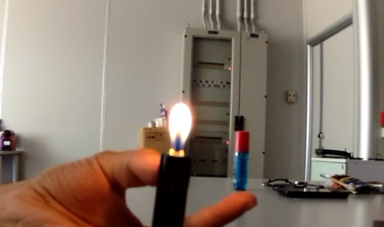
Wireless detection and Scout verification
One stationary event linked across SwarmNet by the same event_id
SENTINEL / logged alert
SCOUT / logged fire score 0.680
0.174
Fire score at dispatch
Flame region
3-frame temporal trigger
Final decision: CONFIRMED
Alert-to-decision: 1.471 s
Sentinel source image not retained
Loaded DDS: 1,000/1,000 replies, p95 RTT 7.984 ms
13/13 strong-flame confirmations. 0/6 direct unlit requests confirmed.
Flame box is an editorial highlight. Recorded model scores are not accuracy estimates.
7
Notes:
TARGET TIME: 0:50
SPOKEN PASSAGE
Here, one physical event is traced from Sentinel to Scout and back across SwarmNet. After three qualifying observations, Sentinel published an alert. Scout independently checked its own camera frame, returned a matching verdict, and the coordinator confirmed the event in about one and a half seconds. Separately, the loaded messaging test delivered all one thousand replies, with a p95 round trip of about eight milliseconds. These are bounded stationary results.
PRIVATE DELIVERY CUE
Explain the shared event identifier and completed wireless workflow rather than reading the two confidence scores. Use rounded spoken timing. The exact values stay onscreen. The blue rectangle is an editorial flame highlight, not a retained detector box. No Sentinel camera image survives for this event.
PRIVATE STUDY NOTES
Matched event: Full event_id 3b317f947f314ca38998bd2ab52ddb3e. Sentinel alert, Scout receipt, inference, verdict and final decision share that identifier. Trial full-postfix-positive-08.
Confidence scores: Live logs record Sentinel 0.17441028356552124 and Scout 0.6801431775093079. Different models, views and score distributions make a numerical increase insufficient to prove increased accuracy. This event is an illustrative selected case.
1.471 s: (449113356130178 - 449111884736995) / 1e9 = 1.471393183 s. Both timestamps come from the Sentinel monotonic clock. This excludes ignition-to-detection time.
Crop and annotation: The image is the original hash-verified Scout JPEG, cropped only for display. The outline manually highlights the visible flame. The event logs did not retain Scout predicted-box coordinates. No Sentinel image is fabricated or relabelled.
Functional and network counts: 13/13 applies to the marked strong-flame interval. 0/6 applies to direct unlit Scout requests bypassing Sentinel. 1,000/1,000 and p95 7.984 ms belong to a separate loaded messaging run, not this flame event.
SHORT ANSWER IF ASKED
This is traceable physical proof of the two-node request-verdict-decision path. It does not show a pair of retained camera images, a calibrated confidence gain, population accuracy, perfect performance or integrated physical flight.
SOURCES
docs/M4_HARDWARE_LAB_20260803.md
docs/M7_LOADED_ROS2_ROUNDTRIP_20260928.md
artifacts/experiments/hardware_lab_20260803/raw/full_nodes/full-postfix-positive-08/sentinel/events.jsonl
artifacts/experiments/hardware_lab_20260803/raw/full_nodes/full-postfix-positive-08/scout/events.jsonl
artifacts/experiments/hardware_lab_20260803/raw/diagnostic_frames/full-postfix-positive-08/full-postfix-positive-08_3b317f947f314ca38998bd2ab52ddb3e.jpg
defense_presentation/Jahanimajd_Thesis_Defense_v22_7min_Slide7_Evidence.json

Slide 8
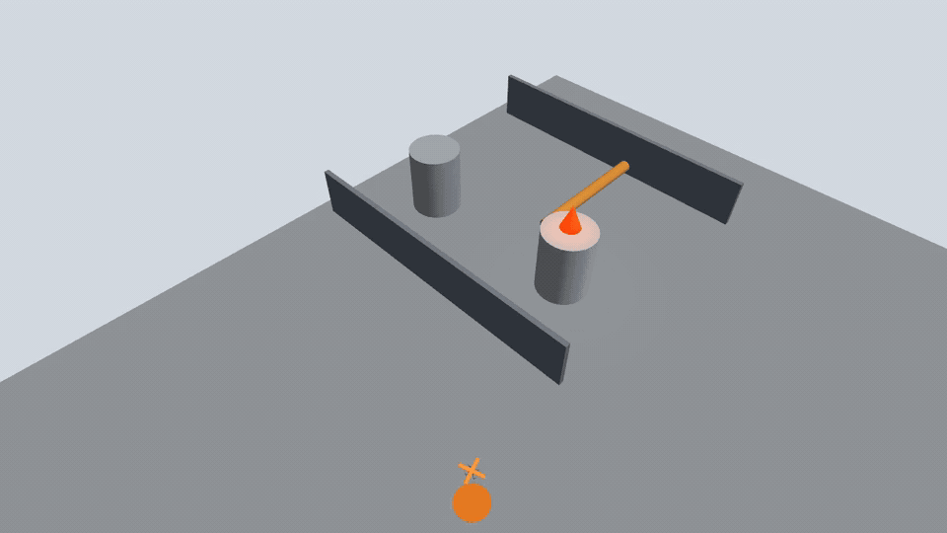
Simulated aerial mission through ROS 2 and PX4
Sentinel patrol, Scout dispatch, verification and coordinated return
4.5 m
Commanded Scout standoff
214.253 s
Until both vehicles landed
and disarmed in the log
Fault correction
0 Scout flight commands
in corrected lost-alert and
unavailable-Scout pilots
Scenario supplies trigger, target and verdict. Provisional airframes.
8
Notes:
TARGET TIME: 1:05
SPOKEN PASSAGE
ROS 2 commands and PX4 telemetry drove this simulated mission, with a four-point-five-metre Scout standoff. The scenario supplied the trigger, coordinates and verdict. [Watch the clip.] Both vehicles finished landed and disarmed in the log. Fault testing exposed an incorrect Scout takeoff state. Corrected lost-alert and unavailable-Scout reruns issued zero Scout flight commands and reached their specified safe outcomes.
PRIVATE DELIVERY CUE
Start speaking as the GIF begins. Pause at [Watch the clip.] and let the complete 31.8-second GIF finish, then finish the passage. The 65-second target allows the full clip plus narration. Do not replay the GIF during the timed talk.
PRIVATE STUDY NOTES
SITL: Software in the Loop: real PX4 flight-control software runs against simulated vehicle physics and sensors.
ROS 2 coordinator: One simulator mission node sends namespaced offboard setpoints and commands and reads each PX4 instance's position, state and acknowledgements.
Scenario truth: JSON provides hazard trigger, local-ENU target and expected verdict. The simulation does not run YOLO on Gazebo camera images to generate them.
4.5 m standoff: Commanded horizontal distance between the scenario hazard and Scout target setpoint; it is not a measured real-world safety distance.
Proxy airframes: Orange Sentinel and blue Scout are visually distinct provisional models. Both inherit X500 dynamics; they are not calibrated replicas of the actual platforms.
214.253 s: Elapsed mission-node time until both vehicles were landed and disarmed in the accepted v17 run. Edited presentation playback has a different duration.
Fault correction: The old logic assigned TAKEOFF before dispatch eligibility. The correction keeps the unavailable or undispatched Scout out of that false state; the reruns retained zero Scout commands.
SHORT ANSWER IF ASKED
The simulation demonstrates executable mission control with PX4 and ROS 2 under modeled conditions. The full closed loop from simulated camera inference to flight response remains untested. Alarm publication and disarming are supported by logs, not by the GIF alone.
SOURCES
docs/M8_DUAL_PX4_VISUAL_MISSION_20260930.md
docs/M3_FAULT_AND_VISUAL_EVIDENCE_20260813.md
tools/px4_sim_hierarchical_mission.py
config/simulation_scenarios_visual_v3.json

Slide 9
Engineering contributions and measured gains
A working onboard Sentinel-Scout system prototype
1 Heterogeneous integration
2 Traceable, fault-contained decisions
Independent camera inference on both UAV computers
Containerized and native ROS 2 Foxy on SwarmNet
10/10 late verdicts rejected, no extra final decision
5/5 no-frame and 5/5 stale-frame error verdicts
3 Measured computational improvement
4 Executable mission orchestration
72.1% lower mean Sentinel pipeline time
>30 min concurrent-service observation on both devices
ROS 2/PX4 simulated mission with a 4.5 m standoff
Both vehicles landed and disarmed in the retained log
Limits: small flame 1/10. Scout p95 2.618 s > 2.0 s. Jetson swap +0.922 MiB.
Next: controlled accuracy ablation, external evaluation and camera-driven aerial validation.
9
Notes:
TARGET TIME: 0:35
SPOKEN PASSAGE
The contribution is a working onboard prototype with traceable decisions, measured safeguards and faster Sentinel processing. ROS 2 and PX4 also executed the simulated mission. Limits remain: small flame one of ten, Scout latency above target, slight swap growth, and no physical-flight or industrial-site validation. Next steps are controlled accuracy tests and external evaluation. Thank you.
PRIVATE DELIVERY CUE
Finish the conclusion by 6:40 and reach Questions by 6:45. The hard ceiling is 7:00, leaving only 15 seconds of buffer.
PRIVATE STUDY NOTES
What was integrated: Stationary physical camera inference and ROS 2 coordination were measured. Simulation separately exercised aerial mission orchestration through PX4.
Next validation: Measure the accuracy benefit with identical inputs, accelerate Scout verification, complete external evaluation and integrate vision with aerial mission control.
Claim boundary: No integrated physical flight, industrial-site validation, physical smoke validation or vision-derived geographic localization is claimed.
SHORT ANSWER IF ASKED
This is a measured engineering prototype, with separately bounded perception, communication, service-coexistence and simulation evidence. Those results support the contribution without claiming operational industrial reliability.
SOURCES
thesis_review/chapters/08_discussion.tex
thesis_review/chapters/09_conclusion.tex
docs/REMAINING_TASK_DISPOSITION_20260930.md

Slide 10
Questions
Tiered Edge AI Architecture for Cooperative UAV-Based Industrial Fire Detection
Mohammadamin Jahanimajd
University of Messina | Academic Year 2025/2026
Notes:
TARGET TIME: 0:05
SPOKEN PASSAGE
I welcome your questions.
PRIVATE DELIVERY CUE
Stop the timed talk here. A1-A8 are hidden examiner references.
PRIVATE STUDY NOTES
Appendix navigation: A1 slide 11: model metrics. A2 slide 12: conversion. A3 slide 13: simulation faults. A4 slide 14: features/future. A5 slide 15: functional outcomes. A6 slide 16: late-verdict log. A7 slide 17: camera/runtime integration. A8 slide 18: network histogram/CDF.
SHORT ANSWER IF ASKED
The six-model AP graph is now main slide 4. Use hidden A1-A8 only for questions, not as a continuation of the talk.
SOURCES

Slide 11
Appendix A1: six-model metrics
Frozen validation and one-time test metrics
Candidate | Val AP | Val F1 | Mean ms | Test AP | Test F1 | Test 95% F1 CI
YOLOv8n-416 | 0.236 | 0.612 | 9.89 | 0.119 | 0.386 | [0.236, 0.544]
YOLOv8n-640 | 0.220 | 0.555 | 7.91 | 0.101 | 0.329 | [0.175, 0.450]
YOLOv8s-416 | 0.203 | 0.541 | 11.14 | 0.130 | 0.393 | [0.236, 0.537]
YOLOv8s-640 | 0.213 | 0.562 | 10.99 | 0.133 | 0.409 | [0.245, 0.545]
SSD MobileNet-320 | 0.185 | 0.571 | 27.44 | 0.114 | 0.330 | [0.162, 0.479]
EfficientDet-320 | 0.161 | 0.497 | 1263.86 | 0.168 | 0.442 | [0.274, 0.596]
The controlled comparison followed the demonstrated hardware deployments. It exposes split-dependent ranking but does not establish a best model for either edge device.
A1
Notes:
TARGET TIME: EXAMINER REFERENCE ONLY
SPOKEN PASSAGE
This table gives the detailed predictive metrics. The test F1 intervals overlap, and the laptop runtime measurements used different execution paths. EfficientDet used CPU/XNNPACK, so its long mean time cannot be interpreted as intrinsic architectural inefficiency or a measured VOXL runtime.
PRIVATE DELIVERY CUE
Examiner reference only. Do not narrate this table during the seven-minute talk.
PRIVATE STUDY NOTES
F1: 2PR/(P+R), equivalently 2TP/(2TP+FP+FN). The decision threshold was frozen using validation.
Test 95% F1 CI: A grouped-bootstrap uncertainty interval using the test source groups, not a confidence score for an individual prediction.
Mean ms: Mean single-image inference-call latency on laptop validation inputs, not full drone decision latency.
EfficientDet 1263.86 ms: About 1.26 s per image on the available CPU/XNNPACK path. Other candidates had GPU-capable execution paths, so the timings are not a hardware-controlled comparison of architectures.
SHORT ANSWER IF ASKED
Predictive test ranking alone does not identify a deployable winner. A complete six-model evaluation on both edge computers is still required.
SOURCES
thesis_review/chapters/07_results.tex
thesis_review/chapters/06_methodology.tex

Slide 12
Appendix A2: conversion and artifact lineage
Fidelity checks for candidate model artifacts and separate historical deployments
Candidate | Prepared form | Match rate | Disposition
YOLOv8n-416 | ONNX FP32 | 0.9603 | Eligible for device build
YOLOv8n-640 | ONNX FP32 | 0.9496 | Held at fidelity gate
YOLOv8s-416 | ONNX FP32 | 0.9598 | Eligible for device build
YOLOv8s-640 | ONNX FP32 | 0.9169 | Held at fidelity gate
SSD MobileNet-320 | TFLite FP32 | 0.8714 | Held at fidelity gate
EfficientDet-320 | Native TFLite | N/A | Ready for device attempt
The fidelity screen tested candidate model artifacts. Historical device timings came from distinct, earlier deployed artifacts. Hashes establish artifact identity; calibration comparisons assess prediction fidelity.
A2
Notes:
TARGET TIME: EXAMINER REFERENCE ONLY
SPOKEN PASSAGE
This calibration screen checks whether exported candidates reproduce native predictions. The historical TensorRT and TFLite deployments are separate artifacts. EfficientDet already provided the native TFLite artifact for a device attempt, so no separate conversion match rate applied to that path.
PRIVATE DELIVERY CUE
Explain match rate only if asked. Eligible for device build does not mean benchmarked on the device.
PRIVATE STUDY NOTES
ONNX: An exchange format used to transport the trained computation graph. ONNX Runtime can execute it and TensorRT can build an optimized engine where supported.
TFLite: A compact deployment model format and interpreter used in the Scout implementation and non-YOLO preparation.
Native TFLite: The EfficientDet workflow supplies a TFLite artifact directly. N/A means the particular converted-versus-native check is inapplicable, not perfect accuracy or successful hardware deployment.
Match rate: On 64 calibration images: one-to-one matched detections / max(native count, converted count, 1). Matching requires the same image and class plus box IoU >= 0.5.
Fidelity gate: Match rate >= 0.95 and mean absolute confidence difference <= 0.02. A displayed 0.9496 remains below the frozen 0.95 threshold.
SHA-256: A file identity/integrity check. It does not establish numerical prediction fidelity or correctness.
SHORT ANSWER IF ASKED
The earlier measured deployments were retained for role fit and available implementations. Candidate fidelity screening did not complete a comparison of all six models on both devices.
SOURCES
tools/validate_yolo_onnx_fidelity.py
manifests/yolo_onnx_export_fidelity_20260813.json
manifests/non_yolo_deployment_preparation_20260813.json

Slide 13
Appendix A3: selected fault-test outcomes
Retained development pilots and their bounded safety evidence
Fault | Run | Result | Safety evidence
Lost alert | v2 | PASS | 0 Scout commands; both reached LANDED.
Scout unavailable | v2 | PASS | Grounded Scout stayed safe; 0 commands.
Delayed verdict | v1 | PASS | Timeout drove DEGRADED to RTL to LANDED.
Sensor/inference error | v1 | PASS | Unverified record retained; safe terminal state.
Low battery | v3 | PASS | Scout grounded; Sentinel landing error 0.076 m.
Duplicate/stale verdict | v2 | PASS | Wrong-ID and duplicate verdicts rejected.
Invalid/geofence target | v1 | PASS | Rejected before dispatch; 0 Scout commands.
One retained development pilot per row. These outcomes do not constitute a formal repeated reliability campaign.
A3
Notes:
TARGET TIME: EXAMINER REFERENCE ONLY
SPOKEN PASSAGE
Each row represents one retained simulation development pilot. The results show specific safe paths and a defect corrected through reruns. They do not provide a repeated-campaign reliability estimate or physical-flight validation.
PRIVATE DELIVERY CUE
Read only the row relevant to the examiner's question. Detailed supporting records remain in the evidence manifest.
PRIVATE STUDY NOTES
DEGRADED / RTL / LANDED: Unverified or failed mission state, return-to-launch sequence and confirmed terminal landing state.
Zero Scout commands: The simulator log records no Scout flight command in that individual fault run.
0.076 m landing error: Simulator-local landing offset in the retained low-battery v3 pilot. It is not real drone landing accuracy.
Fault sample size: One retained development pilot per row, with pre-fix attempts retained where applicable. The 310-run formal campaign was not completed.
SHORT ANSWER IF ASKED
The tests exercised particular safety and identity checks. We report their bounded outcomes rather than estimating operational reliability.
SOURCES
docs/M3_FAULT_AND_VISUAL_EVIDENCE_20260813.md
docs/M3_LOW_BATTERY_FAULT_PILOT_20260813.md
docs/M3_DUPLICATE_STALE_VERDICT_FAULT_20260813.md
docs/M3_INVALID_GEOFENCE_FAULT_20260813.md

Slide 14
Prototype features and future development
Implemented engineering contributions and the next development steps
Implemented prototype feature | Future development / validation
Tiered onboard perception YOLOv8n + YOLOv8s on two computers | Complete the candidate/device matrix Accelerate Scout verification
Correlated ROS 2 decisions event_id, verdict and timeout handling | Repeat network and recovery campaigns Evaluate multiple active events
Three-frame trigger Camera freshness and error gates | Quantify filtering and verification benefits Use identical inputs for each stage
Namespaced dual-PX4 mission control Executed simulated flight sequence | Integrate camera-driven target acquisition Calibrate airframes and test certified flight
Hash-linked logs and reproducible metrics Preserved failures and corrected reruns | Evaluate external UAV / industrial data Measure energy and flight endurance
The contribution is system integration and measured engineering improvements. No new detector algorithm is claimed.
A4
Notes:
TARGET TIME: EXAMINER REFERENCE ONLY
SPOKEN PASSAGE
The left column summarizes implemented features of the system prototype. The right column lists future development and validation. My contribution is the custom integration and measured engineering work across the two platforms. I do not claim a new detector algorithm. The next priorities are accelerated Scout execution, controlled accuracy ablation, camera-driven missions, and external-domain evaluation.
PRIVATE DELIVERY CUE
Open only for questions about originality, implemented features, project extensions or future work. The right column is proposed work.
PRIVATE STUDY NOTES
Prototype feature: A capability implemented and supported by the specific records cited, with the physical or simulation boundary retained.
Engineering contribution: The integration of cameras, heterogeneous runtimes, ROS 2 event handling, safety gates and reproducible evaluation, together with the measured vectorized decoder improvement.
Future priority: Accelerate the measured Scout bottleneck, quantify detection/verification benefits with identical inputs, and close the gap between perception and simulated aerial mission control.
Operational deployment: Requires calibrated sensing/localization, obstacle handling, power/endurance measurements, repeated fault testing and authorized physical flight and industrial evaluation.
SHORT ANSWER IF ASKED
The project produced an executable and measured system prototype. Its contribution is the integration and engineering evidence; external validity and operational flight remain subsequent validation.
SOURCES
thesis_review/chapters/05_implementation.tex
thesis_review/chapters/08_discussion.tex
thesis_review/chapters/09_conclusion.tex
docs/M2_DECODER_OPTIMIZATION_20260729.md
docs/REMAINING_TASK_DISPOSITION_20260930.md

Slide 15
Physical workflow and DDS performance
Stationary functional checks on the implemented onboard system
Observed functional outcomes
LOADED ROS 2 / DDS RUN
1,000 / 1,000
Correlated replies received
7.984 ms
p95 round-trip latency
Freshness gates and event_id correlation
No missing or duplicate replies
recorded in this loaded run.
Separate trials; unlit and fault alerts bypassed detection.
Counts describe functional checks, not population accuracy.
A5
Notes:
TARGET TIME: EXAMINER REFERENCE ONLY
SPOKEN PASSAGE
The stationary workflow confirmed all thirteen requests during the strong-flame interval and rejected all six direct Scout requests using unlit frames. Separate fault trials returned five correlated no-frame errors and five stale-frame errors, with zero verification inferences on missing or stale inputs. These checks demonstrate the implemented freshness gates and event correlation. The alerts for the unlit and fault trials bypassed Sentinel detection. Under inference load, ROS 2 returned all one thousand correlated replies with a p95 round trip of seven point nine eight four milliseconds. No missing or duplicate reply was recorded in that run.
PRIVATE DELIVERY CUE
The bars show different expected outcomes in separate functional checks, not a pooled accuracy score. Mention the small-flame result on the final limitations slide. Network RTT and AI decision latency measure different paths.
PRIVATE STUDY NOTES
Outcome bars: Thirteen strong-flame confirmations, six unlit rejections, five ERROR/no_frame results and five ERROR/stale_frame results. Each row is a separate trial condition. Do not pool them into an accuracy percentage.
6 of 6 rejected: Equivalent to zero of six unlit requests confirmed. All six bypassed Sentinel detection; this is not a complete environmental-negative test.
Freshness gates: No-frame and stopped-stream trials each produced five matching error verdicts and zero inferences on unavailable/stale inputs. The actual camera service remained running; the fault was at the ROS interface.
RTT: Round-trip time for an application request and correlated reply, in milliseconds. It excludes camera and model execution in this messaging probe.
1,000 / 1,000: Application-level complete replies within this loaded run. This does not establish universal zero packet loss or future reliability.
Correlation: The reply must carry the intended event identifier, which supports duplicate, stale and mismatched-message rejection.
SHORT ANSWER IF ASKED
The strong-flame demonstration and complete loaded-message delivery support proof of function. The small-flame result identifies a concrete sensitivity limit, and a common-input ablation is still needed to quantify an accuracy gain.
SOURCES
docs/M4_HARDWARE_LAB_20260803.md
docs/M7_SCOUT_CAMERA_INTERFACE_FAULT_20260928.md
docs/M7_SCOUT_STALE_STREAM_FAULT_20260928.md
thesis_review/chapters/07_results.tex
thesis_review/figures/loaded_ros2_rtt_distribution.png

Slide 16
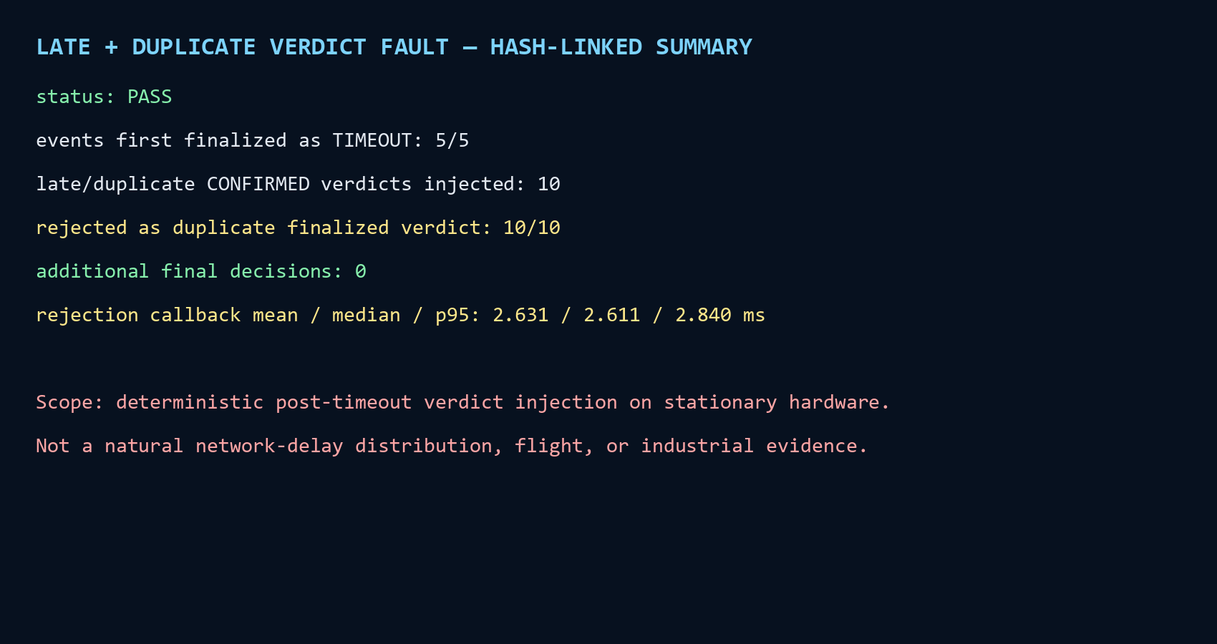
Evidence gallery: late-verdict containment
Retained terminal-style log summary, not a screenshot of a live terminal
A6
Notes:
TARGET TIME: EXAMINER REFERENCE ONLY
SPOKEN PASSAGE
The retained summary shows five completed timeouts, ten rejected late or duplicate verdicts, and zero additional final decisions. It is a derived rendering of hash-linked experiment logs.
PRIVATE DELIVERY CUE
Use this for questions about event finalization or fault injection. The visual is not a live terminal screenshot.
PRIVATE STUDY NOTES
2.840 ms p95: Rejection callback duration for ten injected post-timeout verdicts. It is not hazard-detection or complete decision latency.
Deterministic injection: The harness cancelled the camera timer and injected detections at dispatch. It deliberately separated protocol behavior from vision uncertainty.
SHORT ANSWER IF ASKED
The source event log and analysis hashes identify the evidence behind the visual. The result supports only the tested fault pattern.
SOURCES
docs/M7_DELAYED_DUPLICATE_VERDICT_FAULT_20260928.md
D:/Drones/recovery_images/sentinel_sd_20260909/hardware_evidence_20260928/faults_20260928/delayed_duplicate_verdict/derived_analysis/delayed-duplicate-verdict-20260928-r1/visuals/delayed_duplicate_verdict_terminal_summary.png

Slide 17
Evidence gallery: camera and runtime integration
Concrete interfaces that connect the hardware to the decision protocol
Engineering work | Retained implementation or observation
Sentinel live RGB path | D435i YUY2 via GStreamer to BGR, then TensorRT
Scout vendor-camera integration | MPA bridge to ROS 2, explicit encoding / stride / payload checks
Live camera preflight | Tracking 10/10 mono8 frames, hires 10/10 yuv422 frames
Camera freshness protection | 5/5 no-frame and 5/5 stale-frame ERROR verdicts, zero fault-frame inferences
Deployment environments | Jetson L4T / Docker Foxy and native VOXL 2 Foxy, Cyclone DDS on wlan0
Evidence capture | 4096-record asynchronous queue, UTC + monotonic timing, SHA-256 manifests
These records establish interface compatibility and bounded behavior. They do not establish 4K inference or geometric localization.
A7
Notes:
TARGET TIME: EXAMINER REFERENCE ONLY
SPOKEN PASSAGE
The prototype required camera-byte validation, vendor-bridge integration, and compatible ROS 2 environments across two different platforms. These interfaces make independent onboard verification possible.
PRIVATE DELIVERY CUE
Explain the row relevant to the question. Do not claim that high-resolution stream compatibility means the formal inference tests used 4K images.
PRIVATE STUDY NOTES
MPA: Modal Pipe Architecture exposes vendor-supported camera streams. The ROS bridge publishes those images for the verifier.
Stride and payload: Row step is bytes per row. Validate it together with dimensions, encoding and total buffer length before conversion.
mono8 / yuv422: 8-bit grayscale versus packed YUV color. Actual ROS encoding determines decoding, not an assumed pipe format.
4096 records: Bounded asynchronous logging-queue capacity, not a measured logging throughput.
Physical power work: X500 distribution and DC-DC regulator supply the companion. Electrical efficiency and airborne endurance were not measured.
SHORT ANSWER IF ASKED
This is system engineering beyond detector comparison. The separate interface observations retain their own sample sizes and dates.
SOURCES
thesis_review/chapters/05_implementation.tex
docs/M2_CAMERA_PREFLIGHT_20260729.md
docs/M7_SCOUT_CAMERA_INTERFACE_FAULT_20260928.md
docs/M7_SCOUT_STALE_STREAM_FAULT_20260928.md

Slide 18
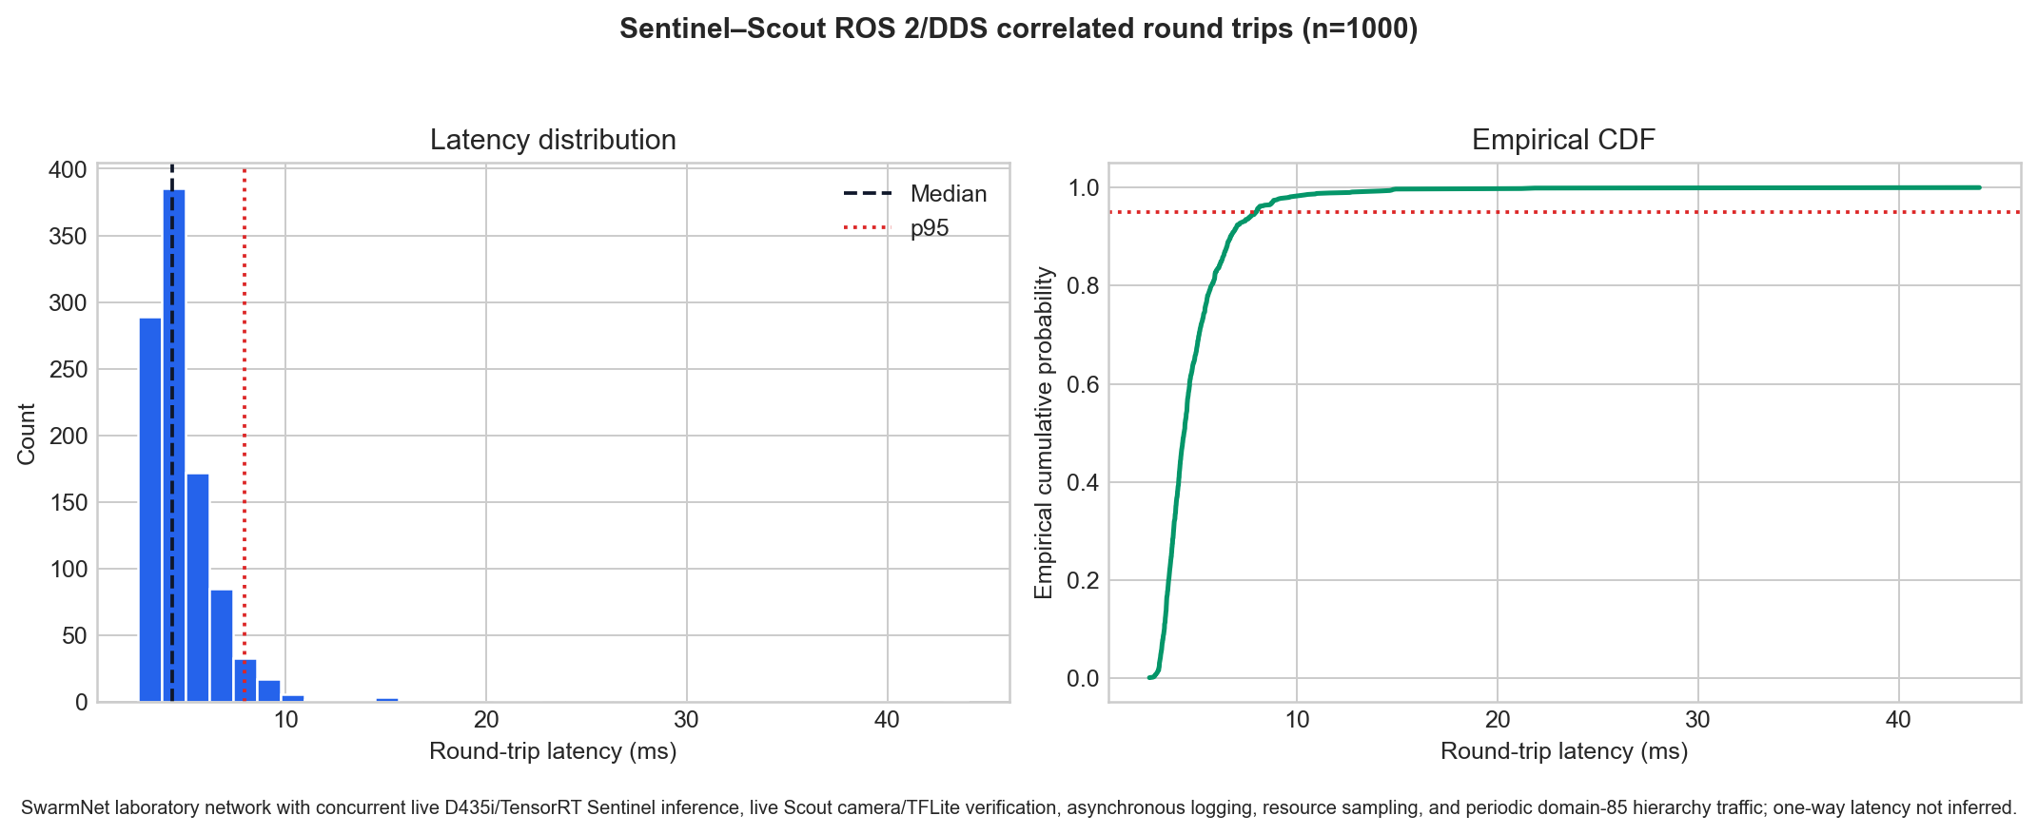
Evidence gallery: loaded message distribution
1,000 correlated ROS 2/DDS round trips with concurrent live inference
Median 4.393 ms. p95 7.984 ms. Maximum 44.011 ms. Same-process round trip, not one-way latency.
A8
Notes:
TARGET TIME: EXAMINER REFERENCE ONLY
SPOKEN PASSAGE
The histogram shows the concentration and tail of observed round-trip times. The empirical cumulative distribution reaches ninety-five percent at seven point nine eight four milliseconds. All one thousand correlated application replies arrived in this run.
PRIVATE DELIVERY CUE
Point to the histogram tail and the p95 reference. Do not infer packet-level loss or one-way delay.
PRIVATE STUDY NOTES
Empirical CDF: At latency x, the fraction of observed RTT samples at or below x. It describes this sample, not a guaranteed future probability.
Wilson interval: Delivery fraction 1,000/1,000 gives the reported 95% Wilson interval 0.99617 to 1.00000. Dependence and shared-network conditions limit generalization.
RTT / inference: This messaging probe excludes the model call. Concurrent live inference provided background load rather than forming part of the timed request.
SHORT ANSWER IF ASKED
One successful loaded run demonstrates the observed communication path. It cannot certify future airborne network reliability.
SOURCES
docs/M7_LOADED_ROS2_ROUNDTRIP_20260928.md
thesis_review/figures/loaded_ros2_rtt_distribution.png

