Slide 1
DISTRIBUTED SYSTEMS · FINAL PROJECT
A Proposed Neural Cache Replacement Policy for NDN
Amin Aghakasiri 810101381
Babak Hosseini Mohtasham 810101408
Instructor: Mohammad Reza Shakournia
University of Tehran · Summer 2026
01

Slide 2
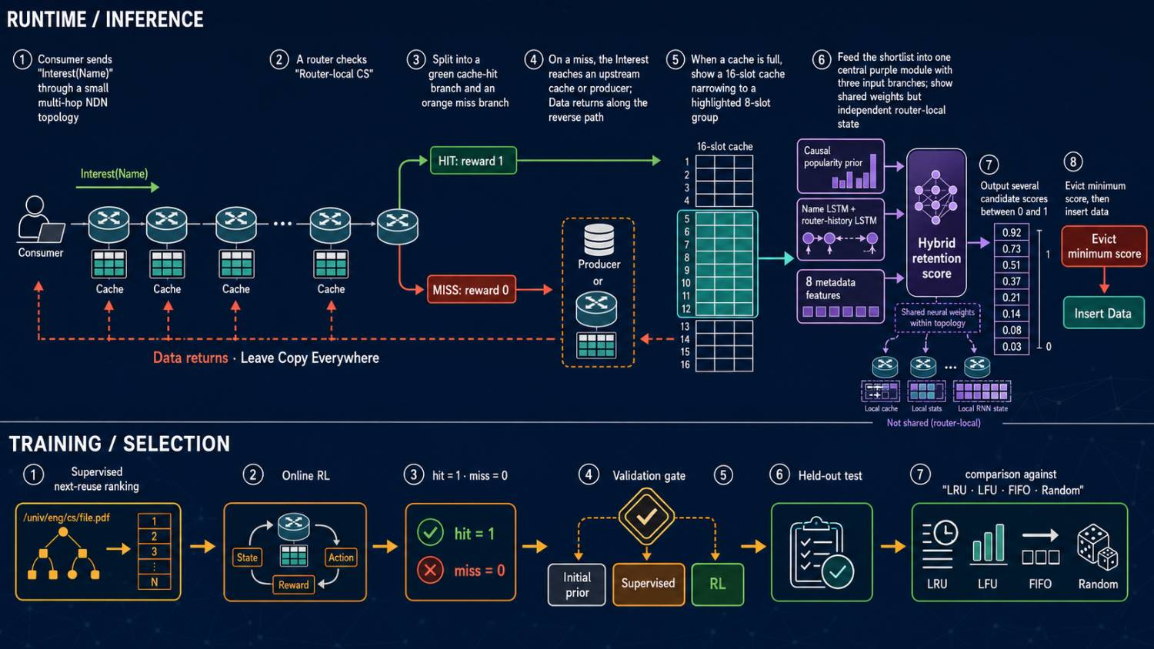
DISTRIBUTED SYSTEMS · FINAL PROJECT
The overall pipeline
02
UNIVERSITY OF TEHRAN

Slide 3
DISTRIBUTED SYSTEMS · FINAL PROJECT
IP vs NDN
03
IP
NDN
Where is the server?
What is the content?
The destination is an address.
The request carries a hierarchical Name.
/dataset/item/category-03/000127
C
192.0.2.42
Server
Interest
C
R1
R2
Producer
routing toward a host
Data
fresh matching Data
Any on-path router with fresh matching Data can answer before the producer.
UNIVERSITY OF TEHRAN

Slide 4
DISTRIBUTED SYSTEMS · FINAL PROJECT
Importance of replacement policy
04
The decision
16-packet Content Store
Keep the packets with the greatest future local reuse value.
/…/041
/…/127
/…/003
/…/098
/…/221
/…/062
/…/044
/…/179
full cache
A poor eviction creates an avoidable miss when that Data is requested again.
NEW DATA
/…/247
/…/015
/…/206
/…/081
/…/144
/…/233
/…/027
/…/115
/…/190
consumer cache-hit ratio
requests answered by router caches
total consumer requests
EVICTION VICTIM
A hit may occur at any router before the producer.
UNIVERSITY OF TEHRAN

Slide 5
DISTRIBUTED SYSTEMS · FINAL PROJECT
Implemented network topologies
05
P0 producer · nodes 1–7 consumers · every router has an independent 16-packet cache
LINE
RING
P0
7
1
P0
1
2
3
4
5
6
7
6
2
5
3
4
STAR
COMPLETE MESH
P0
P0
7
7
1
6
1
2
6
2
5
3
5
3
4
4
UNIVERSITY OF TEHRAN

Slide 6
DISTRIBUTED SYSTEMS · FINAL PROJECT
Router transaction
06
Fresh
hit?
Answer Interest · local reward = 1
No replacement scoring
Receive Interest
Check local CS
YES
NO
Data returns
from cache or producer
Forward with forwarding table · local reward = 0
Free
slot?
Insert Data
YES
NO
Select the 8 least recently used items
Compute scores
Evict + insert
UNIVERSITY OF TEHRAN

Slide 7
DISTRIBUTED SYSTEMS · FINAL PROJECT
Computing the scores
07
A Candidate Name
/dataset/item/category-03/000127
canonical components → stable hash 4,096 → embed 32 → Name LSTM 48
CONCATENATE
Name vector
+ local history
+ metadata
SCORE HEAD
hidden size 64
B Router request history
sᵢ
[0,1]
KEEP ↑
Interest Names in chronological order
context LSTM 64 · separate hᵥ per router · shared weights
C Seven candidate features
1 frequency
2 request recency
3 regularity
4 cache-hit fraction
5 residence recency
6 freshness remaining
7 incoming/resident
UNIVERSITY OF TEHRAN

Slide 8
DISTRIBUTED SYSTEMS · FINAL PROJECT
Computing the scores
08
z_{ᵢ} =
p_{ᵢ}
+ 0.05 tanh(z_{θ}(i, h_{ᵥ}, x_{ᵢ}))
s_{ᵢ} = sigmoid(z_{ᵢ}) ∈ [0,1]
POPULARITY PRIOR
NEURAL RESIDUAL
weight 1.0
bounded ±0.05
candidate-normalized decayed local frequency
τ = 32 router-local requests
Name + router history + metadata
conservative logit correction
Evict arg min sᵢ within the shortlist · higher score means KEEP
UNIVERSITY OF TEHRAN

Slide 9
DISTRIBUTED SYSTEMS · FINAL PROJECT
Computing the scores
09
Most recently used
16-packet cache
LRU FILTER
8 of 16 residents
R1
R2
R3
R4
R5
R6
R7
R8
EVICT
item with
minimum score
S1
S2
S3
S4
SCORE
only the shortlist
S5
S6
S7
S8
50%
8 least-recently-used residents
of residents neurally scored per replacement
UNIVERSITY OF TEHRAN

Slide 10
DISTRIBUTED SYSTEMS · FINAL PROJECT
Training pipeline
10
PRETRAIN PARTITION
ONLINE TRAIN PARTITION
VALIDATION → TEST
1
Supervised pairwise ranking
2
Online reinforcement learning
3
Validation safety gate
LRU behavior observes
15,000 training requests
Local reward
Compare on 2,500 validation requests
r = 1 hit · r = 0 miss
uᵢ = 1 / reuse distance
within horizon H = 32
initial causal prior
vs supervised checkpoint
vs RL checkpoint
A replacement receives only
later router-local hit rewards
sooner reuse → higher score
complete pre-eviction candidate set
keep the highest validation hit ratio
UNIVERSITY OF TEHRAN

Slide 11
DISTRIBUTED SYSTEMS · FINAL PROJECT
Model parameters
11
SYNTHETIC REQUEST TRACE
20,000 consumer requests
TRAIN 15,000
VAL
2,500
TEST
2,500
chronological — never shuffled
catalog
300 packets
Name categories
8
consumer routers
7
node-demand skew α
0.7
Zipf popularity α
1.1
temporal locality
0.45
locality window
64
locality decay
0.88
popularity drift
5% / 1,000
request rate
20 / time
freshness
2–300
MustBeFresh
enabled
packet size
1 unit
locked test seed
29
UNIVERSITY OF TEHRAN

Slide 12
DISTRIBUTED SYSTEMS · FINAL PROJECT
Results
12
Topology | Neural | LRU | LFU | FIFO | Random
Line | 74.64% | 70.32% | 62.40% | 65.32% | 70.64%
Ring | 74.64% | 72.04% | 58.08% | 68.80% | 70.24%
Star | 74.96% | 71.24% | 55.48% | 67.08% | 69.68%
Mesh | 75.00% | 73.72% | 54.88% | 70.92% | 69.28%
Mean | 74.81% | 71.83% | 57.71% | 68.03% | 69.96%
UNIVERSITY OF TEHRAN

Slide 13
APPENDIX · TECHNICAL REFERENCE
Model and training hyperparameters
A1
MODEL
POLICY + CACHE
TRAINING
Vocabulary
4,096
Popularity prior
1.0
Prediction horizon
32
Max Name components
16
Recency prior
0.0
Pretraining epochs
1
Embedding
32
Residual scale
0.05
Pretraining LR
0.001
Name LSTM
48
Popularity decay
32
RL epochs
1
Context LSTM
64
Cache capacity
16
RL LR
0.0001
Score-head hidden
64
Shortlist
8
Gamma
0.97
Numeric features
8
Bypass
disabled
Rollout
256
Dropout
0
Packet size
1 unit
Temperature
0.3
Entropy
0
UNIVERSITY OF TEHRAN

Slide 14
APPENDIX · TECHNICAL REFERENCE
Inference pseudocode
A2
on_interest(router v, Interest I):
update local request statistics and LSTM history
if fresh matching Data exists in local cache:
reward(v) = 1
return Data
reward(v) = 0
forward Interest toward producer
Data = receive upstream response
if cache has free capacity:
insert Data
else:
candidates = 8 least-recently-used residents
score each candidate with model(...)
victim = candidate with minimum score
evict victim; insert Data
finish complete Interest/Data transaction
apply pending training update if required
HIT
return immediately
reward = 1
no scoring
FULL-CACHE MISS
shortlist 8
score residents
evict arg min sᵢ
insert returning Data
UNIVERSITY OF TEHRAN

