Slide 1
托福听力学术讲座分类详解
BY 马孟宇
南京新东方

Slide 2
学科类讲座常见文章结构
总分并列结构
线性深入结构
注意总论点和分论点之前的关系
一般分论点有详有略，略的不考
注意各个分论点论述过程和论据之间的对应关系
随着原始话题的深入，会不断出现新问题。
出现的问题和对应的答案与解决措施，必须要明确对应关系不能混淆
最后得出的结论必然有阶段性，看清楚题设问的是什么情况下的结论
总分
深入
案例
假设
案例分析结构
多重假设结构
核心话题尤其重要，虽然案例分析是文章的主要内容，但案例所说明的论点是必考的。
案例分析不再使用举例考点的笔记方法，案例里的细节是重要的
关于同一个话题提出不同时期、不同种类的假设或理论，一般呈现递进趋势
最后最多有一个正确假设，但一般爱考的是前面几个假设或理论的问题所在
教授态度不确定，随时关注教授对于各假设的评价

Slide 3
1
生命科学
Life Science

Slide 4
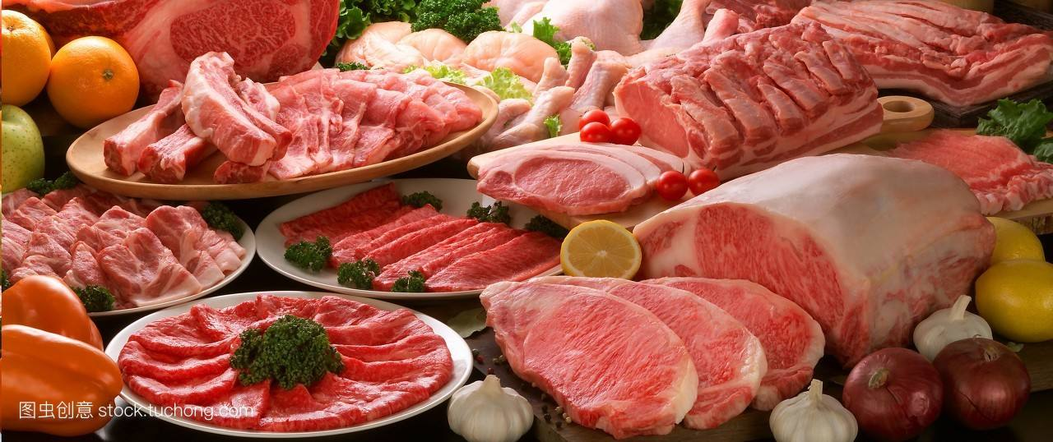
背景知识拓展
动物对于人类来说最大的意义在于？
天上飞的
hen rooster chick; duck; turkey; goose; quail; ostrich
地上跑的
pig hog swine; cow cattle bull buffalo calf; sheep lamp ram goat
kangaroo; llama; rabbit/hare; deer
水里游的
cod; eel; herring; salmon; trout; bass; anchovy; sardine; tuna; halibut; catfish; caviar; crab; lobster prawn shrimp; scallop; octopus; squid; oyster; mussel; clam;

Slide 5
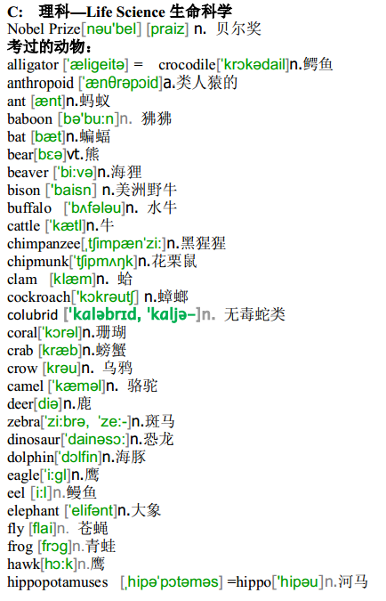
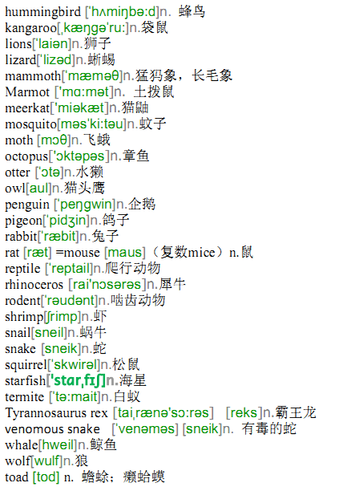
生命科学类讲座

Slide 6
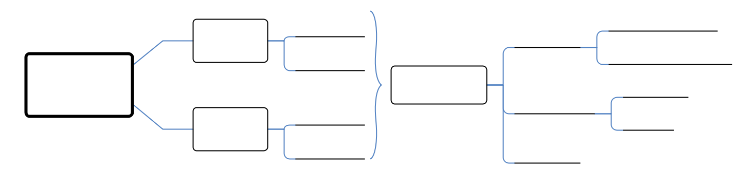
生命科学类常见文章内容
Notes:
tpo27-L3（动物） tpo48-L3（生物学） 19-L3（海洋生物） 51-L1（植物学） 40-2（环境科学）

Slide 7
2
自然科学
Physical Science

Slide 8
天文学讲座高频词汇
astronomy
astronomical observatory
Planetarium
astrophysics
astrology
pseudoscience
cosmos / universe
infinite
cosmic
cosmic radiation
cosmic rays
celestial
celestial body / heavenly body
celestial map / sky atlas
dwarf / dwarf star
constellation
galaxy / Milky Way
star cluster
solar system
solar corona
solar eclipse
solar radiation
planetoid / asteroid
revolve
twinkle
naked eye
orbit
lunar
meteor
meteor shower
meteorite
comet
intergalactic
interstellar
interplanetary
nebula
ammonia
photosphere
chromospheres
sunspot
flare
vacuum
infrared ray
ultra-violet light
emission
high-resolution

Slide 9
地质学讲座高频词汇
crust /mantle
core
continental crust
oceanic crust
layer / stratum
stratigraphy
fault
fault plane
fault zone
rift / crack / split
disintegration/decomposition
erosion
fossil
igneous rock
sedimentary rock
metamorphic rock
limestone
granite
marble
magma / molten lava
quartz mineral
ore deposit
rubble debris
platinum silver
copper aluminum
tin lead zinc
nickel mercury
sodium gem
diamond
emerald
ruby
glacier
glacial
glacial epoch / age / period
glacial drift
iceberg
volcano
active volcano
extinct volcano
dormant volcano
shield volcano
cone volcano
eruption
crater
depression
volcanic dust
volcanic ash
geyser
hot spring
earthquake / quake / tremor / seism
seismic
seismology
seismic intensity scale
Notes:
TPO18 L1 24-4

Slide 10
3
社会科学
Social Science

Slide 11
社会科学
人类学&考古学
商业&市场&经济学
语言学&美国历史
心理学&教育学

Slide 12
考古学&人类学讲座高频词汇
archaeology
paleontology
anthropology
archaeologist
pale-anthropologist
ecological
anthropologist
originate
ancestor
tribe
clan
excavation
excavate / unearth
ruins
remains
artifact
relic
antique
antiquity
Stone Age
Bronze Age
Iron Age
Paleolithic
Mesolithic
Neolithic
morphology
skull
fossil
ancient civilization
cave man
cultural relics
rock painting
Notes:
形态学

Slide 13
商业&经济学讲座高频词汇
accounting
allocation
barrier
capital
capital stock
capital output ratio
capitalism
supply
demand
commodity
common property
compensation principles
competitive market
complement goods
consistence
constraints
corporation
cost minimization
demand schedule
durable goods
inferior goods
distribution
exclusion
hypothesis
long run
luxury
revolution
natural resources
non-rivalry
ordinary goods
discrimination
proportional demand pure exchange
rationality
regulation
law of scarcity
revealed preference
total expenditure
Welfare criterion
subsidy
substitutes
relative price
Insurance
contract
verbal agreement
repay
interest
Merchant
paramount
gross
supply chain
fluctuation
boom bust
recession
depression
Notes:
33-1 42-4

Slide 14
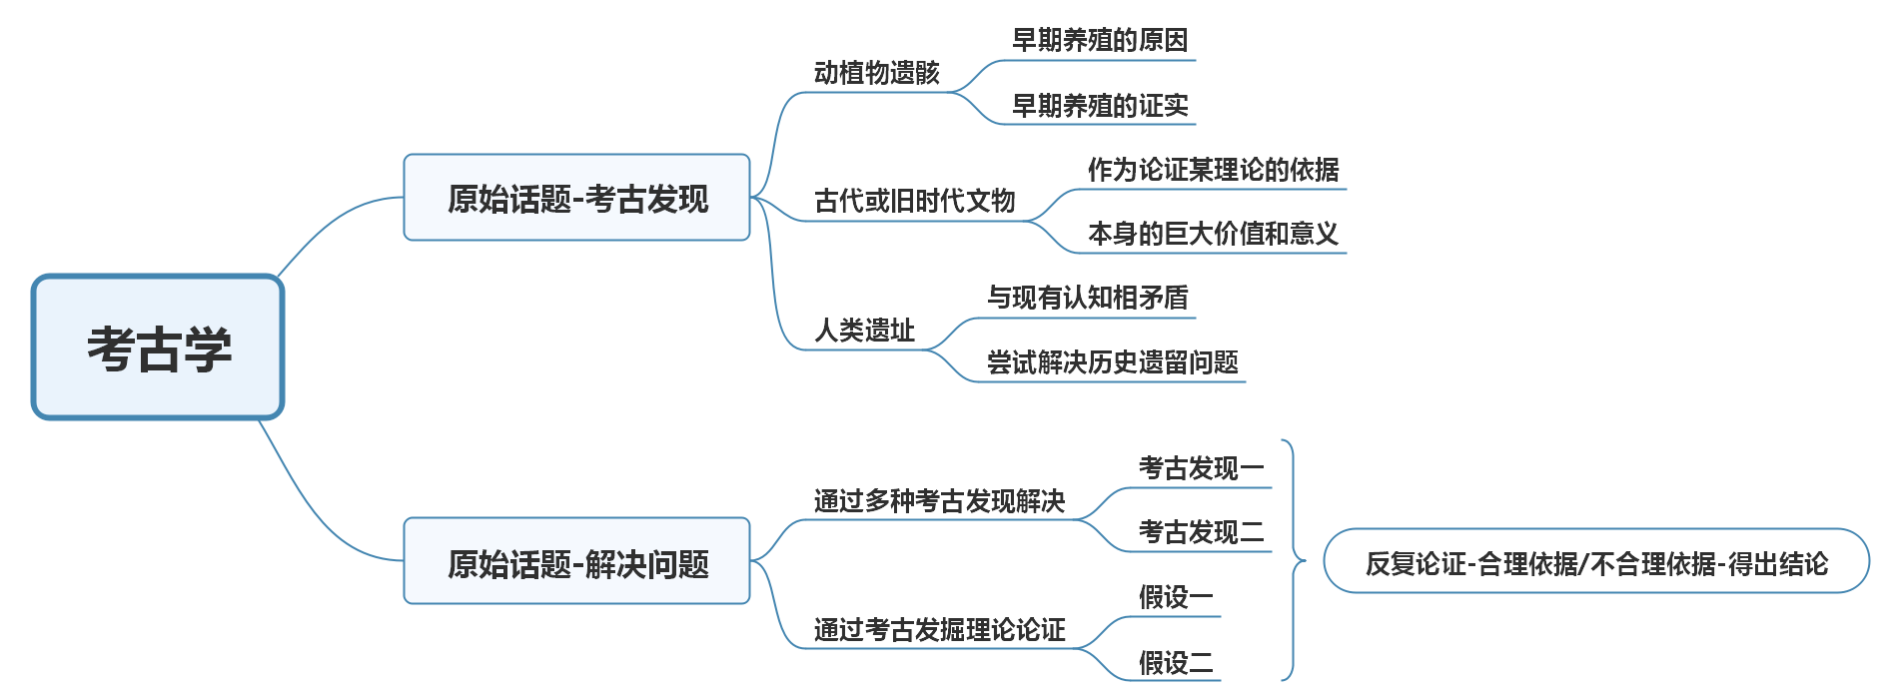
社会科类常见文章内容

Slide 15
4
艺术
Art

Slide 16
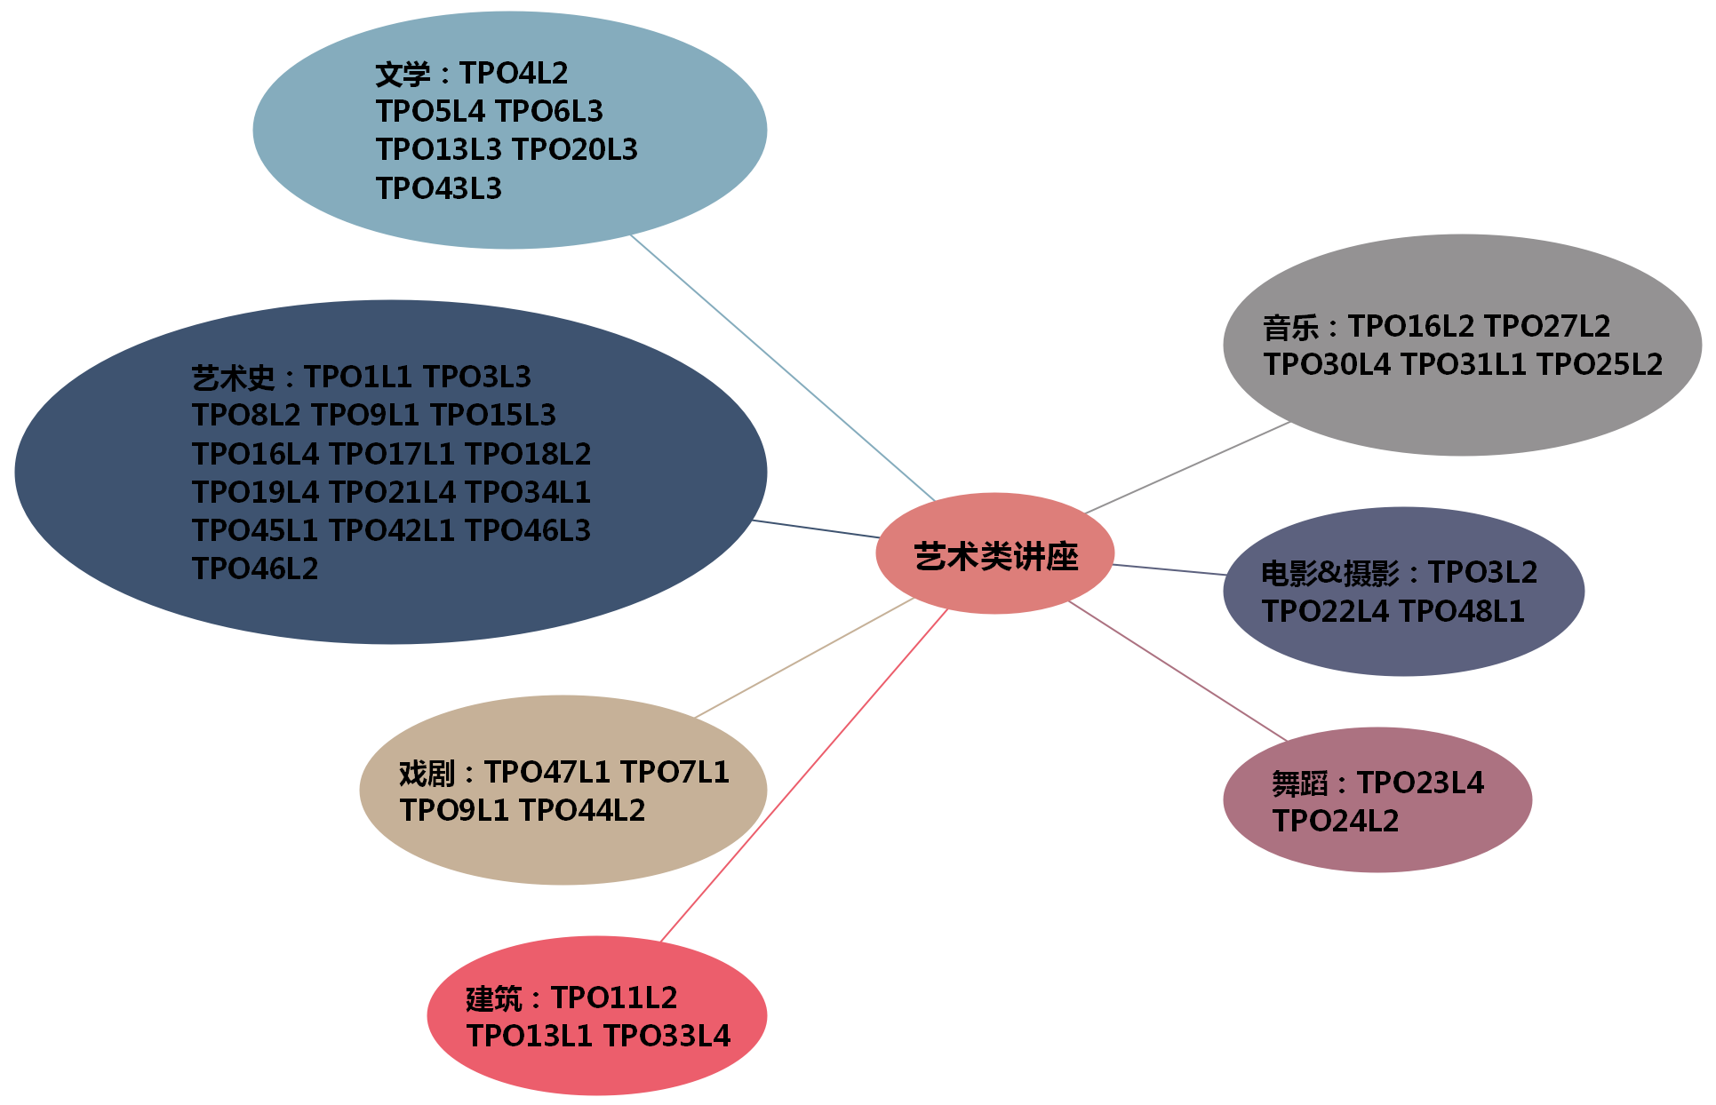
艺术类讲座

Slide 17
艺术类词汇
音乐类：
musical instrument keyboard instrument percussion
string music wind music pluck violin viola cello
harp harpsichord organ horn
clarinet oboe flute folk music pop music
classical music jazz blues rock and roll
hip-hop symphony orchestra choir
quartet note score movement quality
volume pitch chord harmony rest duet solo
lyric rhythm melody conduct podium
accompaniment lullaby ballad
文学类：
prose diary poem poetry poet novel
science fiction allegory fairy tale legend proverb
myth mythology satirist biographer
biographical sketch autobiography model
leading character literary criticism literary studies
school of literature genre surrealism
futurism modernism

Slide 18
艺术类词汇
建筑类：
architecture architect wing log structure
metal-frame skyscraper planetarium
aquarium archive cathedral theatre
concert hall mosque The Triumphal Arch
sphinx pyramid castle temple
The Statue of Liberty
雕塑类：
sculpture statue sculptor figurine bust
original autography copy replica gallery
摄影类：
photographer snapshot develop foreground
exposure high definition instant camera
camera lens long focus lens tripod filter
dark room close-up out of focus

Slide 19
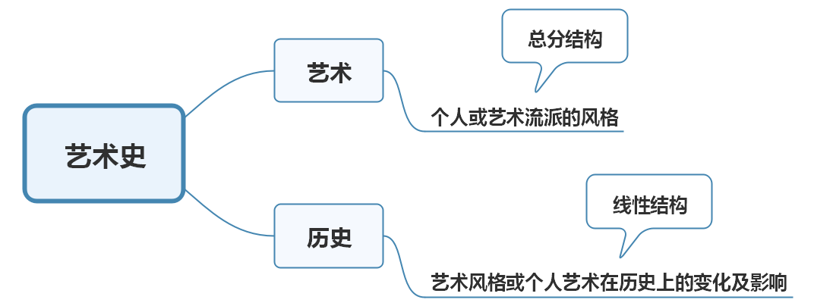
艺术史类讲座常见结构
Notes:
40 44 46.2 40-47 只有43没有艺术史

Slide 20



感谢聆听！
This is a sample letter that has been placed to demonstrate the typing format on the (Your Company). letterhead design. When positioned properly, it will serve to work in harmony with all of the other. This is a sample letter that has been placed.
This is a sample letter that has been placed to demonstrate the typing format on the (Your Company). letterhead design. When positioned properly.

