Slide 1

E-Commerce Application
Realized by:
Amine Ouadrani
COLLEGE YEAR
2020 - 2021

Slide 2
Timeline
Project Overview
Implementation
Introduction
Conception
Conclusion

Slide 3
introduction

Slide 4

problematic
How can I link the seller to the buyer ?

Slide 5





Project overview
Get
access
View
products
Add
products
Client
Platform
Product
Platform
Get
access
Seller
Seller

Slide 6

Project overview
Platform
Admin
Manage
products
Product

Slide 7
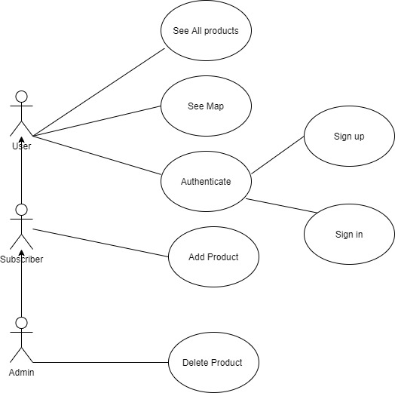
Client Use case diagram

Slide 8
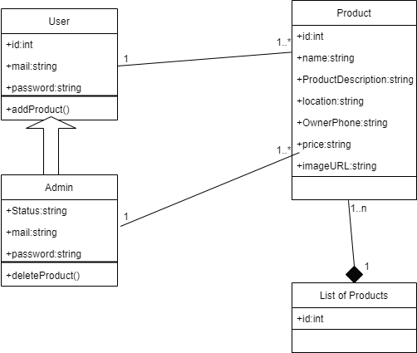
Class diagram

Slide 9
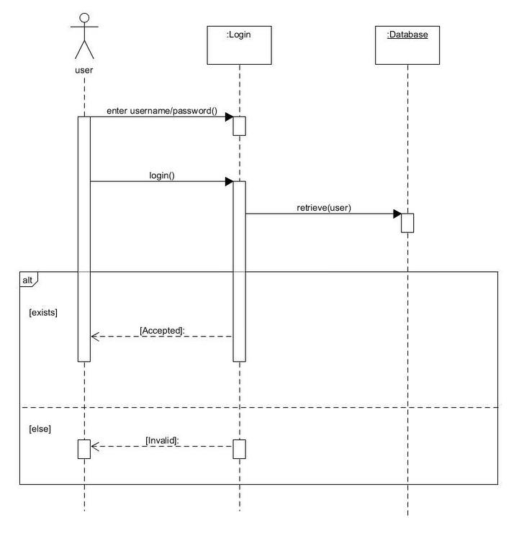
Authentication sequence diagram

Slide 10
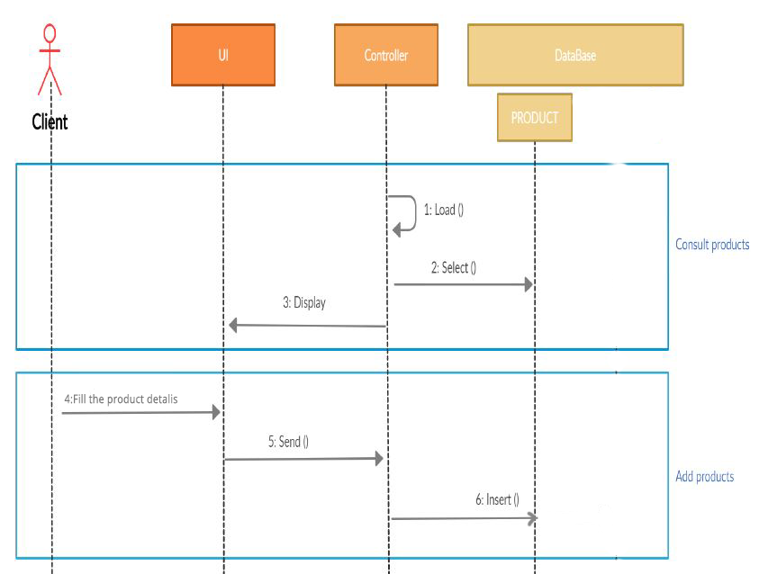
Client general sequence diagram

Slide 11
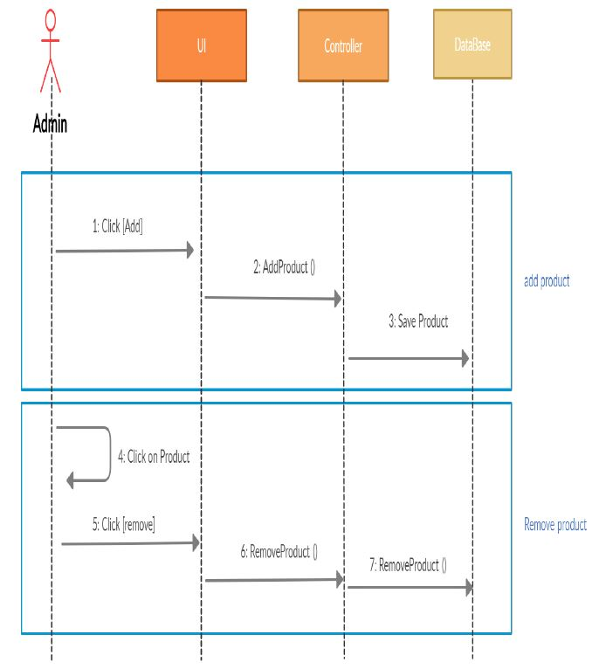
Admin general sequence diagram

Slide 12


Environment tools

Slide 13
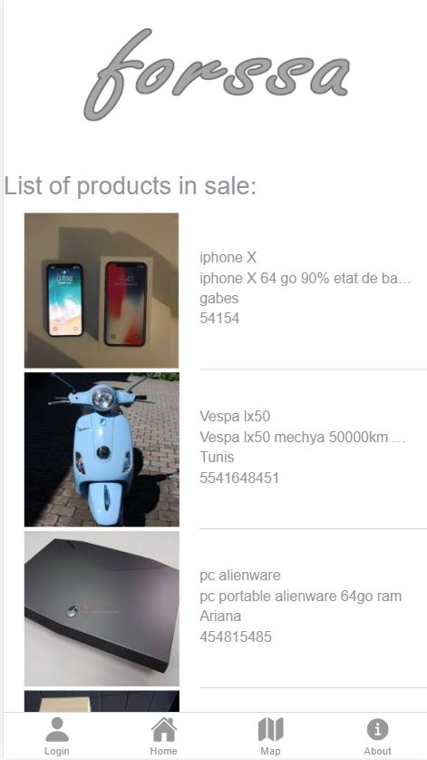
Implementation

Slide 14
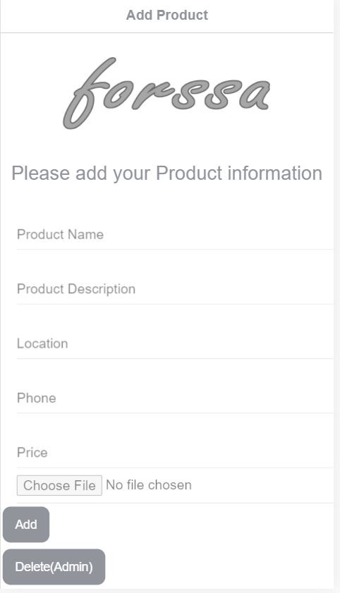

Slide 15
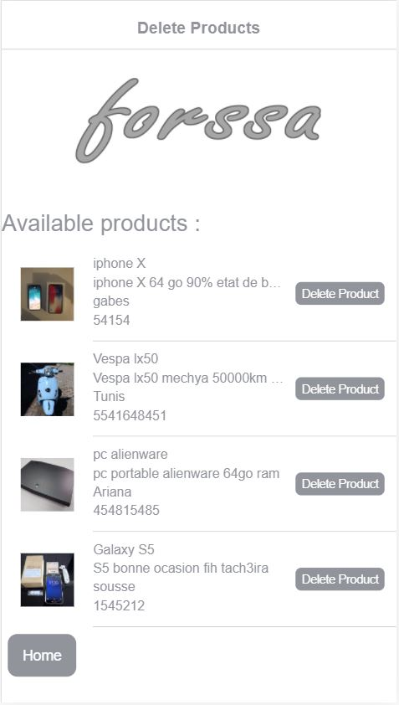

Slide 16
Thanks for your attention

