Slide 1
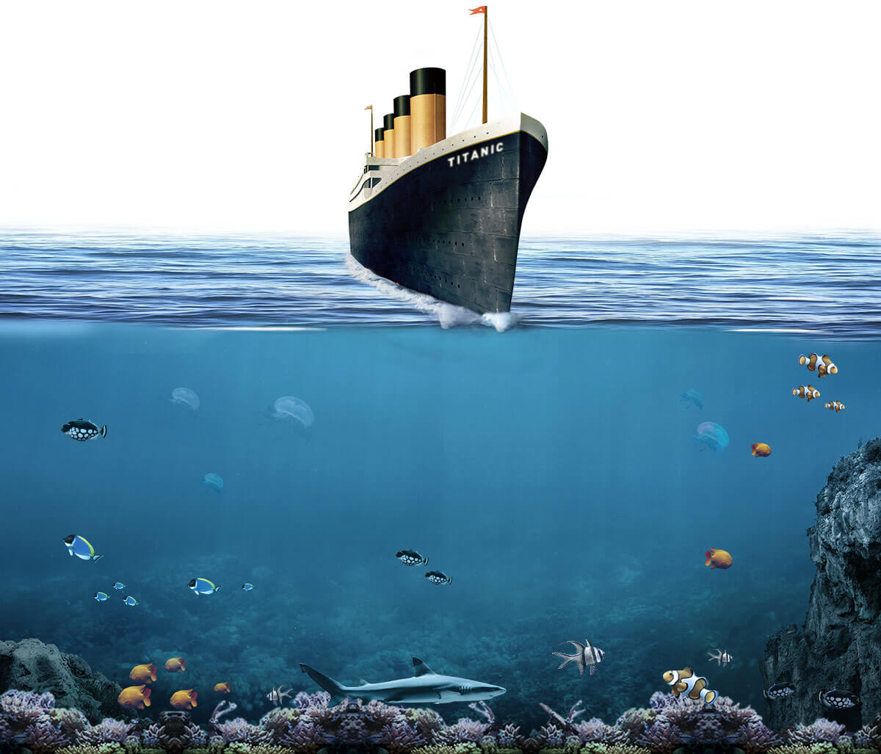


Titanic Data Visualization
By:
Amin Paryavi
Titanic Data Visualization
By:
Amin Paryavi

Slide 2
Why Use Data Analysis?
Provides a clear picture of “what is going on” or “what happened”
Can turn a question that may have initially been looked at qualitatively into a quantitative answer
Allows for decision-making to take place
Data analysis can uncover new truths that may be unpopular or unknown
Potential to solve problems

Slide 3

Why Did I Choose The Titanic?
We all know the story, but what truths are hidden from our knowledge?
Who really survived?
I decided to analyze who survived and who died by CLASS, GENDER,& AGE

Slide 4
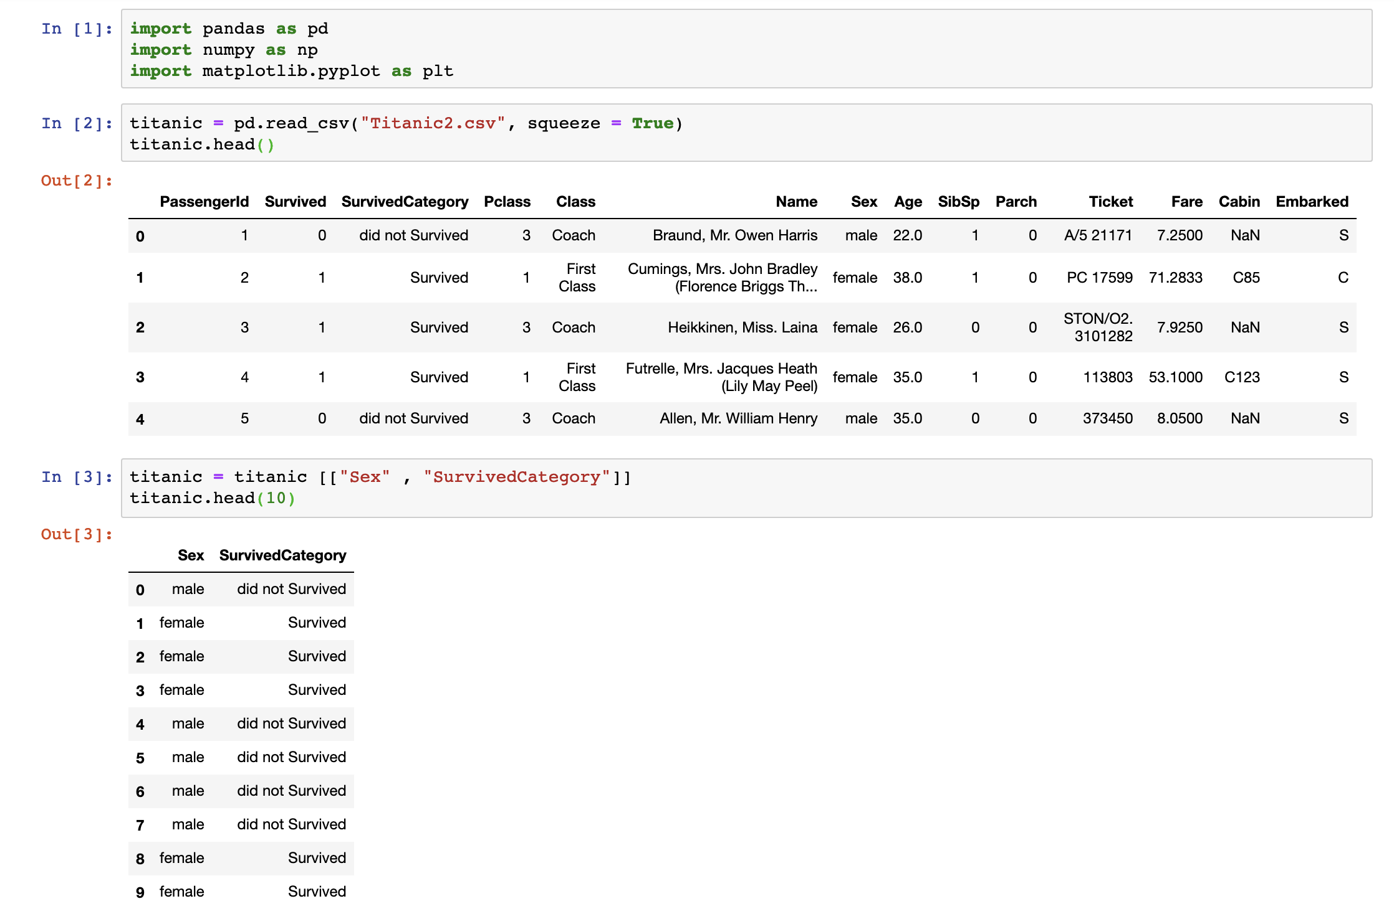

My Steps Analyzing The Titanic Survivals and Deaths
I retrieved data from Kaggle.com https://www.kaggle.com/datasets
I imported useful Python libaries such as Pandas, Numpy and Matplotlib

Slide 5
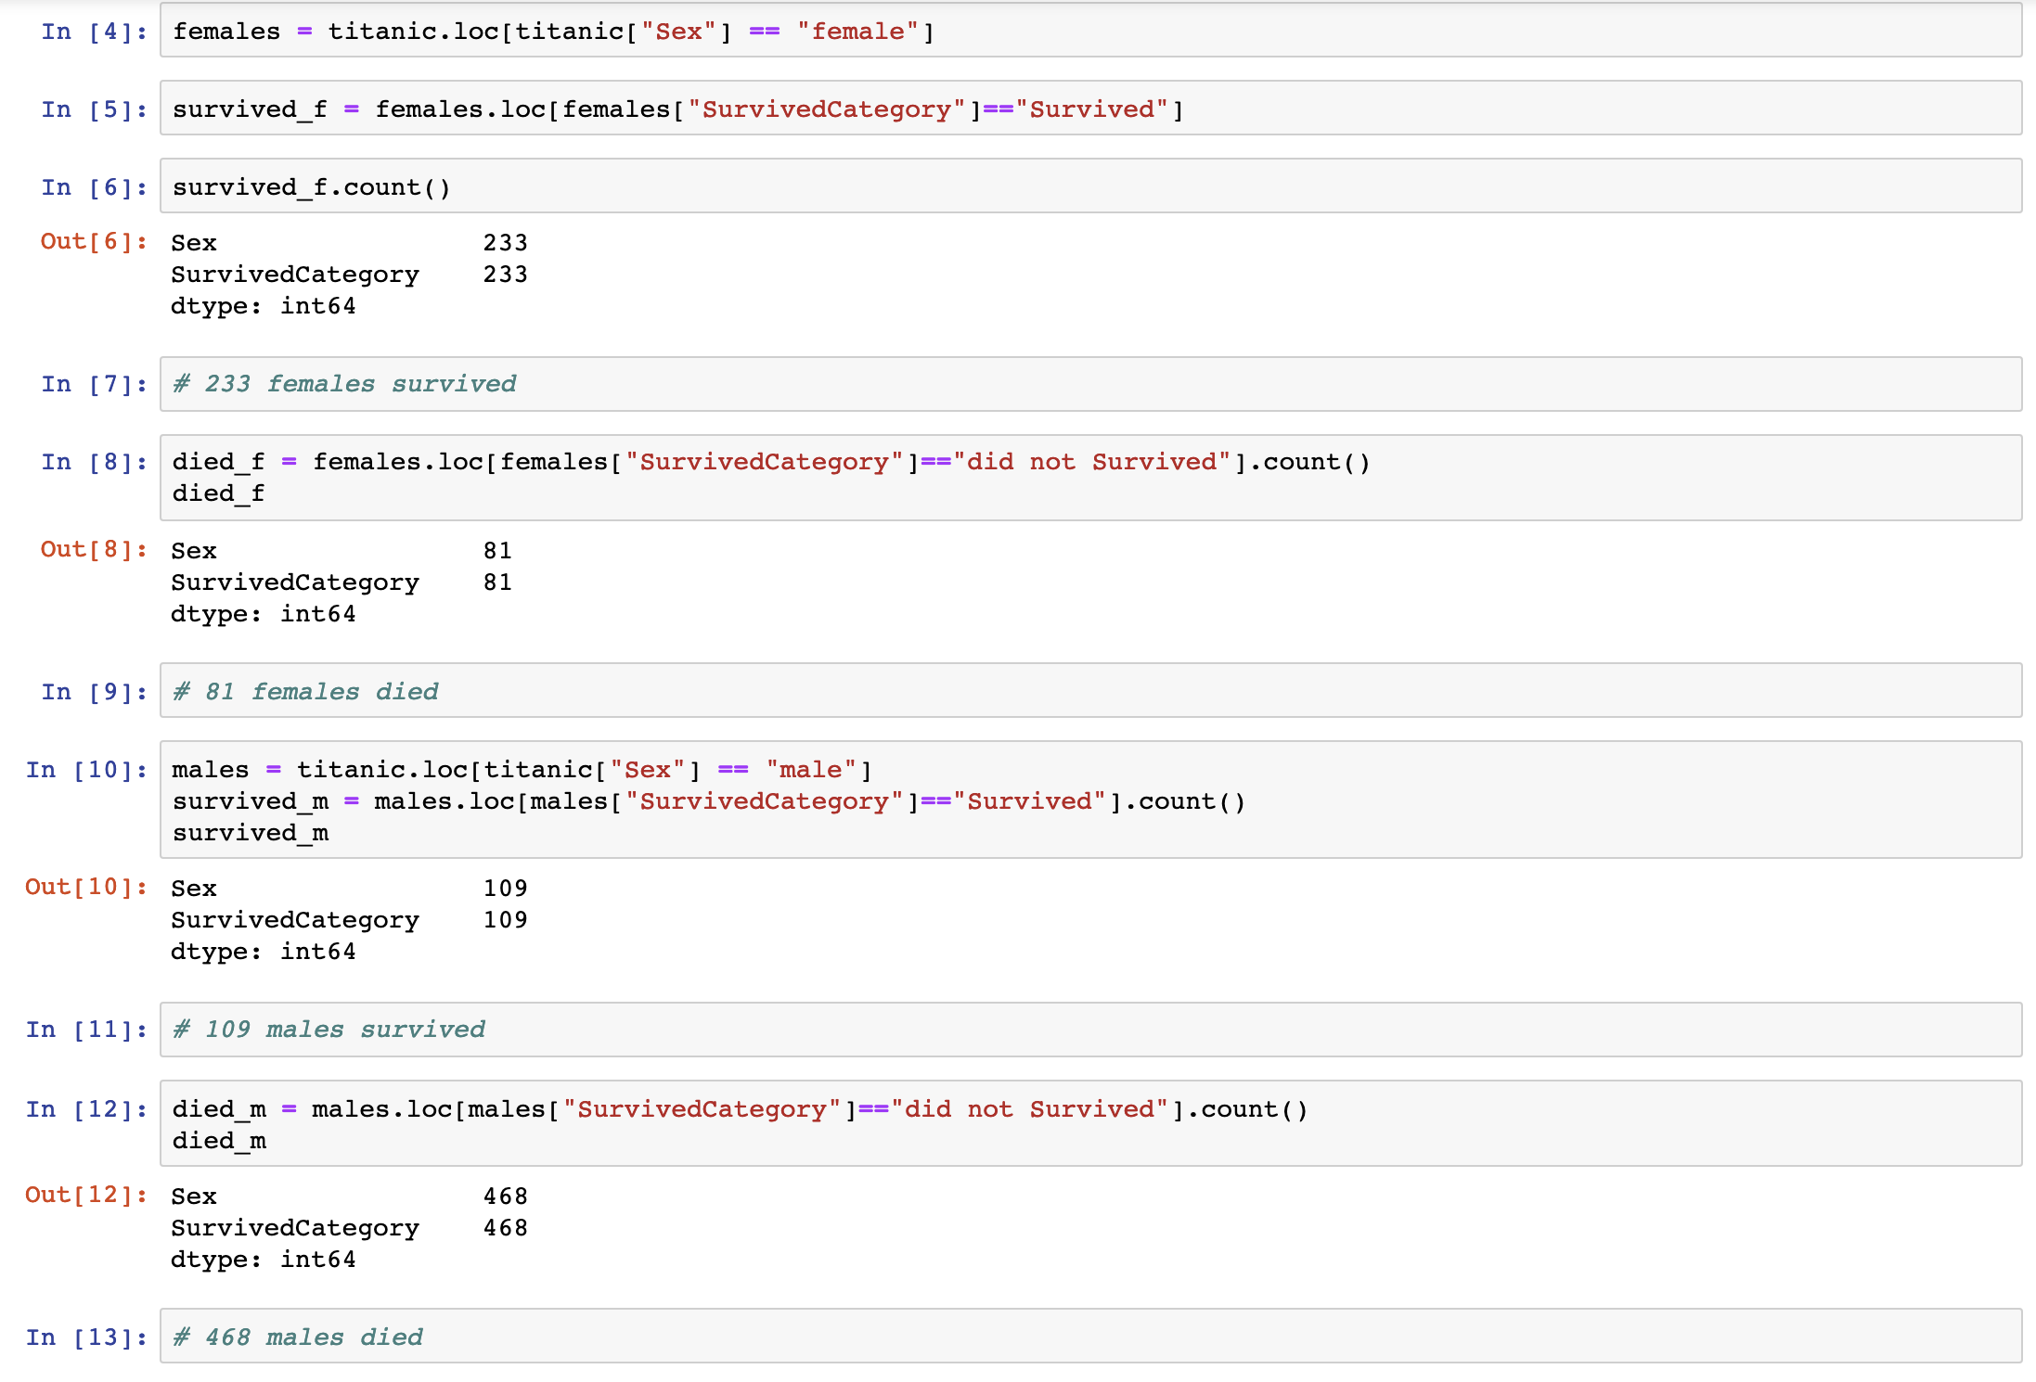
3) Accomplished three bar charts on Male & Female Survived vs Dead etc.

Slide 6
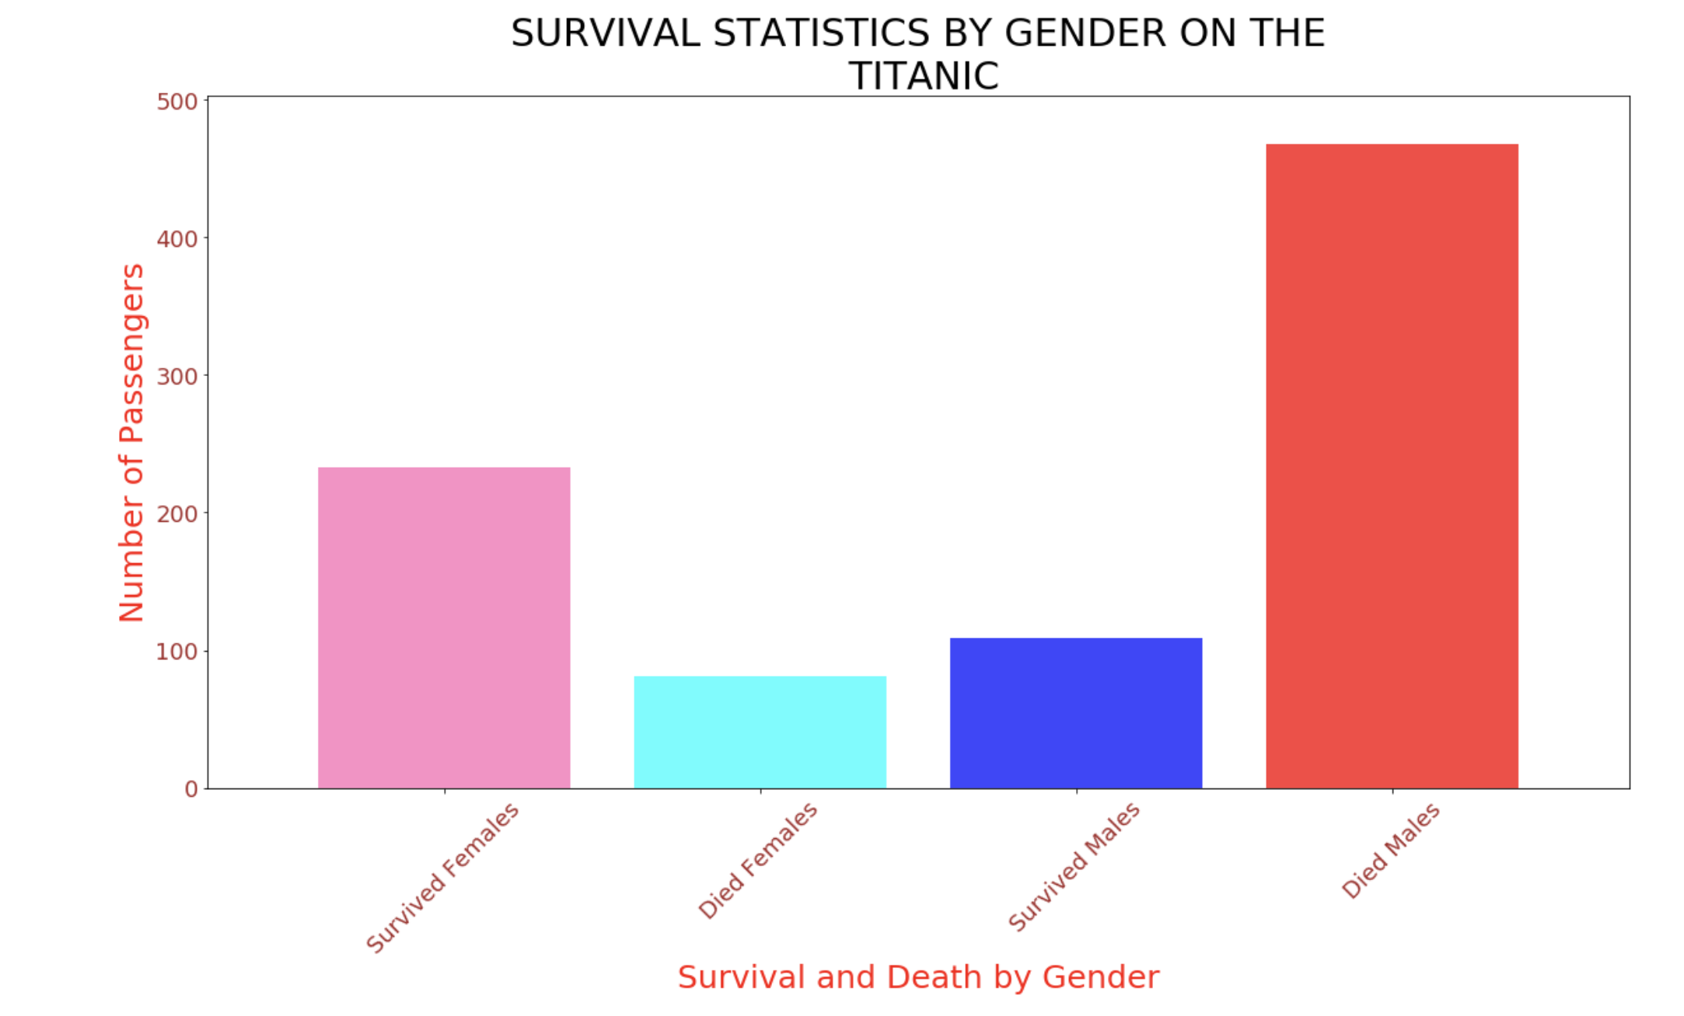

Slide 7
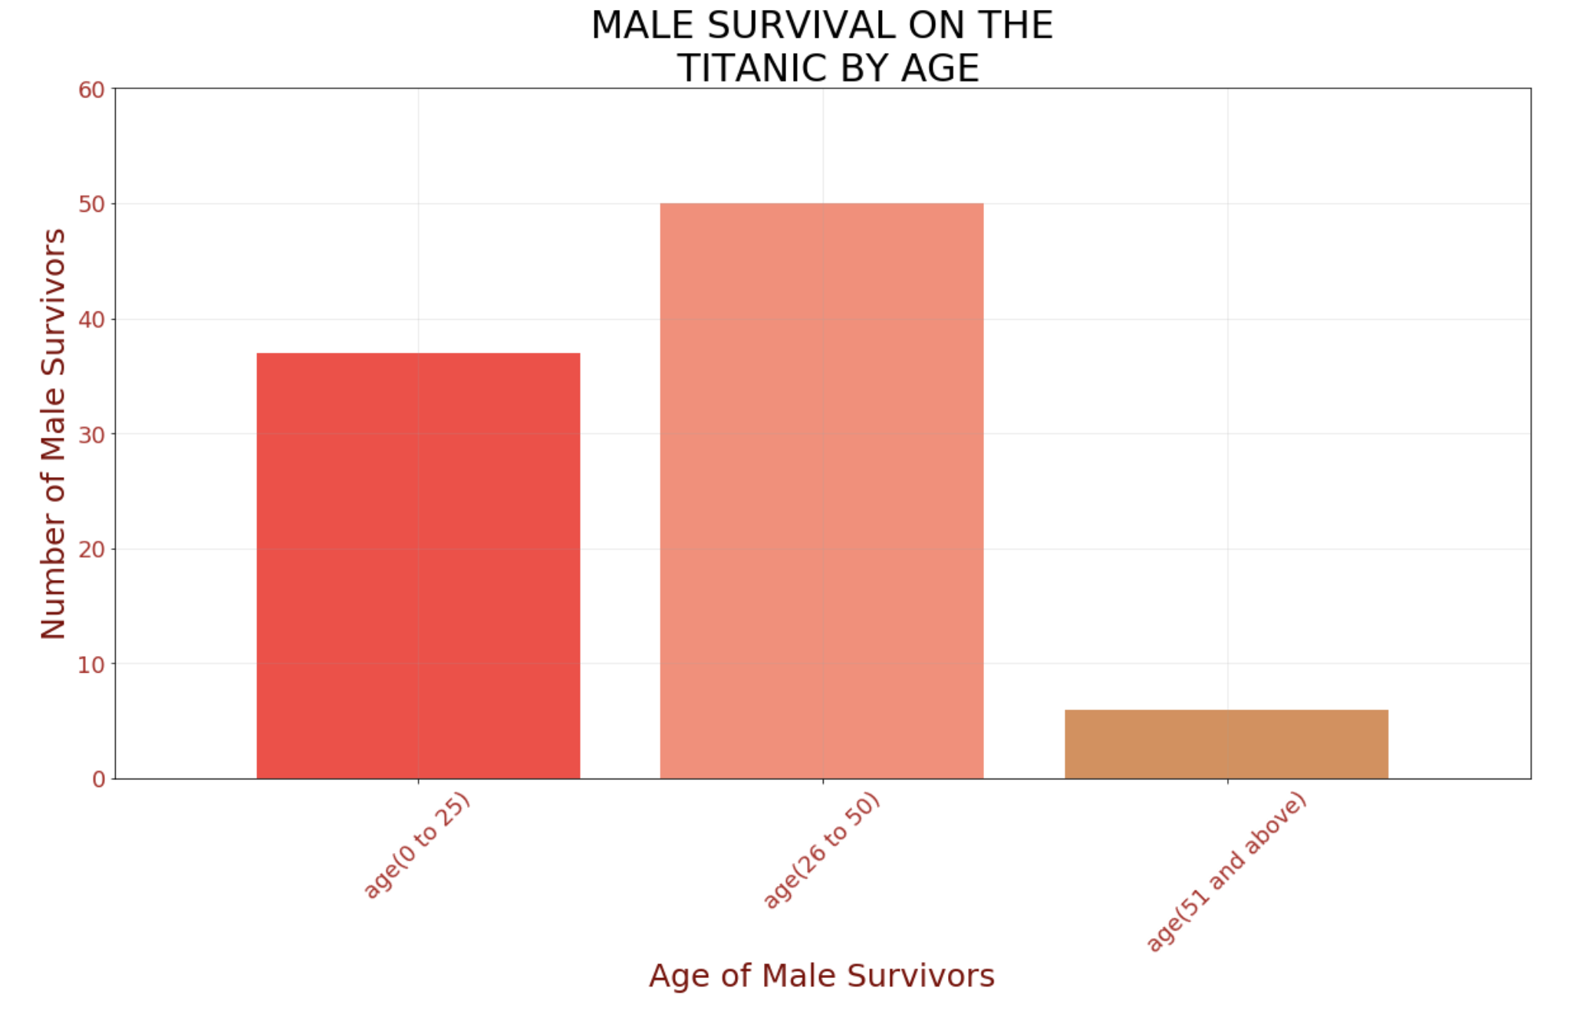

Slide 8
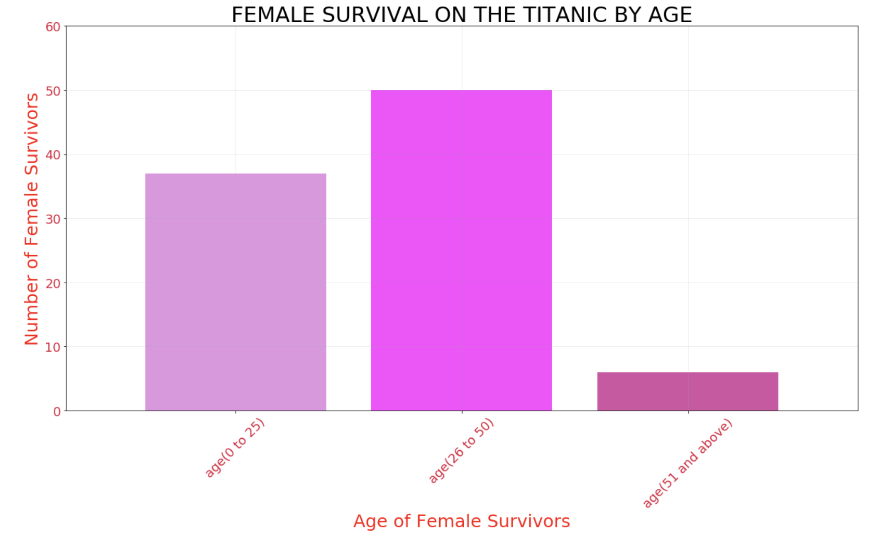

Slide 9
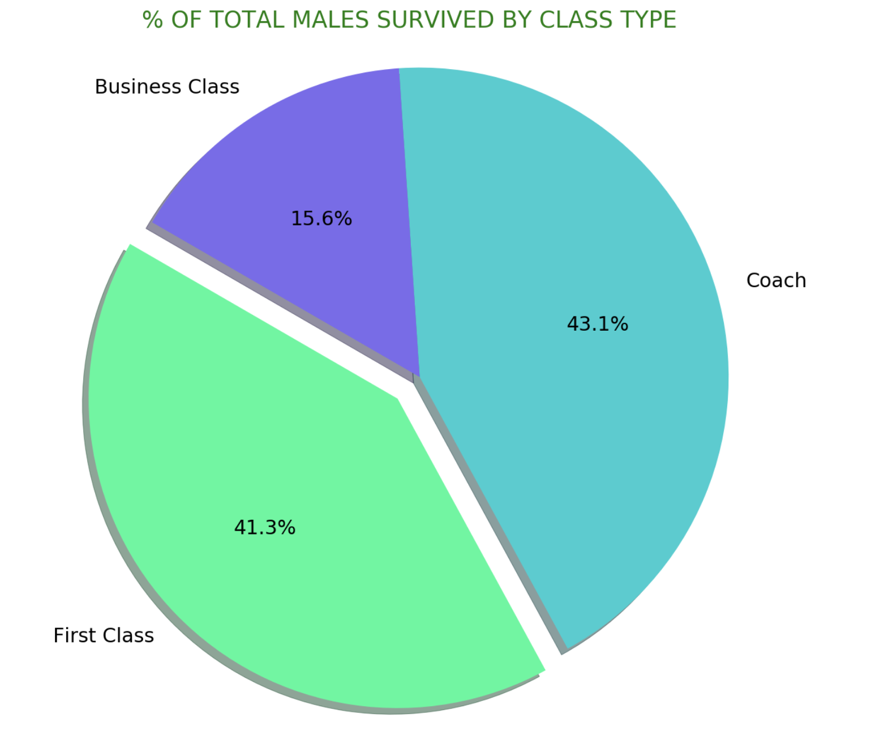

Slide 10
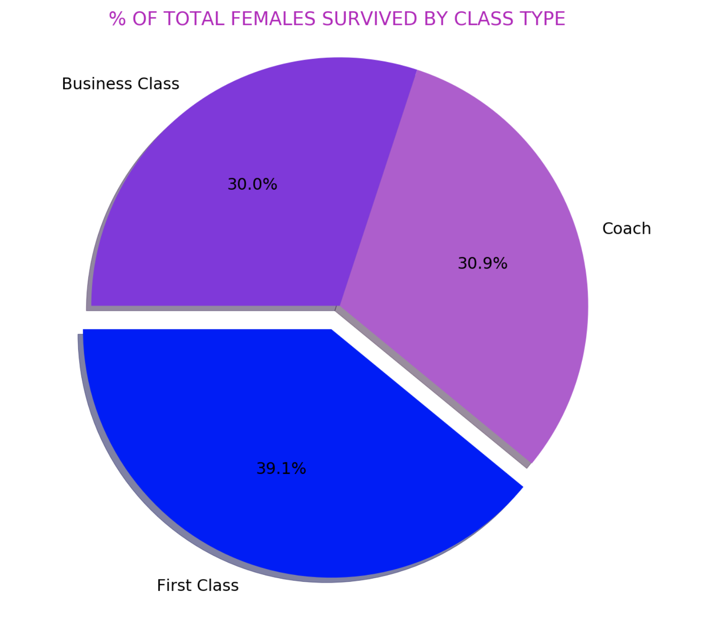

Slide 11

Analysis of Findings
Highest Rates of Survival
BY CLASS
First Class Women
Coach Males
BY AGE
Males age 26-50
Females age 26-50
BY GENDER
More Females survived Males

