Slide 1

ATM Simulation
Supervised by:
Laurent Marsan, Benoit Gaudou
Presented By:
Aminullah Yousufi, Usma Aktar

Slide 2
ATM using raspberry pi
We build a Raspberry Pi-based simulation of an ATM.
The MongoDB database is employed to store information about users, particularly related to cards and bank account.
Users utilize a Raspberry Pi-based ATM machine to check their account balance, deposit funds, and withdraw money from their bank accounts.

Slide 3
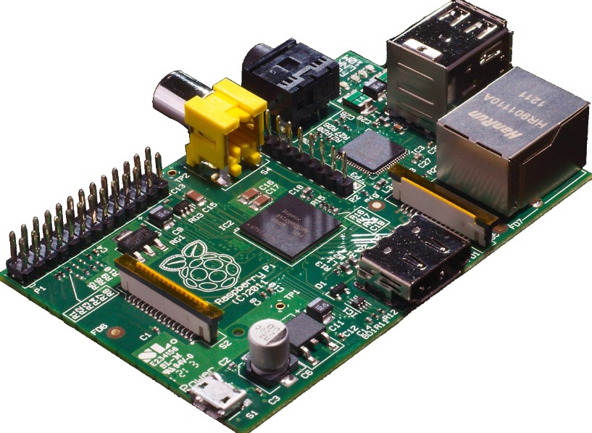
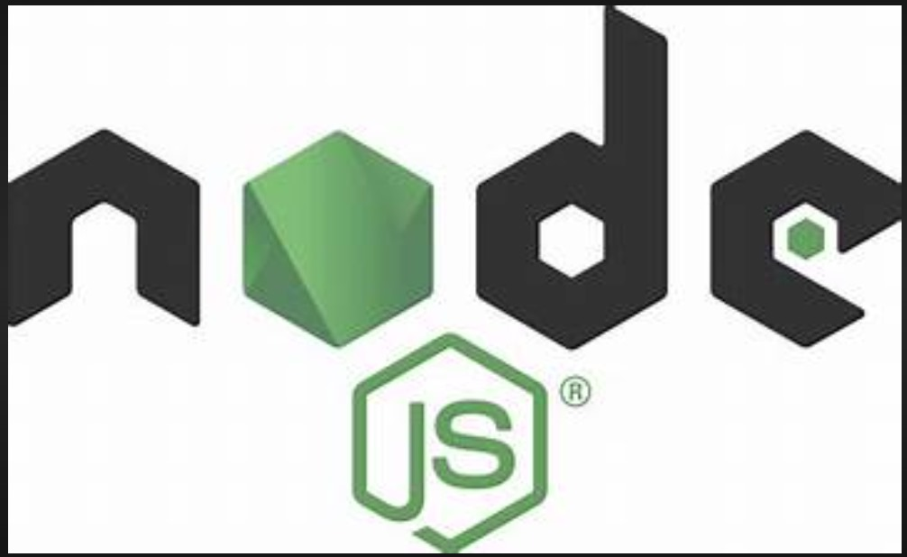


Our Strategies and Plan
Backend Technologies:
Raspberry pi.
MongoDB.
Node js.
Frontend Technologies:
Angular.

Slide 4
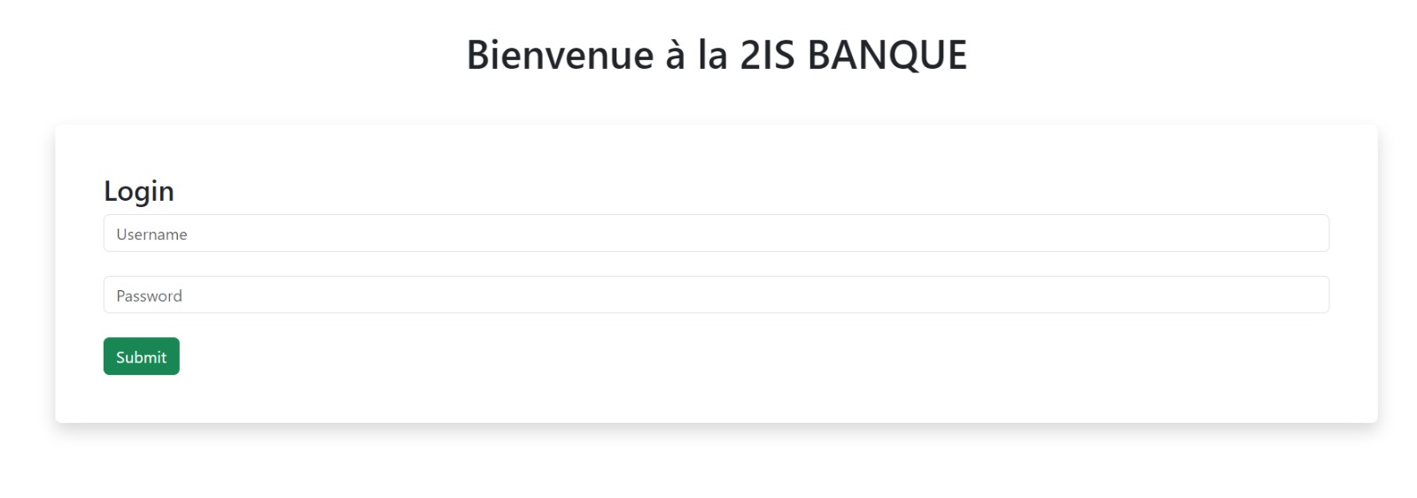
Login View

Slide 5
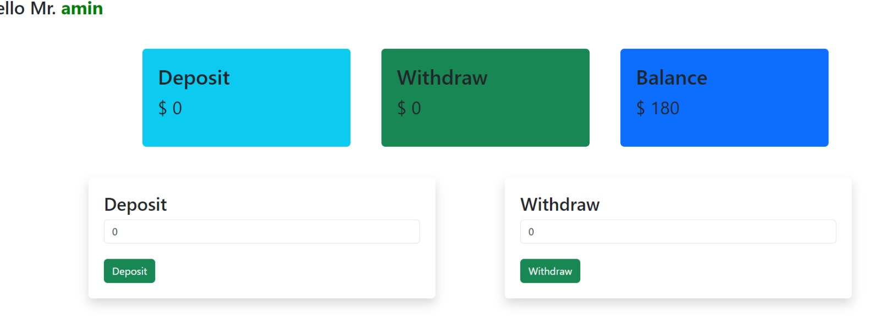
Account View

Slide 6
Conclusion
We gained knowledge on implementing the backend and frontend technologies utilized in the IoT project.
Additional time is required to enhance and incorporate more features into the current project.
Security and multi factor authentications.

