Slide 1
NAV with Sub-Menu
HTML - CSS - JavaScript

Slide 2
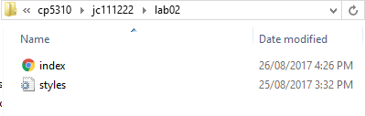
Preparation
If you haven’t created your local folder, please do it and name your local folder as your jc number, for example, jc111222 . Download and extract lab02.zip into your local folder
You should see the following 2 files:

Slide 3
Preparation
Run Dreamweaver and make a FTP connection.
If you did not attend the lab01 in week01, you can follow the instructions from Slide 3 to Slide 10 in Steps_to_work_with_subject_servers_2018.pptx.
In Dreamweaver, click to upload the folder lab02 into your remote folder (make sure the folder lab02 is selected before uploading).
To test, open a browser window and enter:
http://10.250.0.7/your_jc_number/lab02/index.html

Slide 4
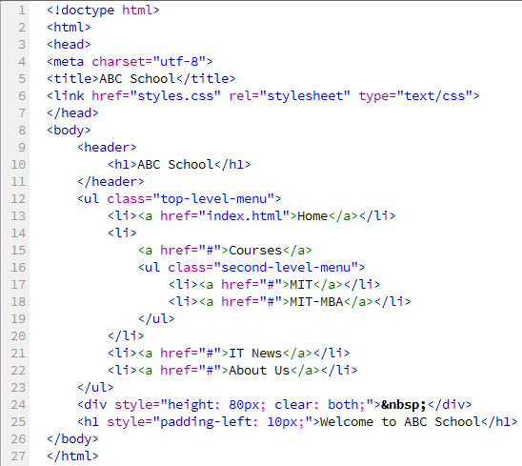
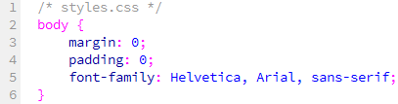

Preparation

Slide 5

Style the header
header {
background-color: #CCCCCC;
}
header h1 {
margin-top: 10px;
margin-bottom: 0px;
padding: 10px;
font-size: 48px;
}

Slide 6

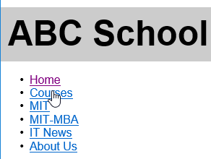
On Hover, display the sub-menu
/* hide the second menu */
.second-level-menu
{
display: none;
}
/* On hover, display the second menu */
.top-level-menu li:hover > ul
{
display: inline;
}

Slide 7

Some settings for all <a> and <li> elements
/* Remove bullet from all <li> items in the multi-level menu */
.top-level-menu li {
list-style: none;
}
/* Apply to all links inside the multi-level menu */
.top-level-menu a
{
font-weight: bold;
text-decoration: none;
font-size: 20px;
/* Make the link cover the width of li */
display: block;
}

Slide 8

Some settings for <li> in top-level-menu
.top-level-menu > li {
float: left;
height: 40px;
width: 130px;
background-color: #999999;
}

Slide 9
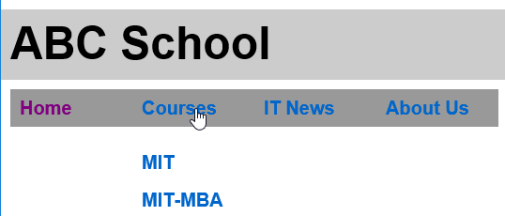
Some settings for top-level-menu and <a>
/* set padding, margin for top menu */
.top-level-menu {
padding: 0 0 0 10px;
margin: 10px 0 0 0;
}
/* set height of <a> to fill the <li> */
.top-level-menu a
{
line-height: 40px;
padding: 0 0 0 10px;
}

Slide 10

Some more settings
/* white color for <a> */
.top-level-menu a
{
color: #FFFFFF;
}
/* get rid of space between menus */
.second-level-menu
{
padding: 0;
}
/* set background color for second menu */
.second-level-menu > li
{
background: #999999;
}

Slide 11

Some more settings
/* hover settings for all <a> */
.top-level-menu a:hover
{
color: #000000;
background: #CCCCCC;
}

Slide 12
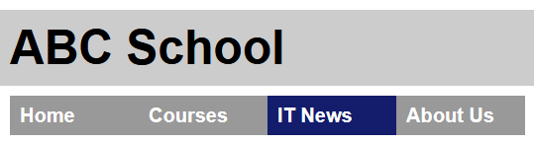
JavaScript for NAV
The next step is to change the link’s background to a different color whenever the user clicks on the links. For example, if the user clicks on IT News, the page looks like:

Slide 13
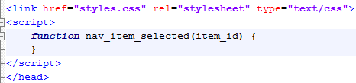
JavaScript for NAV (cont)
To do that, we need to provide a handler for the event onClick i.e. we need to define a JavaScript function to handle clicks on the links. For example, we want the clicked item having background-color of dark-blue, the other items have normal color of gray.
Firstly, define an empty JavaScript function named as nav_item_selected with one argument item_id.
Switch to Source Code, in the <head>, after <link>, enter the following <script>:

Slide 14
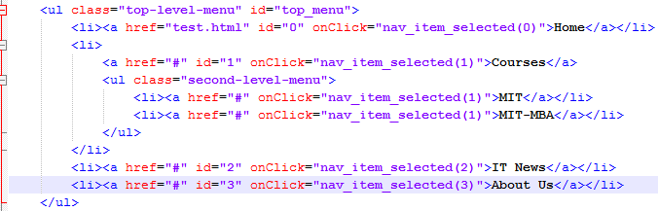
JavaScript for NAV (cont)
item_id is the id of the clicked item. To obtain HTML elements in JavaScript, we have to define IDs for the elements. Modify the li elements as follows:
Index.html

Slide 15
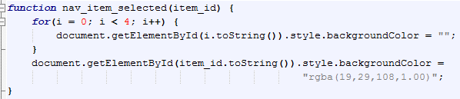
JavaScript for NAV (cont)
We are now going to implement the empty JavaScript function nav_item_selected, enter the following code into the function:
Save the file and reload it on the browser to test.

Slide 16

JavaScript for NAV (cont)
If you have done everything correctly, you can now see the background color changes from gray to light gray when you mouse over an item and the background-color changes to dark-blue when you click on it.
However, we haven’t made linked pages yet. All we have are dump links. Time to make some pages to test our design.
We are going to make a page, for example, about_us.html to test. (See next page)

Slide 17
JavaScript for NAV (cont)
To make about_us.html, from index.html, click File → Save As and name the file as about_us.html.
You then need to update some info as follows:
<title>: From ABC School to ABC School - About Us
<h1> after <ul>: From Welcome to ABC School to About Us
Change the value of href from # to about_us.html in both index.html and about_us.html pages – the <a> with id=“3”
Save all pages. Reload index.html. Click on the link About Us to test.
Is there any problem? What is it?
The background-color didn’t change to dark-blue when you click on it!

Slide 18
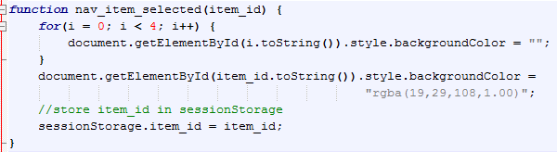
JavaScript for NAV (cont)
To fix this issue, we have to pass the id of the clicked item from index.html to about_us.html and vice visa. To do so, we can use the client-side session storage named as sessionStorage (HTML5 only). It is a global variable provided by the browser.
Firstly, store clicked id in sessionStorage, modify function nav_item_selected in both index.html and about_us.html pages:

Slide 19
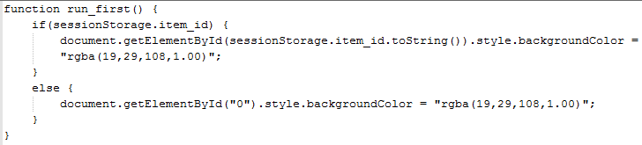
JavaScript for NAV (cont)
Secondly, define another JavaScript function named as run_first in both index.html and about_us.html, put the new function before the function nav_item_selected as follows:
Finally, change <body> to <body onLoad="run_first()"> in both index.html and about_us.html pages. See next page.

Slide 20
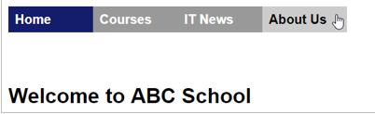
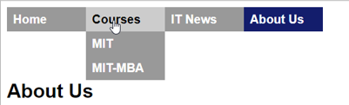
JavaScript for NAV (cont)
Save all pages. Reload index.html. Click on the links to test.

Slide 21
Activity 2
Create another css file named as nav.css and move the css nav code to this external css file. On your index.html and about_us.html, make another link to this css file. You should have 2 links to styles.css and nav.css files.
Create a js file named as nav.js and copy the JavaScript code to this external js file.
Do not include <script>, </script> tags in the js file
Remove the JavaScript code in index.html and about_us.html and enter the following statement to link the js file to your web page.
<script src="nav.js"></script>
Create the remaining pages it_news.html, courses.html, mit.html and mit_mba.html.
Have some text in the body, using dummy text generator to generate some dummy text.
Create the footer.
See pics on the next slide.
When you have done, please show your work to your tutor.

Slide 22
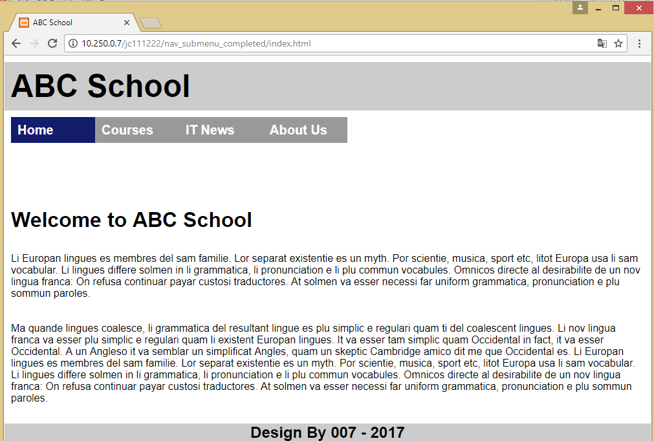
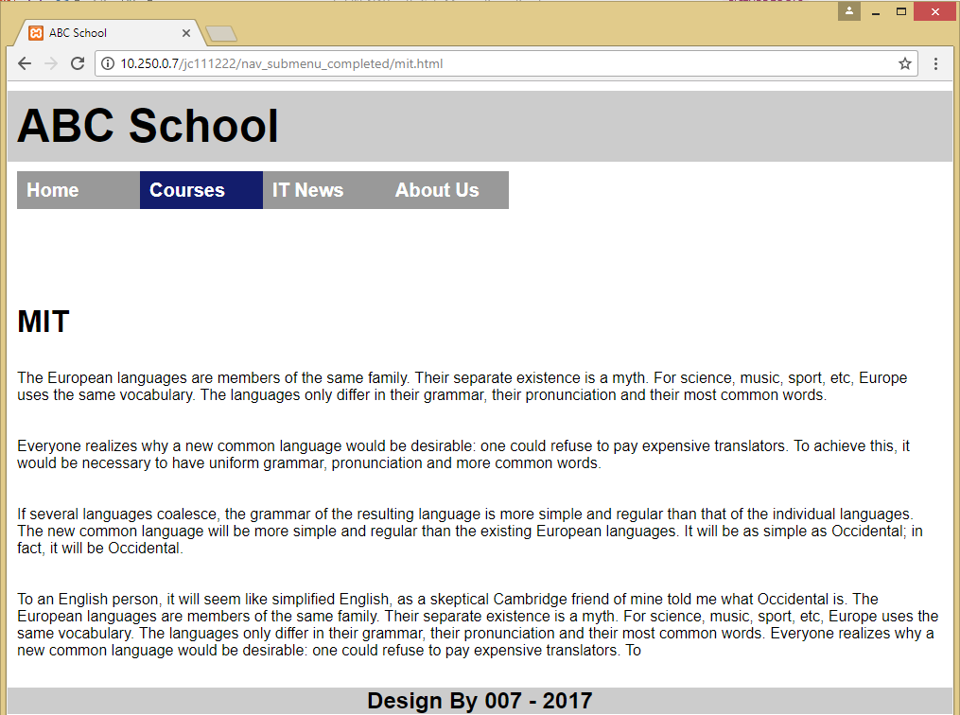
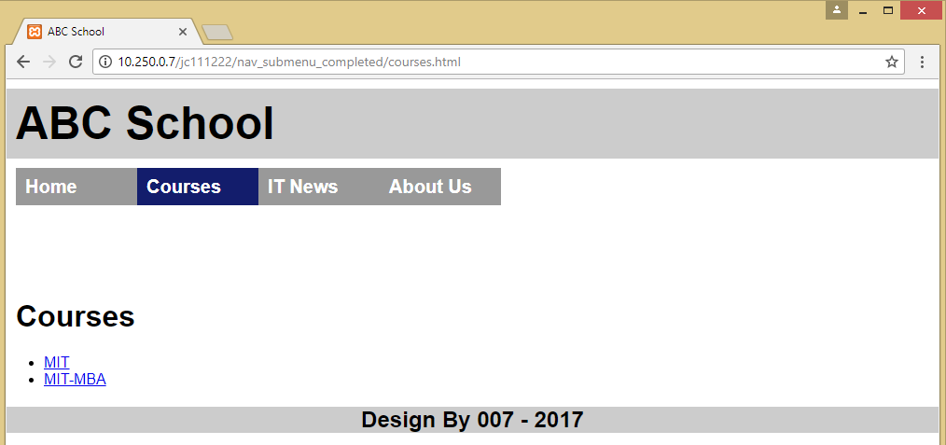
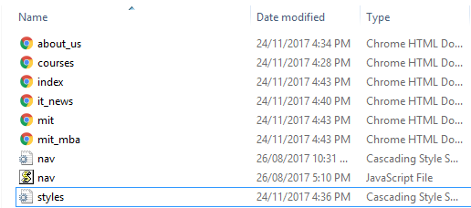
Activity 2 – Example Pics

