Slide 1

On the bias of K-fold cross validation with stable learners
Statistics for Data Science
Master in Data Science and Business Informatics
SUBMITTED TO:
Prof: Salvatore Ruggieri
SUBMITTED BY:
Attia Maqbool
Amir Hassan
Tolgonai Nasibek Kyzy
Academic Year 2023/24

Slide 2


Problem Statement
?
Biasness: Biasness in ML models, leading to lack of transparency, unfair results & minimizes the performances of models.
Stability Assumptions: Traditional bias in K-fold CV can lead to unreliable and unstable risk estimates under general stability assumptions.
Inconsistency in risk estimates: K-fold risk estimate does not behave correctly & inconsistent so need for a biased corrected version of K-fold CV that addresses the bias introduced by the model's stability properties.

Slide 3
Objectives
To predict these techniques to offer a more efficient method of predicting risk for any machine learning algorithm when algorithmic stability is presumed.
To investigate the efficiency of K-fold cross-validation and its bias corrected version for estimating the generalization risk of a learning algorithm.
1
2
3
To compare the performance or risk estimating of standard K-Fold & Biased corrected K-Fold.
To improve the reliability of cross-validation as a model evaluation technique.

Slide 4
S
Techniques & Technologies
K-fold cross validation
Provides a reliable estimate of model performance.
Assesses model's ability to generalize to new data, reducing overfitting.
K-fold cross-validation involves splitting the dataset into K parts
Training on 1/3rd parts, Testing on the 1 part, and repeating this process K times, each time using a different part as the test set.
Simple in operation
Ability to give good accuracy
Reason of Choice
Suitability
01
02
03

Slide 5
S
Techniques & Technologies
Targets at reducing such inconsistency of risk estimates.
K adjusts the basic K-fold estimates for improved and precise risk estimations.
Better estimation of the risk by reducing the sampling variance.
Debiasing the estimates is expected to help improve the quality of model.
More stable assessments
Easy to handle
Reason of Choice
Suitability
01
02
03

Slide 6
S
Technologies
R Programming Language
Selected for its large libraries for statistical analysis
caret & e1071 & boot libraries
Interface relatively easy to use
01
Support Vector Machine (SVM)
Chosen this as the learning algorithm due to its high reliability and accuracy in cases related to classification.
02

Slide 7






Implementation Workflow
5. Debiased K-Fold Cross-Validation Model
1. Data Collection
3. Data Splitting
2. Data Pre-processing
6. Results comparison
4. Standard K-Fold Cross-Validation

Slide 8



Implementation Workflow of Paper
Step By-Step
Data Preprocessing
K-Fold cross validation model
Biased Corrected K-Fold Cross validation model
`4 Classification & 4 Regression Datasets collected from UCI repository
Missing values
Outliers
Normalized data
Data Splitting
Divided data as 1/3rd of each dataset for training set remaining for validation set

Slide 9


Formulas & Algorhithms
Generalization Risk Predictor at A(T)
Risk Assessment K-Fold CV for a Learning Algorhithms
Assumption: The paper demonstrates how K-fold cross-validation estimates the generalization risk of a learning algorithm.
Assumption: K-fold CV, a standard method, splits the data in various ways, trains a model on each, and then estimates the generalization risk by evaluating each trained model.
K= No. of folds
Rcv[A, V1:k]: Cross-validation risk estimate for the learning algorithm A. It's computed as the average of the risks computed on each fold's validation set.
R[A(Tj), Vj] This is the risk computed for the model trained on the training subset Tj and evaluated on the validation subset Vj. Risk R here could be defined in various ways depending on the learning task. i-e, MSE for Regression
1/K: Average total risk calculated by summing across all K validations.
A(T) = Is the model trained on dataset T
O is new observation independent from DT.
L Loss function , which measure the model’s performance.

Slide 10
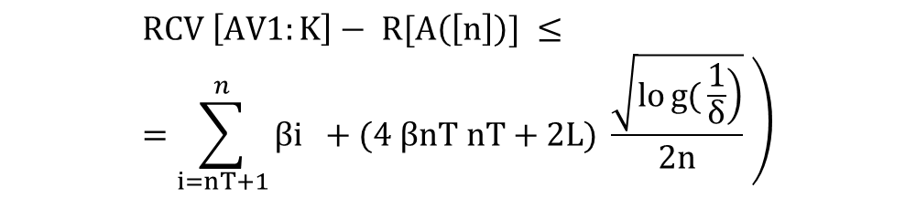
Formulas & Algorhithms
Bias Corrected K-Fold uniformly learning algorithm
$$\left.RCV \left[AV1:K\right]− R[A\left(\left[n\right]\right)] ≤=\sum_{i=nT+1}^{n}{βi} +(4 βnT nT+2L) \frac{\sqrt{\left.log{(}\frac{1}{δ}\right)}}{2n} \right)$$
For upper bound: The stability condition used in our learning algorithm is uniform, it gives us a maximum bound of how much the learning algorithm’s prediction can change when there is a change in the training information.
L is the upper bound on the cost function
n is number of samples
Βi is the stability coefficient here.
nT is the number of training samples in upper bound algorithm.
RA([n]) is the true risk.
RCV is cross validation risk estimate.

Slide 11
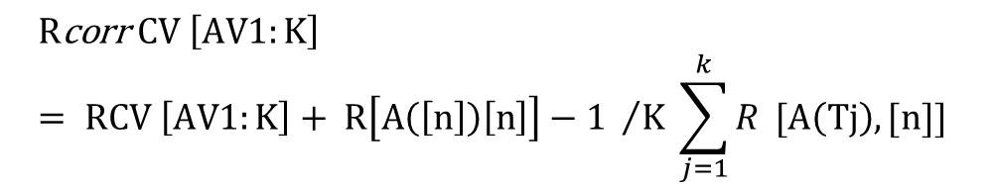
Formulas & Algorhithms
Biased Corrected K-Fold with stable learners
$$R\text{corr} CV \left[AV1:K\right]= RCV \left[AV1:K\right]+ R\left[A\left(\left[n\right]\right)\left[n\right]\right]−1 /K \sum_{j=1}^{k}{R} [A\left(Tj\right),[n]]$$
Reduce the biasness in traditional K-fold
Takes into consideration the stability of the models
Helps to contribute methodological advancements in the model evaluation and selection processes.
Corrected cross validation estimate of generalization risk

Slide 12
Paper Results
Results
Root mean squared errors of four regression datasets for the standard K-Fold method as well as biased corrected K-Fold methods were found after applying all learning algorhithms.
Dataset | K-Fold | Biased corrected K-Fold
REV; K=3 K=4 K=5 | 74.198 (12.57) 74.189 (12.48) 73.359 (12.38) | 68.958 (11.63) 68.958 (11.63) 68.958(11.63)
EE: K=3 K=4 K=5 | 15.501 (1.81) 15.825 (1.84) 14.730 (1.73) | 14.405 (1.86) 14.350(1.77) 14.298(1.79)
QSAR; K=3 K=4 K=5 | 1.183(0.16) 1.112(0.15) 1.112(0.15) | 3 1.035(0.14) 1.035(0.14) 1.035(0.14)
CS; K=3 K=4 K=5 | 146.881(13.81) 144.195(13.16) 137.060(11.48) | 126.492(10.23) 124.205(9.46) 123.641(9.30)

Slide 13
Results
Results
Hinge loss was calculated on four different classification datasets taken from UCI.
Dataset | K-Fold | Biased corrected K-Fold
RS; K=3 K=4 K=5 | 0.470(0.048) 0.420(0.039) 0.420(0.039) | 0.419(0.038) 0.418(0.039) 0.419(0.038)
IO;K=3 K=4 K=5 | 0.454(0.081) 0.447(0.092) 0.477(0.091) | 0.414(0.072) 0.425(0.072) 0.464(0.095)
BIODEG; K=3 K=4 K=5 | 0.361(0.039) 0.363(0.037) 0.381(0.041) | 0.357(0.036) 0.357(0.036) 0.357(0.036)
AR; K=3 K=4 K=5 | 0.112(0.023) 0.108(0.027) 0.107(0.025) | 0.109(0.021) 0.105(0.025) 0.106(0.024)
Bias-corrected K-Fold method produced generally lower hinge losses so better classification on all folds.
Lower the hinge loss values reflects the better classification.

Slide 14
Reimplementation of K-fold Cross-Validation with Bias Correction
Re-implementation on R-studio
Objective:
Implement and compare standard K-fold cross-validation with a debiased version to improve risk estimation accuracy.
Work Done from the Paper:
Implemented Standard K-fold Cross-Validation
Implemented Bias-Corrected K-fold Cross-Validation

Slide 15
Reimplementation of K-fold Cross-Validation with Bias Correction
Re-implementation on R-studio
Downloaded 3 datasets from UCI repository 2 from regression datasets & 1 from classification datasets.
Real estate valuation (REV, 414 house price of unit area with 5 covariates) regression dataset
Energy efficiency (EE, 768 heating loads with 8 features.)
Raisin dataset (RS, 900 Keciman/Besni raisin with 7 attributes)

Slide 16
Reimplementation of K-fold Cross-Validation with Bias Correction
Technologies I used:
Language:
R
Libraries:
readxl: For reading Excel data
caret: For cross-validation and training models.
e1071: For SVM implementation.
boot: For Bootstrap resampling methods.
Reason for Choosing Technologies
Mainly as per requirement of paper work
Efficiency: Comprehensive tools for data manipulation and model training.
Suitability: Well-suited for cross-validation tasks.
Community Support: Extensive documentation and active user community.

Slide 17
Reimplementation of K-fold Cross-Validation with Bias Correction
Parameters I used:
K (number of folds): 3, 4, 5 (varied for comparison).
Model: SVM with radial kernel (svmRadial)
Metrics: Mean Squared Error (MSE) and Estimated Standard Deviation(estd).
Configuration: linear for (SVM)
Configuration I used:

Slide 18
Reimplementation of K-fold Cross-Validation with Bias Correction
Methodology - Standard K-fold CV
Data Splitting: Divided dataset into K equal-sized folds.
Model Testing: one third of the data are removed (S) and reserved for testing
Model Training: Remaining two thirds on train dataset.
Repetition: Repeated the process for K=3,4 & 5 times.
Initial Training: Performed standard K-fold CV.
Bias Adjustment: Calculated bias adjustment term using stability coefficients.
Final Estimation: Adjusted the initial risk estimate to obtain the debiased risk.
Methodology – Biased Corrected K-fold CV

Slide 19
Reimplementation of K-fold Cross-Validation with Bias Correction
Comparison - Standard & Debiased K-fold CV
Regression Datasets- MSE(SD)
REV; K=3 K=4 K=5 | 66.10(1.365) 65.66(1.921) 63.85(1.537) | 64.42(10.57) 65.24(10.67) 63.72(10.62)
EE; K=3 K=4 K=5 | 3.653(0.043) 3.397(0.133) 2.907(0.133) | 3.454(9.026) 3.329(9.029) 3.186(8.971)
Biased corrected K-fold gave a little higher, but more accurate, estimate of risk as compare to papers result.
Classification Datasets- Hinge Loss(SD)
RS; K=3 K=4 K=5 | 0.132(0.497) 0.134(0.498) 0.134(0.497) | 0.132(0.497) 0.134(0.498) 0.134(0.497)

Slide 20
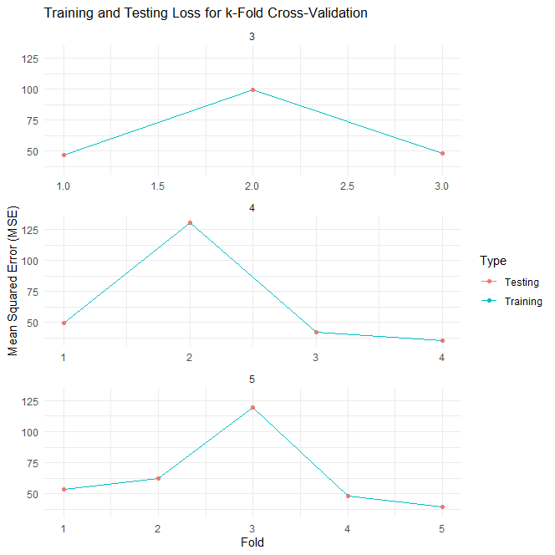
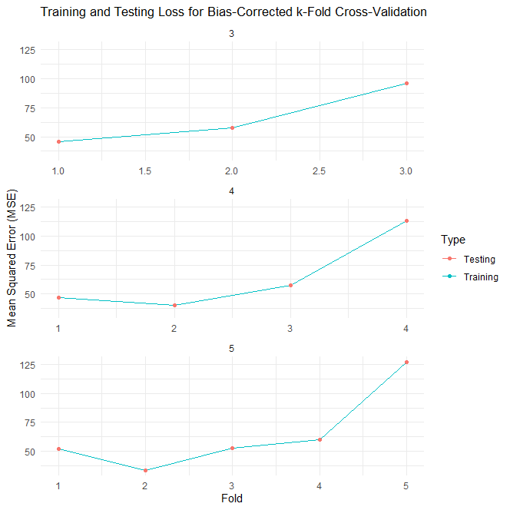
Reimplementation of K-fold Cross-Validation with Bias Correction
REV – Training & Testing Loss
Biased corrected K-fold gave a little higher, but more accurate, estimate of risk.

Slide 21
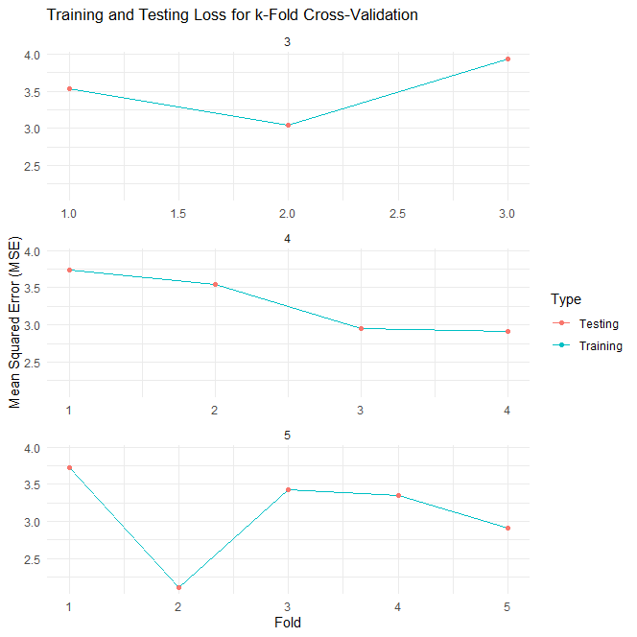
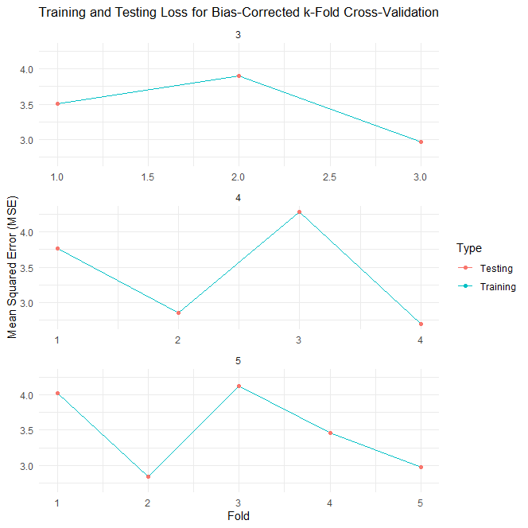
Reimplementation of K-fold Cross-Validation with Bias Correction
EE – Training & Testing Loss

Slide 22
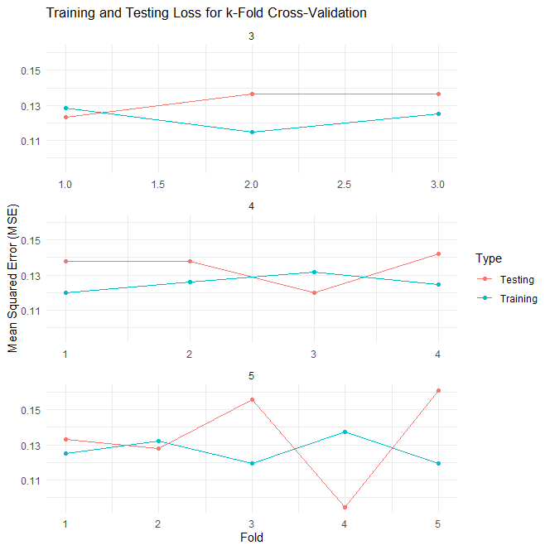
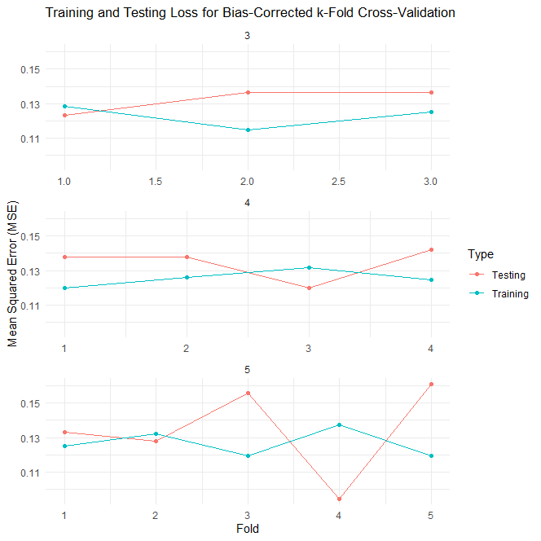
Reimplementation of K-fold Cross-Validation with Bias Correction
RS – Training & Testing Loss

Slide 23
Reimplementation of K-fold Cross-Validation with Bias Correction
Conclusion:
The debiased K-fold CV gives a little higher, but more accurate, estimate of risk.
Larger values of K decrease the bias of the K-fold CV.
MSE values for bias-corrected k-fold cross-validation are slightly lower than those for k-fold cross-validation across all values of k.
Bias corrected K-Fold showed lower generalization risk estimates.

Slide 24
Future Perspectives
Further Testing: On larger and more complex datasets it is completely relevant to apply the debiased K-fold CV
Optimization: Refine the debiasing approach in order to increase the general improvement and efficiency.​
Extension: Discuss the applications of debiased method to other type of stable learning algorithms and tasks. ​

Slide 25
Q&A
Do you have any question?
Attia Maqbool ( a.maqbool2@studenti.unipi.it)
Amir Hassan ( a.hassan29@studenti.unipi.it)
Tolgonai Nasibek Kyzy (t.nasipbekkyzy@studenti.unipi.it)
THANKS!

