Slide 1
Summer Course Training
1 st year summer training
Faculty of computers & informatics
.NET Desktop Apps Intern
Dr. Omar salem
Dr. Sameha
C# : Scientific Calculator
Team members : Amir Haytham Salama & Nayera sayed & Nadin Elgammal

Slide 2
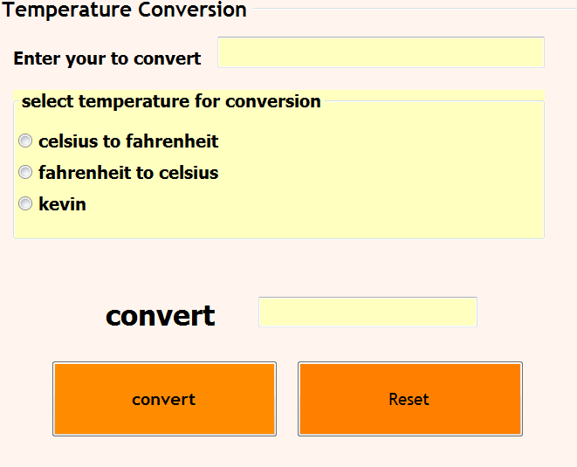
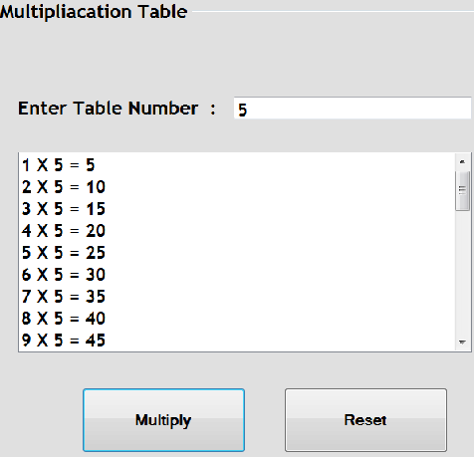
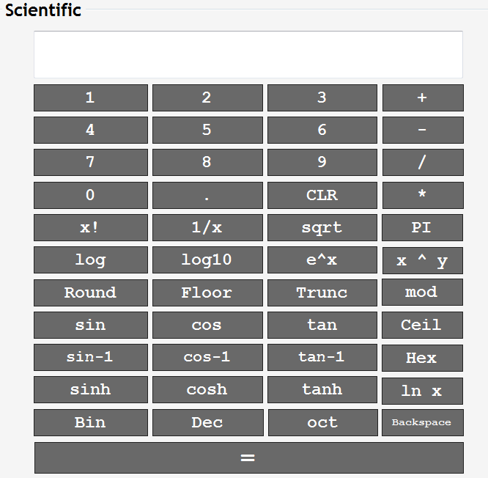
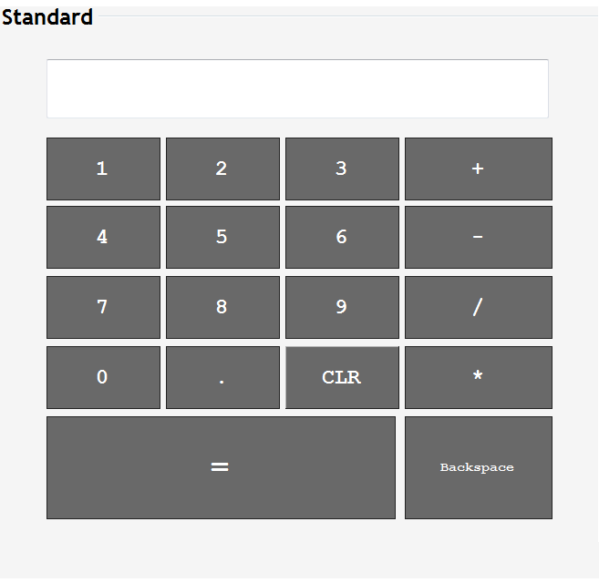
Calculator Components
Basic | | Standard
E.g. Addition ,Subtraction,Division, …. etc
Scientific
E.g. X! , Trunc,Round,sin , e ^ x ,cos, …. etc
Multiplication Table
Show in a list box Multiplication table
Temperature Conversion
E.g. Covert celsius to fahrenheit , vice versa
And kevin

Slide 3
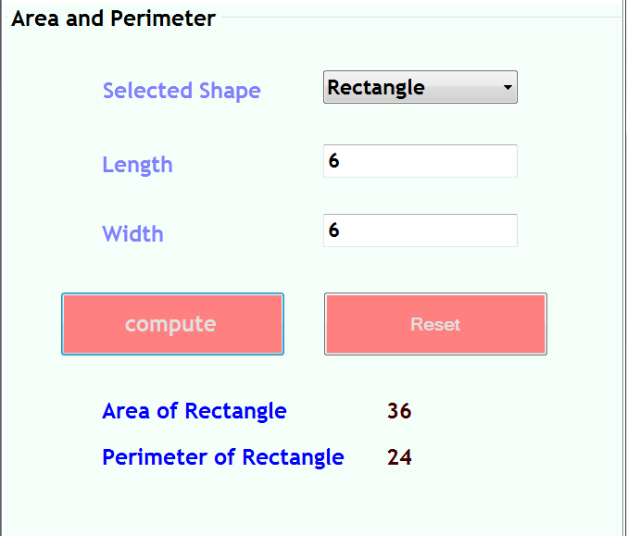
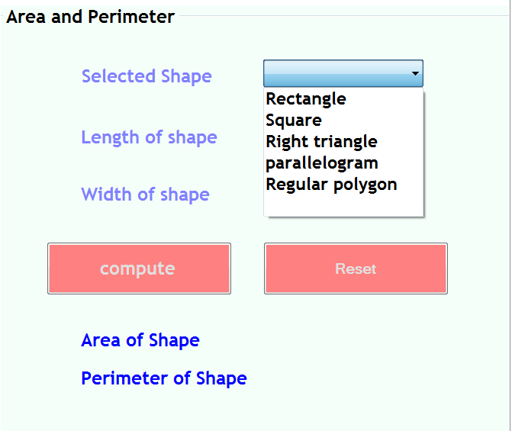
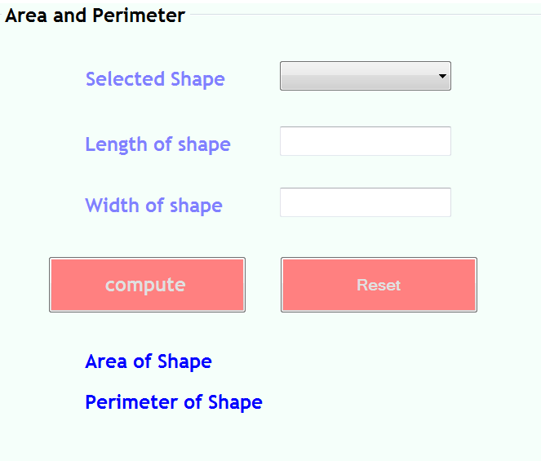
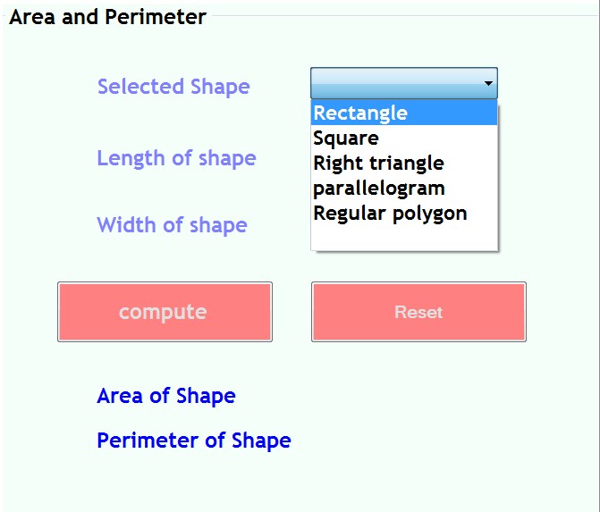
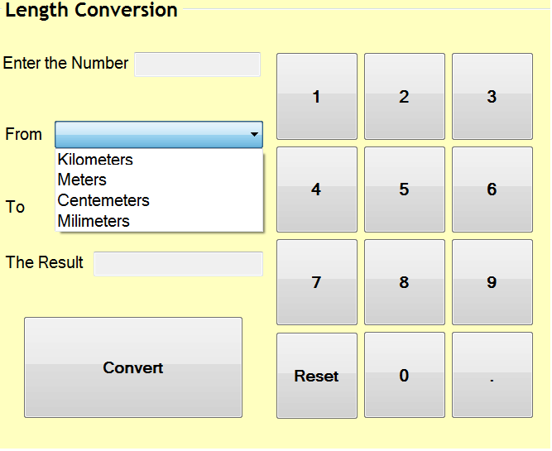
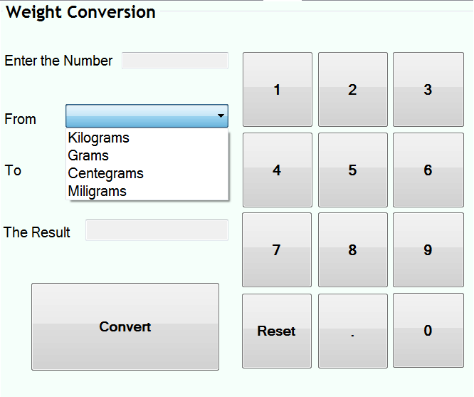
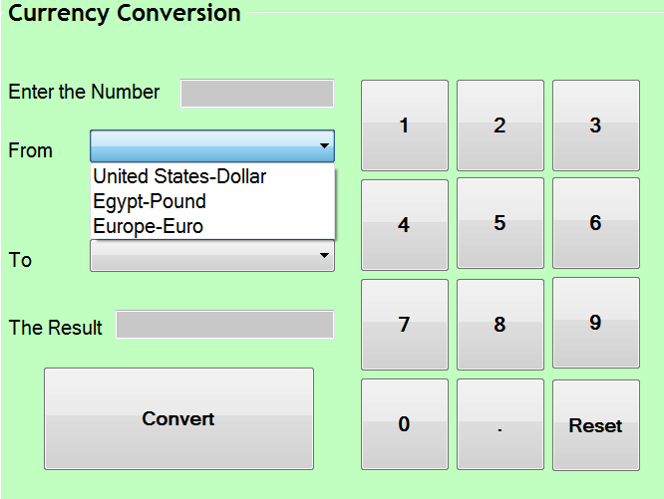
Continue …
Currency Conversion
E.g. To change from one => United States-Dollar | | Egypt-Pound | | Europe-Euro => To other one
Weight Conversion
E.g. To change from one => Kilograms | | Grams | |
Centegrams | | Miligrams => To other one
Length Conversion
E.g. To change from one => KilometersMeters | | Centemeters | | Milimeters => To other one

Slide 4
Code Flow
Requirements
Make user choose specific tap
E.g. Standard | | Scientific | | Multiplication Table | |
Conversions Types
Reading input successfully ☺
E.g. Reading right input Not string for example
Validate input => proper output ☺

Slide 5
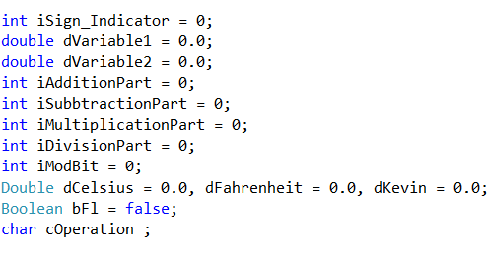
Code in detail
In real life there’s a way “camel case” such that to declare And initialize variables to zero
Handling operations in one function just call it
E.g. Choose operation => call function => output

Slide 6
Continue …
Thinking in bugs …
E.g. As possible as we could ☺ … we could catch the important test case by Try ... Catch handling
E.g. if user enter string | | log10 (0) | | log(.) | | Div by zero… etc
Normal Test case ☺ :
Reading 2 no : 5 6
Reading operation : +
Output : 11

Slide 7
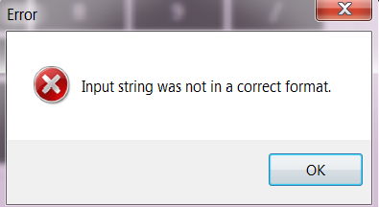
Continue …
Case 2 – Wrong input Case ☹ :
And so on

Slide 8
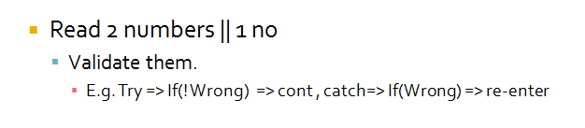
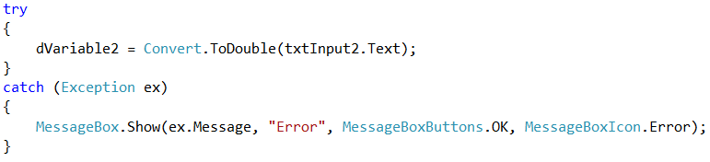
Final Sketching
Read 2 numbers || 1 no
Validate them.
E.g. Try => If(! Wrong) => cont , catch=> If(Wrong) => re-enter
Read Operation
If invalid, reenter
E.g. Try => If(! Wrong) => cont , catch=> If(Wrong) => re-enter Show Result
Brief :
Reading => validate => Choose operation => validate => process => show output
As possible as we could
As possible as we could ☺

Slide 9

Last word …

