Slide 1

FarmFlow
Every farm. Every animal. Every dollar — in one place.
Multi-farm management system · clickable prototype demo · July 2026
Notes:
Open with the prototype on screen. One system connecting the daily work on each farm to the numbers the owner needs.

Slide 2




Today: paper, Excel, and guesswork
What running the farms looks like without a system
Records live in notebooks
No profit per animal or crop
Feed, vet visits and wages are written down — then lost or never added up.
Which cow earns money? Which crop loses it? Nobody can say.
Production losses are invisible
The owner finds out weeks late
Milk goes in, cheese comes out — how much disappeared in between?
Numbers arrive at season end, too late to act.
Notes:
Keep it relatable — these are his current pains, not abstract problems.

Slide 3



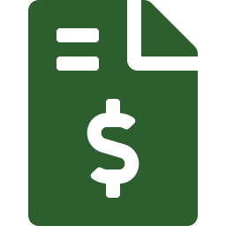

The whole farm in one picture
Everything is connected — enter data once, every report updates
→
→
→
→
ASSETS
PRODUCTS
PRODUCTION
STOCK
SALES
animals & crops
milk · eggs · wheat
recipes → losses tracked
quantities & cost
invoices & credit
Stock feeds back into production — cheese from your own milk
Expenses attach to assets feed · vet · seeds · wages · general costs
Purchases go into stock supplies + ready goods bought for resale
Notes:
This is the heart: the production loop. Point at the green bar — stock can be an ingredient again.

Slide 4


The manager's day: three taps on a phone
Simple mobile app — no training needed, data entered where the work happens
Add an expense in 30 seconds
Green Valley Farm
Wed 15 Jul · 3 expenses · 2 sales
Pick category, amount, snap the receipt — linked to an animal, a crop, or the whole farm.
Add expense
Record production with a recipe
Inputs come from stock, output goes to stock. Loss is calculated automatically — flagged if above normal.
Record production
Sell with a simple invoice
Record sale
Paid, partial or credit — customer balances tracked for you.
⚠ Vaccine due in 3 days
Halima · GV-C-001
Get reminded, don't remember
Vaccine due dates and low-stock alerts arrive on the phone.
Notes:
Demo the manager view here: add expense, production run with the loss warning, and a sale.

Slide 5


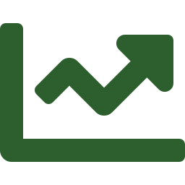

You see everything — live, from anywhere
Owner dashboard across all farms, updated the moment data is entered
Expense breakdown
Feed 42% · wages 18% · vet 16% — see where money goes, per farm.
Alerts find you
Low stock, abnormal production loss, vaccine due, overdue customer credit.
Production efficiency
Expected vs. actual losses per recipe — catch waste early.
…then drill down: profit per animal group, per flock, per crop plot.
Read-only, with an audited override
You watch by default. To edit, you “enter as manager” — and every action is logged.
Notes:
Switch prototype to Admin view. Show dashboard, then Green Valley detail, then click Enter as manager to show the audit note.

Slide 6



Starts simple. Grows with the farm.
Included from day one — and comfort features we can add when you're ready
IN THE CORE
LATER OPTIONS
Vaccine & health reminders
QR tags on animals scan a cow, see her record
Abnormal loss alerts on every production run
Expiry tracking medicine & product shelf life
Low-stock warnings
Plot & season planning plan crops by plot and season
Customer balances & credit sales
Smarter analytics trends, forecasts, comparisons
Notes:
Frame later options as choices, not promises — keeps phase 1 scope safe.

Slide 7
Delivery: three phases, no surprises
A live demo every month — you watch it grow, on your own data
1
CORE SYSTEM
2
COMFORT
3
REFINEMENTS
~3–4 months
next
ongoing
Farms, animals & crops, expenses, production runs, stock, purchases, sales & invoices, owner dashboard with the key reports.
QR tags, expiry tracking, richer reminders, extra reports — chosen together after you've used the core.
Plot & season planning, analytics, and polish driven by real daily use on your farms.
Next step: pick a start date — the prototype you just saw becomes phase 1.
Notes:
Close on the monthly demo promise — it de-risks the project for him.

